Slide 1
Germany
04 Steve
07 Yvonne
08 Zoe
14 Rosa
17 Wendy
Date: 05/12/2016

Slide 2
Outline
Ⅰ) Introduction
Ⅱ) Overview
Ⅲ) Economy and Industry
Ⅳ) Company
Ⅴ) Conclusion
Ⅵ) Q&A

Slide 3
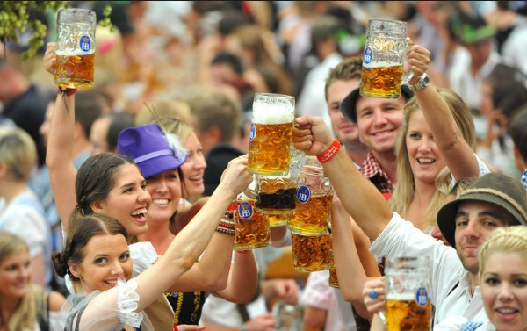
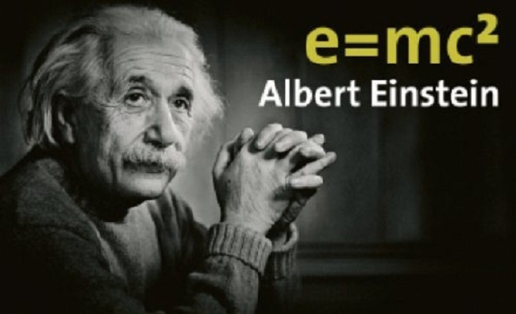


Ⅰ) Introduction

Slide 4
Ⅱ) Overview
Name & Capital
Geographic
Climate
Language
Population
Distributed of people
Prime minister
Religion
Education
Festival

Slide 5
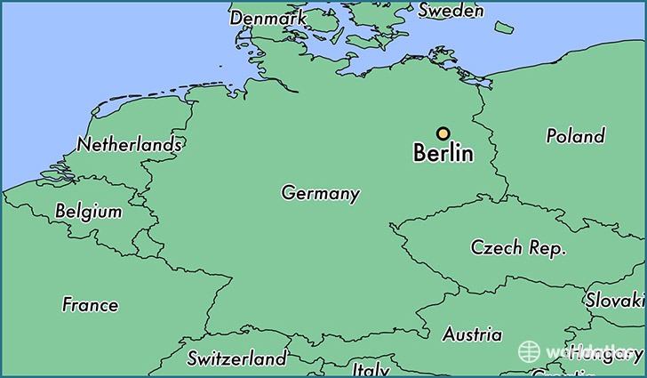
Name & capital
Federal Republic of Germany
Capital city

Slide 6
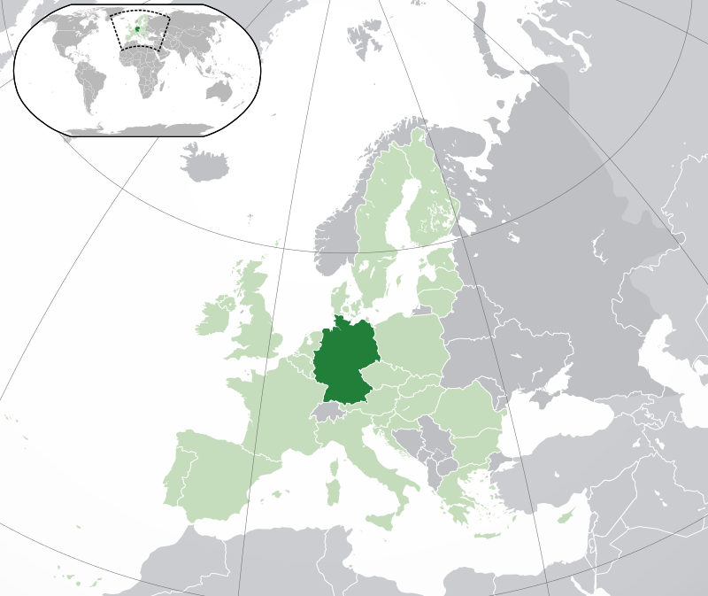
Geographic (1/2)
across Central and Western Europe
Germany

Slide 7
Geographic (2/2)
North : Denmark, North Sea, Baltic Sea
Northwest : Belgium, Netherlands
West : France, Luxembourg
South : Austria, Switzerland
East : Poland, Czech
Baltic Sea
North Sea
Luxembourg

Slide 8
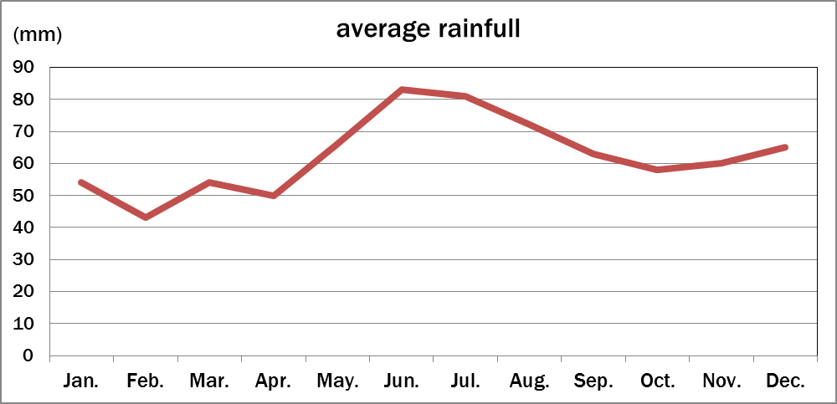
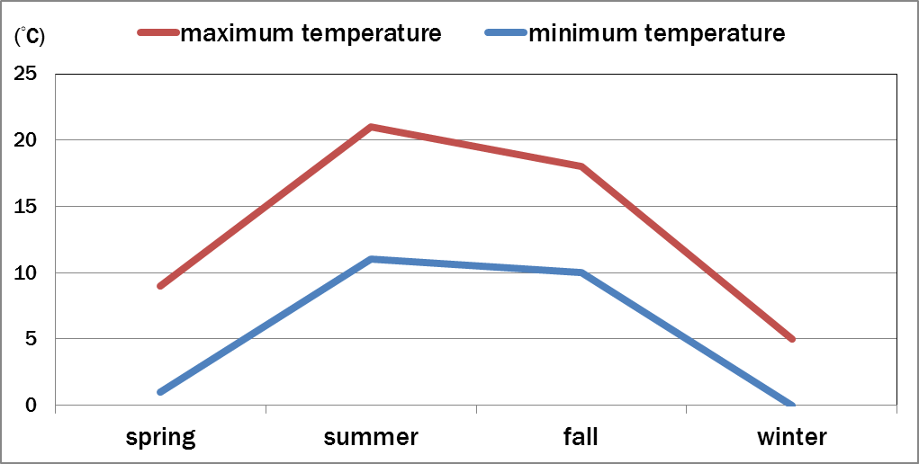
Climate
temperate maritime climate

Slide 9
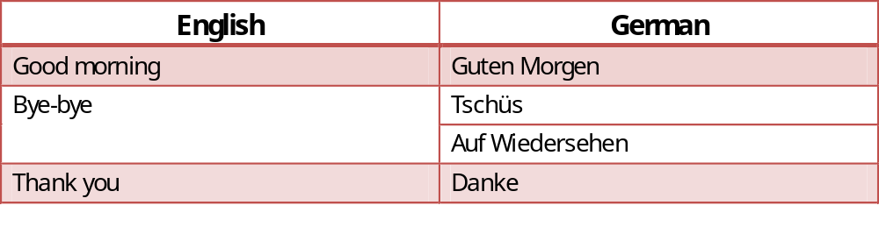
language
official & mainly
common conversation

Slide 10
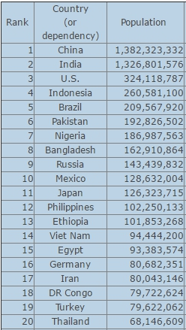
Population
May 8, 2016 : 81,266,767

Slide 11
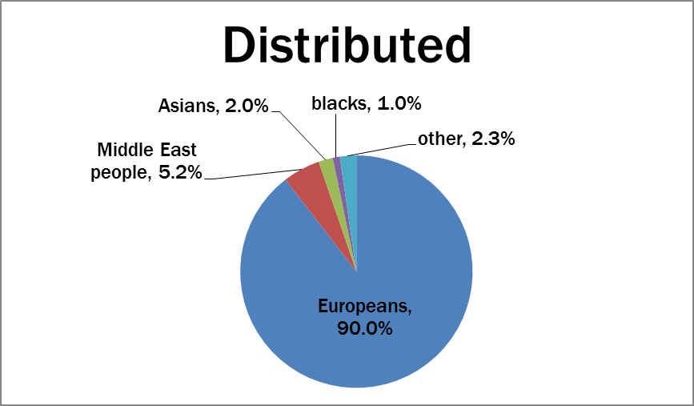
Distributed of people
mixed race
Americans
etc.

Slide 12
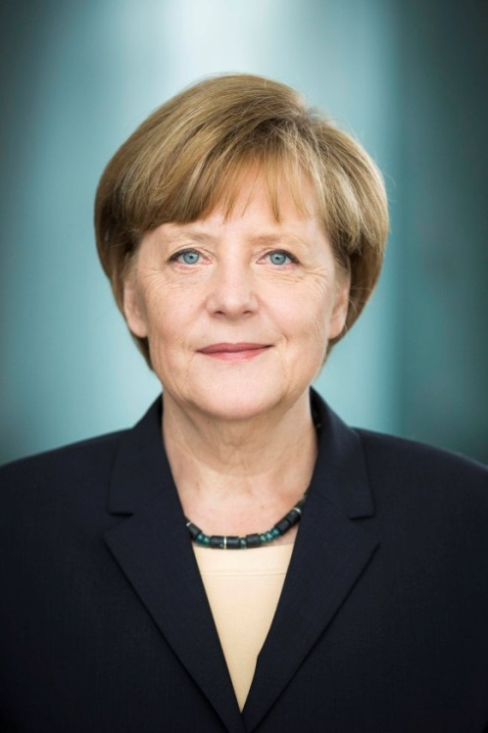
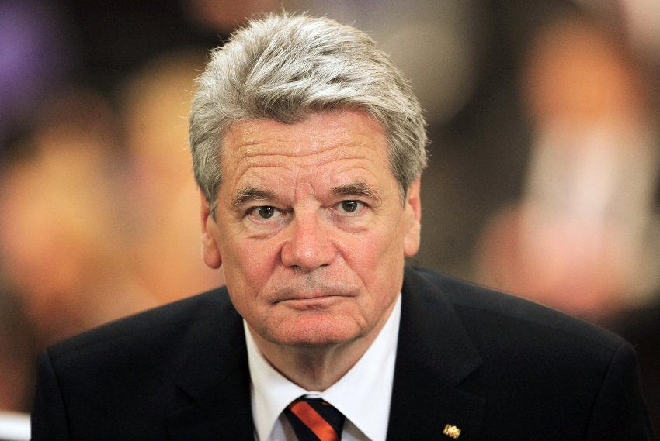
Prime minister
Joachim Gauck
Angela Merkel

Slide 13
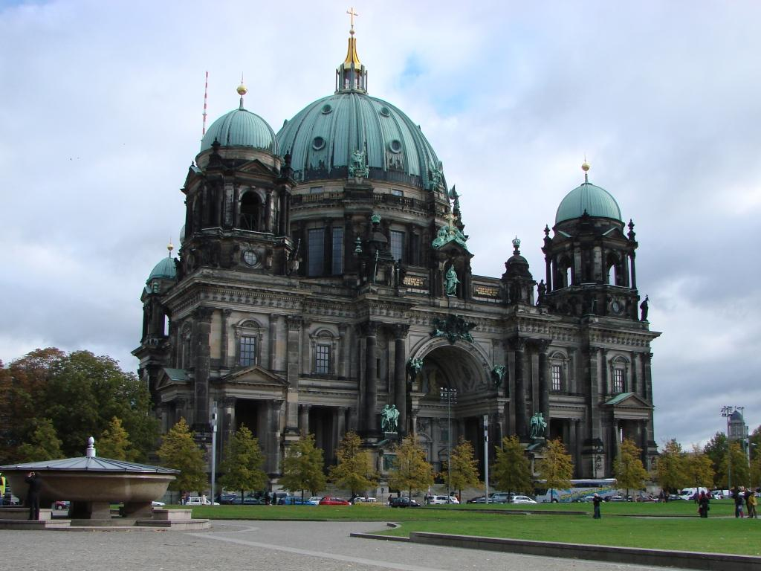

Religion
Christian: 62.8%
Islam: 5.2%

Slide 14

Education
A stitch in time saves nine.

Slide 15
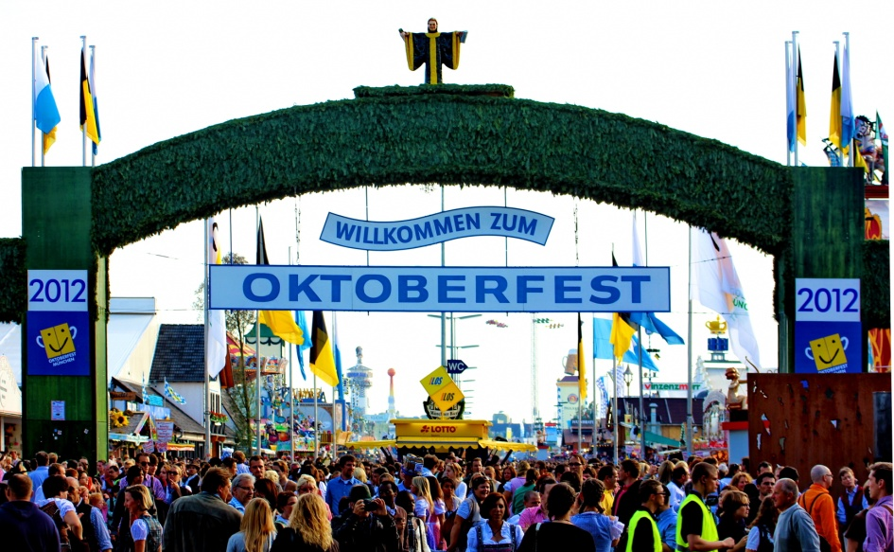
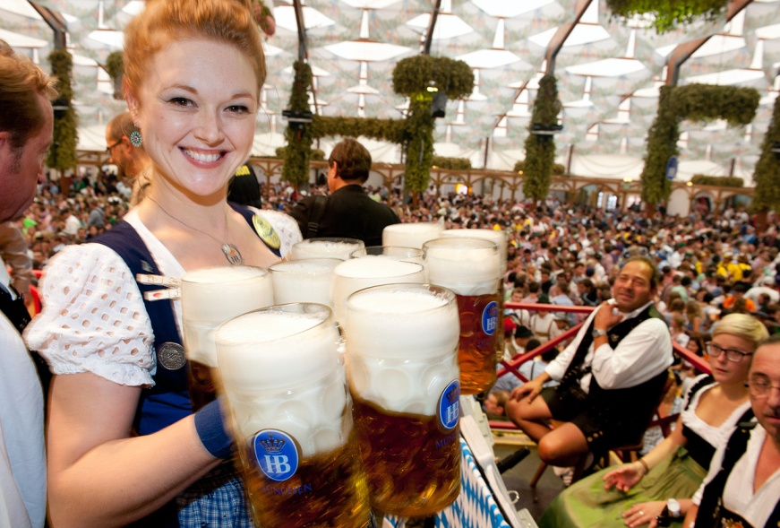
FESTIVAL
Oktoberfest
Late September to the first weekend in October for 16–18 day
Since 1810

Slide 16
Ⅲ) Economy and Industry
Currency
Economy
Well-known industry
Science and Technology

Slide 17
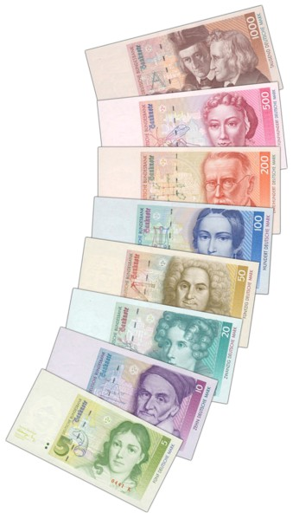
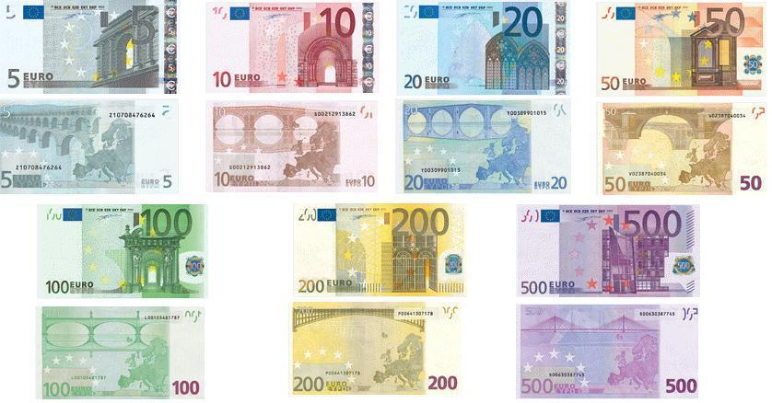
CURRENCY
German Mark, since 1948
Euro, since 2002
Mark ↑
←Euro

Slide 18



ECONOMY
social market economy
Rank | Country | Exports
1 | China | $2,270,000,000,000
2 | United States | $1,598,000,000,000
3 | Germany | $1,292,000,000,000
4 | Japan | $624,000,000,000
5 | South Korea | $535,500,000,000

Slide 19
ECONOMY
Rank | Export
1 | Vehicles
2 | Machinery
3 | Chemical goods
4 | Electronic products
5 | Electrical equipment

Slide 20
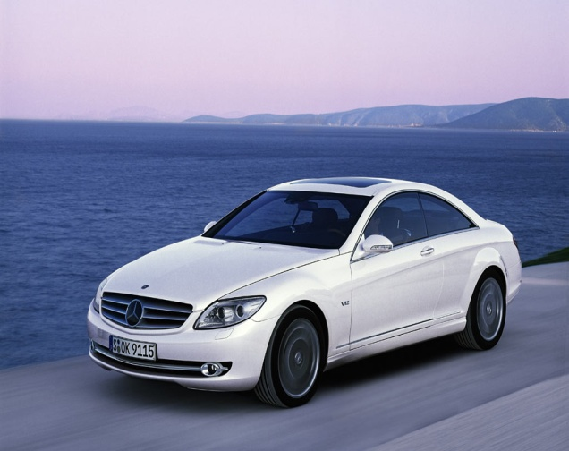
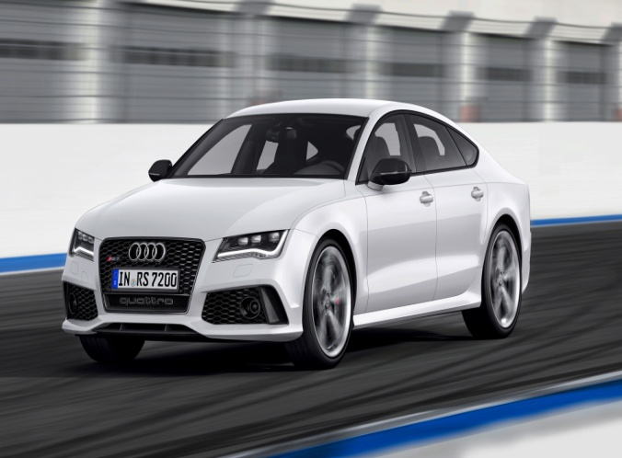
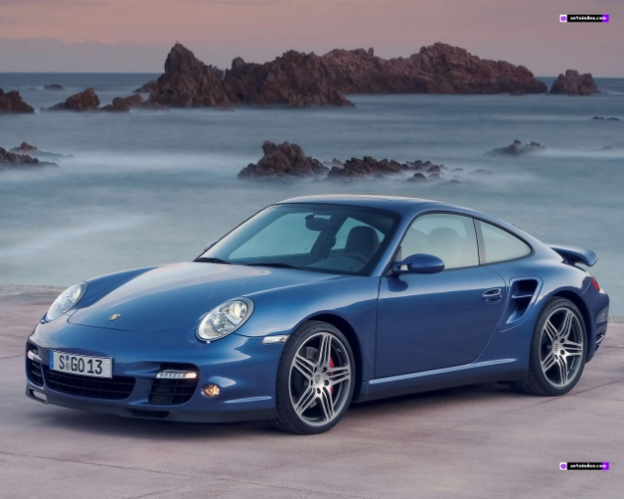
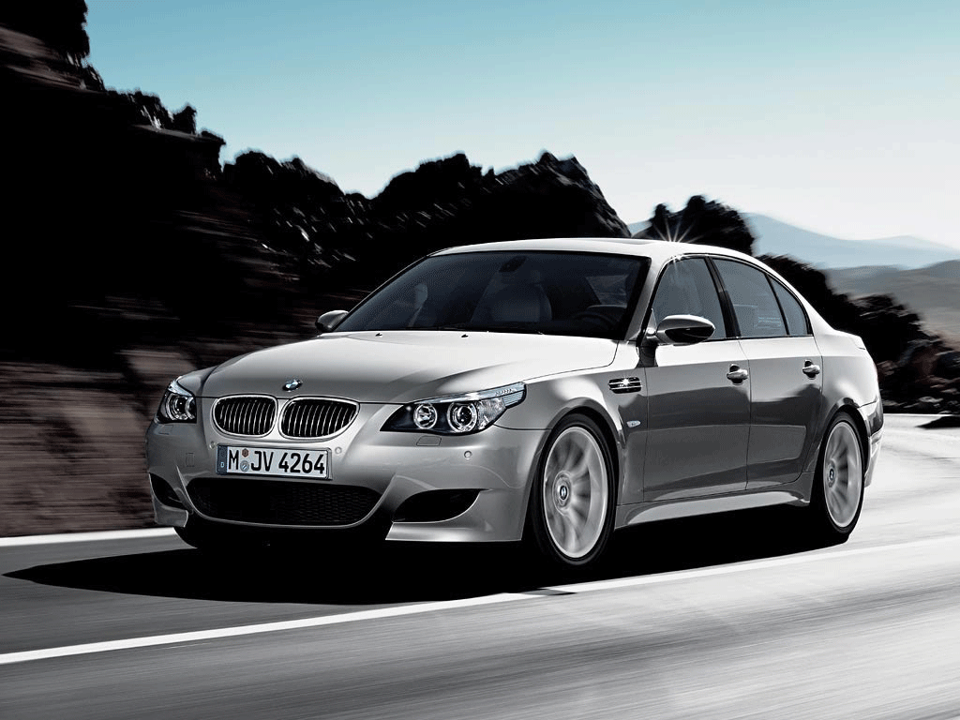
Well-Known INDUSTRY
Benz ↑
Audi ↑
Porsche ↓
BMW ↓

Slide 21
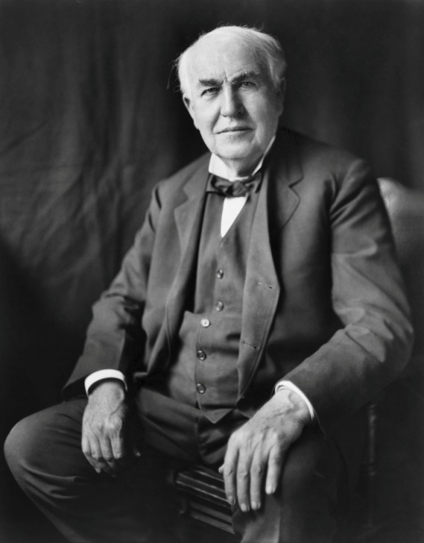
SCIENCE AND TECHNOLOGY
104 German won the Nobel Prize
← Albert Einstein

Slide 22

Ⅳ) Company - BMW
Video
Founder
Form time
Location of headquarter
Major product
Marketing
Statistics
Future plan

Slide 23
video
Exciting times ahead (0'45)
https://www.youtube.com/watch?v=HuB1JCYXzSM

Slide 24
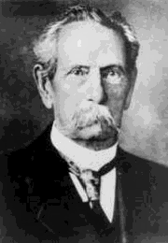

Founder & form time
Karl Rapp
1916/3/7
↓
2016
100 YEARS

Slide 25
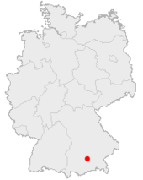
LOCATION OF HEADQUARTER
Munich

Slide 26
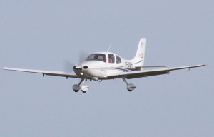
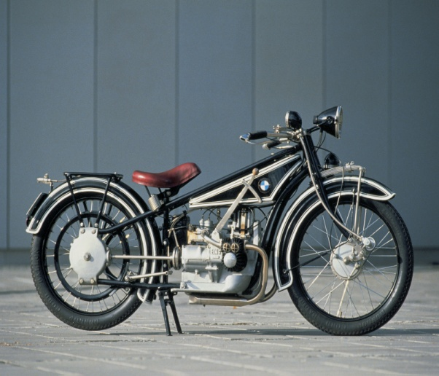
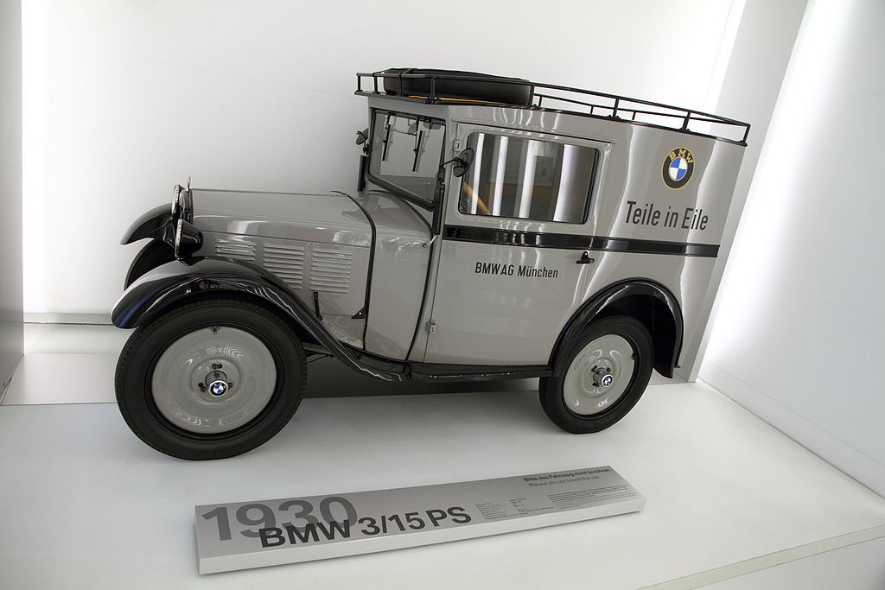
Major product
1916
1923
1928

Slide 27
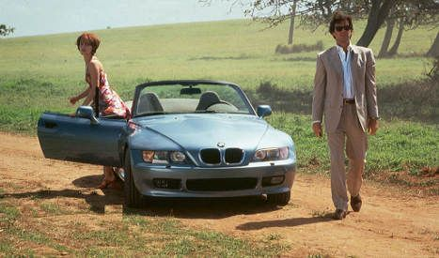

MARKETING
Movie-James Bond (007)
Social Website

Slide 28
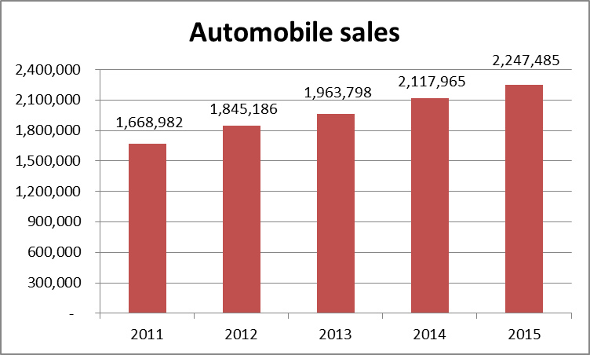
Ⅳ) Statistics
The number of sales

Slide 29
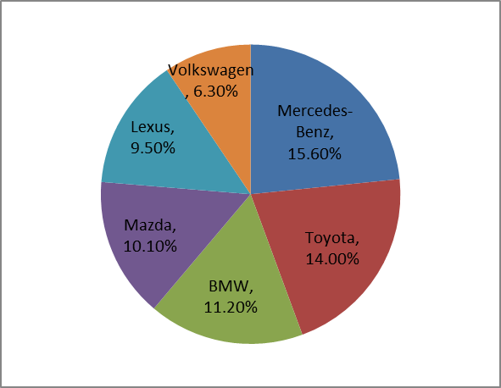
2016/03 Statistics in Taiwan
Rank | Brand | Sales
1 | Mercedes-Benz | 2,235
2 | Toyota | 2,005
3 | BMW | 1,602
4 | Mazda | 1,447
5 | Lexus | 1,362
6 | Volkswagen | 895
 | Market | 14,283

Slide 30
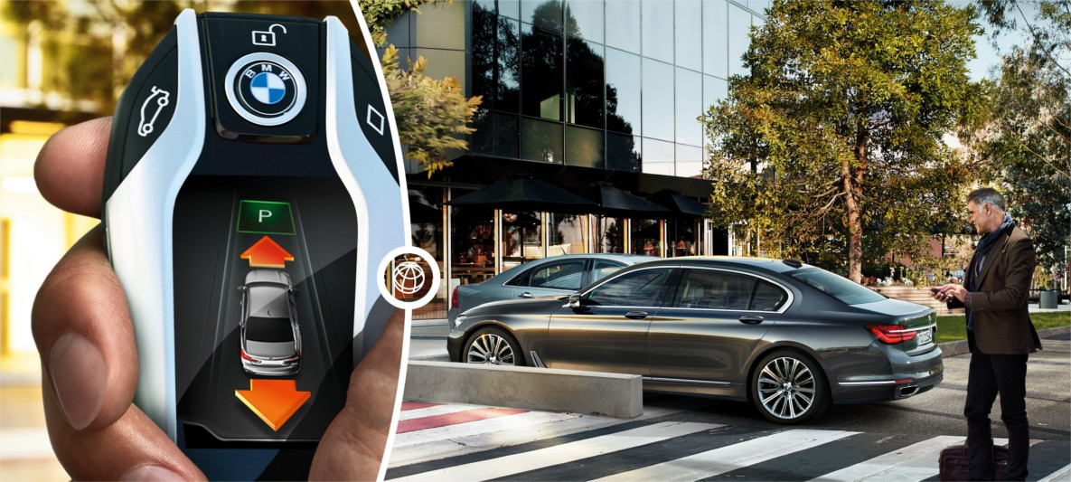
Ⅴ) Future plans
Automatic parking system

Slide 31

Ⅴ) Conclusion

Slide 32
Division of work
Member | Present | Work
Steve | Introduction, education and conclusion. | Design the opening, served the host.
Yvonne | Overview. | Integration talk script.
Zoe | Statistics and future plan. | Make power point.
Rosa | Company. | Make handout.
Wendy | Economy and Industry. | Print handouts and power point.

Slide 33
Reference
Country
https://zh.wikipedia.org/wiki/%E5%BE%B7%E5%9B%BD#.E6.B0.A3.E5.80.99
Geographic
http://www.tianqi.com/qiwen/deguo-1/
Population
http://countrymeters.info/ct/Germany
http://www.cnrencai.com/easy/343935.html j5/
Education http://www.cmoney.tw/notes/note-detail.aspx?nid=12988
BMW
https://zh.wikipedia.org/zh-tw/BMW
BMW Group
https://www.bmwgroup.com/en.html

Slide 34
Thanks for your listening.

Slide 35
QA Time

