Slide 1
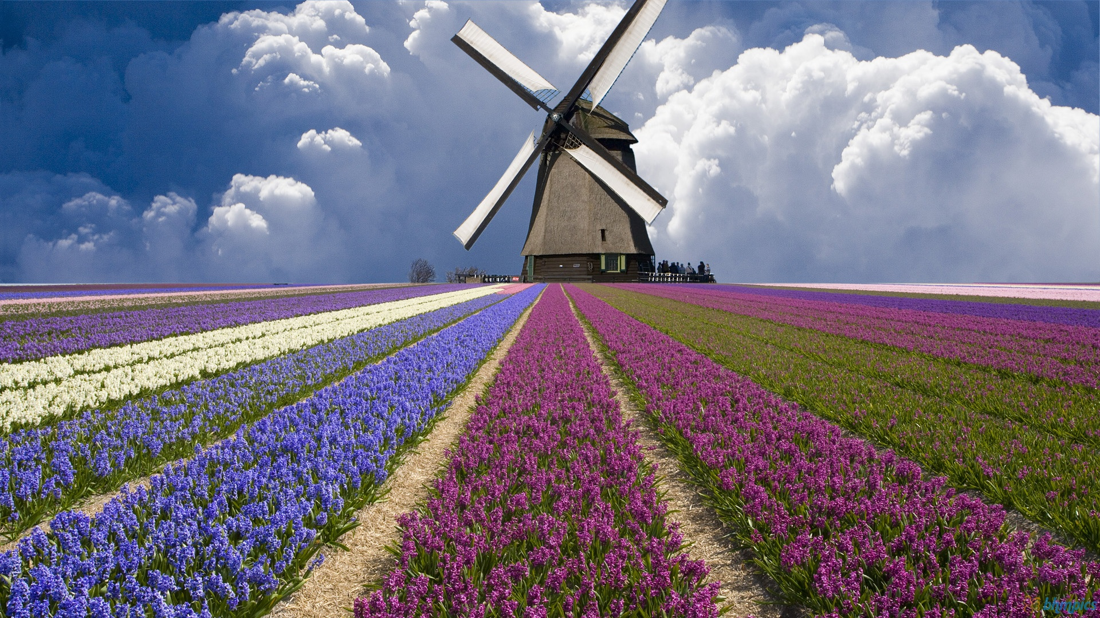

Netherlands
Group 4
11 Tracy 06 Sophia 10 Patty
18 Stanley 22 Brad

Slide 2
Outline
Overview of country
Economy & Industry
Representative company
Conclusion

Slide 3

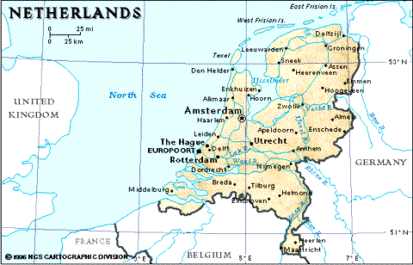
Overview of country
Map

Slide 4
Overview of country
Introduction
Language | Dutch
Capital | Amsterdam
Population | 6.1 million
Geography | 7,494 square kilometers(land and water included) 5,488 square kilometers (land alone)
Weather | Ocean climate country, westerly, often rains
Politics | Constitutional monarchy

Slide 5
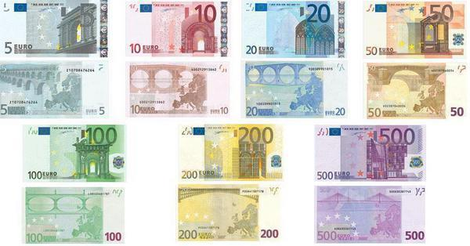
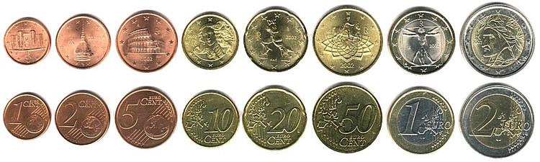
Overview of country
Currency EUR

Slide 6
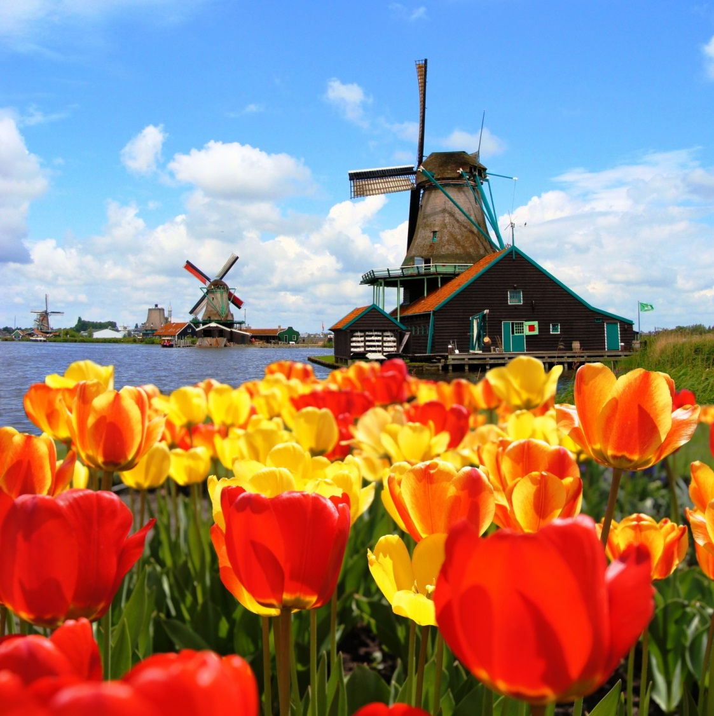
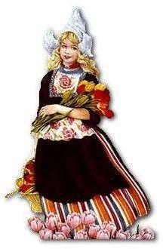
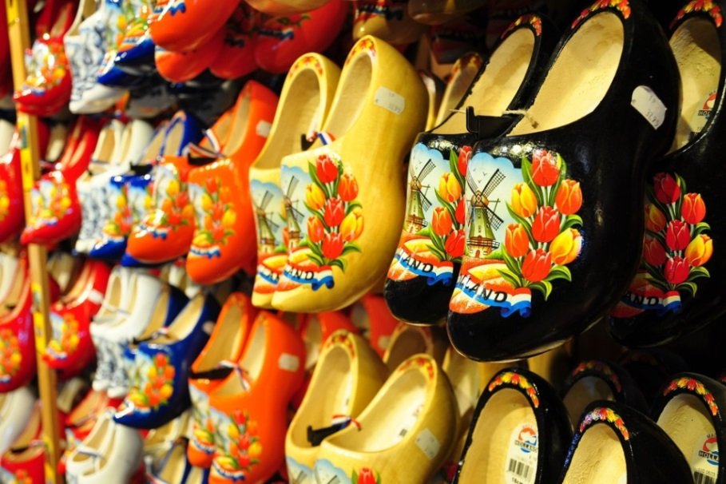
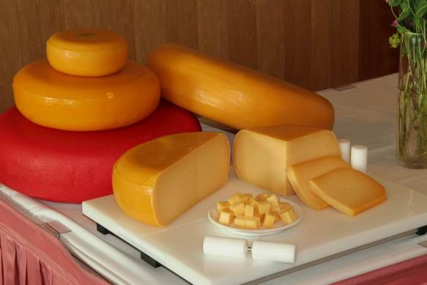
Overview of country
Stereotypical images
windmills
clogs
Tulips
cheese
klederdracht

Slide 7
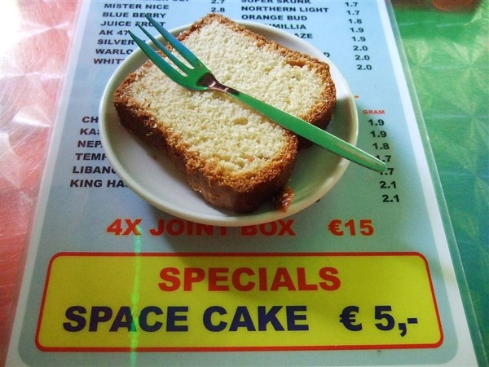
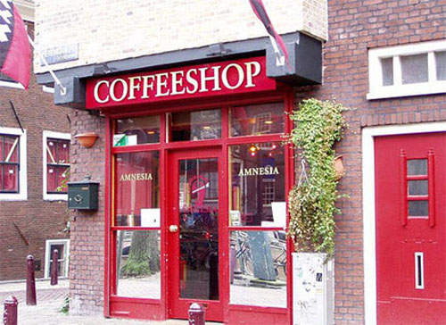
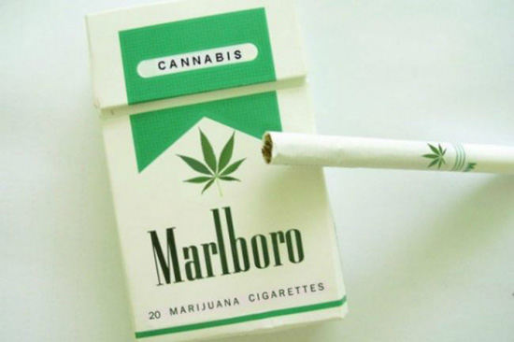
Overview of country
Cannabis
Cannabis cigarette

Slide 8
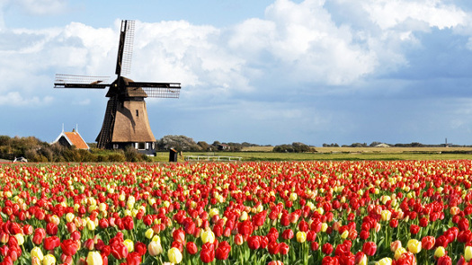
Overview of country
YouTube：
Holland.
The Original Cool.
The Beginning.

Slide 9
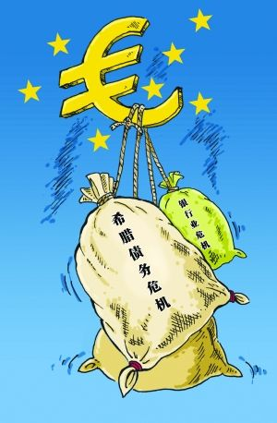
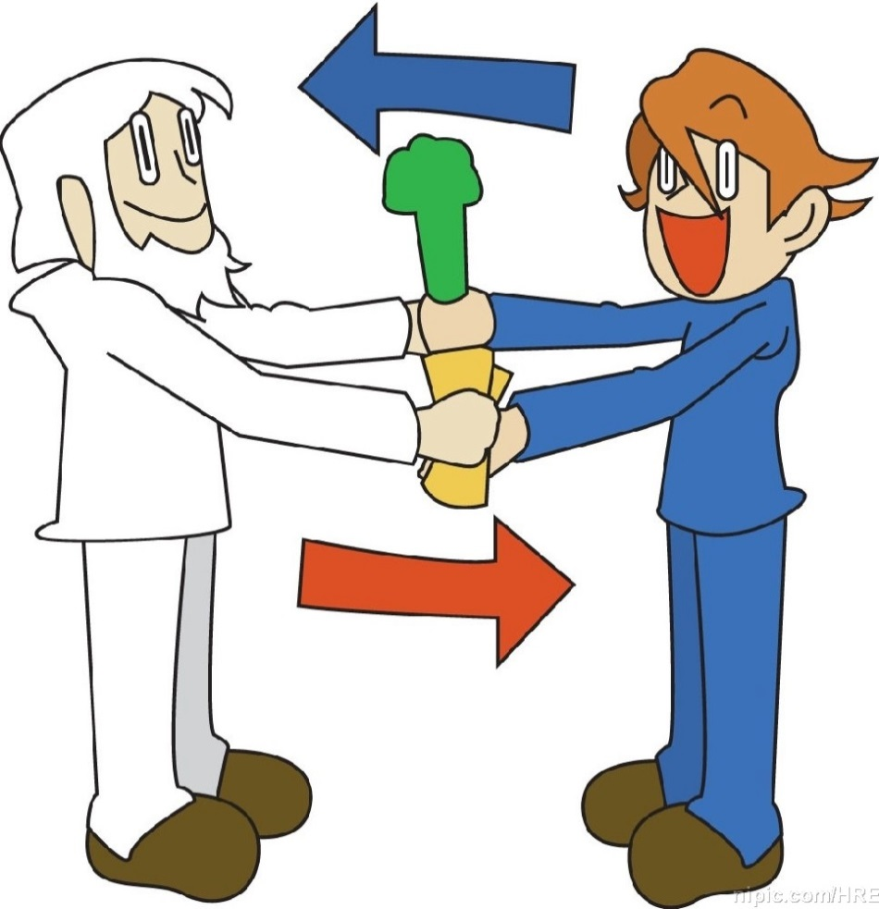
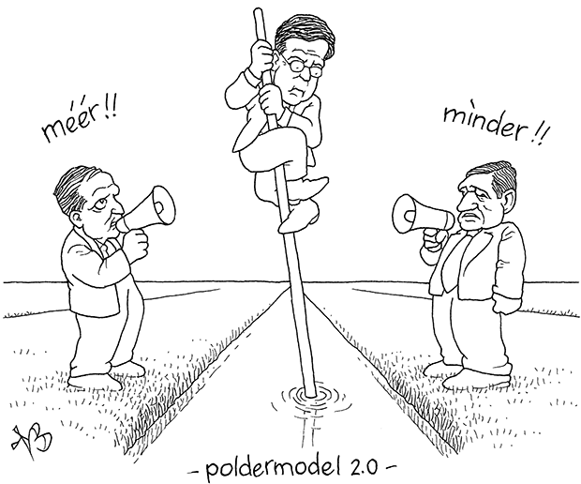

Economy & Industry
Economy
Polder Model
Eurozone debt crisis
Dependent on exports
Job opportunities

Slide 10
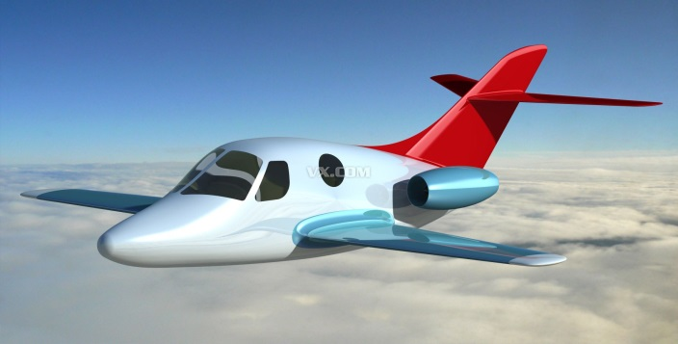

Economy & Industry
Famous Industry：Transport
Aviation industry
logistics and transport
Shipbuilding

Slide 11
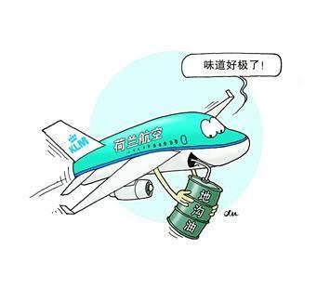
Economy & Industry
1.Aviation industry
Development of a hundred years of history
Innovative technology
Provide more than
120,000 Jobs

Slide 12

Economy & Industry
2. logistics and transport
Good location
Low tax system
Highly qualified staff

Slide 13
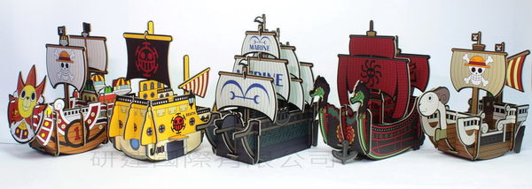
Economy & Industry
3.Shipbuilding
The world's 7 largest
Europe's 4 largest shipbuilding country
Provide excellent service

Slide 14
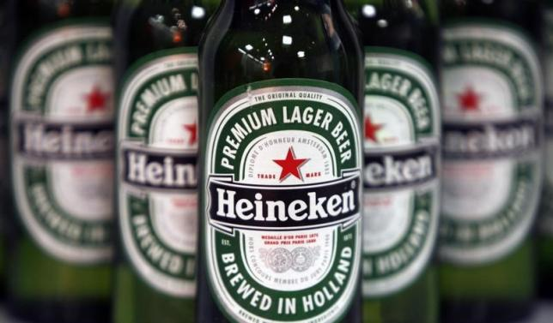

Representative company

Slide 15

Representative company
Establish | Gerard Adriaan Heineken
Head-quarter | Amsterdam
Production | >170 different beers
Brewery | 1 largest in Europe 3 largest in the world
Revenue | >20 billion euros 700 billion NT dollars

Slide 16
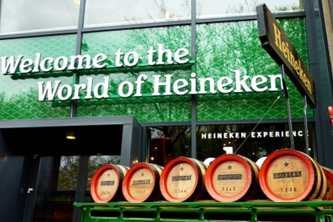
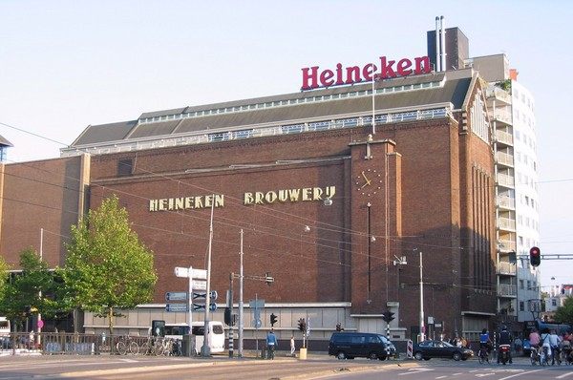
Representative company

Slide 17

Conclusion
1.European garden & Bicycle paradise
2.A developed country
3.Heineken

Slide 18

Reference
Wikipedia
Library of Academia Sinica
GOOGLE Photos
Reference Wiki
YouTube

Slide 19
Division of responsibility
Overview of country | 11 Tracy | 王玥涵
Overview、PowerPoint | 06 Sophia | 莊舒涵
Economy & Industry | 22 Brad | 楊晉愷
Representative company | 18 Stanley | 魏士淵
Conclusion | 10 Patty | 阮寶瑩

Slide 20
Thanks for your listening
Group 4
11 Tracy 06 Sophia 10 Patty
18 Stanley 22 Brad

Slide 21



