Slide 1
Sweden
2016,05,26 Group 5
10445021 RJ
10445009 Tina
10055007 Kimmy
10055024 Cherry
10055026 Angel
10341096 Gloria

Slide 2
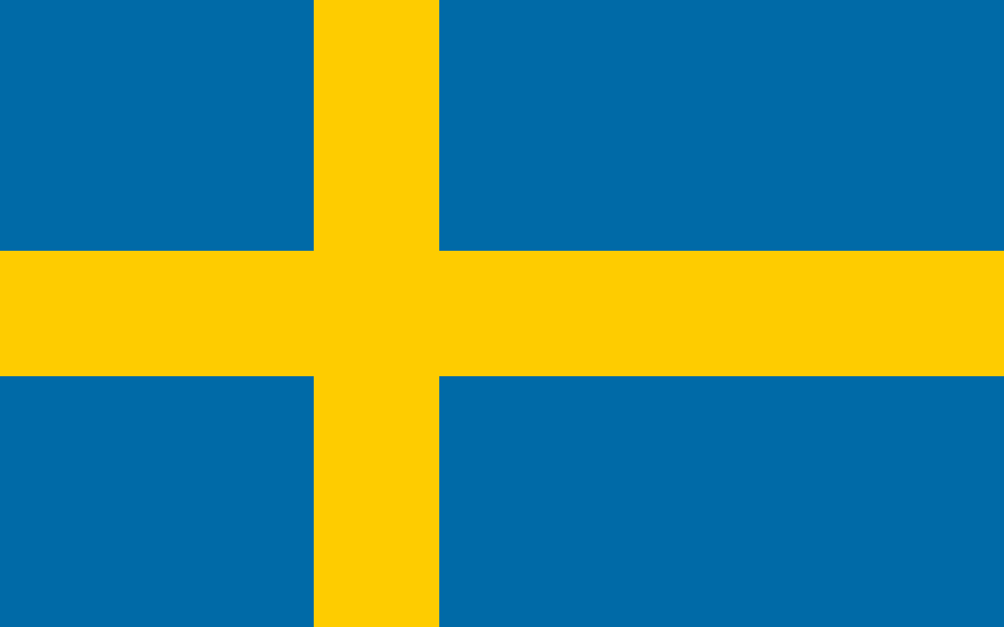
Overview
Part 1 (Sweden introduced)
Part 2 (Swedish Economy)
Part 3 (Ikea)
Conclusion
Responsible Assignment
Reference

Slide 3
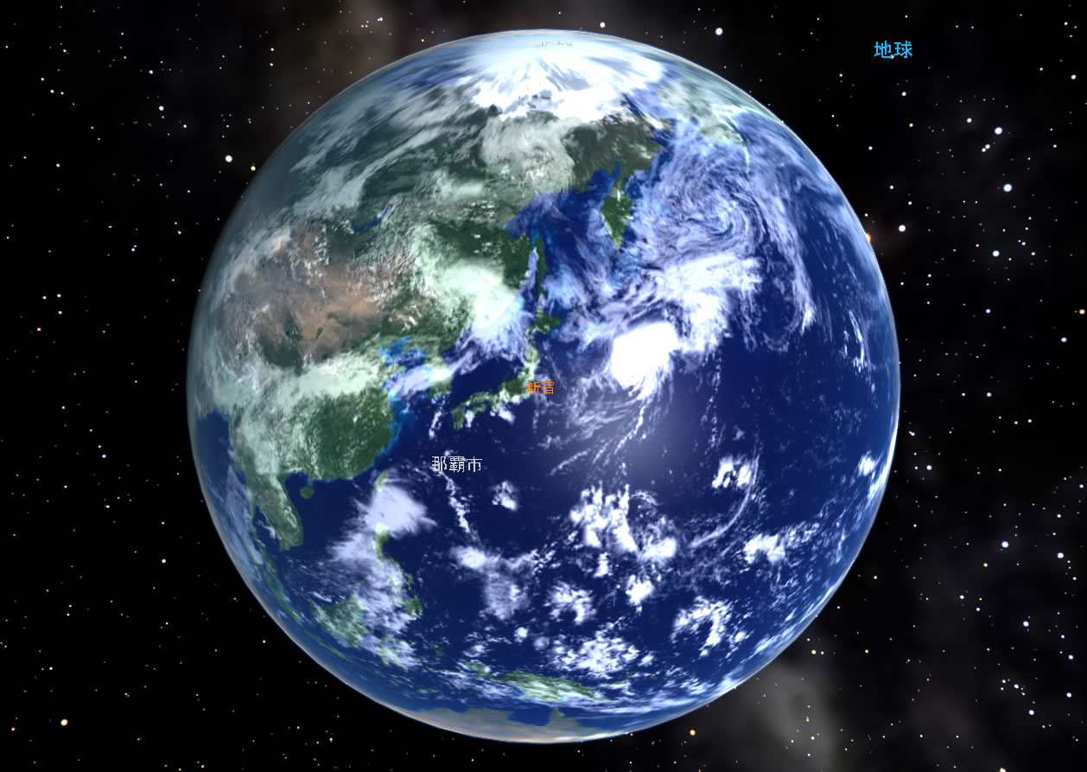

Slide 4
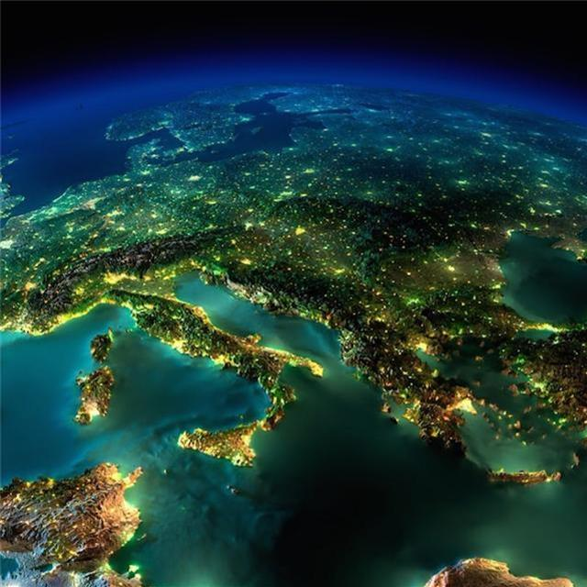

Slide 5
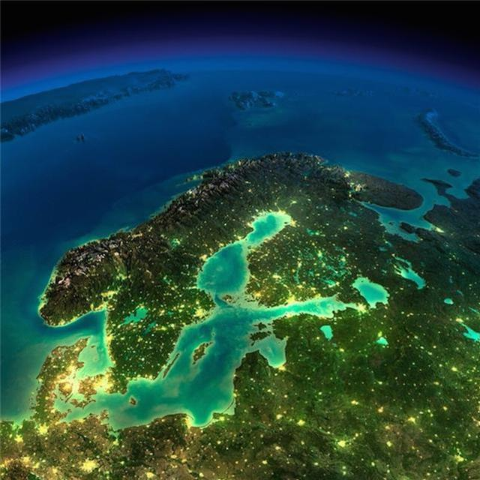

Slide 6
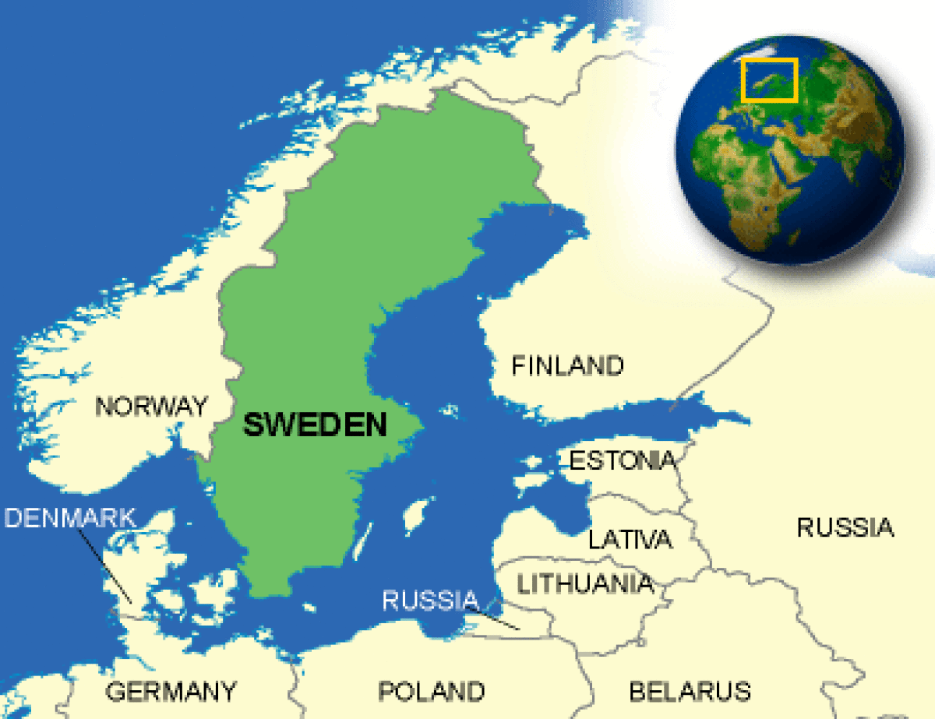
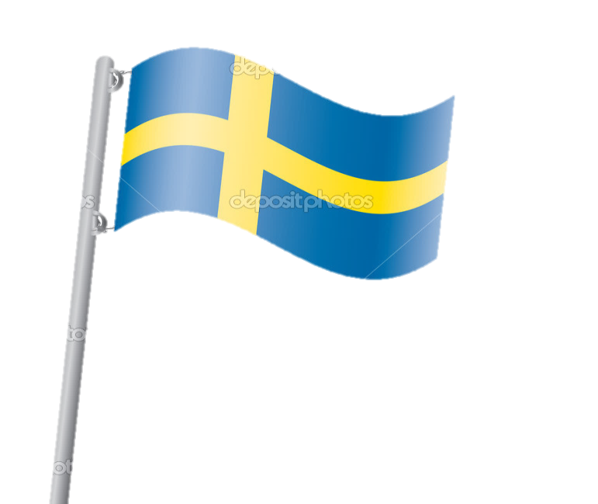
location

Slide 7
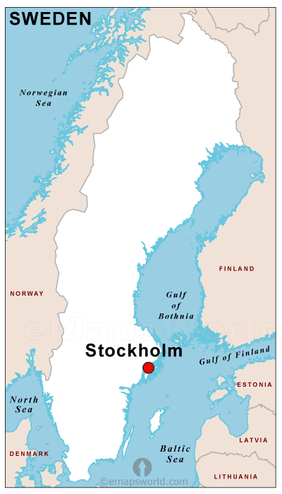
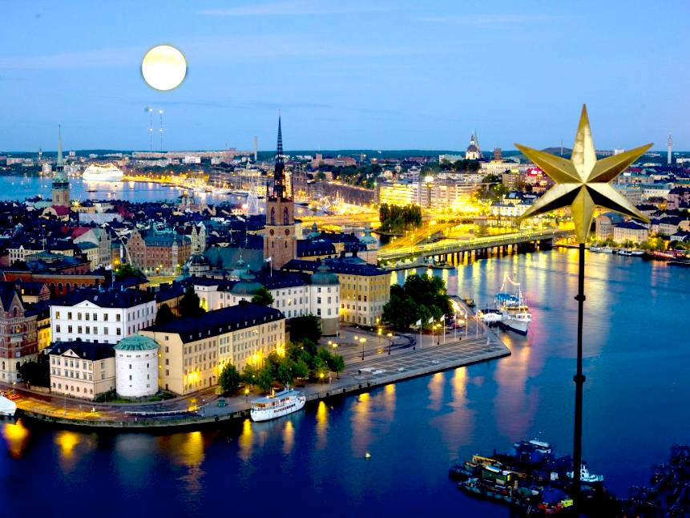
Capital
Stockholm

Slide 8
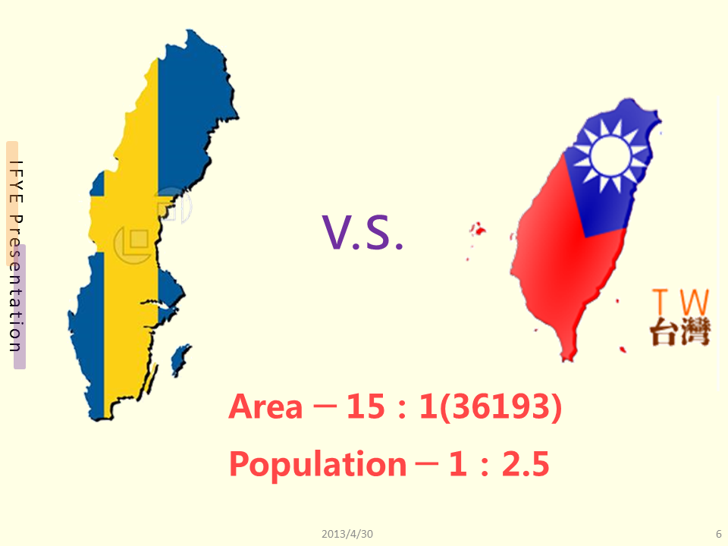

Slide 9
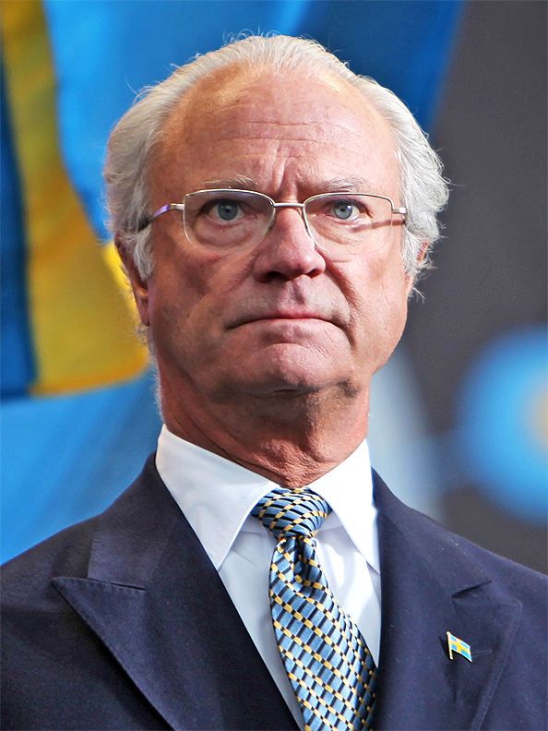
Sweden
Carl XVI Gustaf

Slide 10
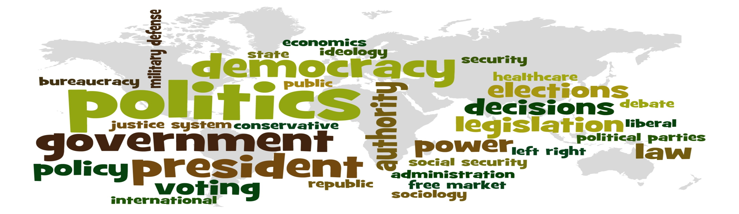
Politics
Constitutional monarchy
Prime minister

Slide 11
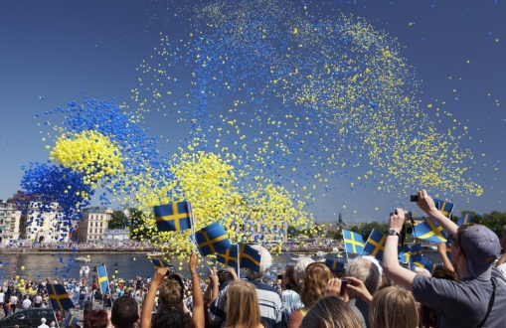
Sweden temperatures

Slide 12
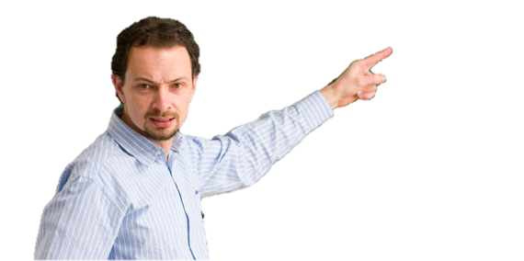
Official language
Swedish
English | Swedish
Hello | Hallå
Bye bye | hejdå
Thanks | Tack
Ikea | ikea

Slide 13
Religion

Slide 14

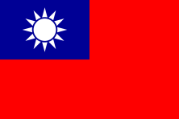
Swedish Krona
SEK 1
NT 3.99
SEK 5
NT 19.96
SEK 10
NT 39.91
：
＝
0.25：1

Slide 15
Swedish Krona
SEK 20
NT 79.83
SEK 500
NT 1995.69
SEK 1000
NT 3991.38
：
＝
0.25：1

Slide 16
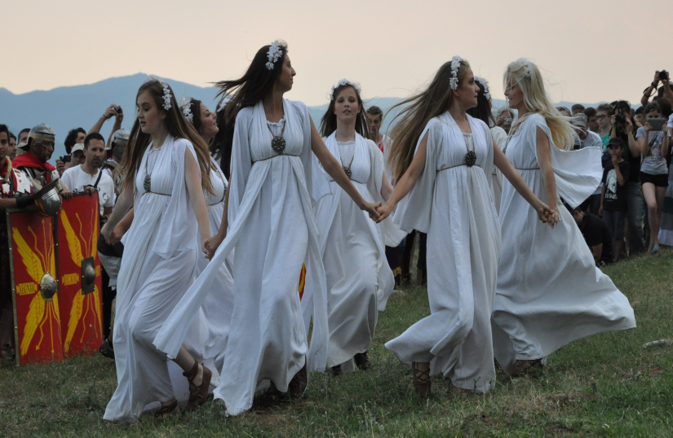
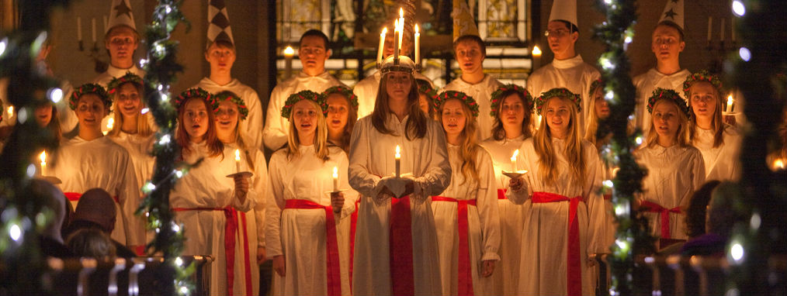
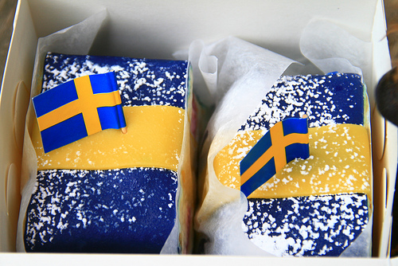
Holiday
Midsummer Festival
Saint Lucia's Day
Swedish National Day

Slide 17
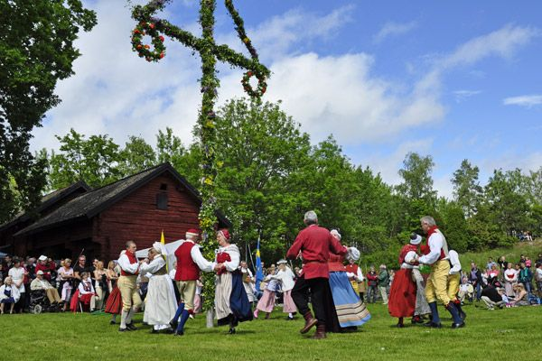
Midsummer Festival
Midsommardagen

Slide 18
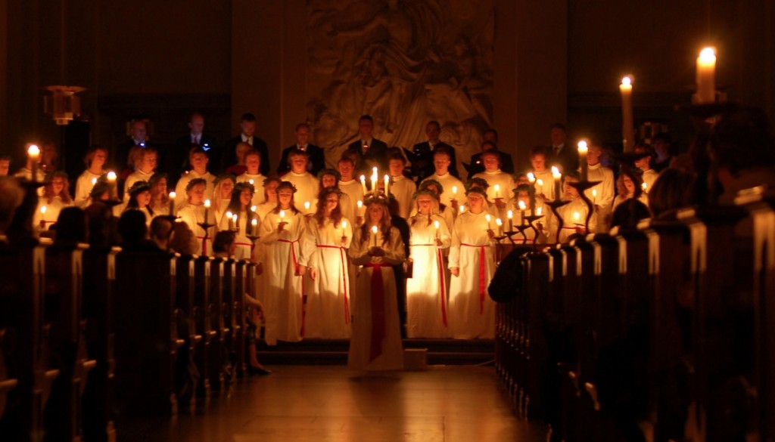
Saint Lucia's Day
stjärngossar

Slide 19
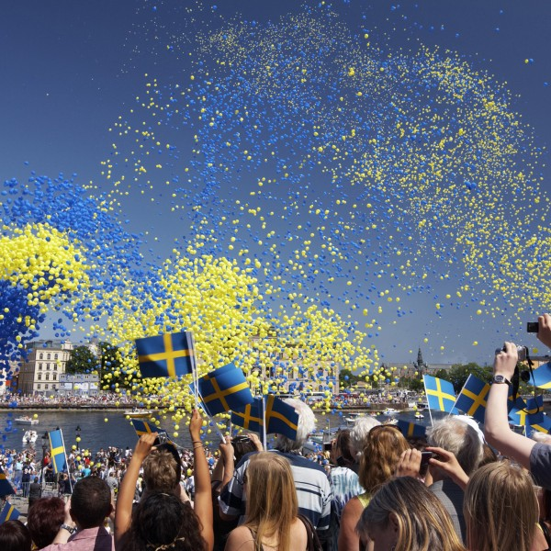
Swedish National Day
Sveriges nationaldag

Slide 20
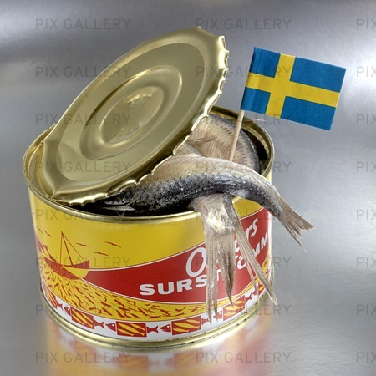
Salted herring
Most disgusting food ever
Surströmming

Slide 21
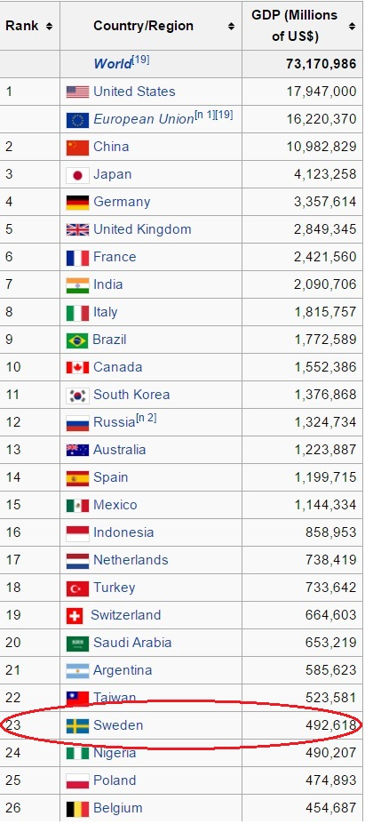
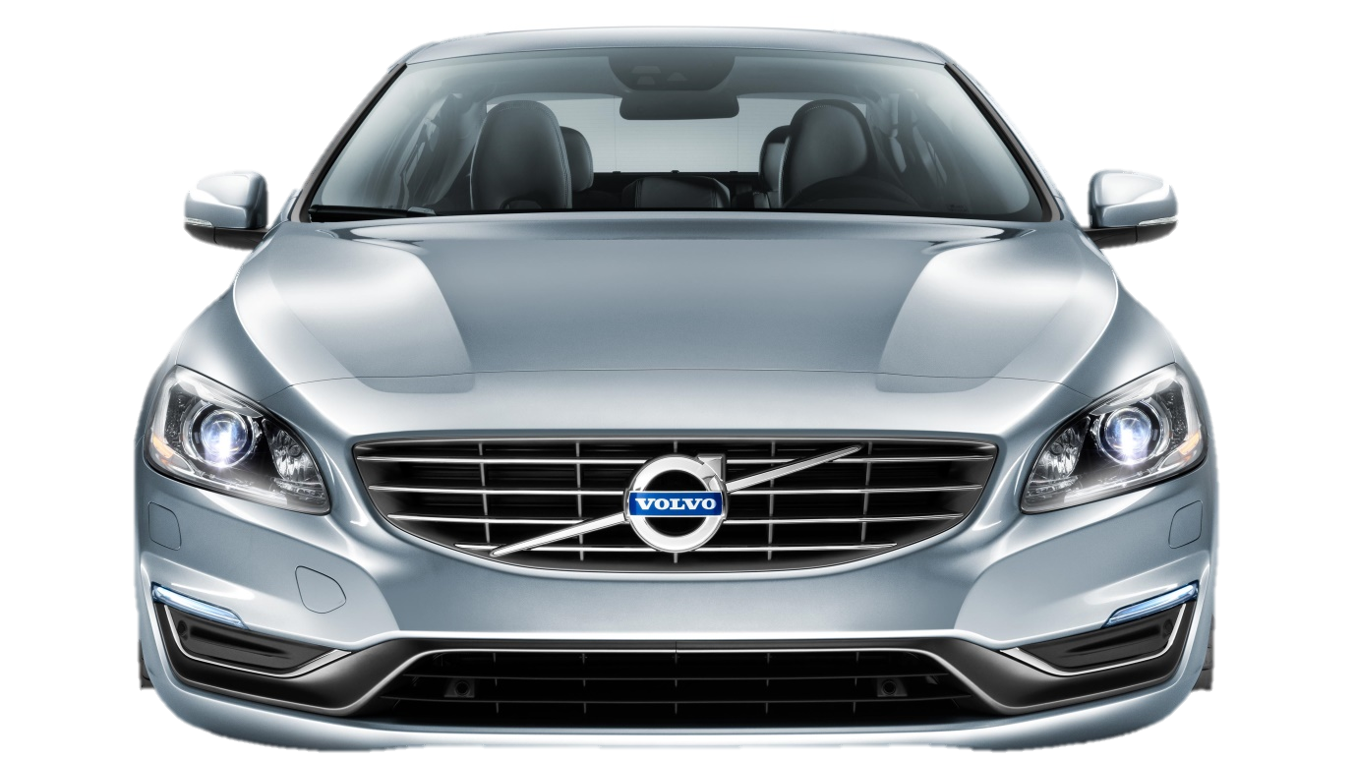
Economy and industry
Annual GDP : about $492.6 billion (USD)
The main economic activity is mechanical industry.
For example : VOLVO
Degree of dependence on foreign trade : about 80%

Slide 24
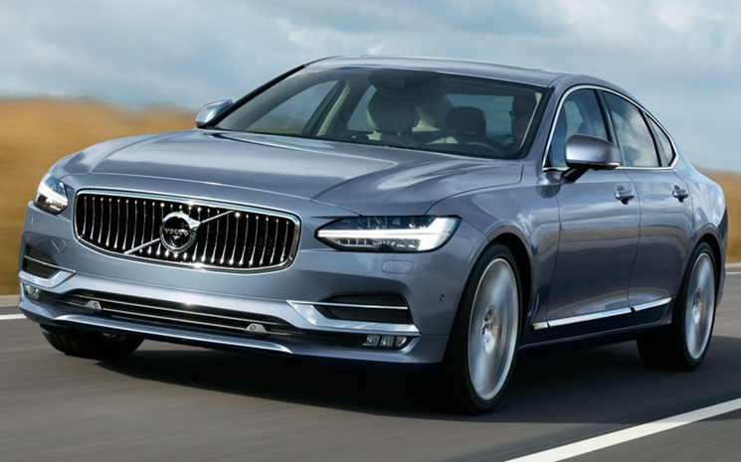
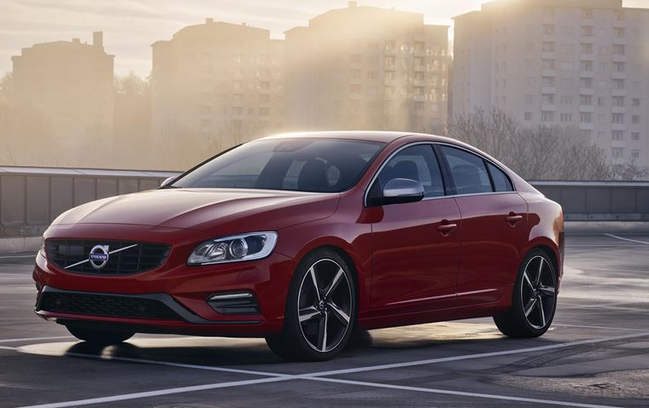
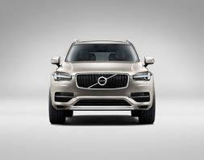
VOLVO
The largest car manufacturers of Sweden
Annual Revenue : about $27 billion (USD)

Slide 25
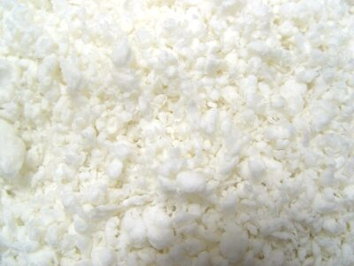
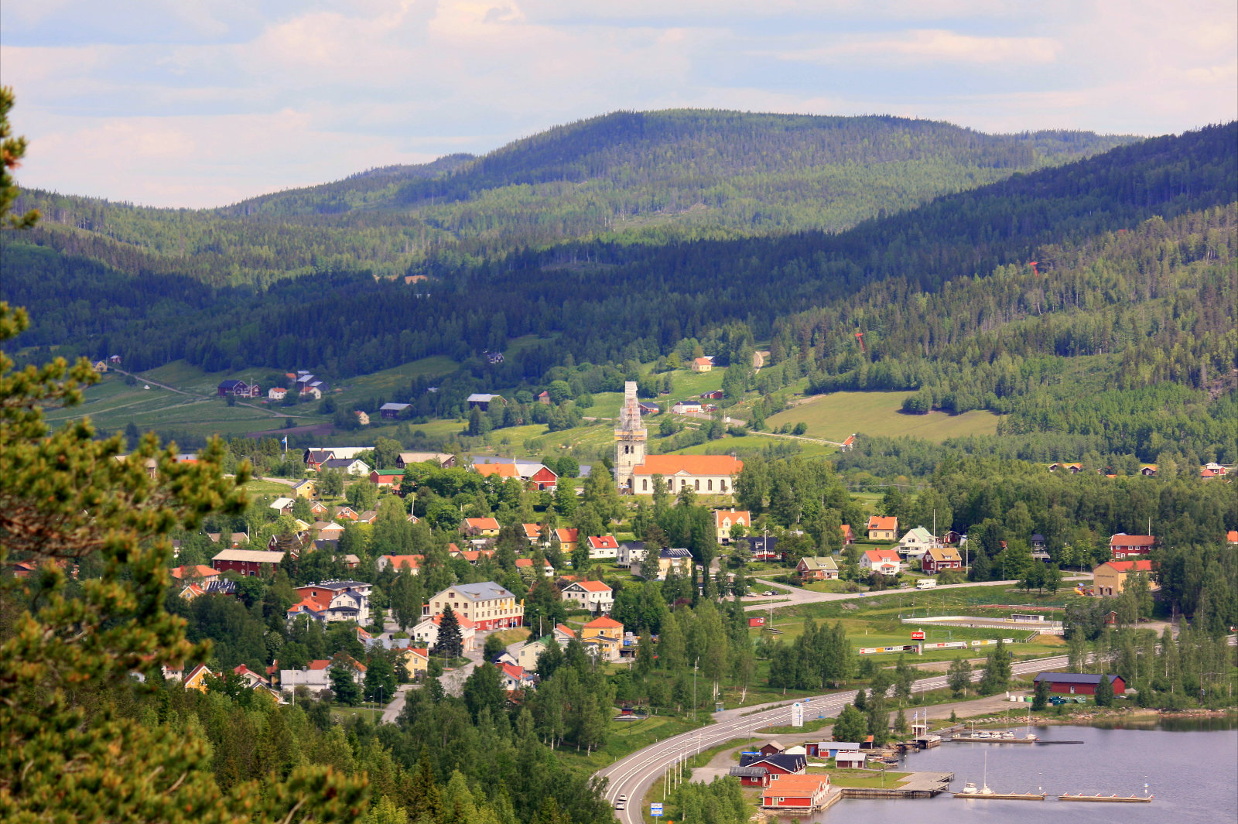
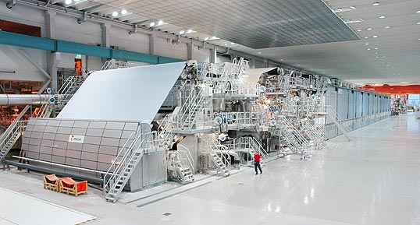
Economy

Slide 26




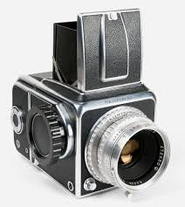
Telecommunications

Slide 27
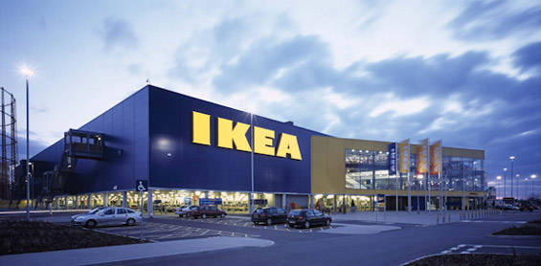
IKEA
founded in 1943
the world's largest furniture retailer.

Slide 28
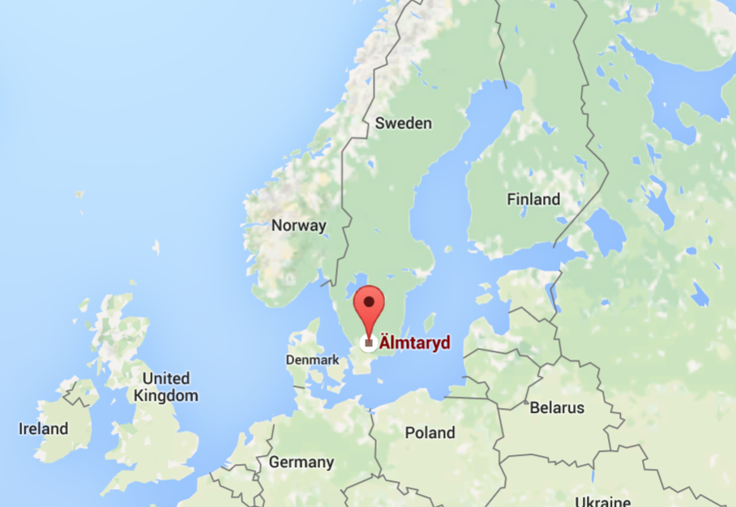
IKEA
Ingvar
Elmtaryd
Agunnaryd
Kamprad

Slide 29

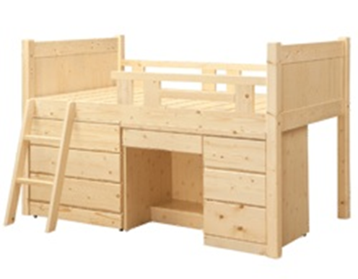
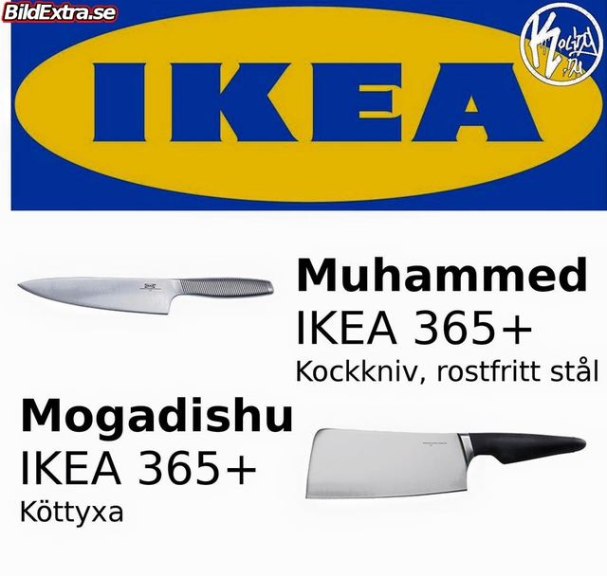
IKEA
Modern architectural designs for various types of appliances and furniture.
Eco-friendly simplicity

Slide 30
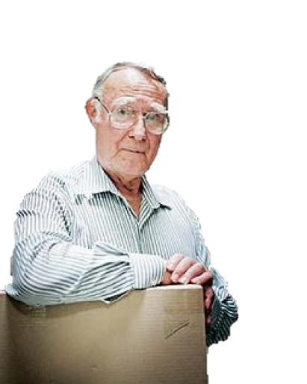
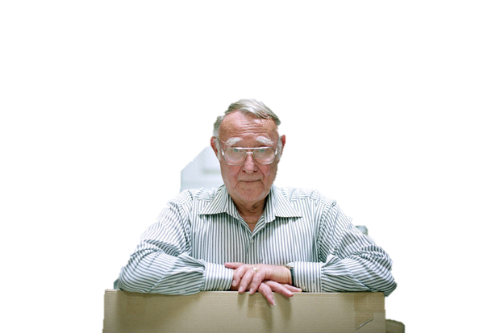
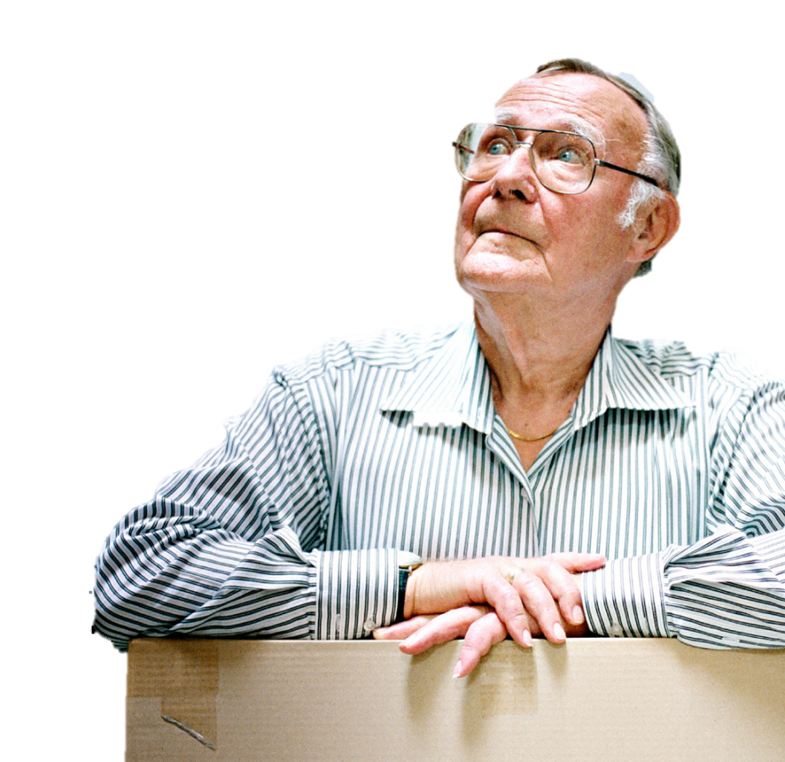
Founder Ingvar Kamprad
One of the world's richest people in 2013
Who born on 30 March 1926

Slide 31
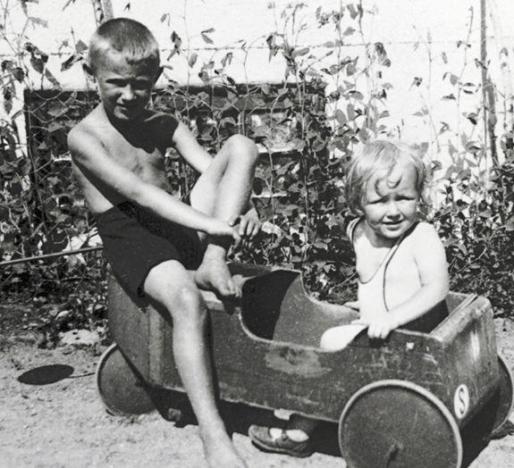
Founder Ingvar Kamprad
He found sell them at a low price, and still make a good profit
develop a business as a young boy
Selling matches to neighbors

Slide 32
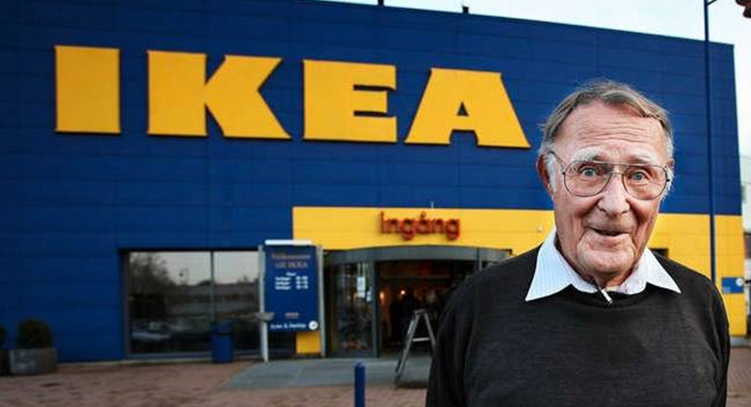
Founder Ingvar Kamprad

Slide 33
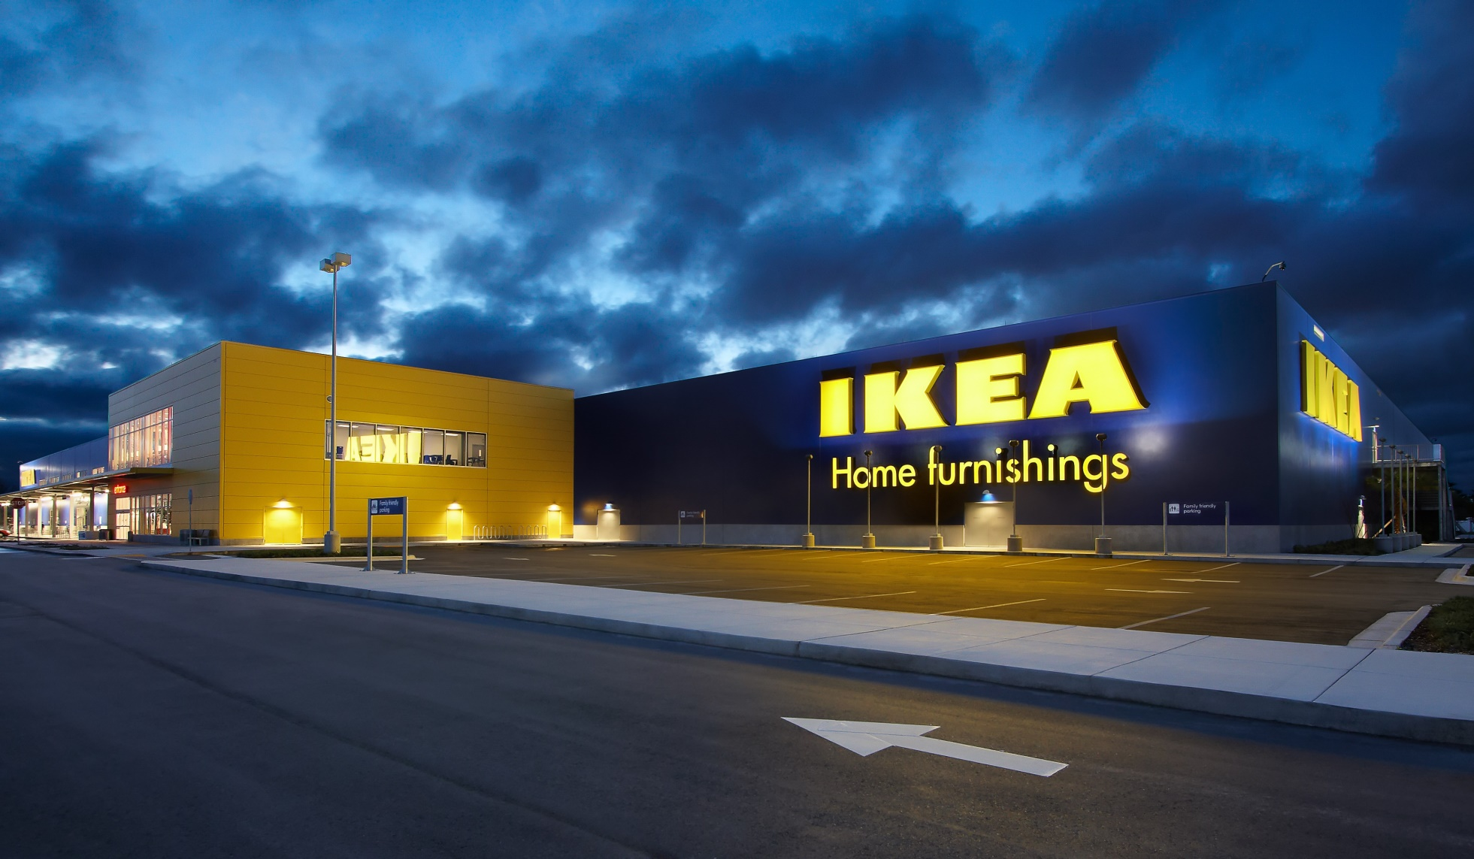
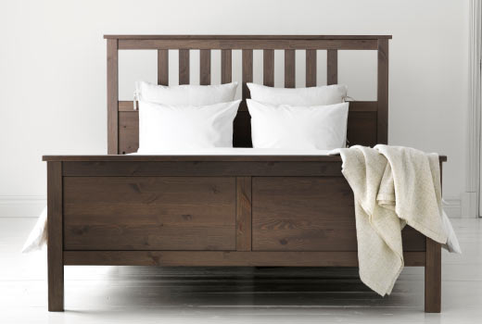
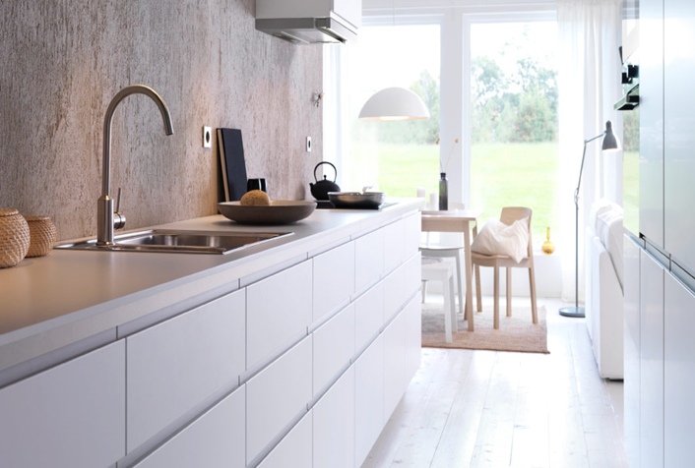
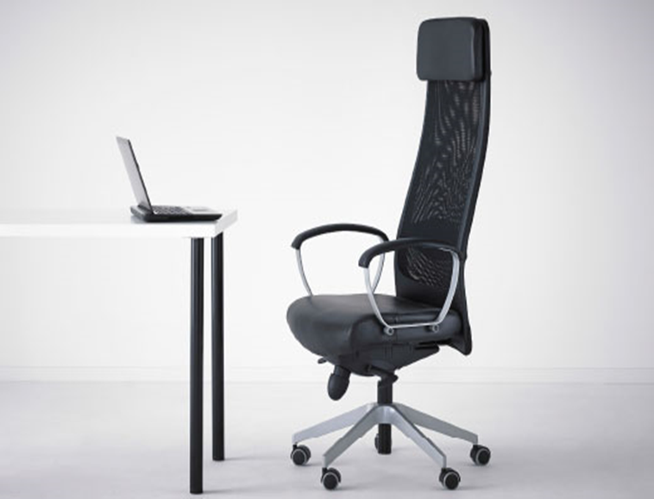
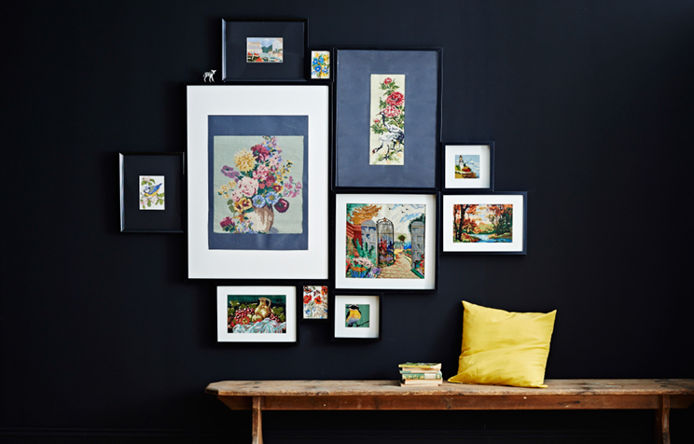
Product Introduction

Slide 34
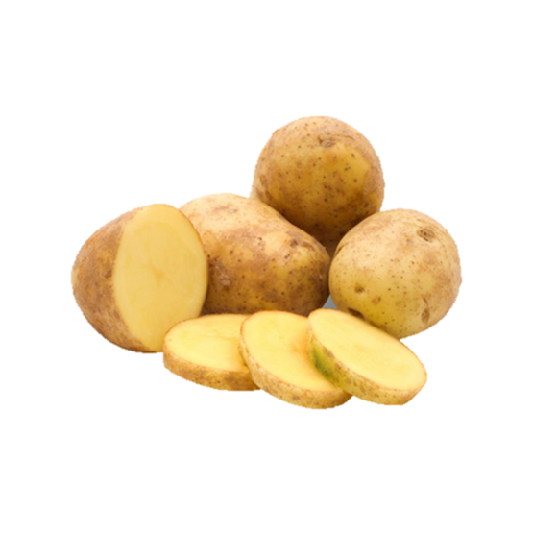
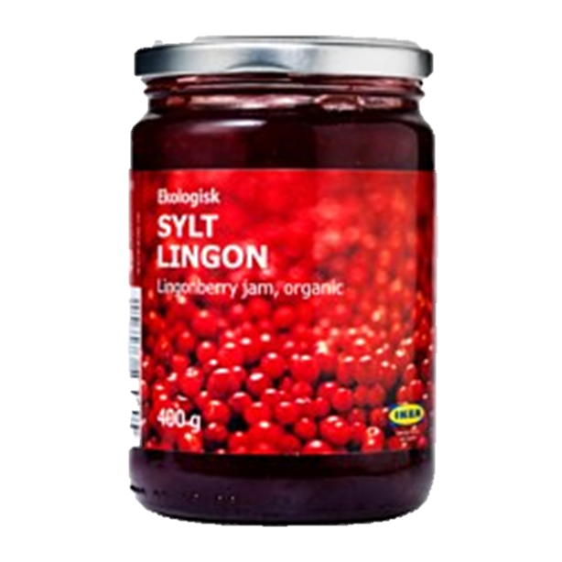
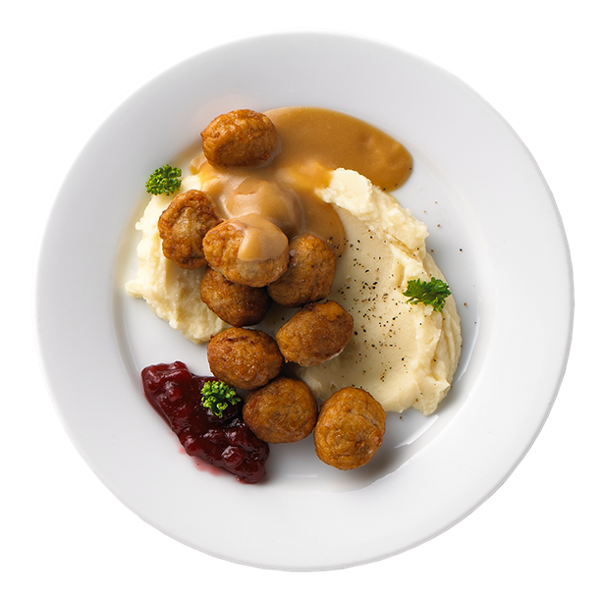
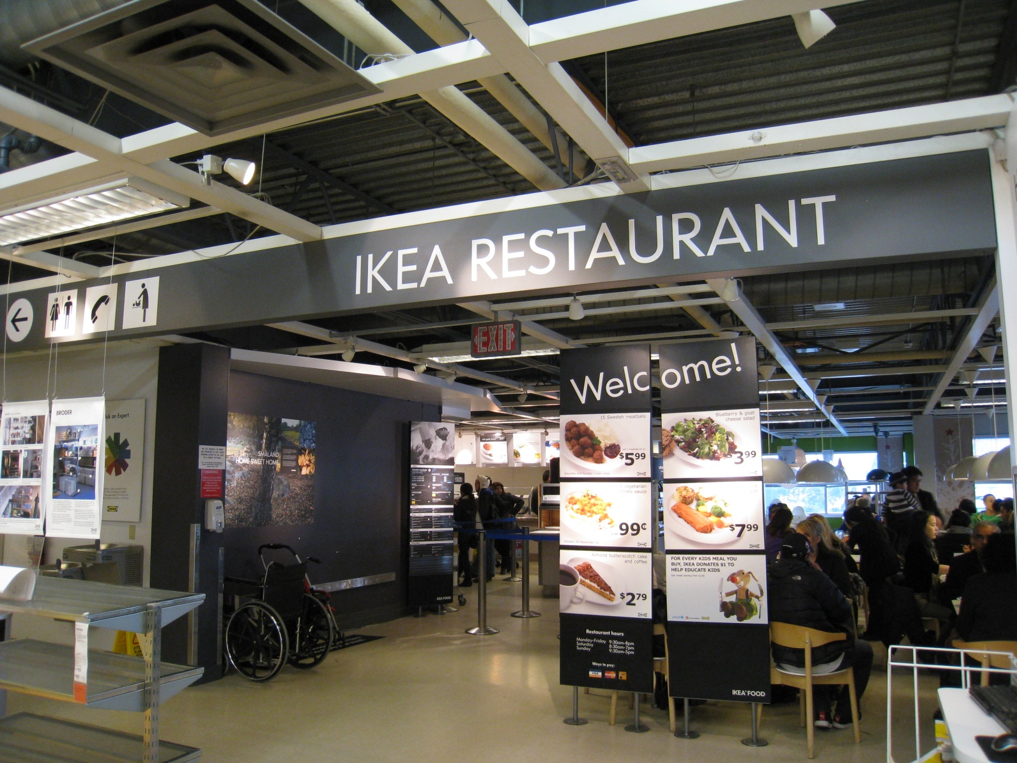
Ikea food

Slide 35
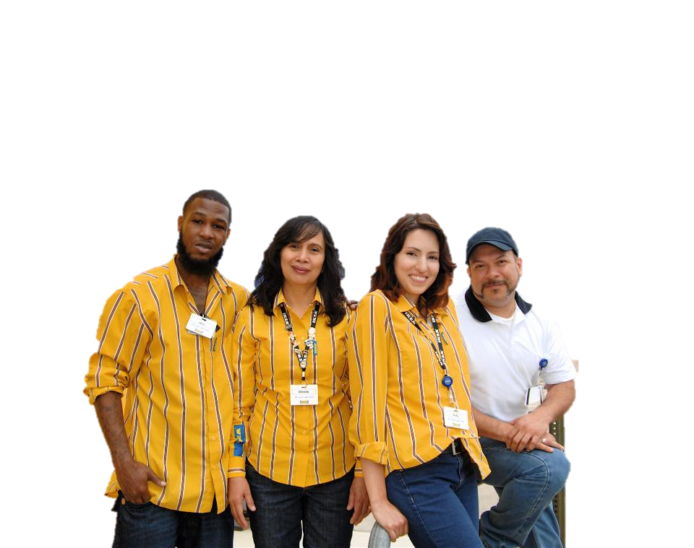
Number of Employees
135,000

Slide 36
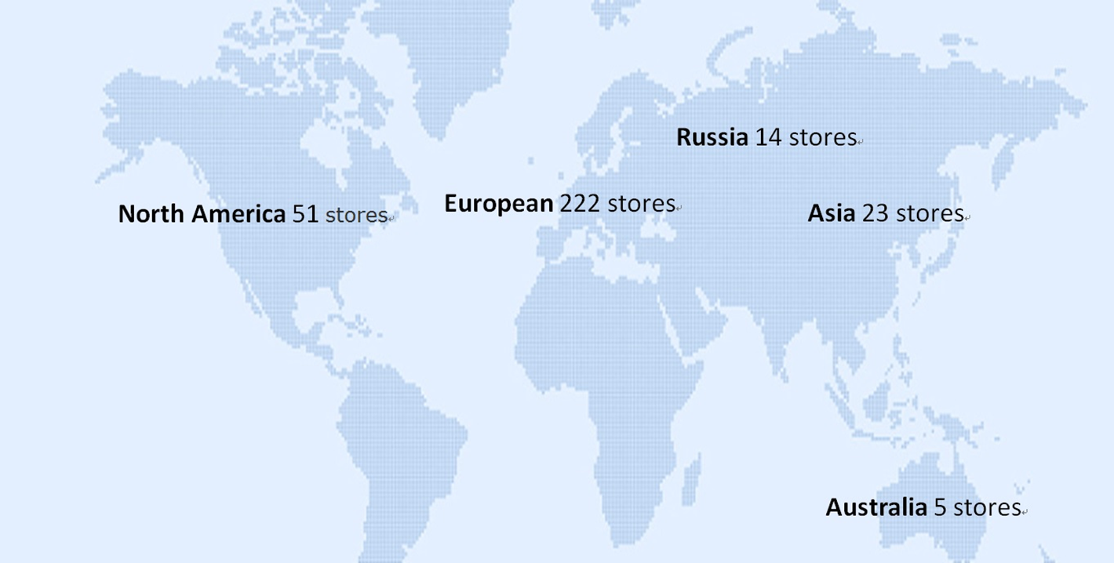
Worldwide Locations
315 stores in 27 countries worldwide

Slide 37


Slide 38
Responsible Assignment
Name | Part
Cherry | Location、Capital、Population、President、Politics、Weather
Angel | Official Language、Religion、Swedish Krona、Holiday、Salted Herring、PowerPoint
Gloria | Economy and Industry Ⅰ、Swedish GDP Proportion、American GDP Proportion、Volvo、Ikea
RJ | Economy and Industry Ⅱ、Opening、Handout
Kimmy | Ikea profile、Ikea founder、WORD
Tina | Product Introduction、Number of Employees、Worldwide Locations

Slide 39
Reference
Wiki
http://www.liontravel.com/event/festival/lightbox.aspx?tourid=44
http://www.liontravel.com/event/festival/lightbox.aspx?tourid=45
http://zt.coinmill.com/SEK_TWD.html
https://www.nordic.com.tw/store/main/others/articles.asp?id=409&open=6
http://www.mottimes.com/cht/article_detail.php?serial=498&type=1

Slide 40

The End
thank you for your listening!
Sweden aurora☺

