Slide 1

Switzerland
10445015 Sara
10445016 Stephanie
10445023 Sharon
10445025 Supeir
10445026 Maggie

Slide 2
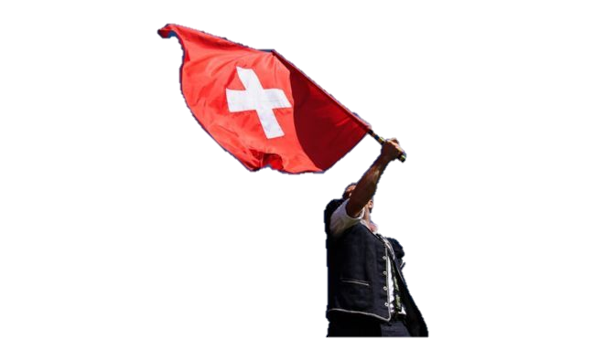
Contents
Overview of Switzerland
Economy
Representative company

Slide 3

Overview of Switzerland
Geography
Capital
Weather
Population
Official language
Religion
Currency
Politics
Festival
Celebrity
Famous story
Food and Drinks

Slide 4
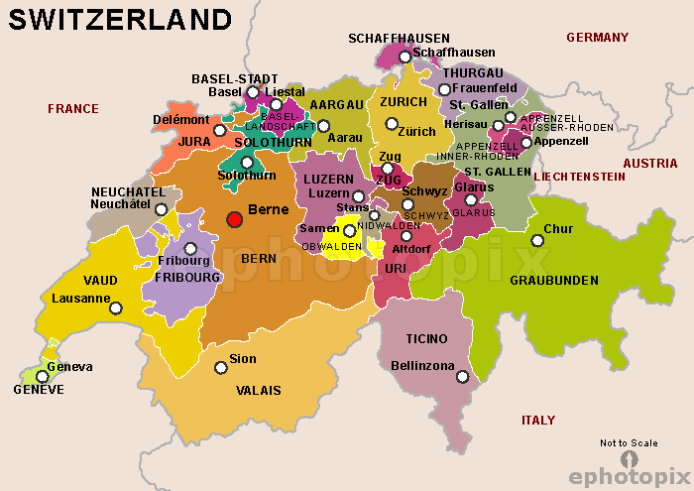
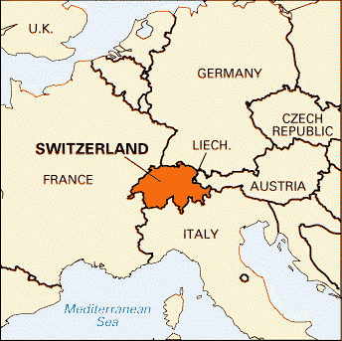
Geography

Slide 5
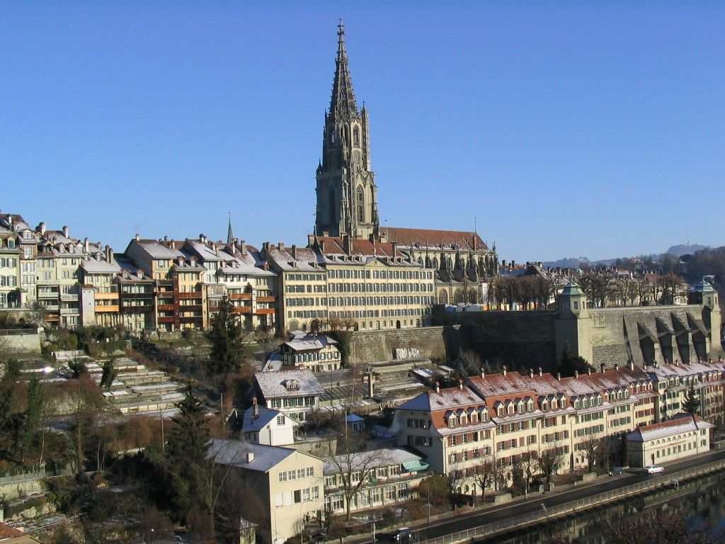
Capital - Bern

Slide 6
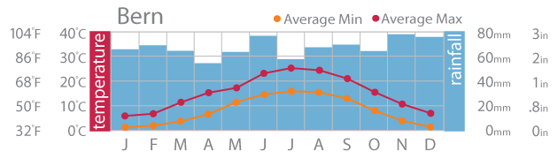
Weather

Slide 7
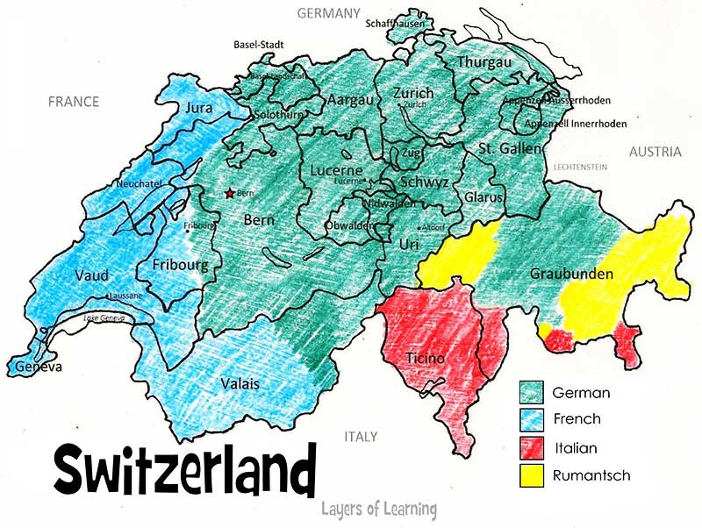
Population

Slide 8
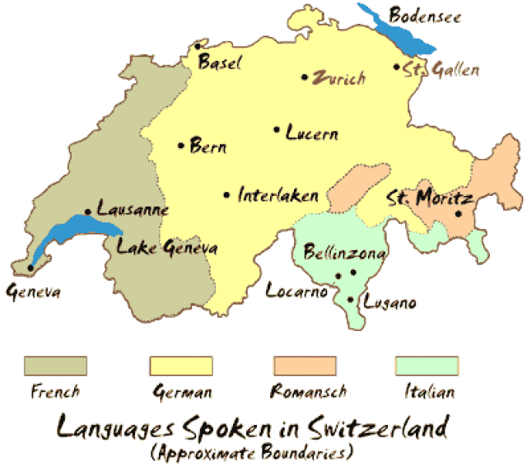
Official language

Slide 9
Religion

Slide 10
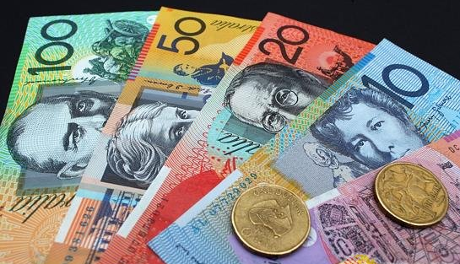
Currency
Swiss Franc

Slide 11
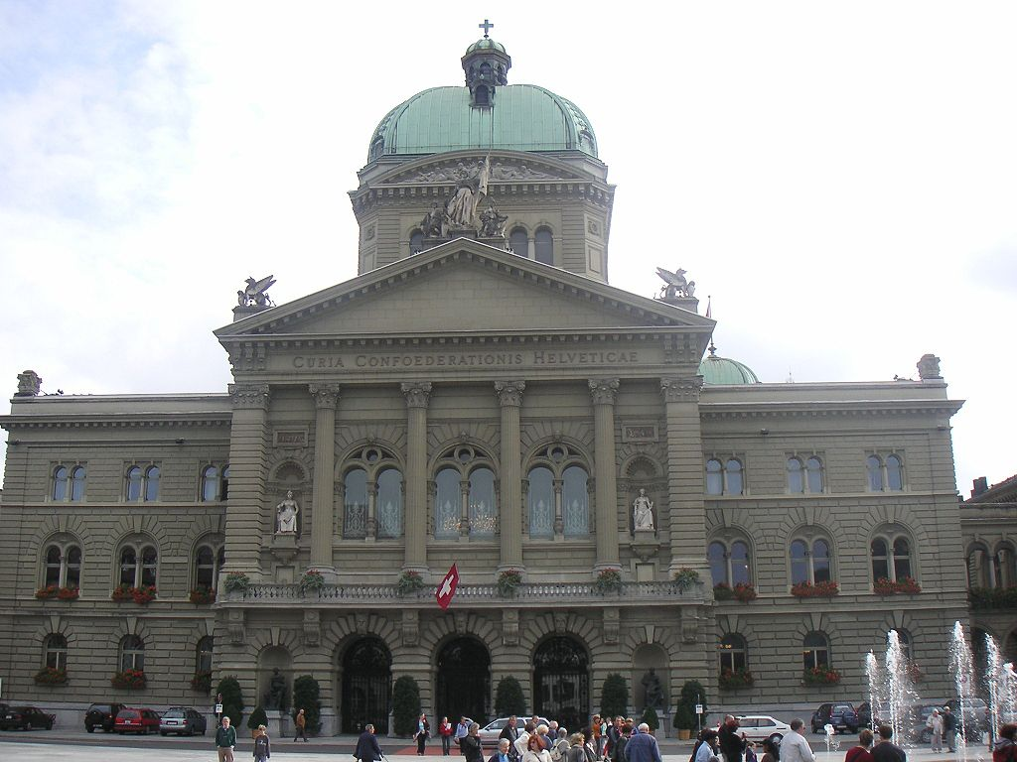
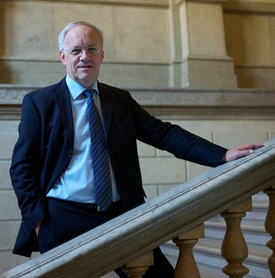
Politics
Federal Building
Johann Schneider-Ammann

Slide 12
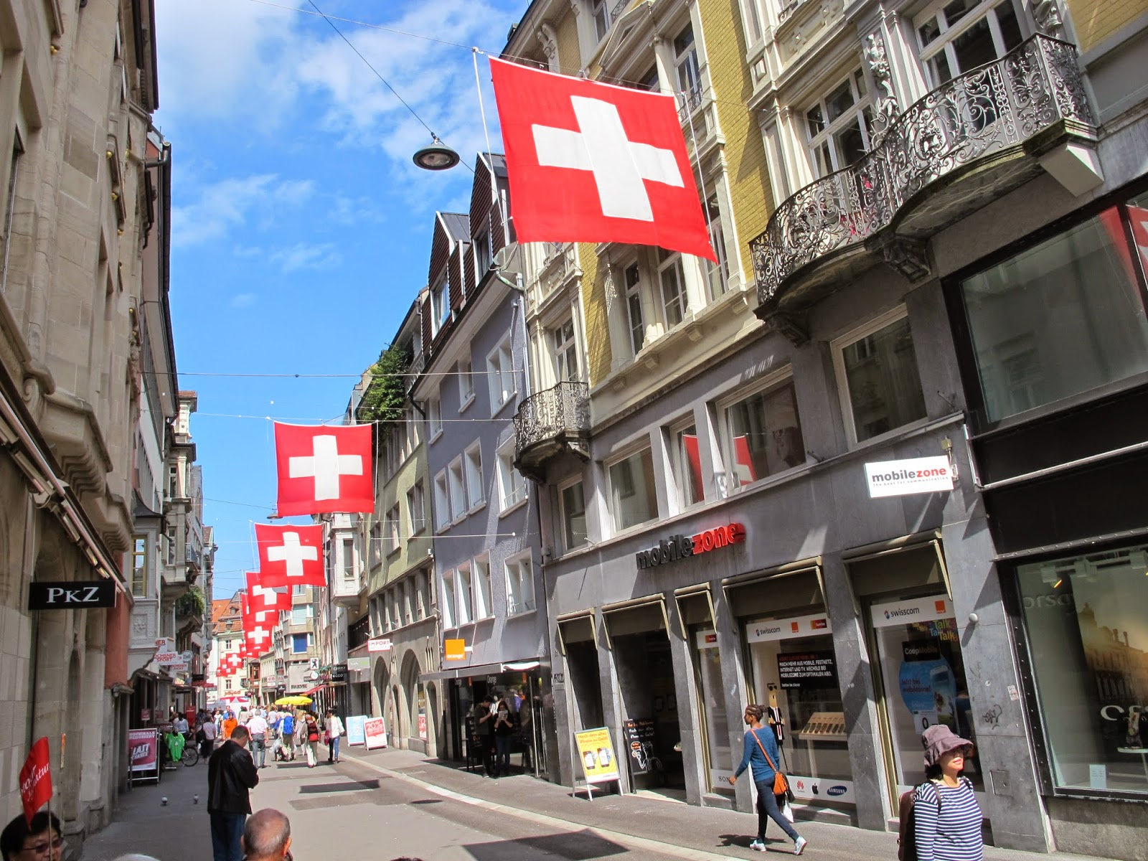
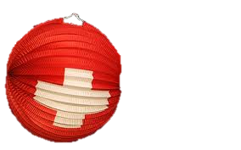
Festival
Switzerland National Day

Slide 13
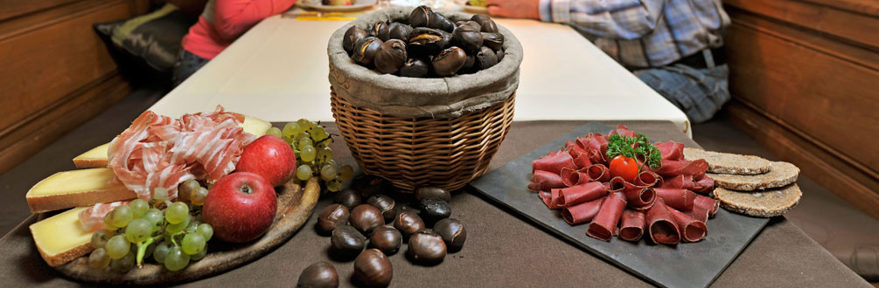
Festival
Chestnut Festival
Cheese Red wine or Spirit beef jerky Grape juice

Slide 14
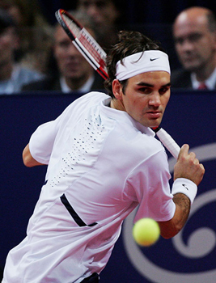
Celebrity
Name ： Roger Federer
Age ： 35 (1981/8/8)
Awards record ：
Australian Open Win 4 times
French Open Win 1 time
Wimbledon Win 7 times
US Open Win 5 times

Slide 15

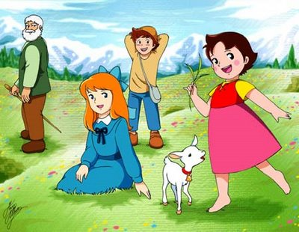
Famous story
A girl of the Alps
Heidi

Slide 16
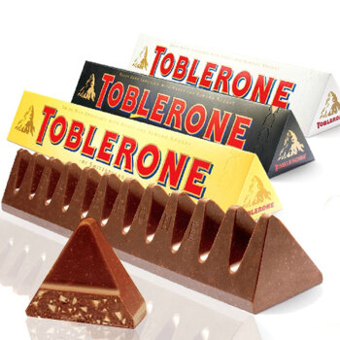
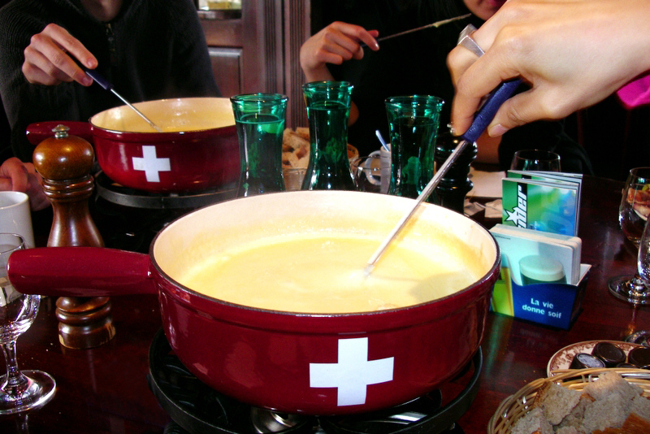
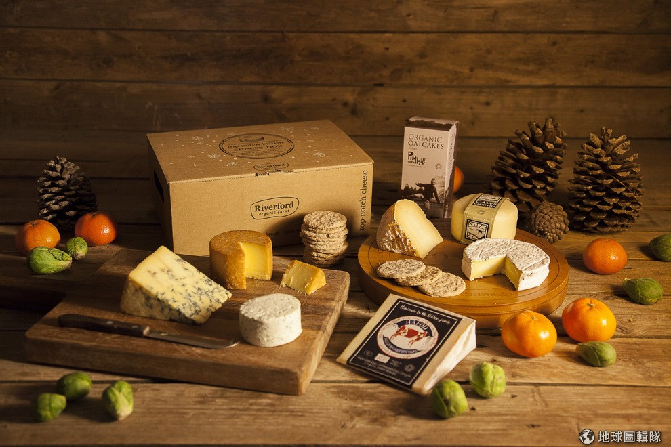
Food and Drinks

Slide 17
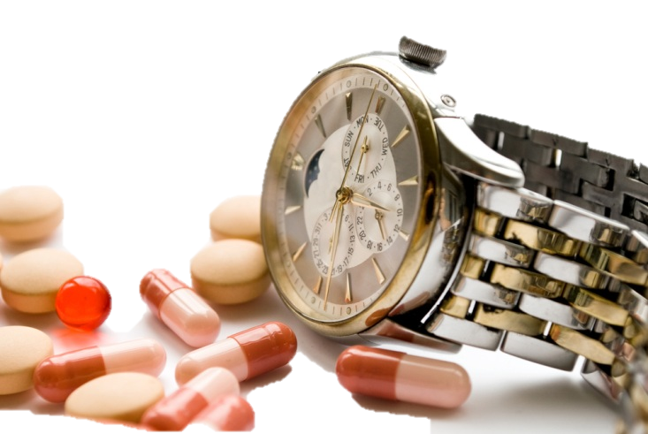
Economy
Organization
Industry
Famous corporation

Slide 18






Organization

Slide 19
Industry

Slide 20






Famous corporation

Slide 21


Slide 22
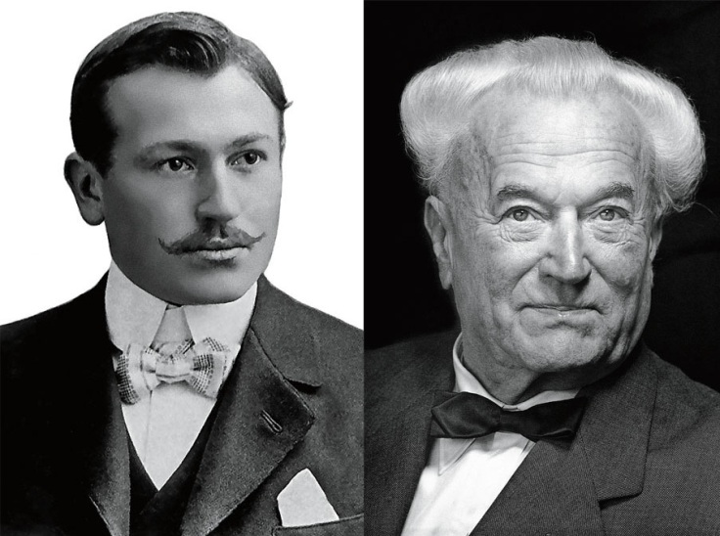
Representative company – ROLEX
Since：1905
Founders：
Alfred Davis and Hans Wilsdorf
Headquarters：Geneva, Switzerland
Major Products：watches
Number of employees：2,800

Slide 23
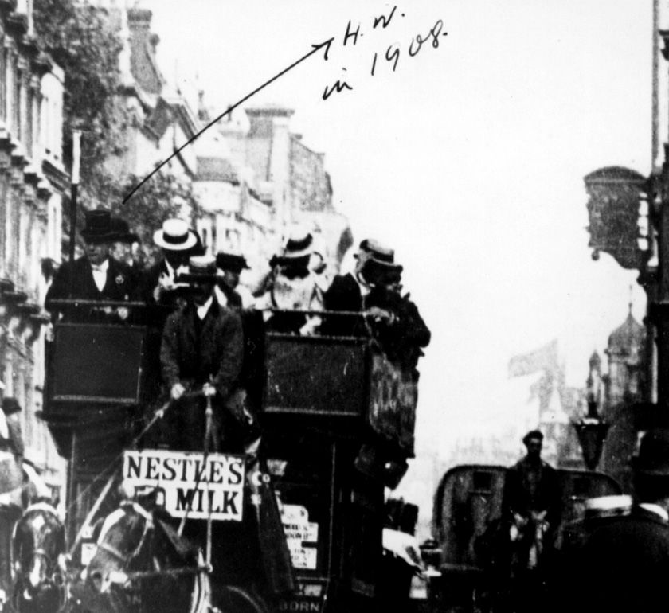

Representative company – ROLEX

Slide 24
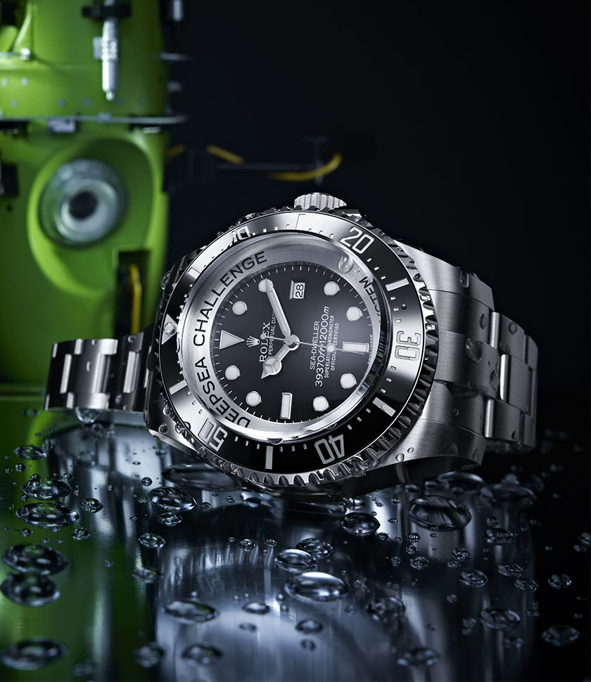
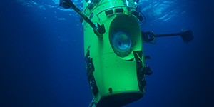
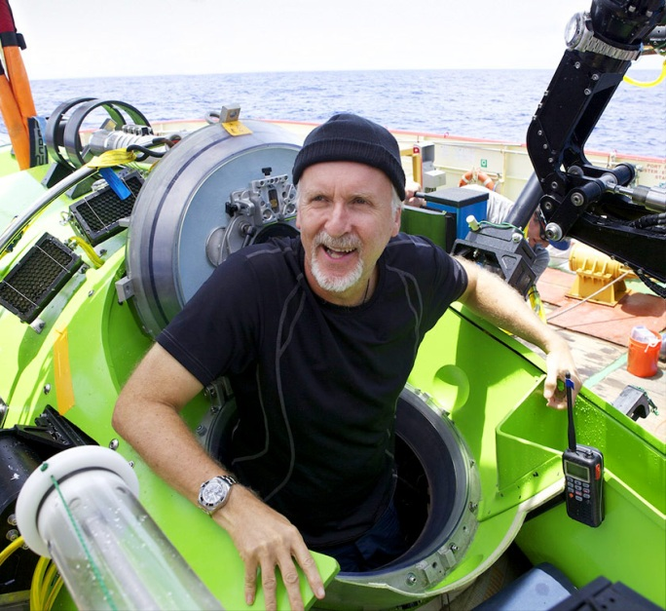
Representative company – ROLEX
In Mariana Trench
ROLEX DEEPSEA CHALLENGE

Slide 25
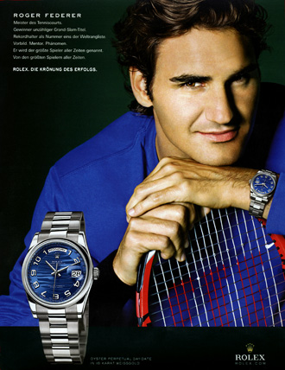
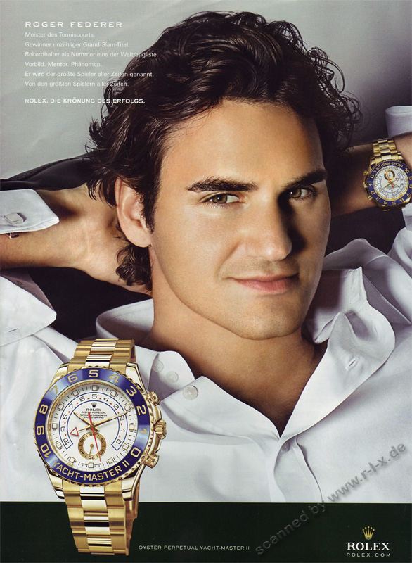
Representative company – ROLEX

Slide 26

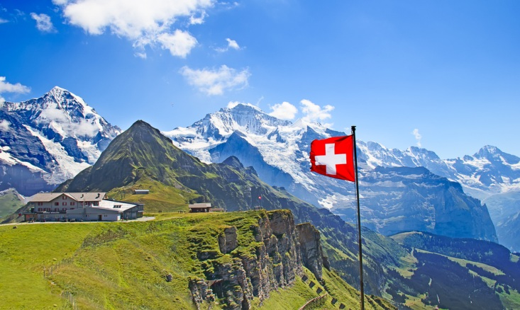
Conclusion

Slide 27
Assignments
PPT → Supeir & Maggie
Handout → Stephanie
Talk script → Sara & Sharon

Slide 28
References
Wikipedia – Switzerland
https://en.wikipedia.org/wiki/Switzerland
Wikipedia – Roger Federer
https://en.wikipedia.org/wiki/Roger_Federer
Rolex
http://www.rolex.com/watches/datejust/m116233-0149.html

Slide 29


Slide 30

Q&A

