Slide 1
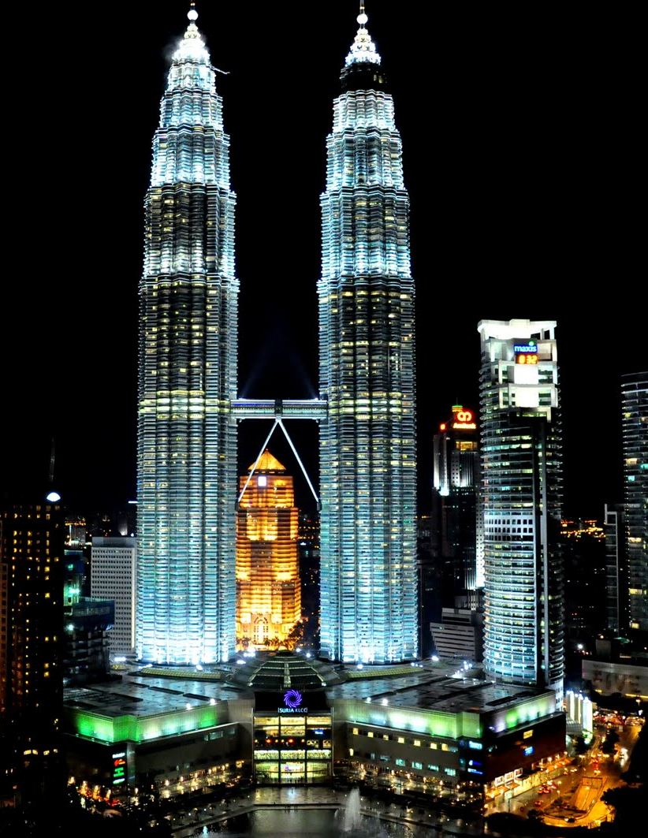
Malaysia, Truly Asia
May 26th 2016
Yee Fun [28] Eddie [29] Stanley [30] Kevin [31] Cynthia [32]

Slide 2
Outline
Country Overview
Biodiversity
Economy & Industry
Infrastructure
Representative Company
Conclusions

Slide 3
Country Overview
Weather
Official language
Capital city
Population
Religion
Currency
Government & Politics
Fun facts
Foods & Tourism
Country subdivisions

Slide 4
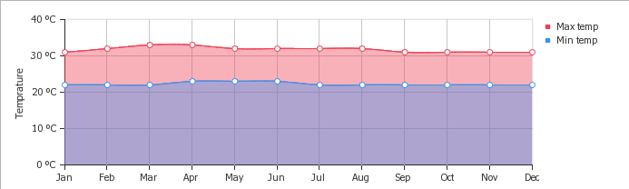
Weather

Slide 5
Official Language
✓ Official language: Malaysian.
Second language: English.
Common Chinese languages: Cantonese, Mandarin, etc.
Malaysian Indians speak Tamil.

Slide 6
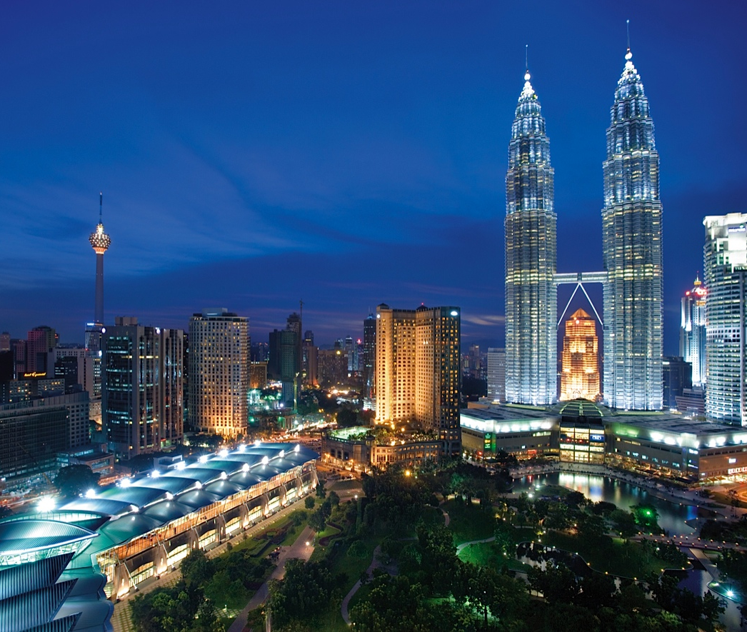
Kuala Lumpur
The seat of the Parliament of Malaysia.
The official residence of the Malaysian King.
The Petronas Twin Towers.
One of the New 7 Wonder Cities.

Slide 7
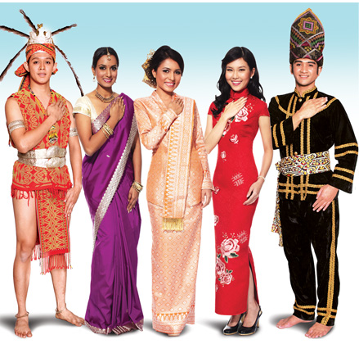
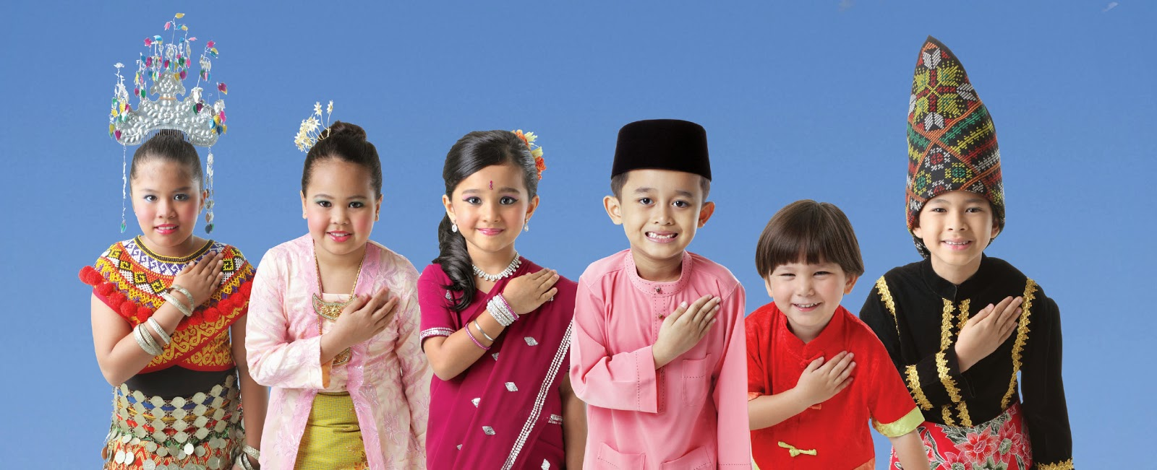
Population
2016 estimation: 31,029,000
44th most populous country

Slide 8
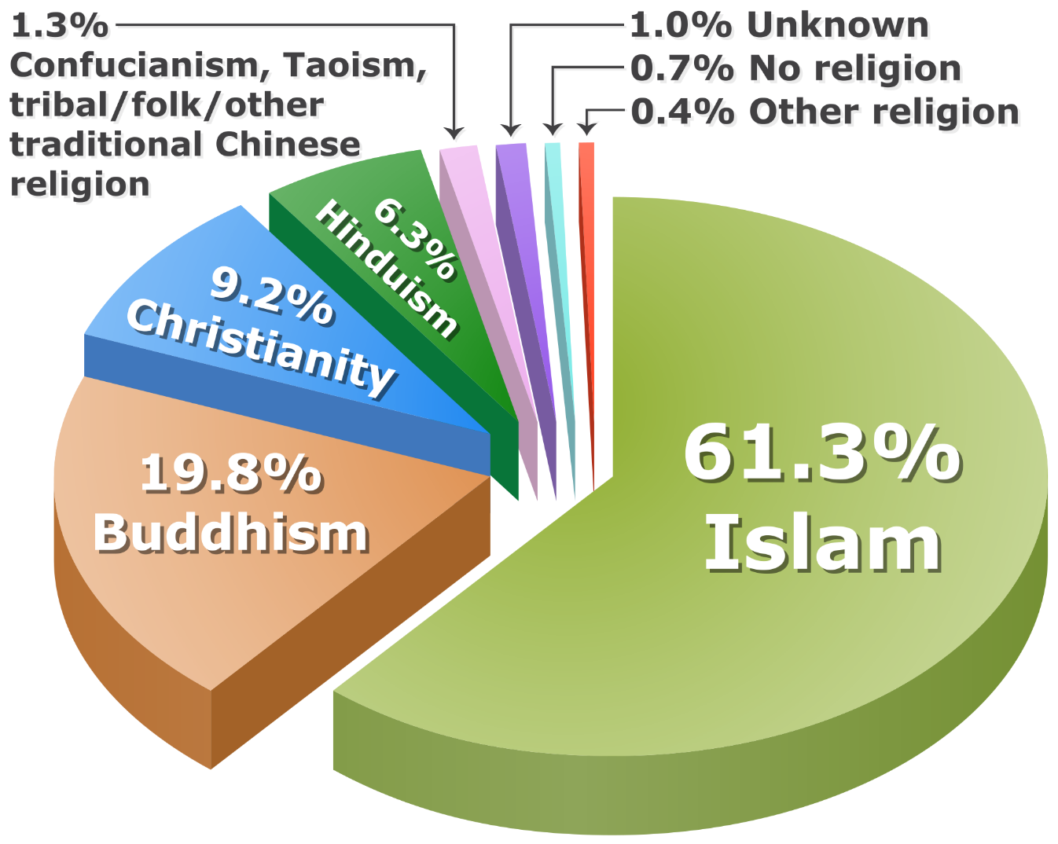
Religion

Slide 9
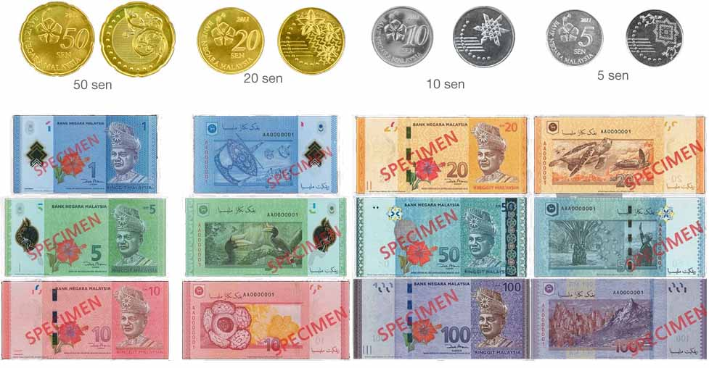
Currency

Slide 10
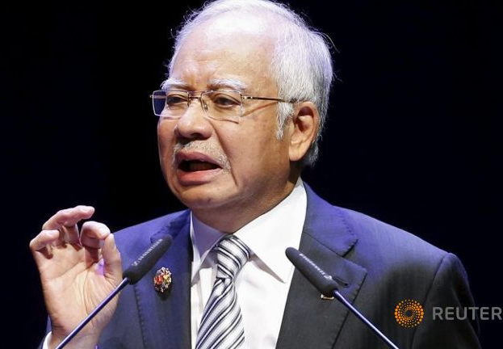
Prime Minister
Najib Razak, appointed on April 3rd 2009.

Slide 11
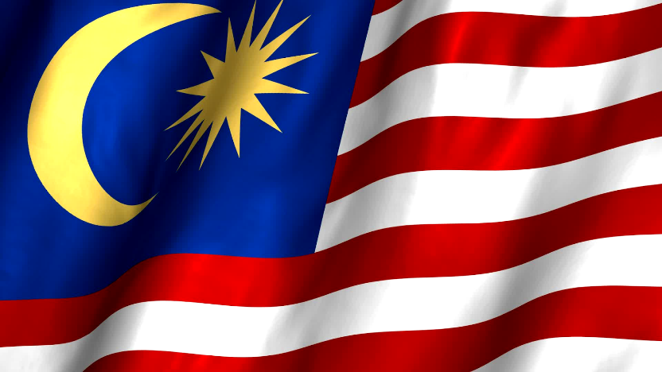

Government & Politics
Federal constitutional elective monarchy.
Executive power is led by the Prime Minister.
The Prime Minister is both the head of cabinet and head of government.

Slide 12
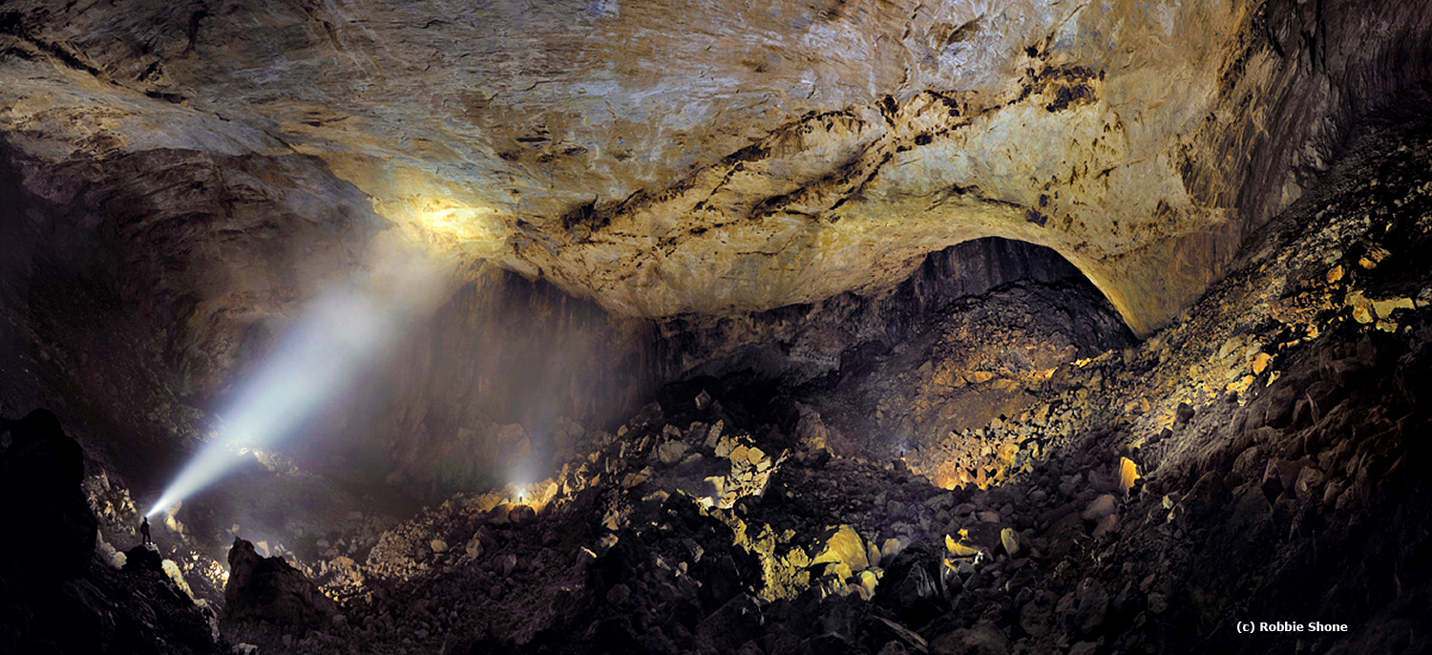
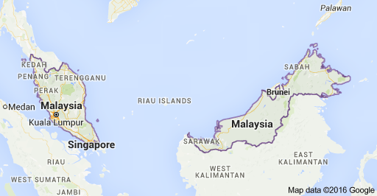
Fun Facts!
United with North Borneo, Sarawak, and Singapore on 16 September 1963. In 1965, Singapore was expelled from the federation.
Sarawak Chamber, in the Gunung Mulu National Park, Malaysia.

Slide 13
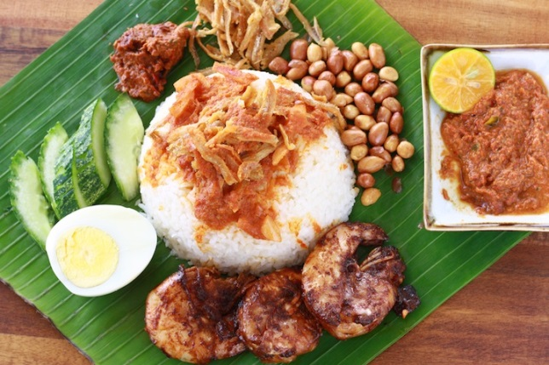
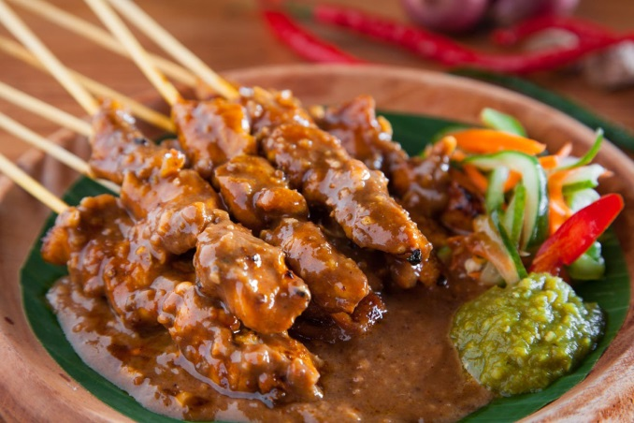
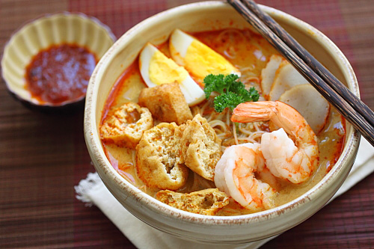
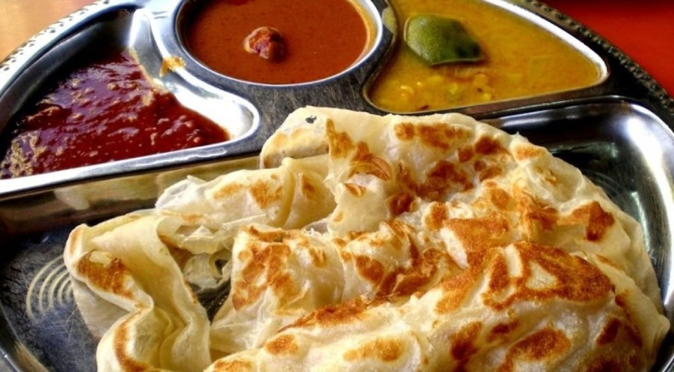
Foods
Nasi Lemak
Satay
Laksa
Roti Canai

Slide 14
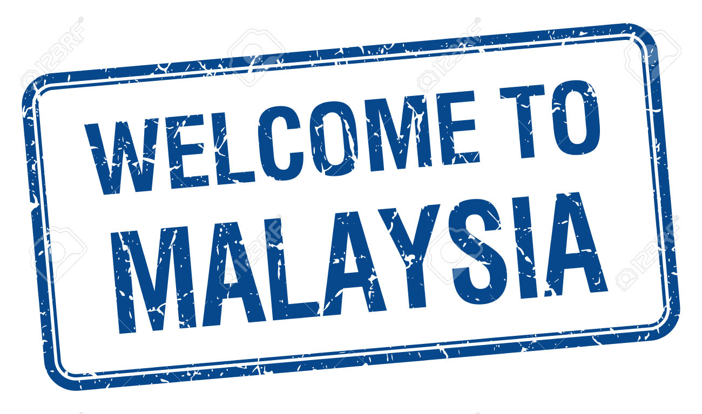
https://www.youtube.com/watch?v=T38uknAaxuk

Slide 15
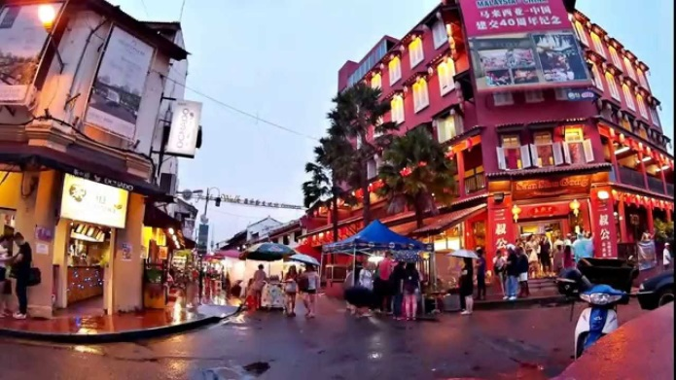
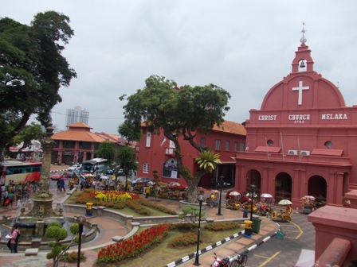
Tourism
Jonker Street – the centre street of Chinatown, in Malacca
Christ Church in Melaka

Slide 16
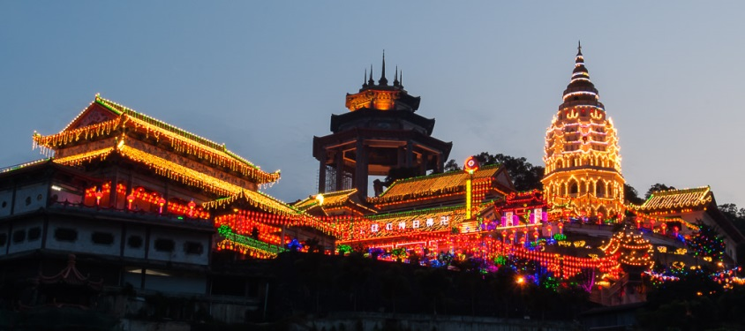
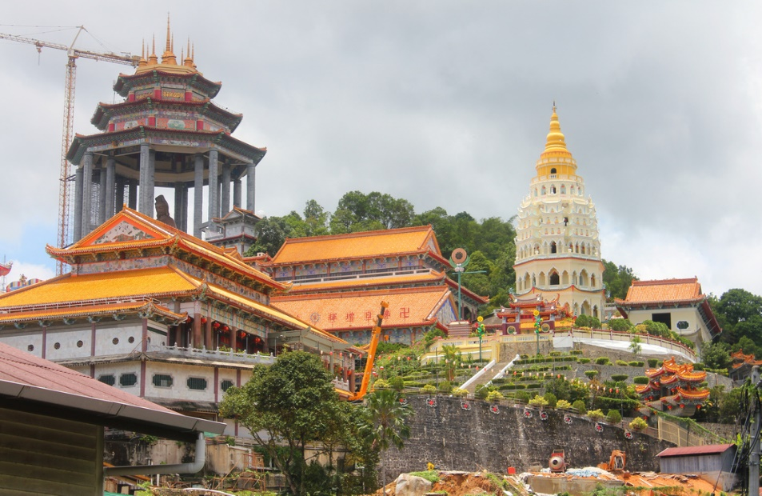
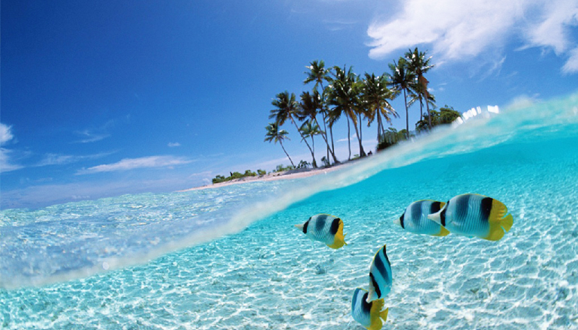
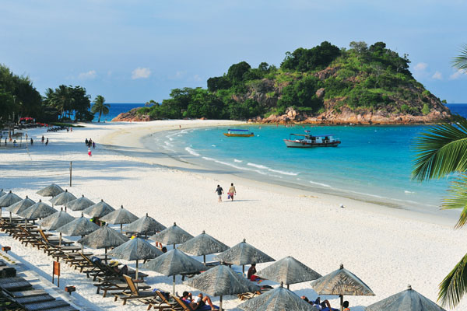
Kek Lok Si Temple in Penang
Redang Island

Slide 17
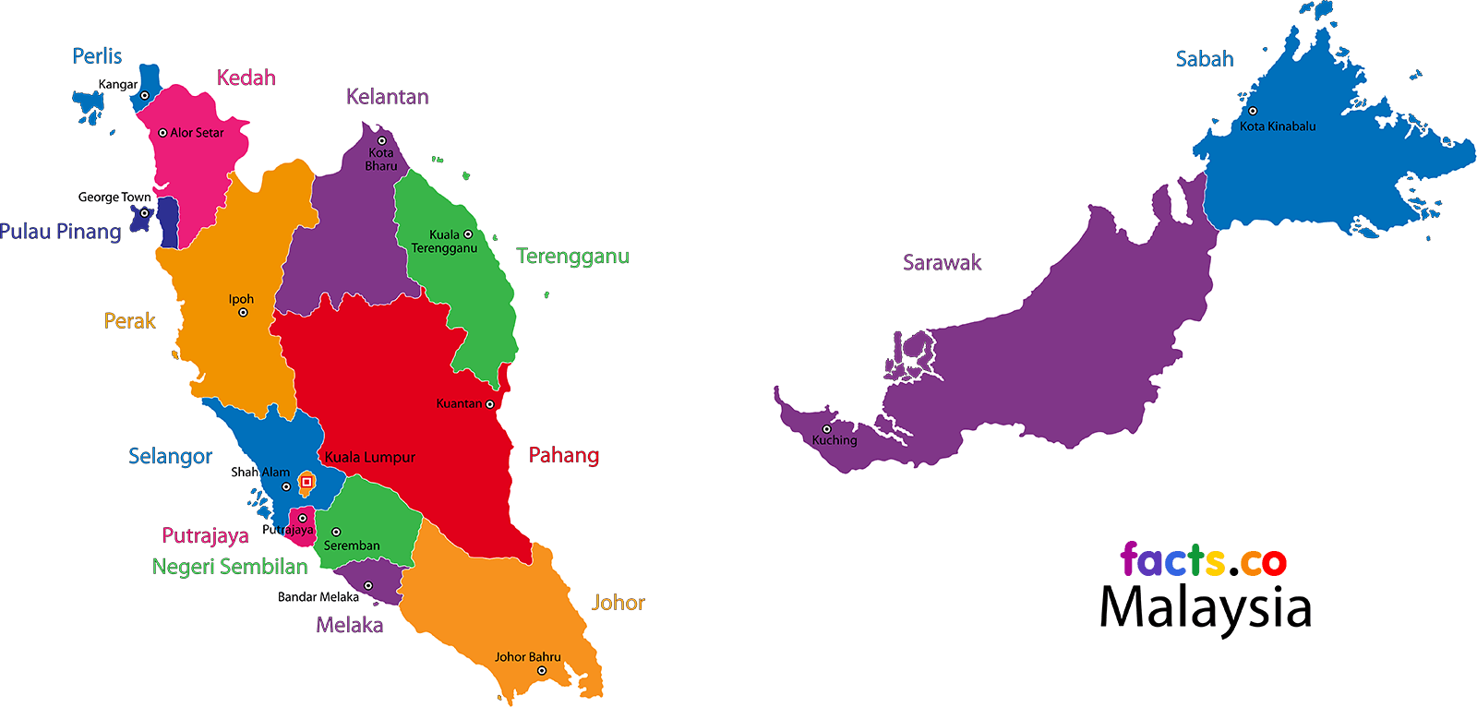
Country subdivision

Slide 18

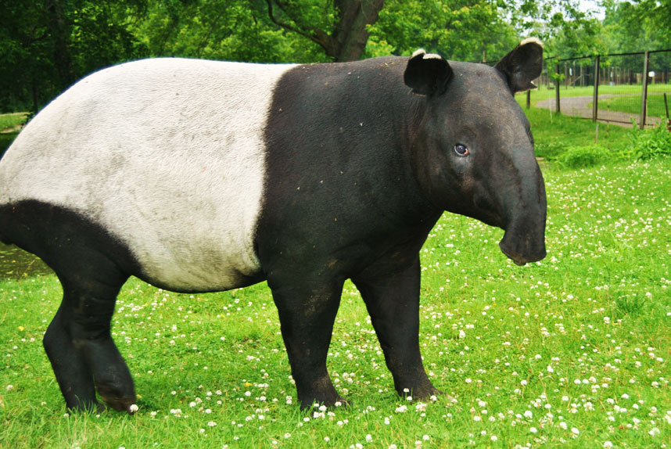
Biodiversity
Name: Malayan tapir
Habitat: Southeast Asia, including Cambodia, Indonesia, Laos, Malaysia.

Slide 19
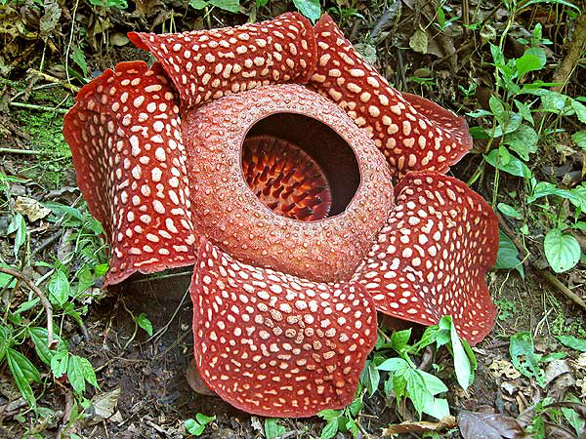
Rafflesia arnoldii
The largest flower in the world
100cm & 10kg
 Smells bad

Slide 20
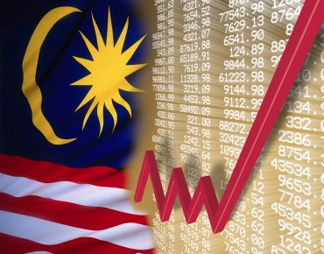
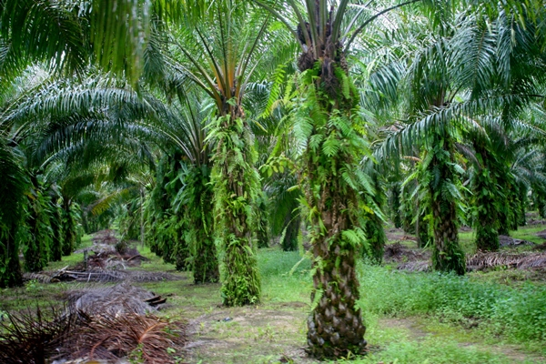
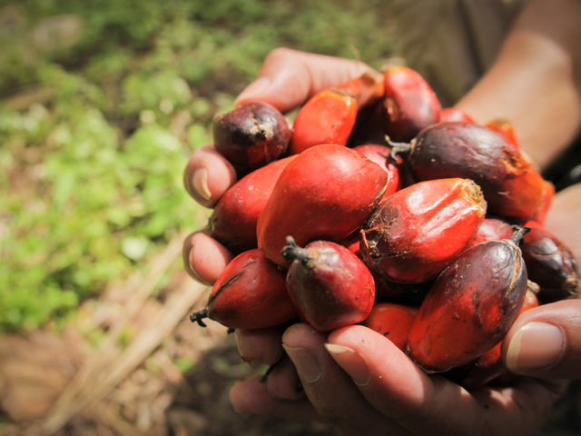
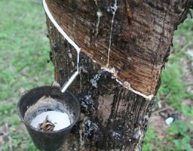
Economy & Industry

Slide 21
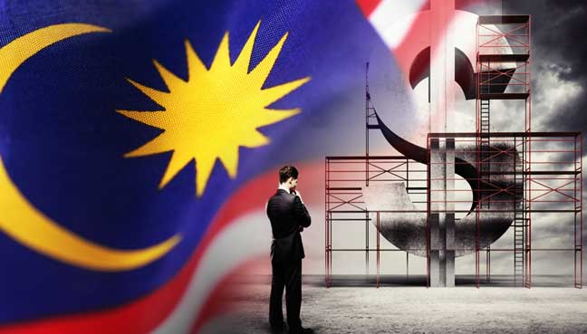
Economy
One of the best economic records in Asia.
GDP growing an average 6.5% annually from 1957 to 2005.
In 2014–2015 was ranked 6th in Asia & 20th in the world.

Slide 22
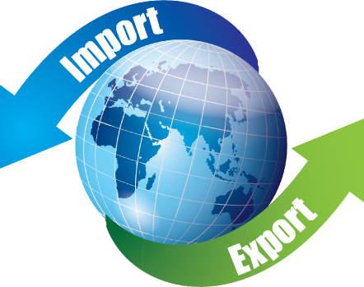
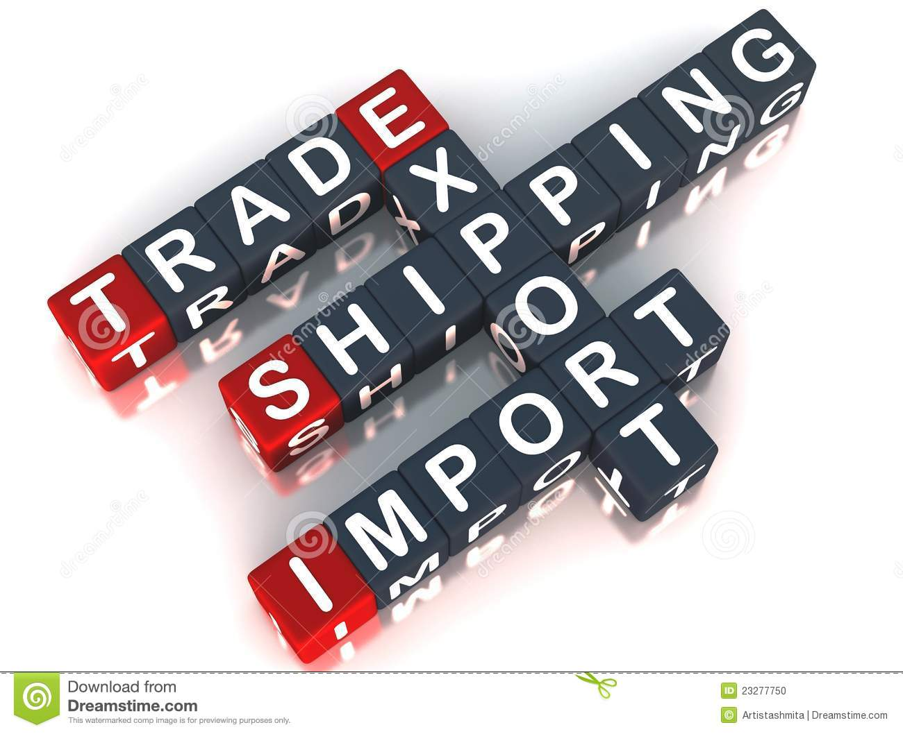
Industry
International trade and manufacturing are the key sectors.
Exporter of natural and agricultural resources.
Petroleum is a major export.
One of the world’s largest producers of palm oil.

Slide 23
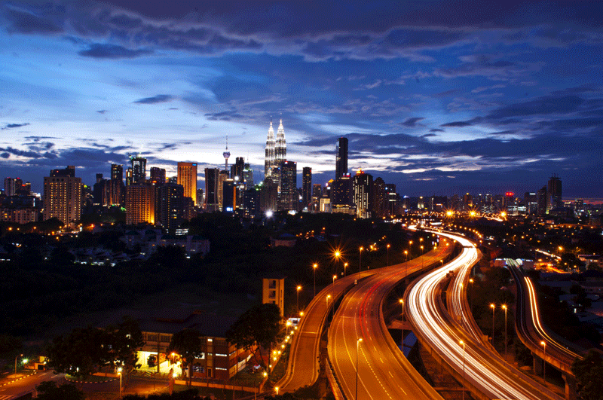
Infrastructure
Overall infrastructure of Malaysia is one of the most developed in Asia, ranked 8th and 25th in Asia and the world.
Ranked 19th in the world for its road quality, port infrastructure and air transport.

Slide 24
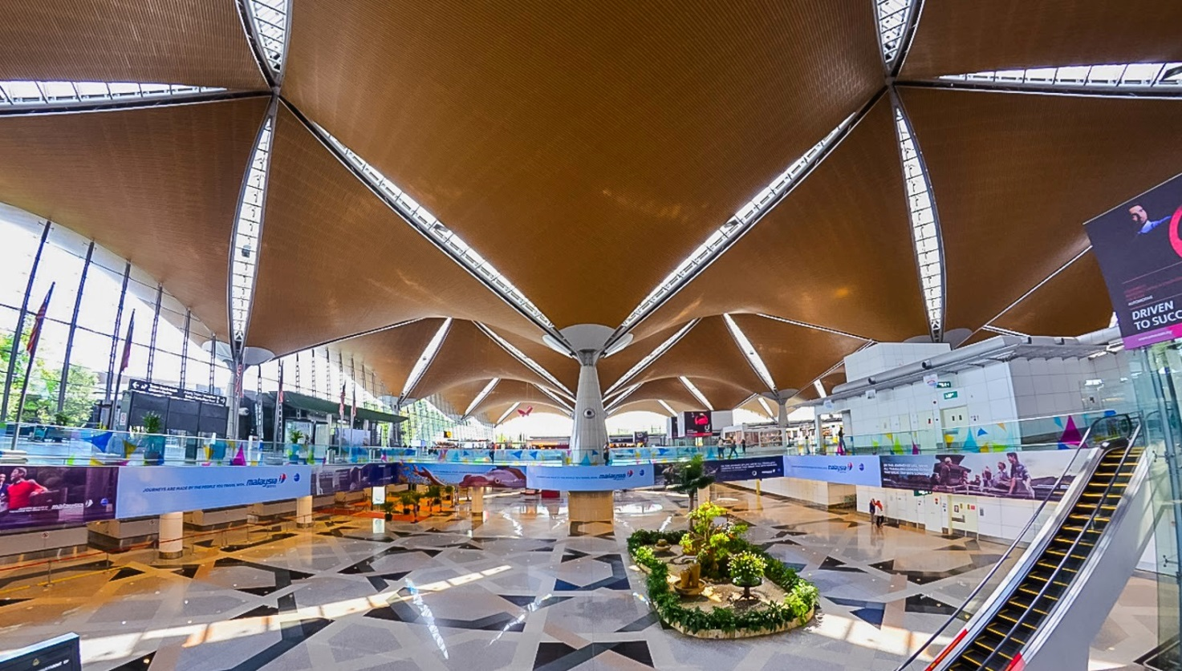
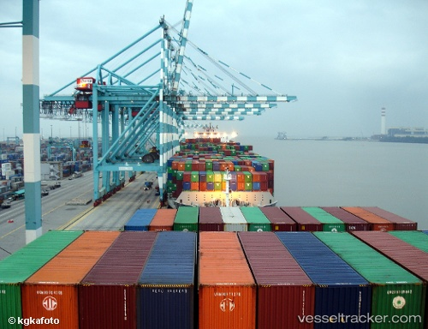
Malaysia has 118 airports; the biggest one is the Kuala Lumpur International Airport.
Port Klang and Port Tanjung Pelepas, the top 20 busiest ports in the world, which are the 2nd & 3rd busiest ports in Southeast Asia.

Slide 25

https://www.youtube.com/watch?v=2GU_rXzCAwQ

Slide 26
Representative Company
Petroliam Nasional Berhad
Malaysia’s fully integrated oil and gas multinational company
Manage Malaysia’s oil & gas field resources

Slide 27
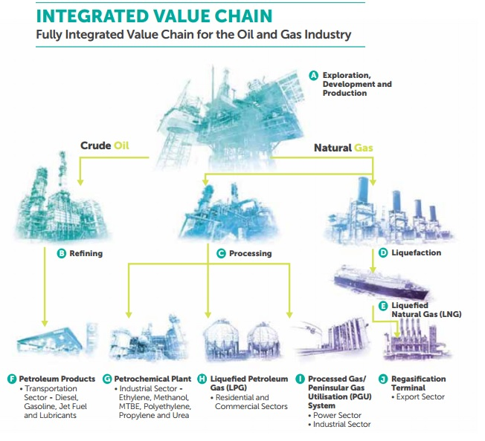

Slide 28
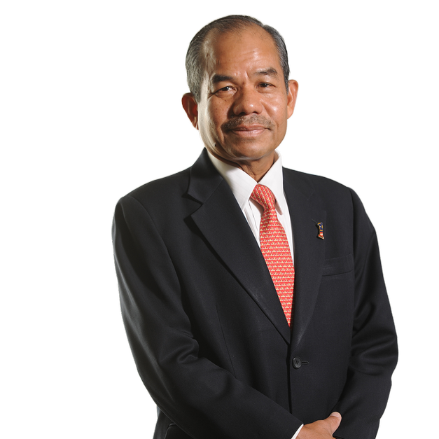
Tan Sri Mohd Sidek Hassan
The director of Petronas

Slide 29
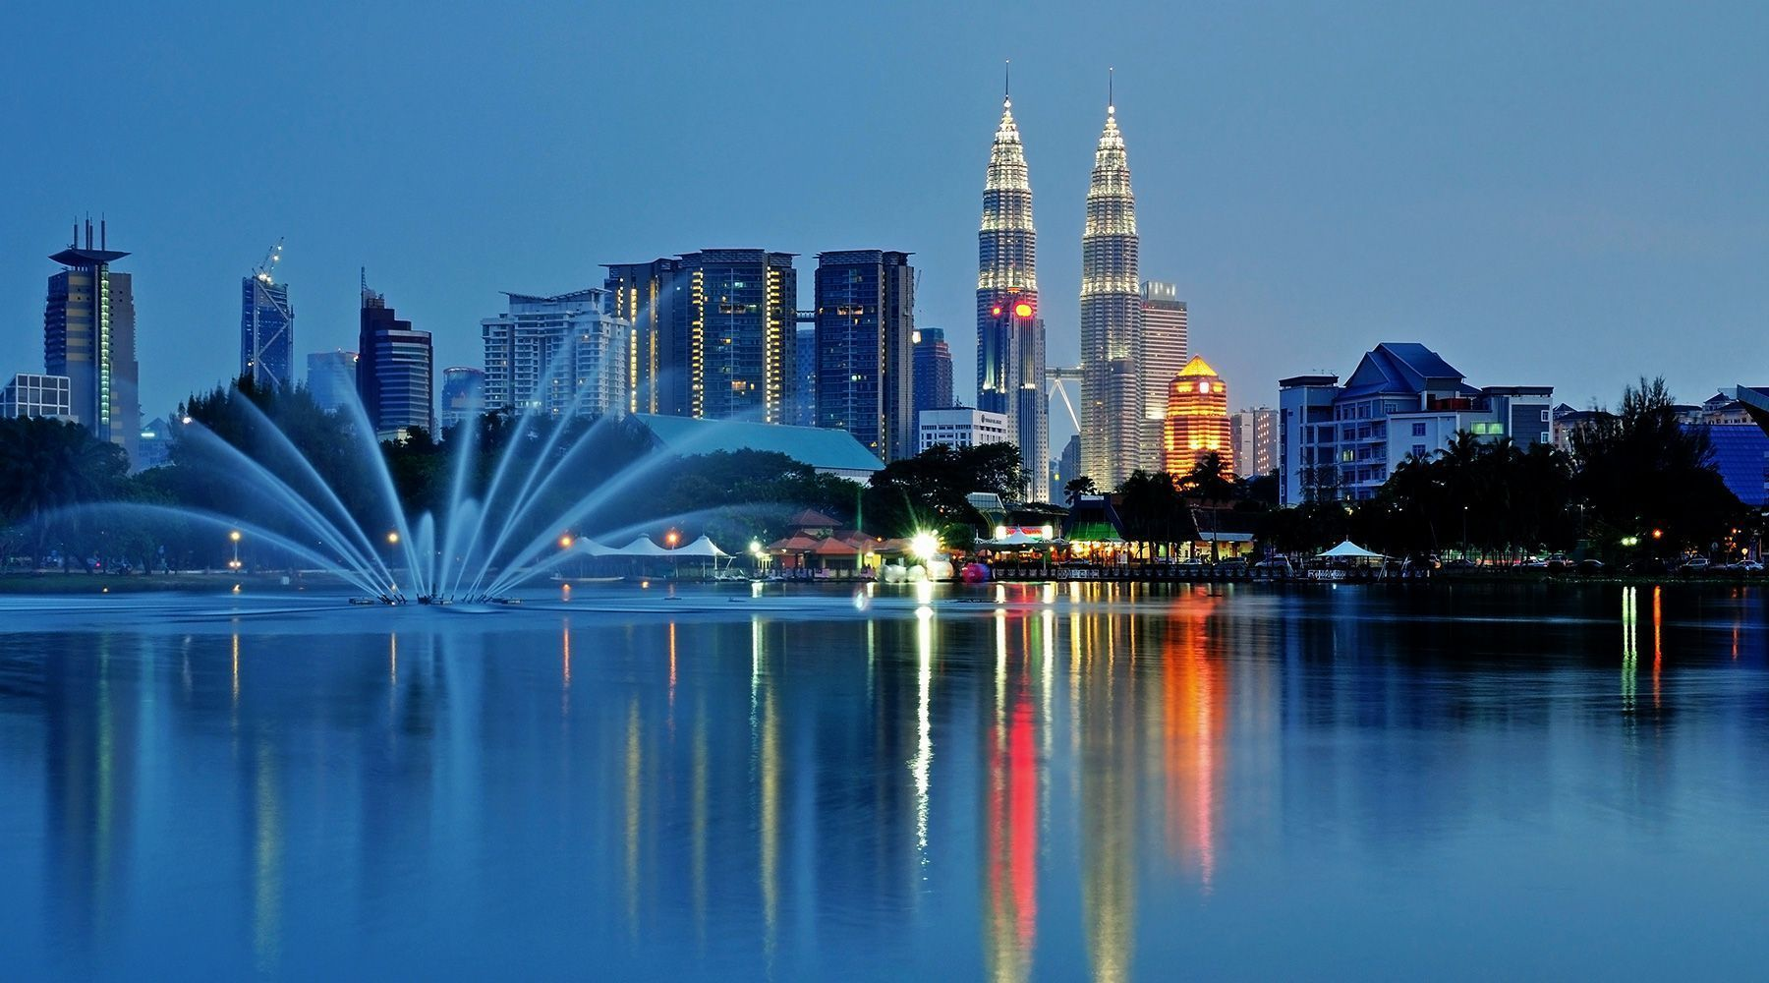
Conclusions

Slide 30
References
Overview of the country: https://en.wikipedia.org/wiki/Malaysia
Prime Minister: https://en.wikipedia.org/wiki/Prime_Minister_of_Malaysia
Fun facts of Malaysia: http://www.sciencekids.co.nz/sciencefacts/countries/malaysia.html
Nasi Lemak: https://en.wikipedia.org/wiki/Nasi_lemak
Laksa: https://en.wikipedia.org/wiki/Laksa
Satay: https://en.wikipedia.org/wiki/Satay
Roti Canai: https://en.wikipedia.org/wiki/Roti_canai
Jonker Street: http://www.malacca.ws/jonker-street/
Christ Church: http://www.malacca.ws/attractions/christ-church-malacca.htm
Kek Lok Si Temple: http://www.penang.ws/penang-attractions/kek-lok-si.htm

Slide 31
Division of Responsibility
Information about Malaysia: Cynthia, Eddie, Kevin, Stanley, Yee Fun
Talk script: Cynthia, Eddie, Kevin, Stanley, Yee Fun
Powerpoint slides: Cynthia
Handouts: Cynthia and Yee Fun

Slide 32



