Slide 1
United states of America
01 Selina
17 Kate
24 Penny
38 Jack
Daniel
45 Zoe
2016.05.11

Slide 2
Outline
Overview
Economy and industry
Representative company
  -Under Armour

Slide 3
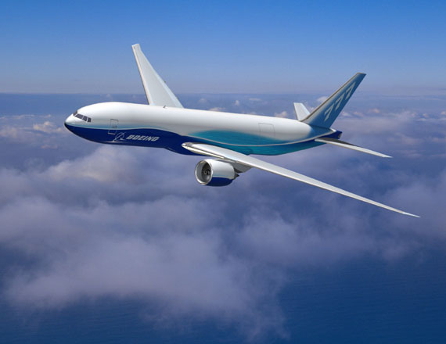


Slide 4
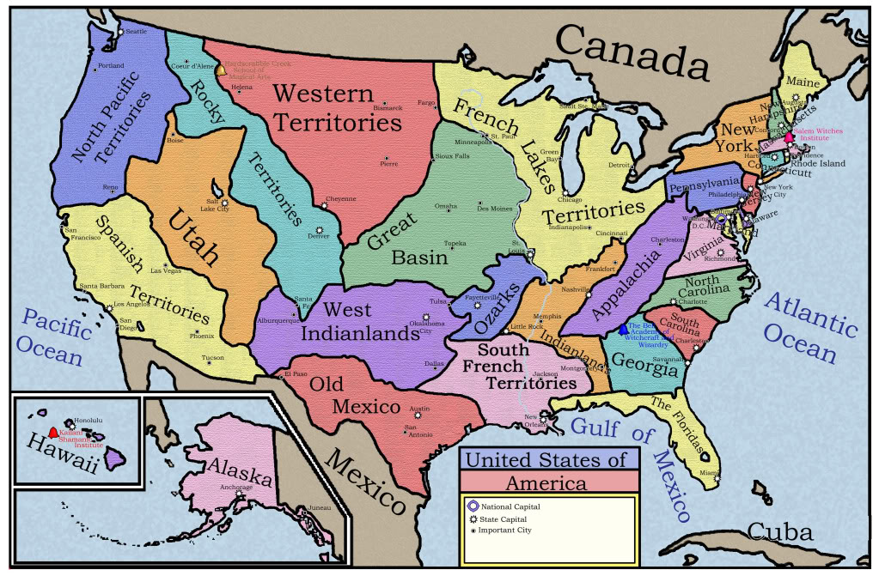
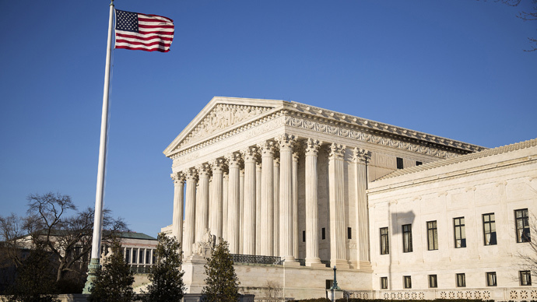
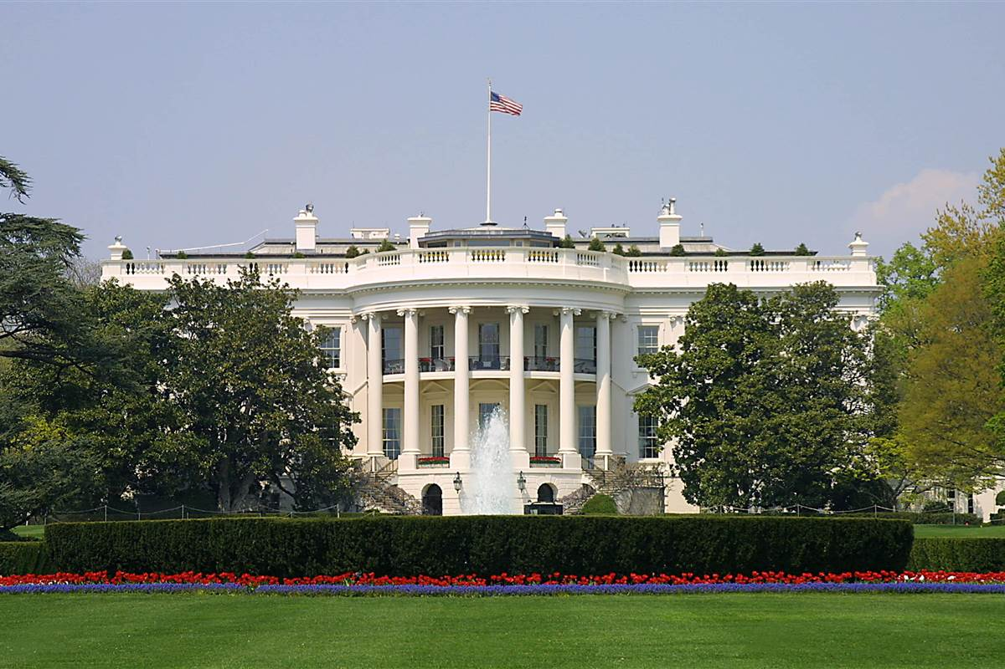

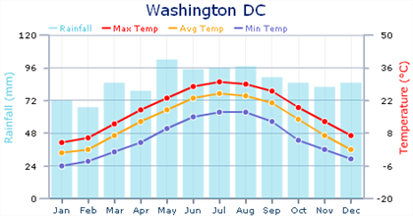
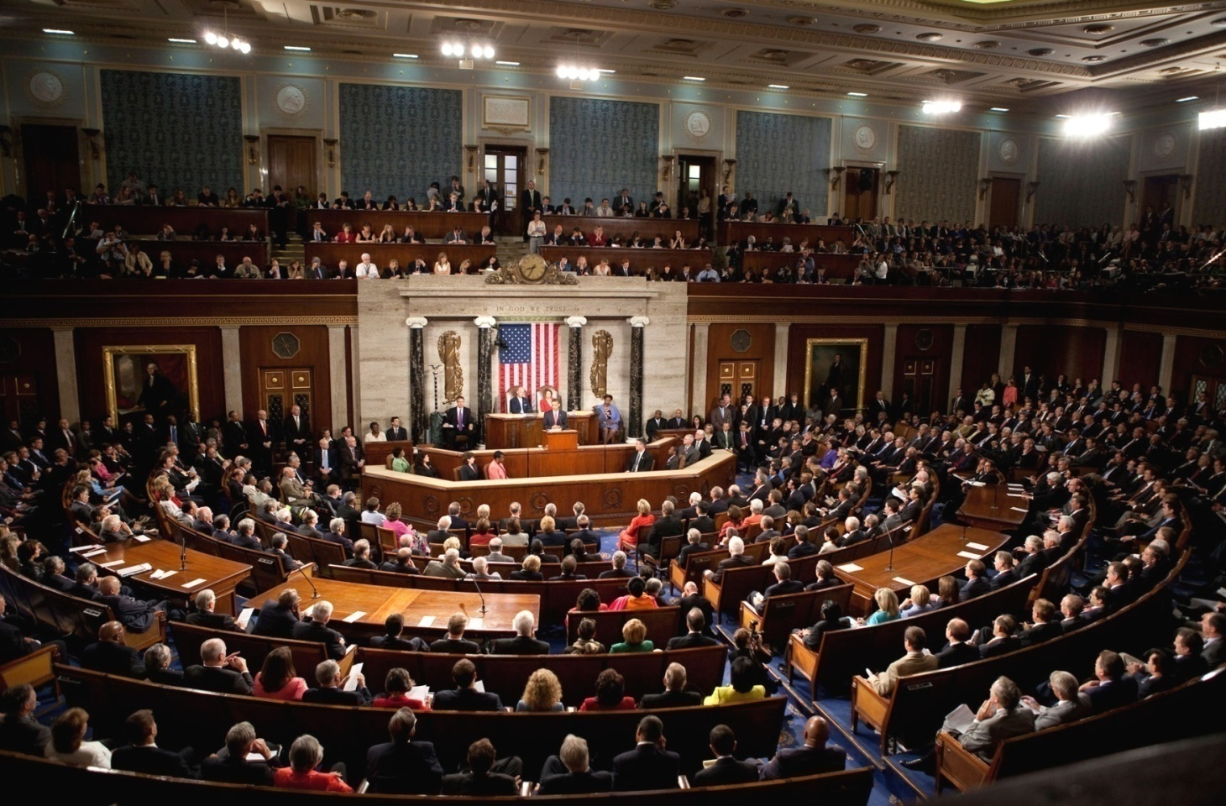
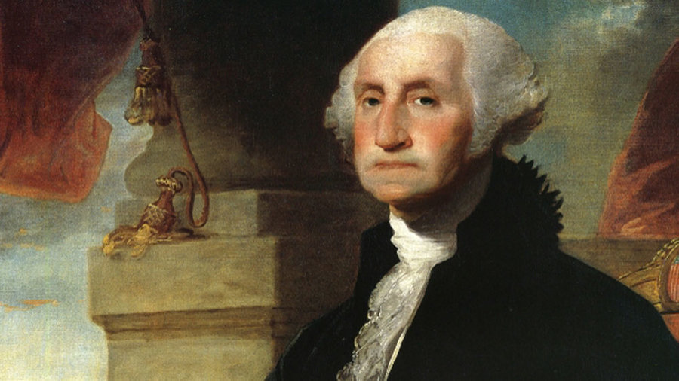
The Supreme Court
George Washington
Weather
White house
Congress
Capital
Location
Summer
Winner

Slide 5
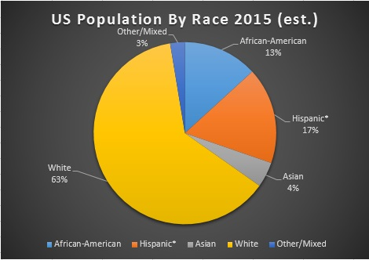
Population

Slide 6
Language

Slide 7
Education
Pre
Elementary
Middle
High
Higher
Kindergarten
Elementary
Junior
Senior
College
6
2
4
4

Slide 8



Culture

Slide 9

Economy

Slide 10
America
Economy
No.1 Importer
No.2 Trading country
No.2 Exporter
No.1 Industrialized country
Industry
Agriculture

Slide 11
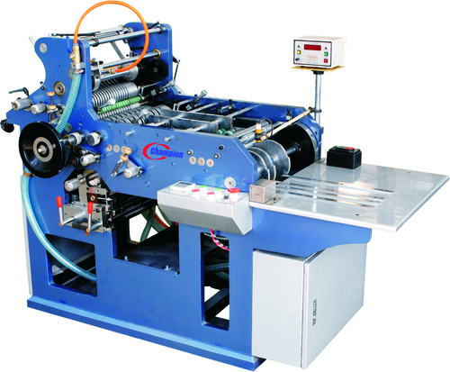

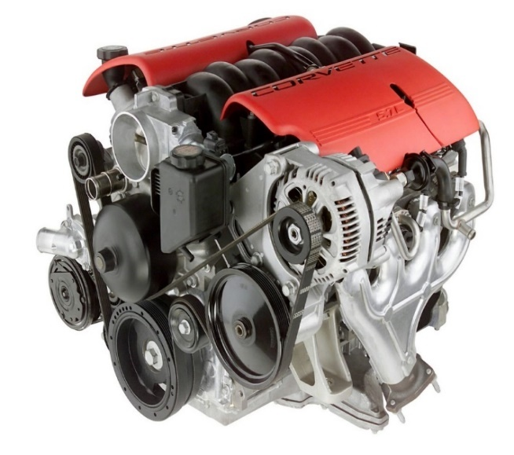

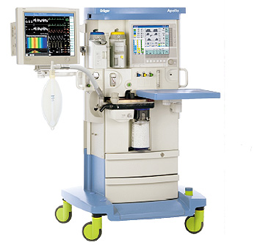



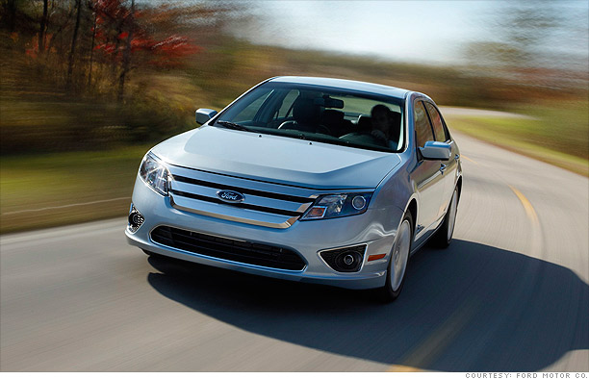

Export
Import

Slide 12

Agriculture
Extensive farming

Slide 13
Major Crops
(US$ billions)
 | 2014
Corn | $52.40
Soybeans | $40.30
Wheat | $11.90
Alfalfa | $10.80
Cotton | $5.10
Hay, (Other than Alfalfa) | $8.40
Tobacco | $1.80
Sorghum | $1.70
Barley | $0.90

Slide 14

Representative Company

Slide 15
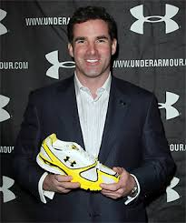
Founder : Kevin Plank

Slide 16
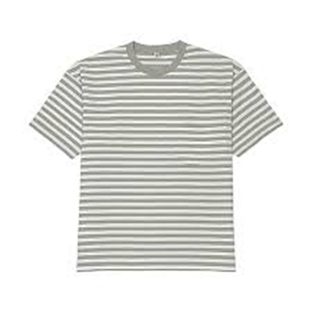
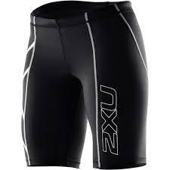
Inspiration
Compression Shorts
T-shirt

Slide 17
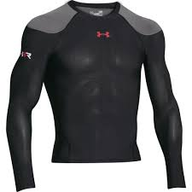
Material
moisture-wicking material

Slide 18
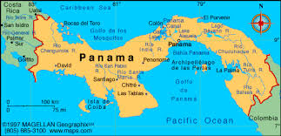
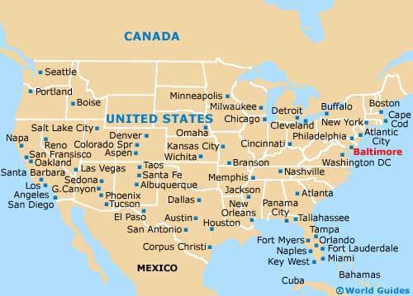
Location
Panama City
Baltimore, Maryland

Slide 19
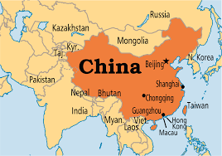
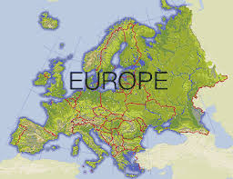
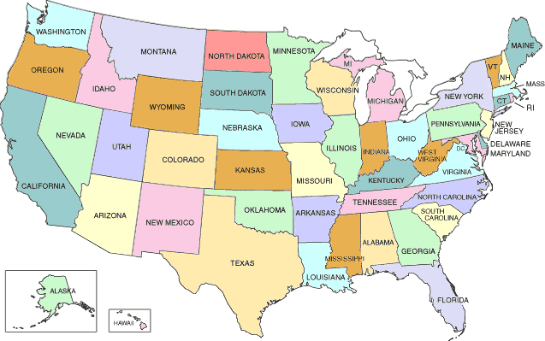
Main Market

Slide 20
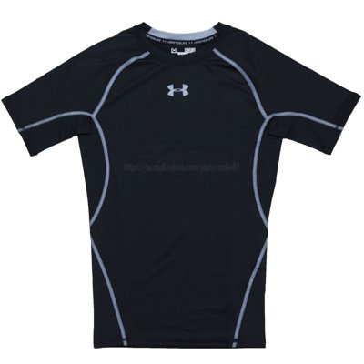
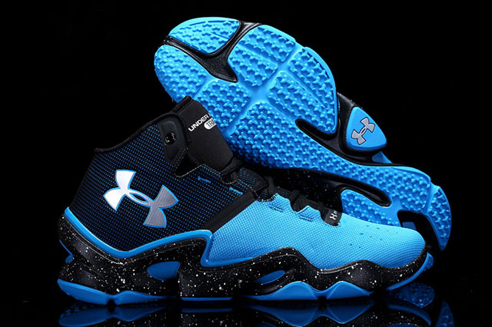
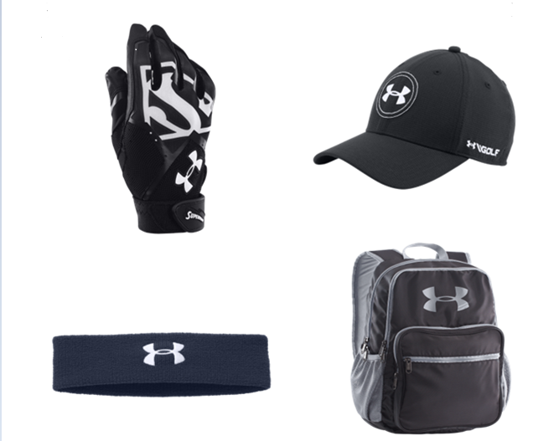
Major Products

Slide 21

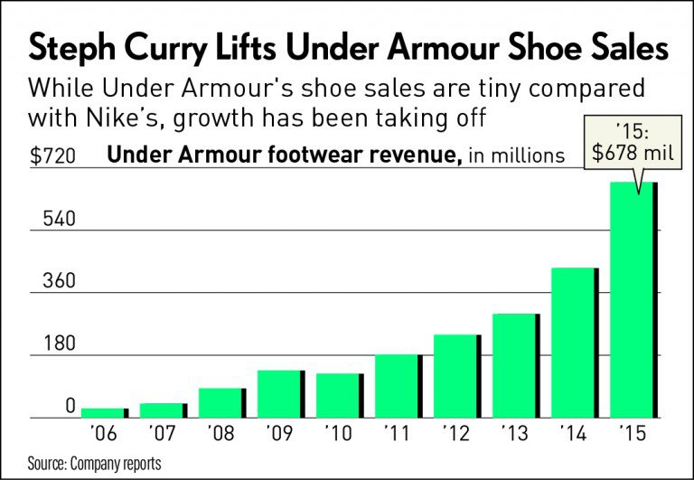

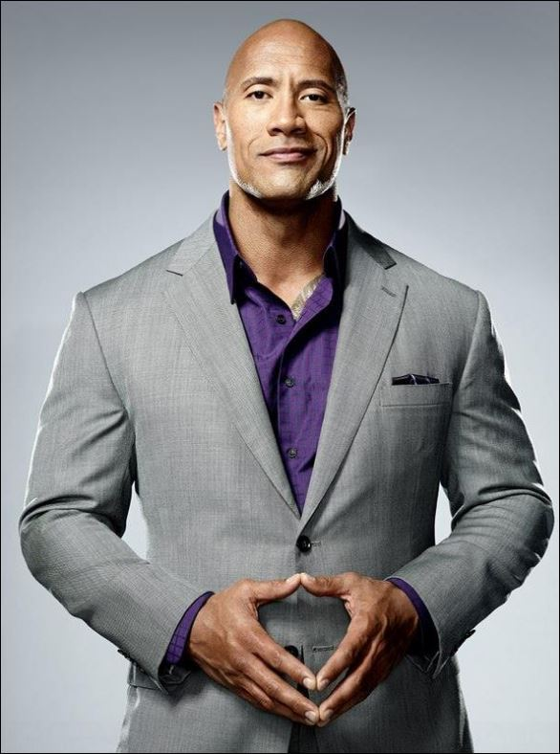



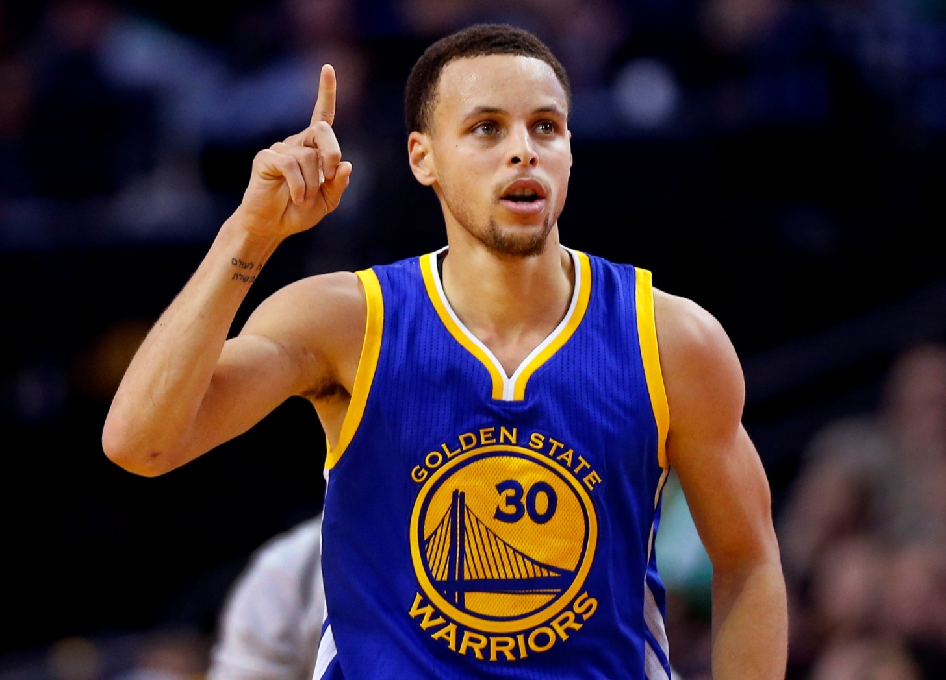
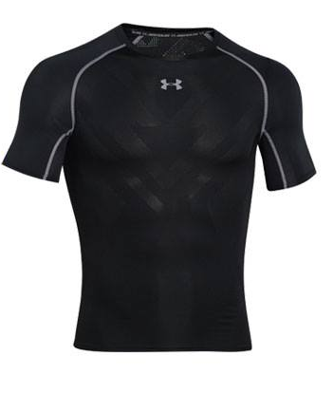

Mode of Business Operation
UA
Another Brand
UA$52
UA$36.8

Slide 22


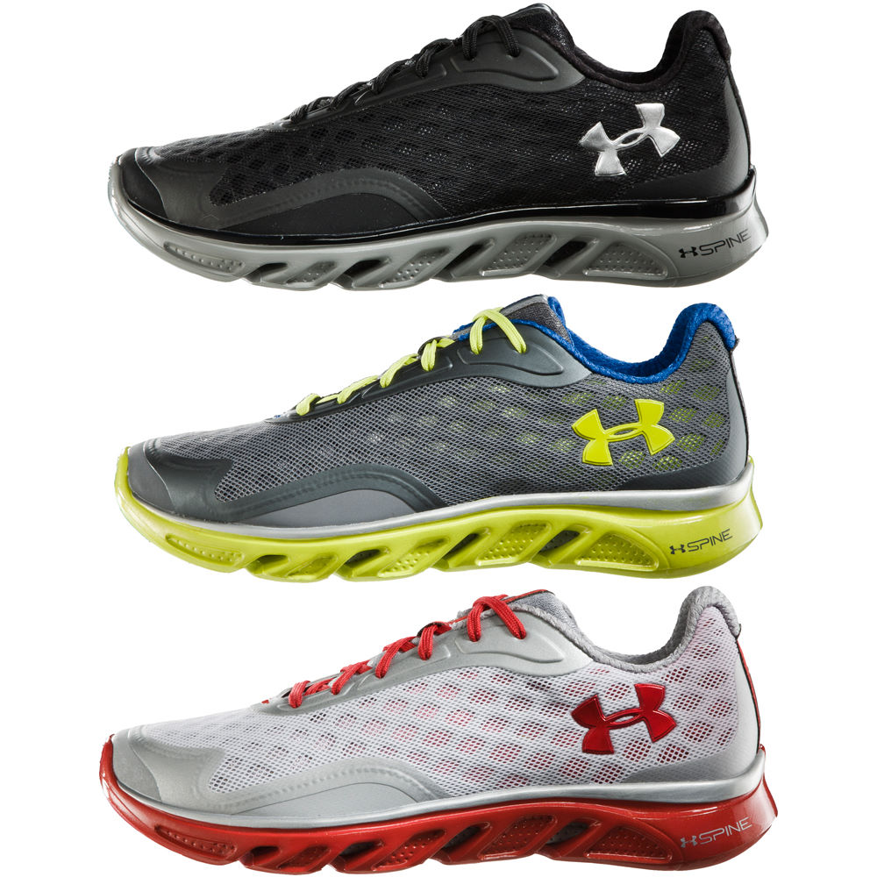
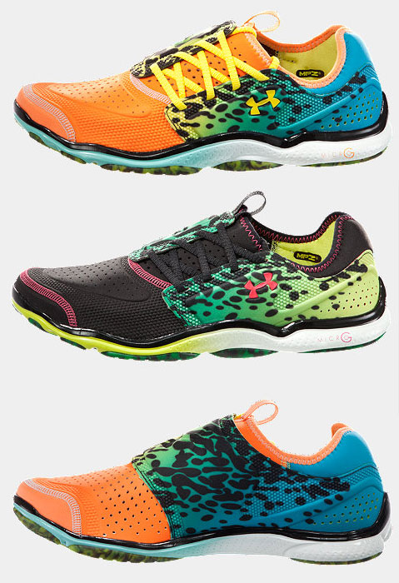
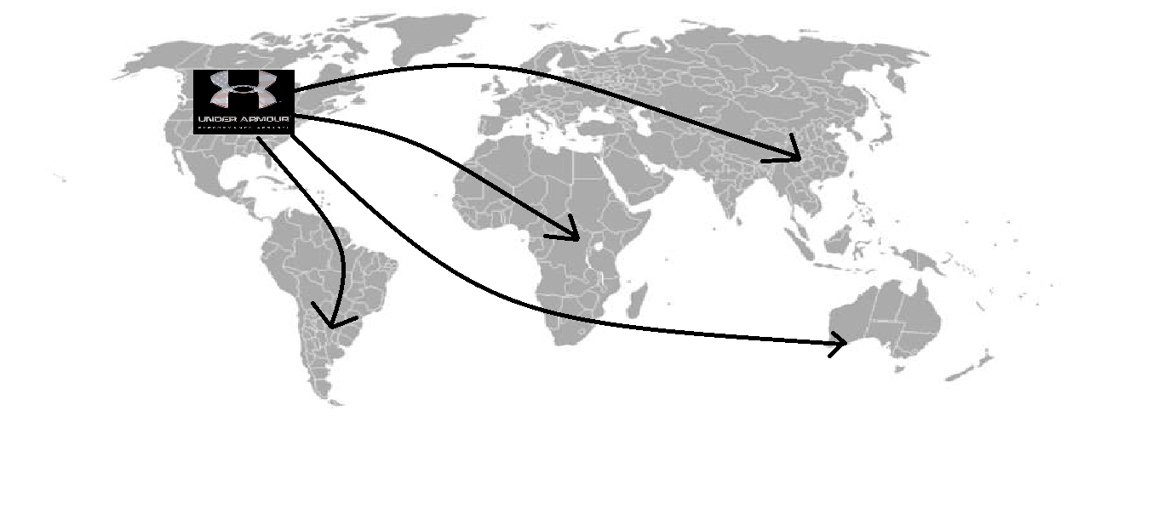
Future Plans
Women and Youth Business
International Expansion
Footwear

Slide 23
Conclusion
Diversity
Advance
Lifestyles

Slide 24
Assignment
Collect Information | Selina Kate Penny Jack Daniel Zoe
Make PPT | Selina Kate Penny Jack Daniel Zoe
Integrate PPT | Penny Jack
Make Handout | Daniel

Slide 25
Reference
Wiki
https://en.wikipedia.org/wiki/United_States
UA Story
http://www.underarmour.tw/brand/uastory.htm
CNN News
http://money.cnn.com/2016/04/21/investing/under-
armour-earnings-steph-curry-nike/
FanPiece
http://www.fanpiece.com/

Slide 26


Slide 27


Slide 28


