Slide 1
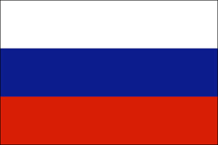
Russia
Member：02 FRANK
10 WALTER
11 ALLEN
15 TIM
31 ND
50 BENJAMIN
Instructor: Shu-Li Lai Date:2016/05/11

Slide 2
Outline
Overview
Economic
Company
Conclusion
Q&A

Slide 3
OVERVIEW
Geography
-Weather
Population
-Tatars
-Bashenjie
Attractions
-Culture
-Cuisine
-Festival
-Tourism

Slide 4
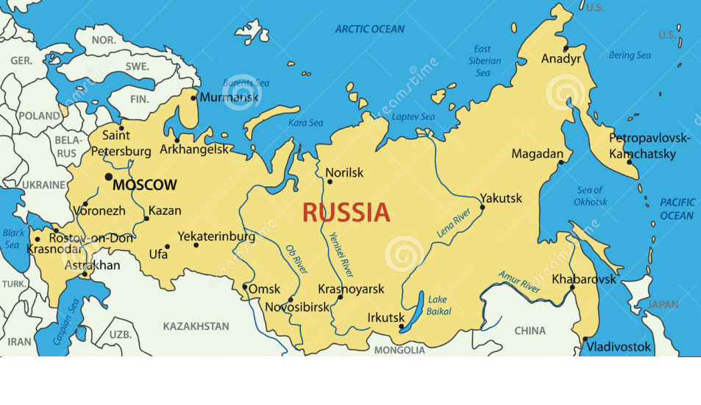
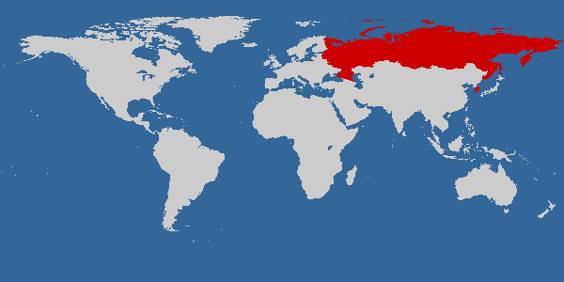
Geography

Slide 5
Weather

Slide 6
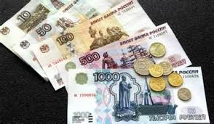
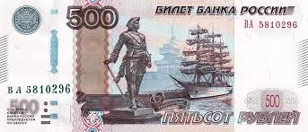
Population
Language: Russian
Capital: Moscow
Currency: ”Rubles” and NT is about 1: 0.5

Slide 7
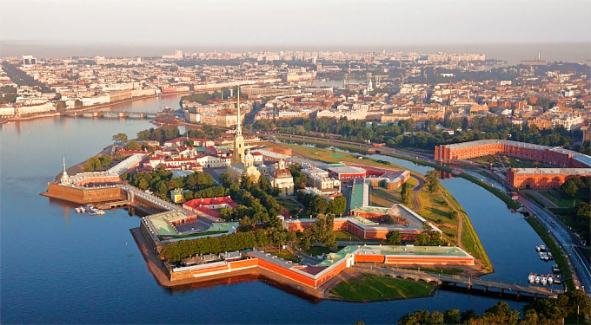
Culture
St. Petersburg:
Nempire through three revolution First Russian Revolution ,February Revolution , The October Revolution.

Slide 8
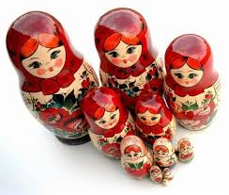

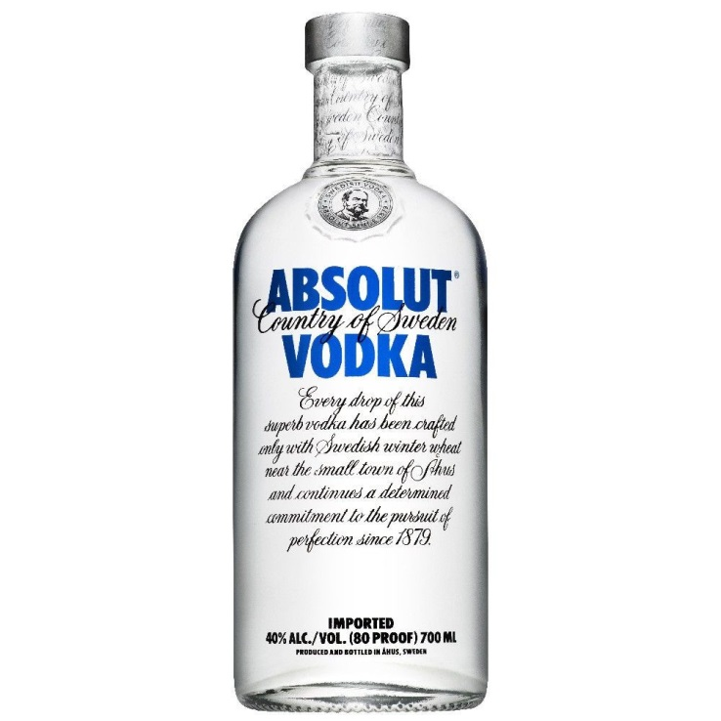
Vodka: “water of love“ , a deep-rooted national image. History of Russia.
Russian Dolls: One is Russia after the war had uneasy times, frontline constantly returned startling news so many suddenly lose love.

Slide 9
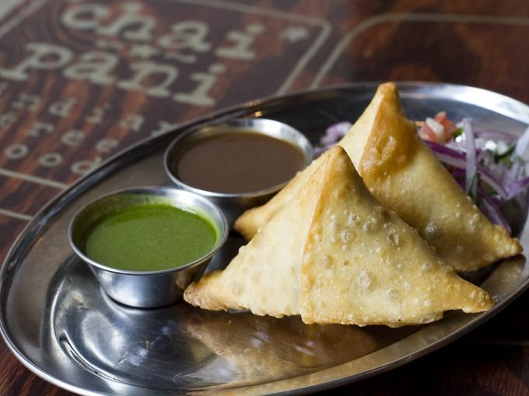
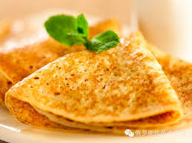
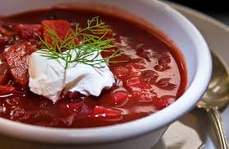
cuisine
Blinis: A kind of pizza.
Dumplings: A traditional Russian food.
Cold borscht soup: On top with a ball of yogurt, taste special.

Slide 10
festival
Russian Christmas: 1/17.
Victory Day: 5/9.
Moscow city celebration: 9/2.

Slide 11
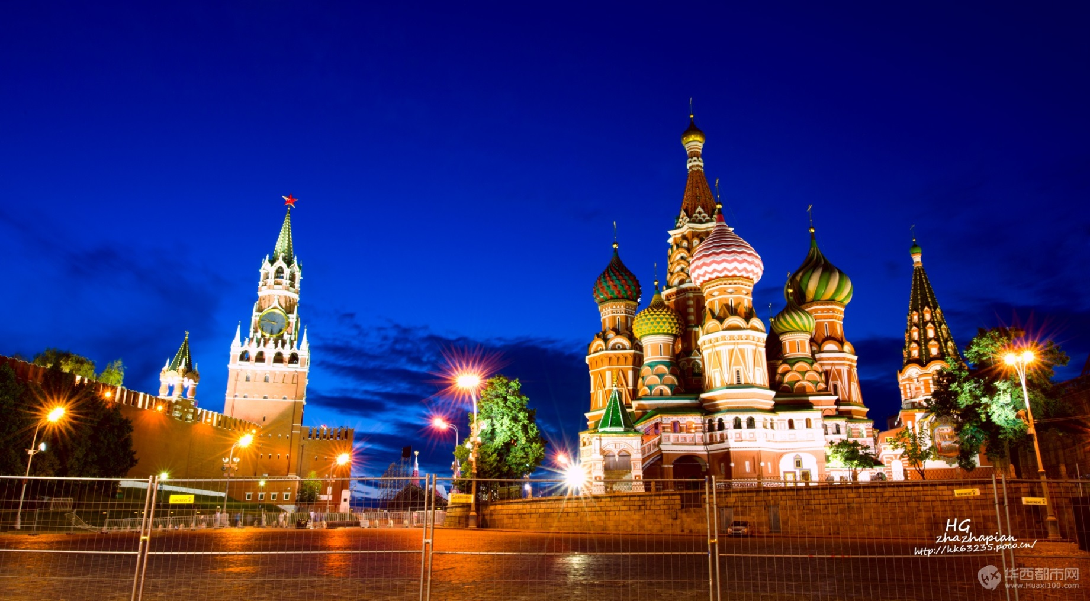
tourism
World Heritage Site Kremlin

Slide 12
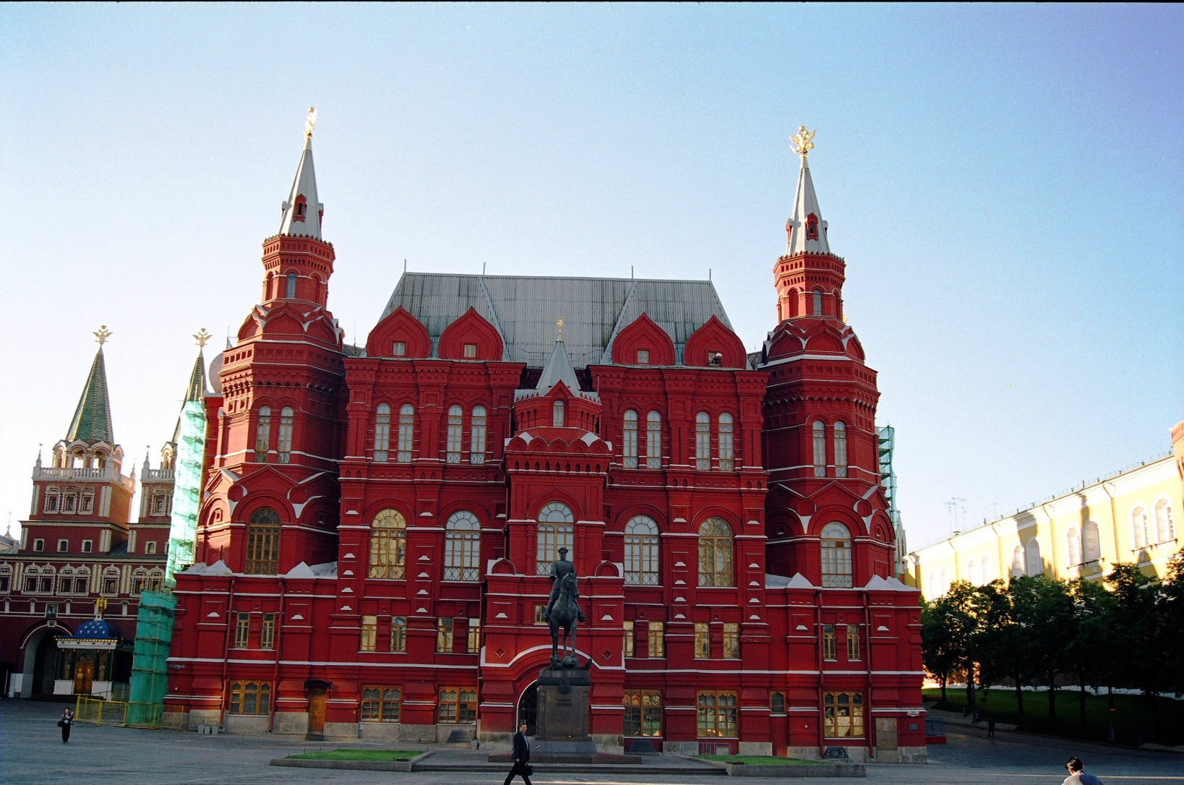
Red Square

Slide 13
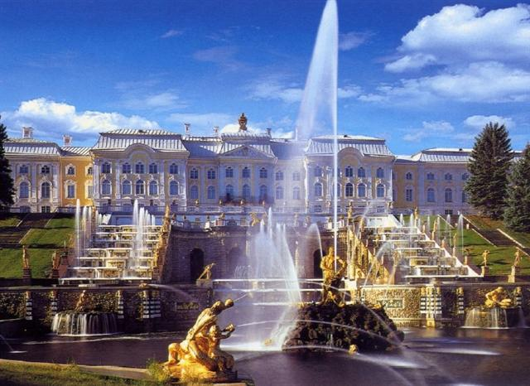
Catherine the Great Palace

Slide 14
Economic
Industry
Main imports/export

Slide 15
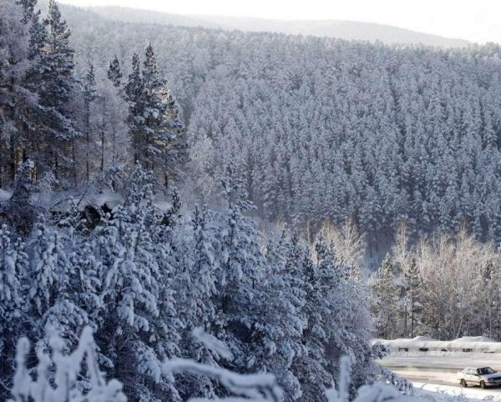
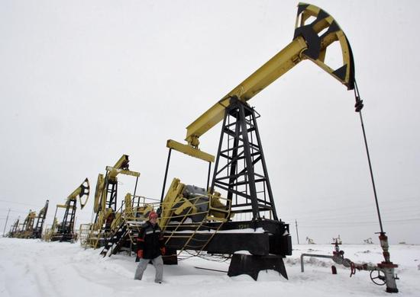
Industry
Agriculture: Russia is a big country of Forestry because there are 47.9% of area cover by forest.
Mining: Mining exports of natural resources is the largest economic pillar in Russia.

Slide 16
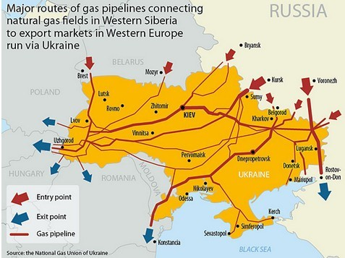
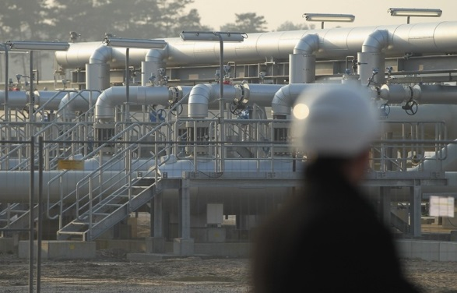
Natural gas: In Russia it is the most important source of income.

Slide 17
imports/export
Main imports: medicines, fresh and frozen meat, sugar…
Main export: petroleum products, alcoholic beverages, steel…
GDP: 1,857,000 (one million US dollars)

Slide 18

Company
Gazprom

Slide 19
introduction
Headquartered in Moscow.
The world's second largest energy companies.
Mainly engaged in natural gas also travel Industry, agriculture, aviation and communications business.

Slide 20
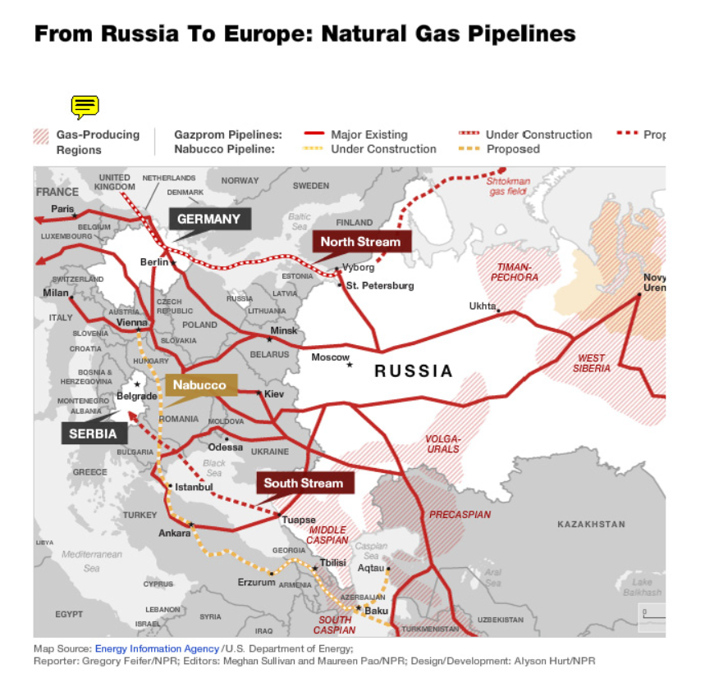
crisis
The rise of the US-based shale gas revolution.
The United States how cheap natural gas, provide their own domestic price is only a quarter of Russian exports in Eastern Europe.

Slide 21
Recent developmentS
China and the world's natural gas consumption growth potential.
Development cooperation with China.

Slide 22
Conclusion
Sum up, each country has its own characteristics, and this is
Russia.

Slide 23
Assignments
PPT Translation InformationSearch
ND BENJAMIN FRANK
WALTER
ALLEN
TIM
ND

Slide 24
The end
Thank you for listening.

Slide 25

Q&A

