Slide 1


Korea
Group 3
20 Johnny
41 Leon
46 Adam
48 Jesse
10035 Elton
2016.5.18

Slide 2
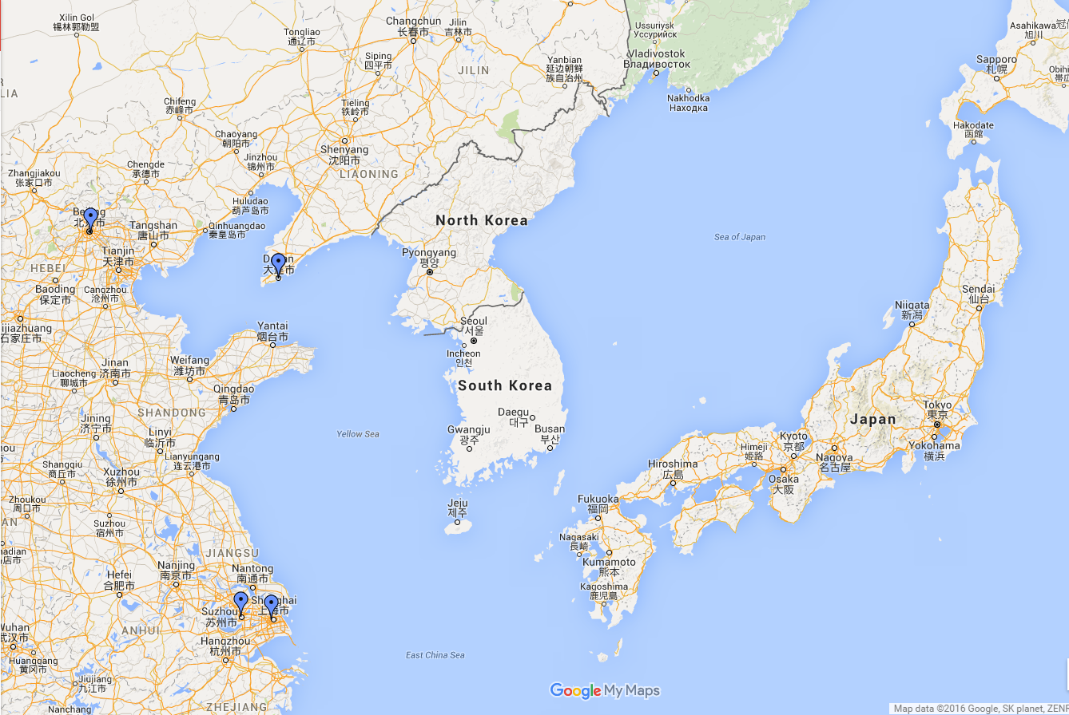

Slide 3
Outline
Overview of Country
Economy & industry
Company
Conclusion

Slide 4
Overview of Country
Location
Population
Weather
Currency
President
The political system
Special food & drink
Customs & Culture
Special building

Slide 5
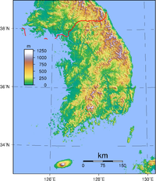
Location
Area: 100,000 square kilometers
Capital: Seoul
System of law: Civil law

Slide 6
Population
Total: 51 million people
Race:97%Korean, 1.76%Chinese people, 1.24%etc.
By2014

Slide 7
Weather
Temperate
Four season distinct

Slide 8



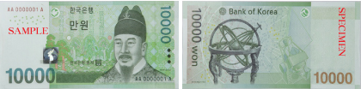

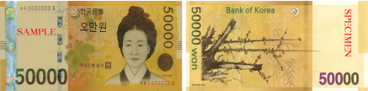
Currency

Slide 9
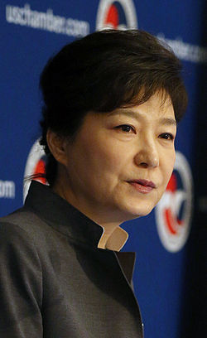
President
Name: Geun-hye Park (박근혜)
Age:64
Term of office:2013~2018
The eighteenth president of Korea

Slide 10
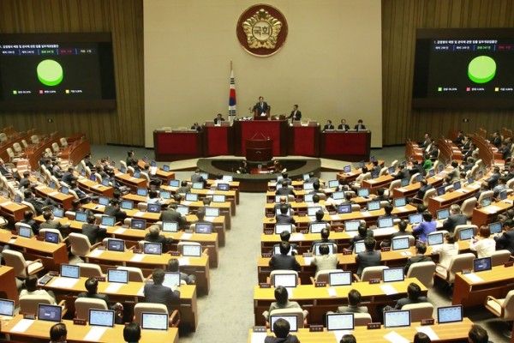
The political system
Democratic country
Legislation
Administrative
Judicature
Military:
Navy
Army
Air force

Slide 11
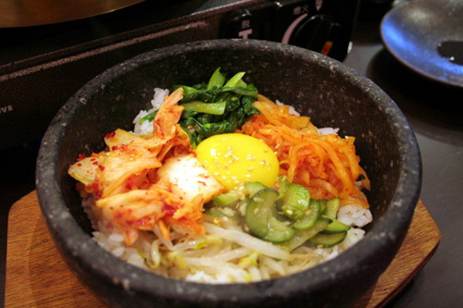
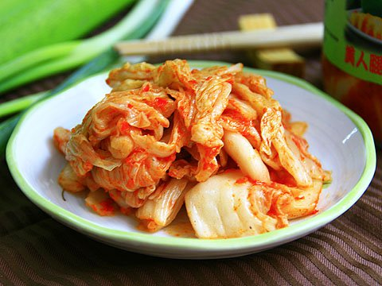
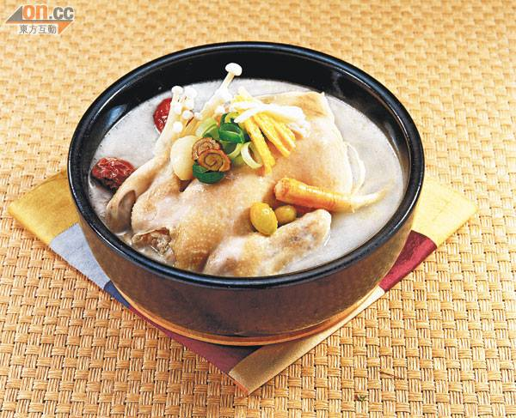
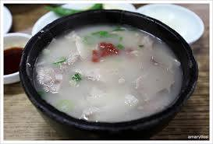
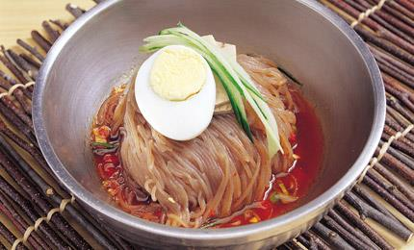
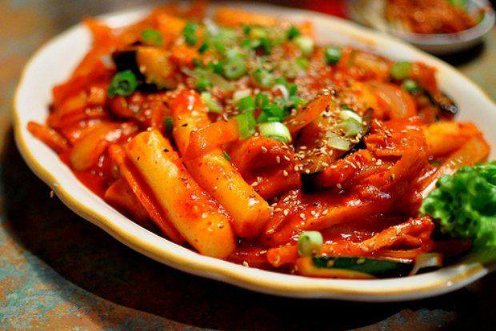
Special food & drink
Ginseng
chicken soup
bibimbap
Kimchi
Rice bubble bath
Cold noodle
Tteokbokki

Slide 12
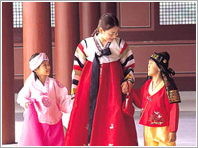
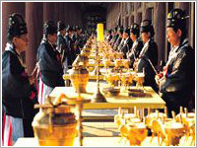
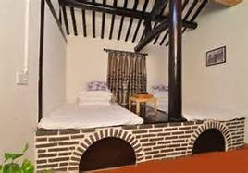
Customs & Culture
Traditional clothing
Worship
Ondol

Slide 13
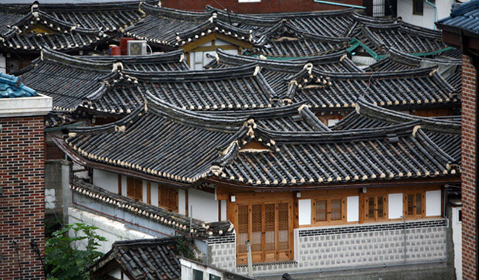
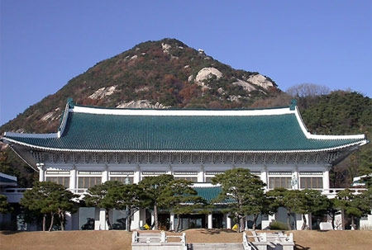
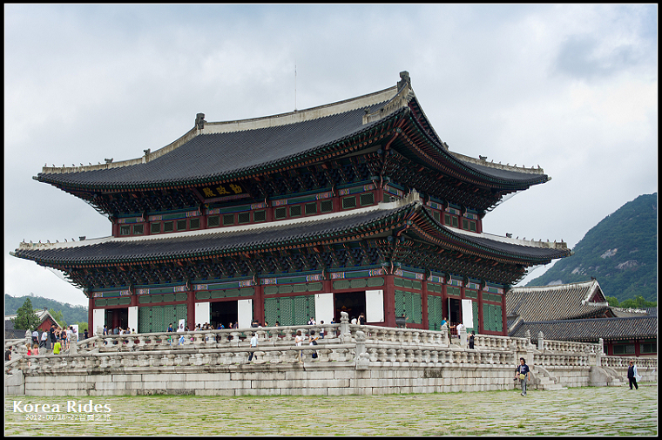
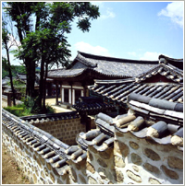
Special building
1.Bukchon
hanok
3.Cheong
WA Dae
2.Jingfu
Palace
4.Hanok

Slide 14
Economy & Industry
Economy
Industry
Korean Drama
Tourism

Slide 15
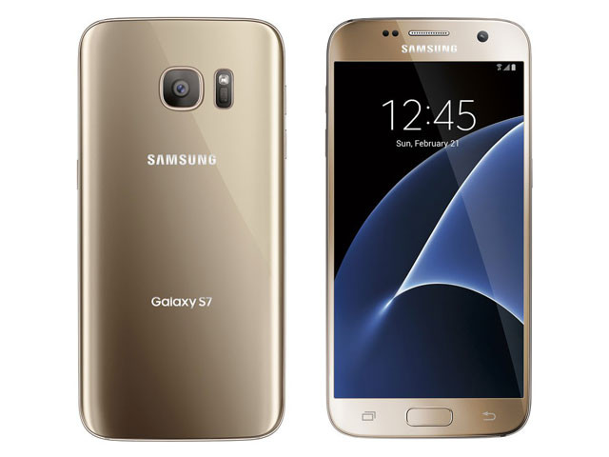

Economy
One of the world’s greatest economies
GDP: $28738 (USD)
The sixth largest exporter
The ninth largest importer

Slide 16
Industry
The proportion of industry

Slide 17

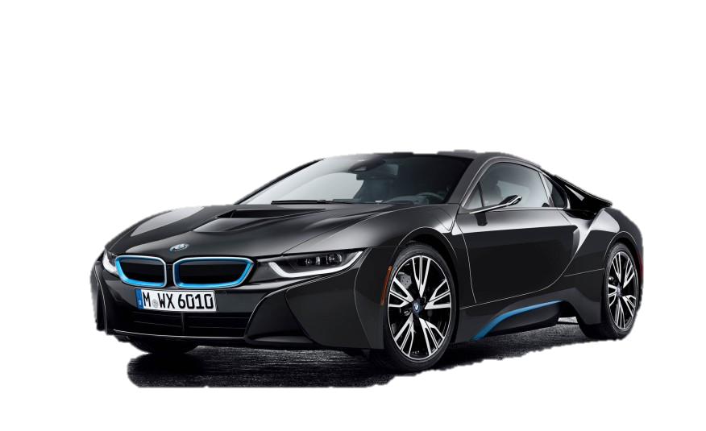

Industry
Agriculture
Industry
Shipbuilding
Samsung Motors
Samsung Electronics
Services
Korean Drama
Tourism

Slide 18


Korean Drama
Descendants
of
the sun
MY Love From
the Star

Slide 19

Korean Drama
Reason
First: Find innovative opportunities.
Second: Personalize .
Third: Place and dress.
Forth: Setting the scene and character.

Slide 20

Korean Drama
Feature
Where is the prominent feature?
How to make your viewers happy?
Why your viewer like this?

Slide 21
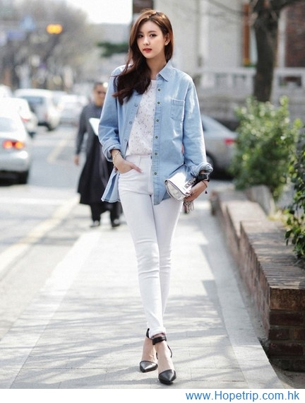
Korean Drama
Impact
Food: Kimchi…
Clothes: Outfit, brand…
Series: Audi, BMW, benz…

Slide 22
Korean Drama
Impact
Current: Phone, accessories…
Plastic surgery: Appearance, feature
System of values: Respect, tradition

Slide 23
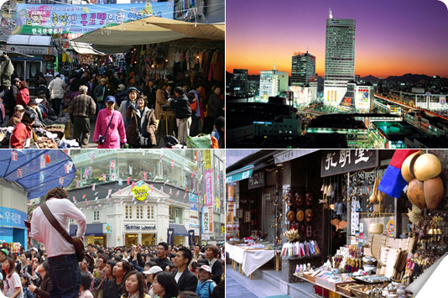
Tourism
Traditional markets
One of the most people go to tourist attractions
These are many special food and clothes.

Slide 24
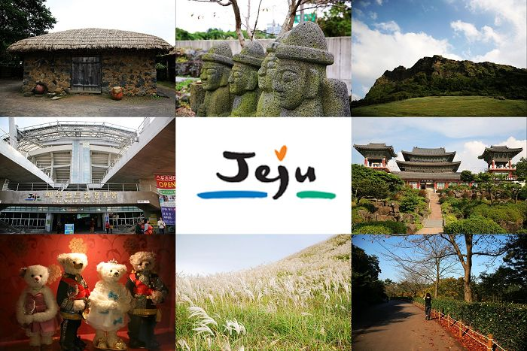
Tourism
Jeju Island
Island formed volcanic eruption
Famous from stones
Many Water Activities

Slide 25
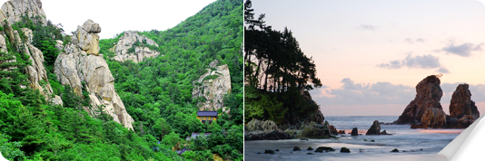
Tourism
Gangwon & gyeongpo
The most snow in winter
The best ski resort

Slide 26

Company
Company: Samsung Group
The most famous group in Korea
Have 85 subsidiaries
Samsung Electronics
Samsung Life Insurance
Samsung Heavy Industries
...ect.

Slide 27
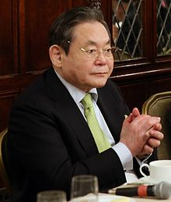
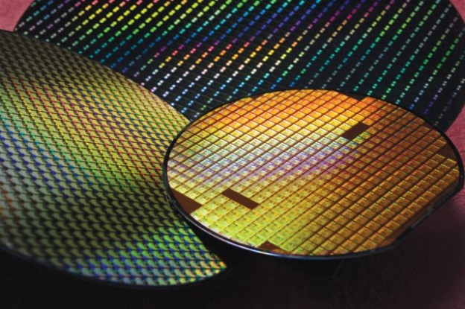

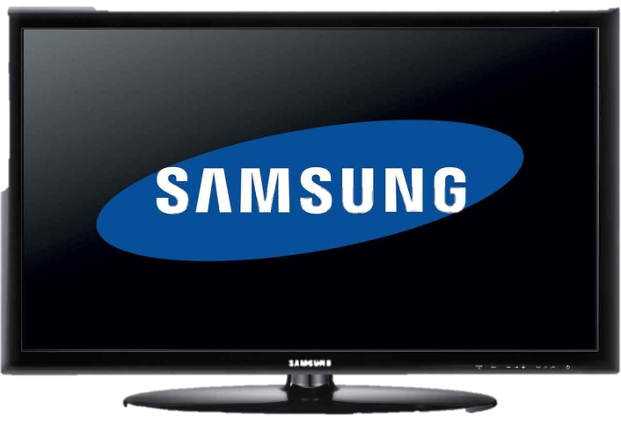
Samsung Electronics
President: Kun-hee Lee (이건희)
Founded: 1969/1
Revenue represent 70% of parent company
Product: semiconductor & cell phone & TV ...

Slide 28
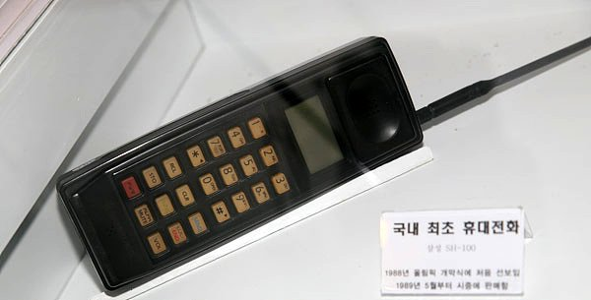
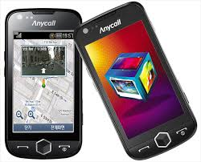
Samsung Electronics
Cell phone
1988 The first one cell phone
2009 The first one smartphone was made
Flagship smartphone annually on the market
SH100
SCH-W850
Galaxy S7

Slide 29
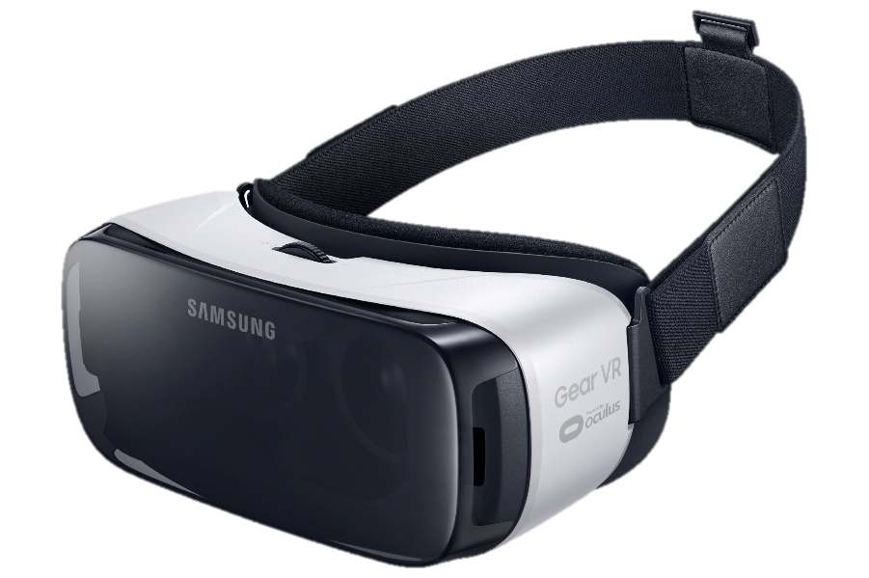
Samsung Electronics
Future
VR(virtual reality)
Use to medical
Use to education
https://www.youtube.com/watch?v=RQ4gp-_XHvk

Slide 30
Conclusion
Korea is very smart
Why?
Foster chaebol
Korean prevailed
US-ROK Mutual Defense Treaty

Slide 31
Reference
https://zh.wikipedia.org/wiki/%E4%B8%89%E6%98%9F%E9%9B%BB%E5%AD%90#.E9.9B.BB.E8.A6.96
https://zh.wikipedia.org/wiki/%E9%9F%93%E5%9C%8B%E7%B6%93%E6%BF%9F
https://tw.answers.yahoo.com/question/index?qid=20120408000051KK00409
https://zh.wikipedia.org/wiki/%E5%A4%A7%E9%9F%A9%E6%B0%91%E5%9B%BD#.E5.86.9B.E4.BA.8B
https://tw.news.yahoo.com/%E9%9F%93%E5%9C%8B%E8%BB%8D%E5%8A%9B%E4%B8%96%E7%95%8C%E6%8E%92%E5%90%8D%E7%AC%AC11%EF%BC%8C%E6%97%A5%E6%9C%AC%E7%AC%AC7%EF%BC%8C%E6%9C%9D%E9%AE%AE%E7%AC%AC25-080641812.html

Slide 32
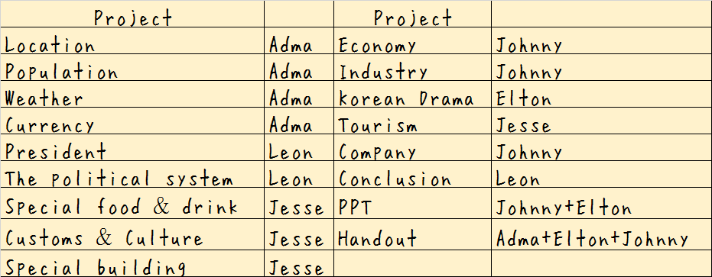
Assignments

Slide 33
Thank you for
your listening

Slide 34
Q&A

