Slide 1

France
Leader:37GG
Members:08Lucy
19Oriel
25Abby
27Hsin
Mentor:Shu-li Lai
Date:2016/5/18

Slide 2

Outline
 Overview of the country
 Culture
 Economy and Industry
 Profile of a representative company
 Conclusion

Slide 3
➢Geography
➢Capital
➢Weather
➢Population
➢Language
➢Currency
Overview of the country

Slide 4

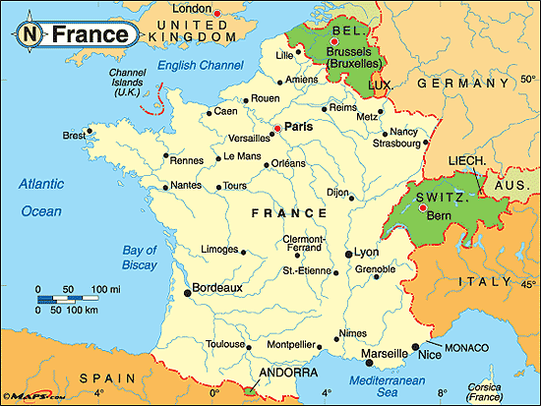
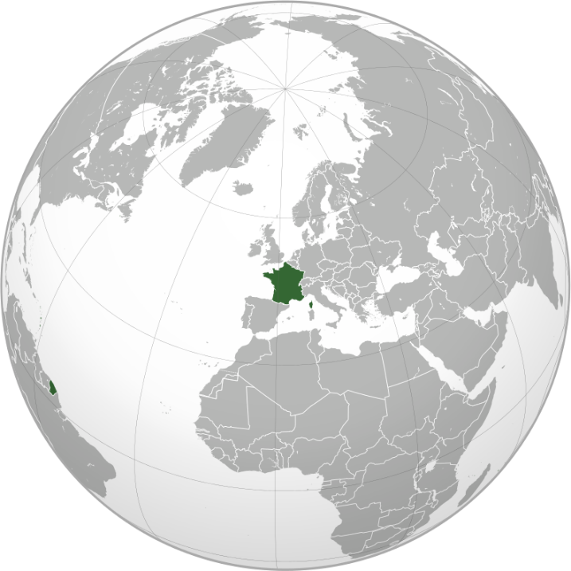

Geography

Slide 5
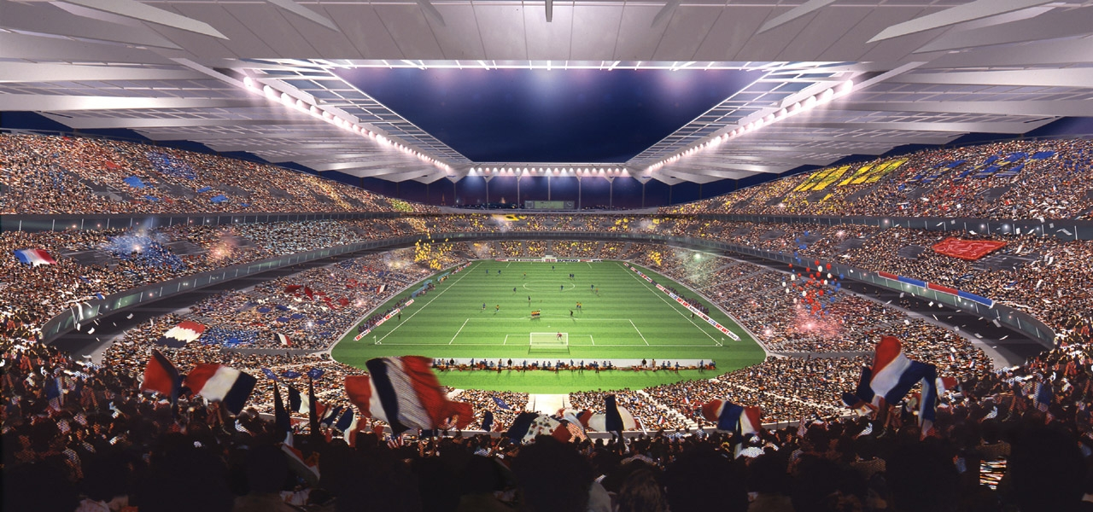
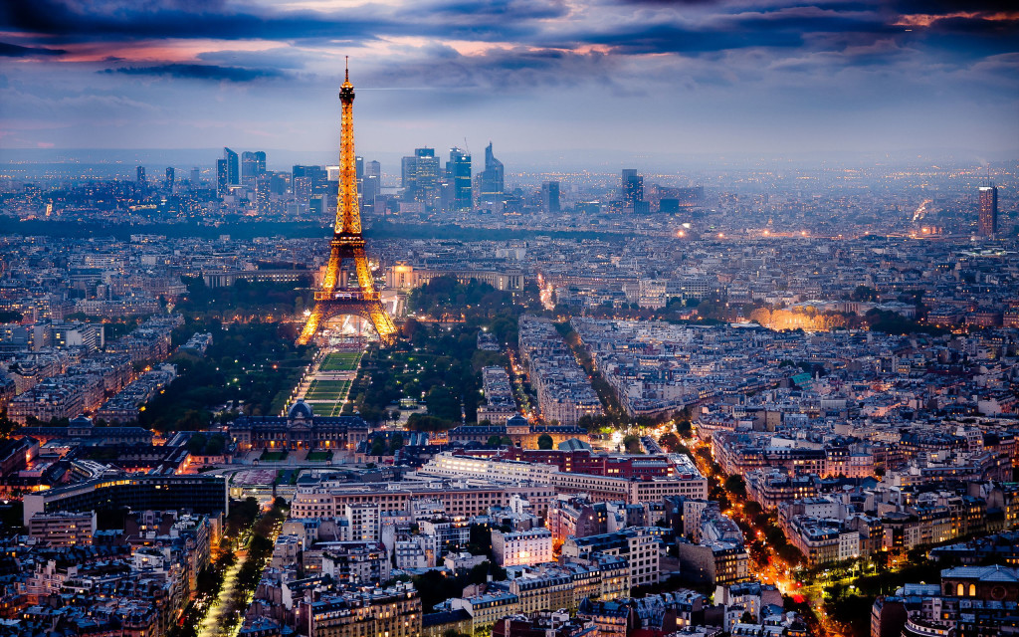
Capital─Paris
The most populous city of France
One of the world's top tourist destinations
Paris Fashion Week
Stade de France

Slide 6
Weather

Slide 7
Population

Slide 8
Language

Slide 9
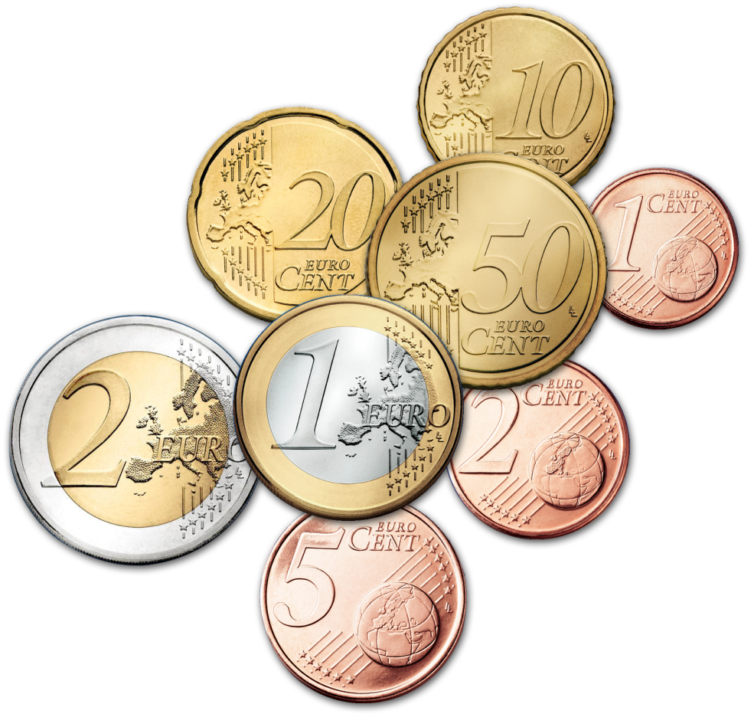
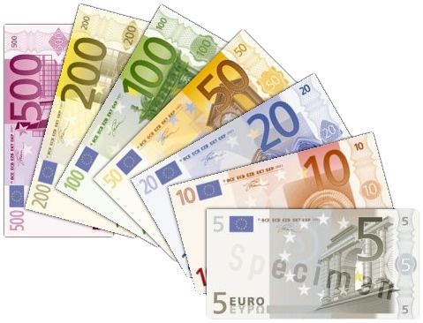
Currency
EURO (EUR)
1 EUR = 37.111 NTD

Slide 10
➢Festival
➢Dessert
➢Travel
Culture

Slide 11
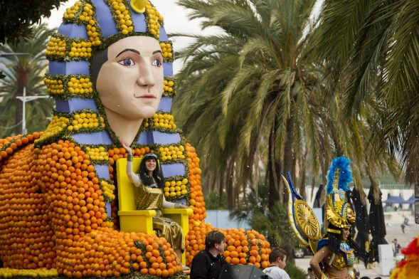
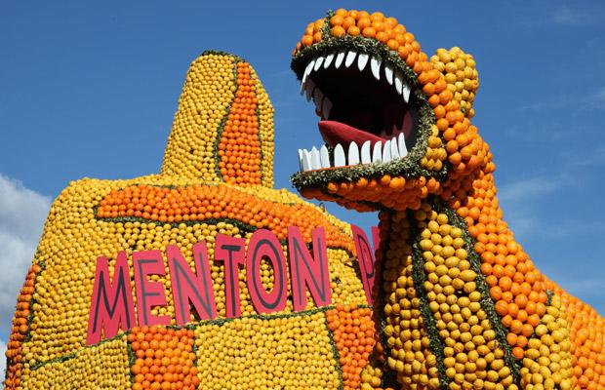
The Lemon Festival
In Menton
An annual three-week-long event
The second most important event
in the French Riviera calendar

Slide 12
Let’s learn French!
English | French
Good morning | Bonjour
Good night | Bonsoir
Thank you | Merci
You are welcome | De rien
I love you | Je t'aime
Good bye | Au revoir

Slide 13
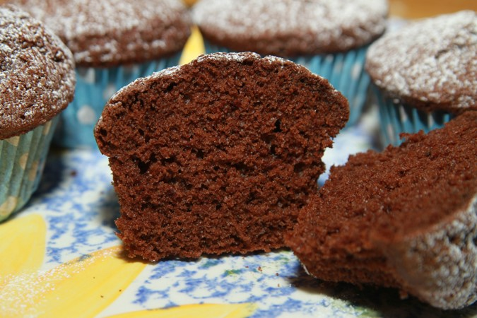
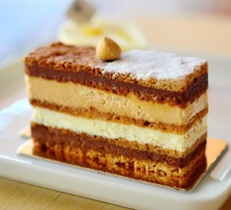
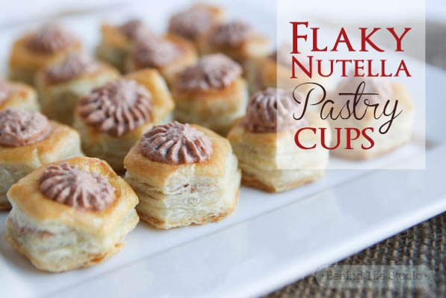
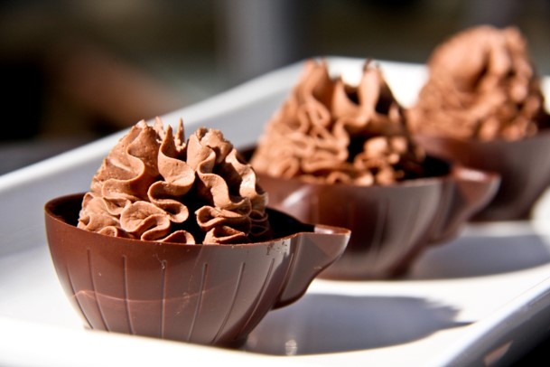
Dessert
Light and fluffy
Rich and creamy
Layered
Long and complicated
Flaky
Attention to detail

Slide 14
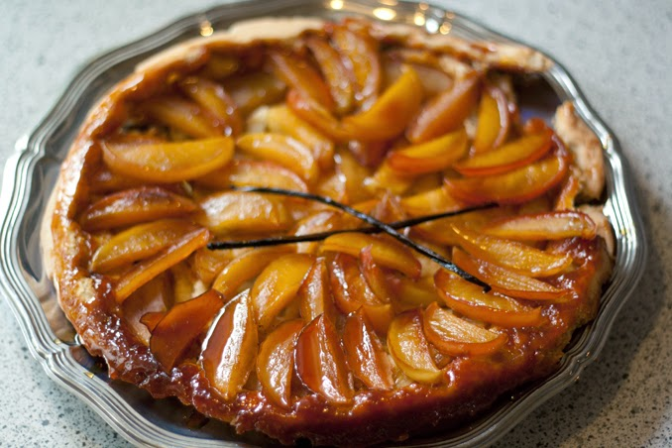
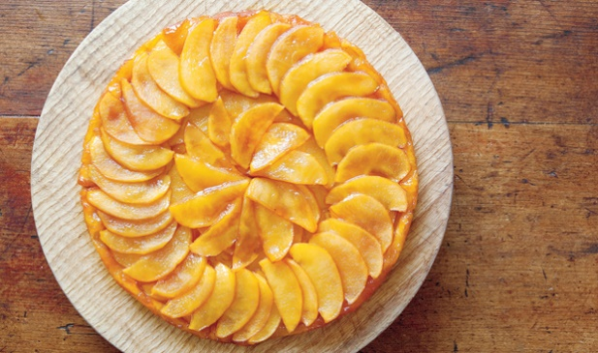
Dessert
Tarte Tatin

Slide 15
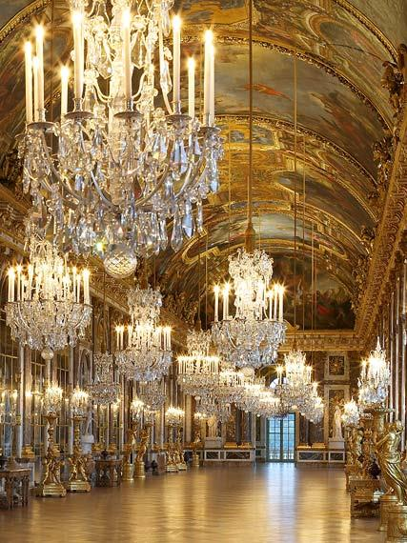
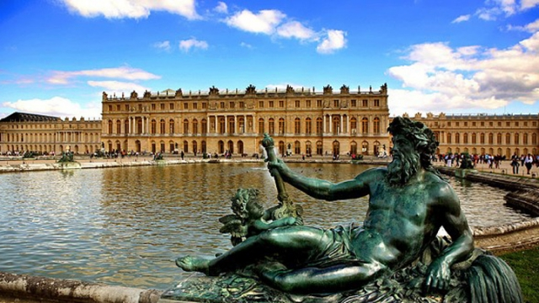
Palace of Versailles
Palace
Classical-style building
Beautiful gardens
Hall of mirrors

Slide 16
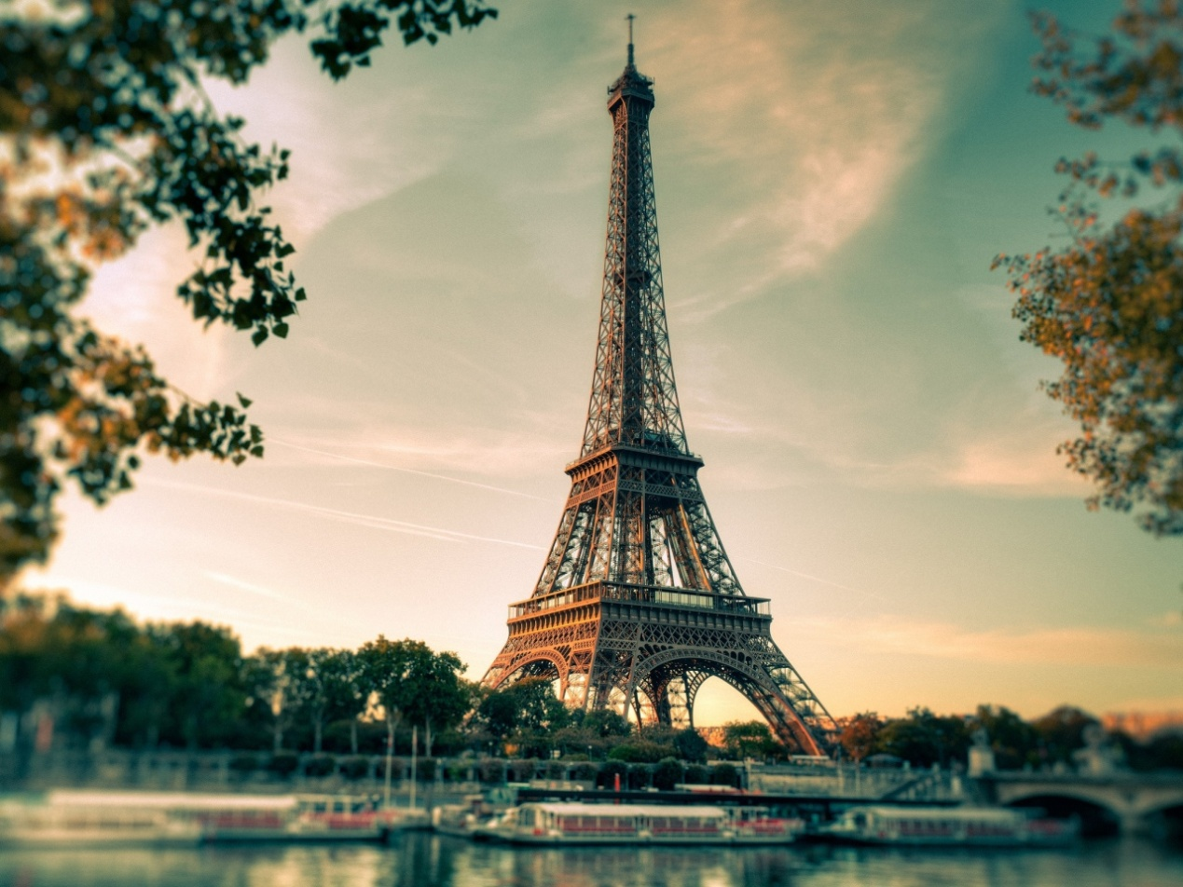
Eiffel Tower
The most recognizable structures
The most-visited paid monument
Gustave Eiffel

Slide 17
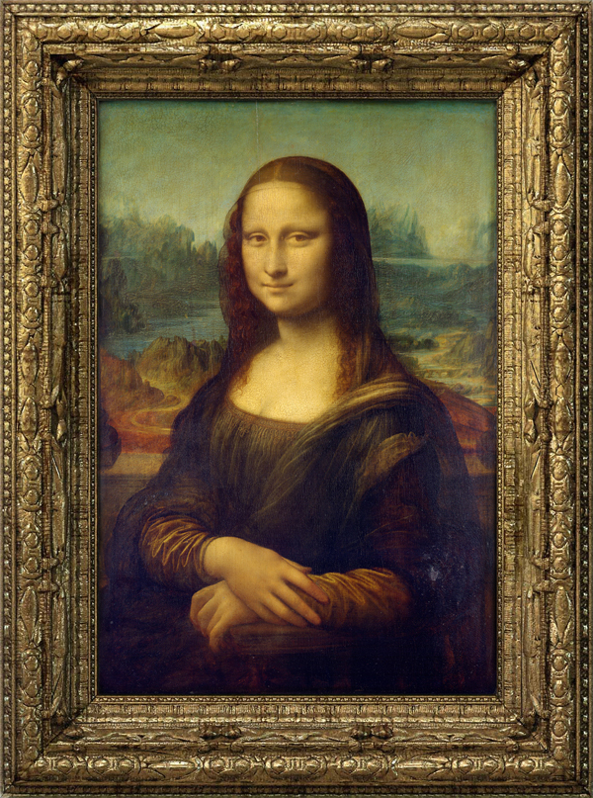
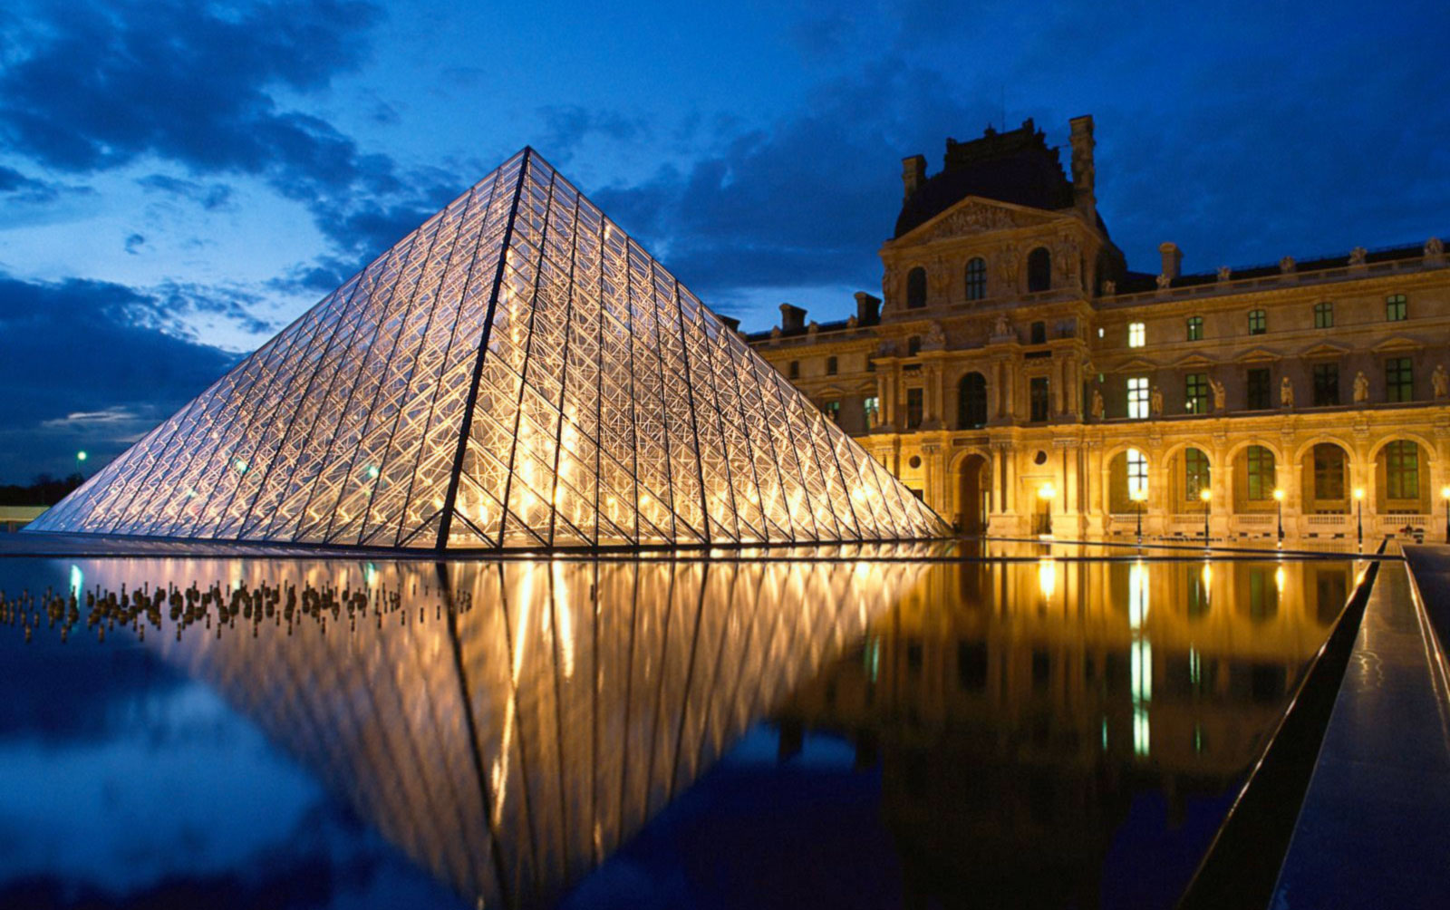
Louvre
The most popular art museum
In the center of Paris
A prison
Mona Lisa
Leonardo da Vinci

Slide 18
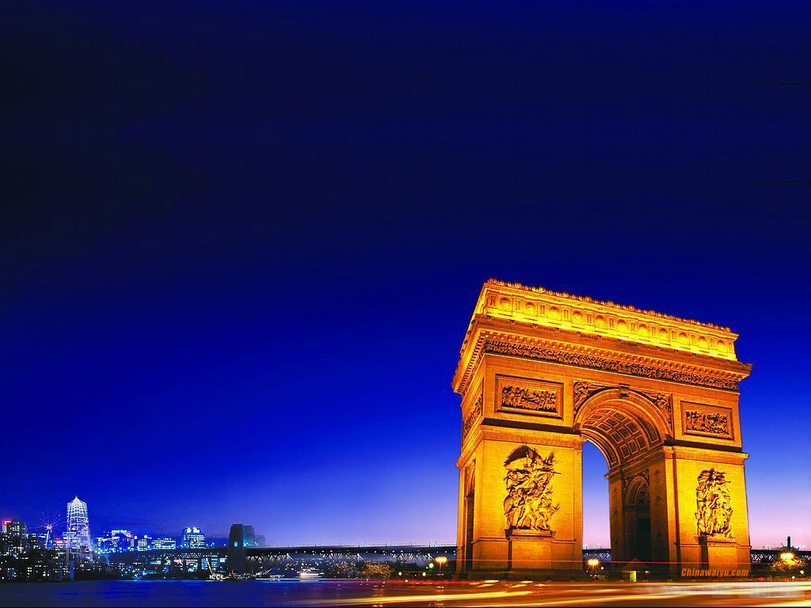
Arc de Triomphe
Champs-Élysées
Arch of victory

Slide 19
➢Agricultural
➢Import/Export
Economy and Industry

Slide 20
French labor force

Slide 21
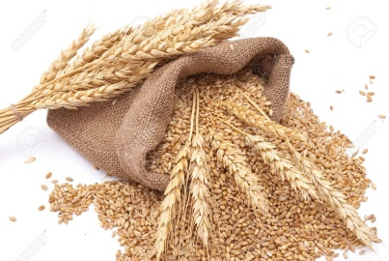
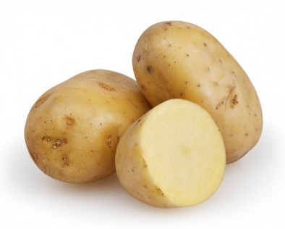
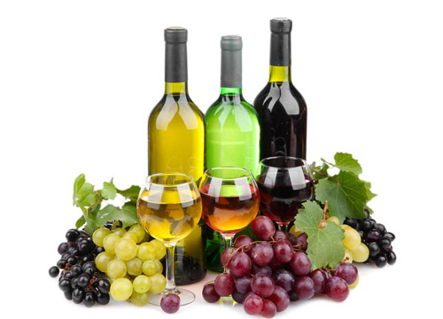
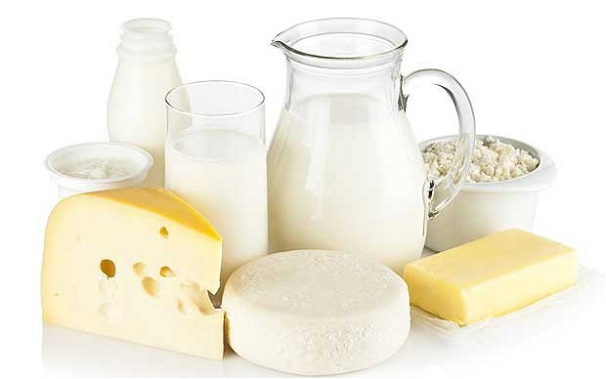
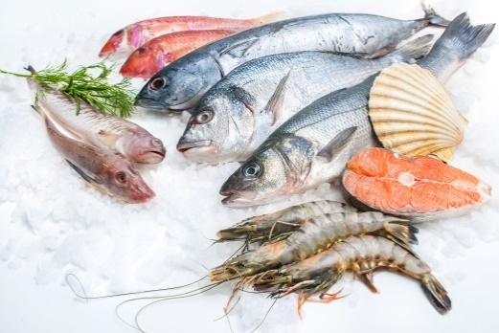
Agricultural
Wheat
Potatoes
Wine grapes
Dairy products
Fish

Slide 22
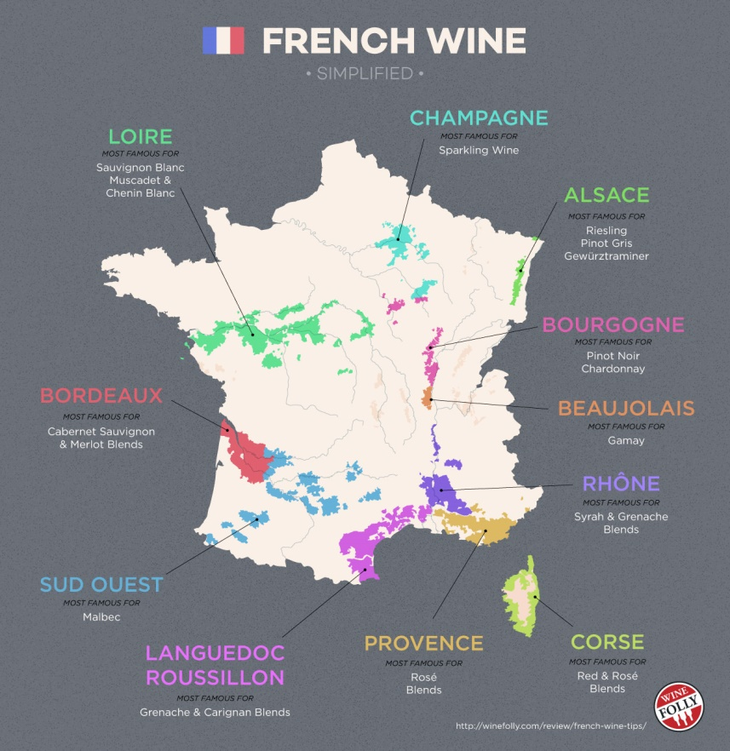
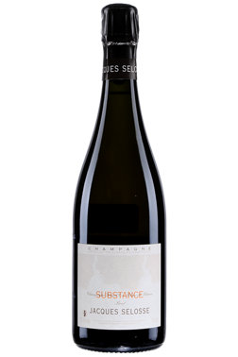
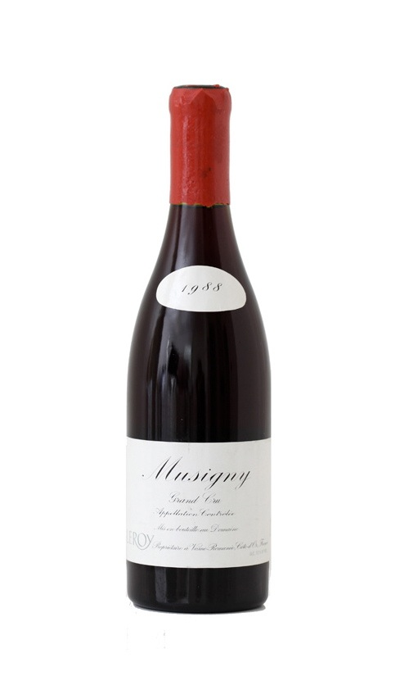
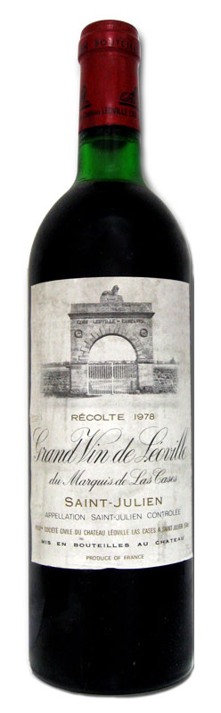
Wine
Grapes
Jacques Selosse Substance
Price: $300
Domaine Leroy Musigny
Price: $4,500
Château Léoville-Las Cases
Price: $200

Slide 23

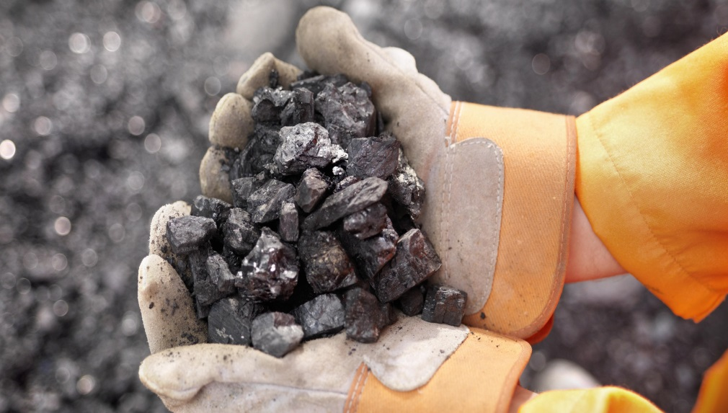
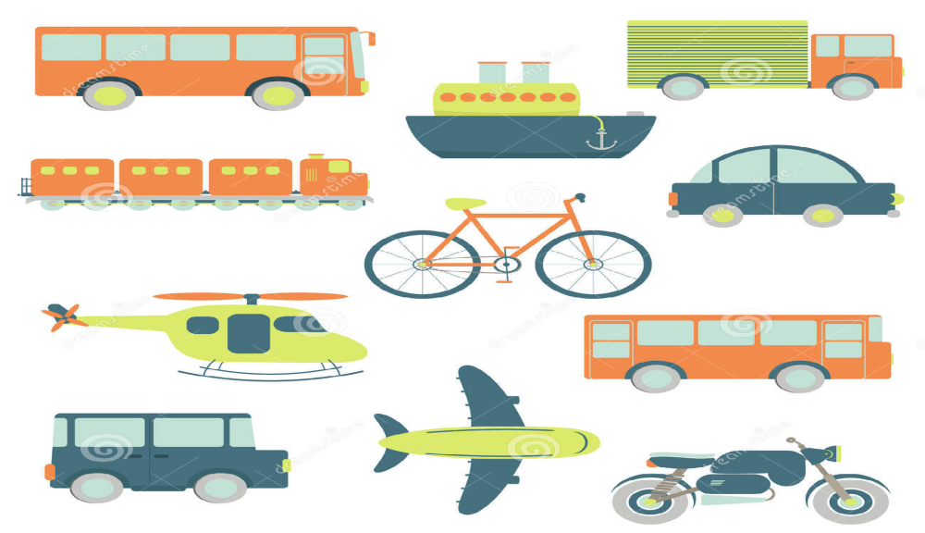
Import
1. Electronics
2. Mineral products
3. Automobile parts

Slide 24

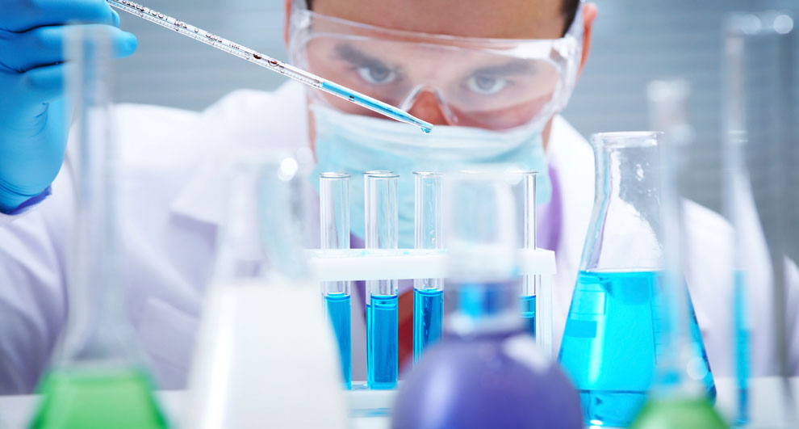
Export
1. Electronics
2. Transport equipment
3. Chemical products

Slide 25








Slide 26
➢Overview of Chanel
➢About Chanel N°5
➢Future plan
Profile of a
representative company

Slide 27
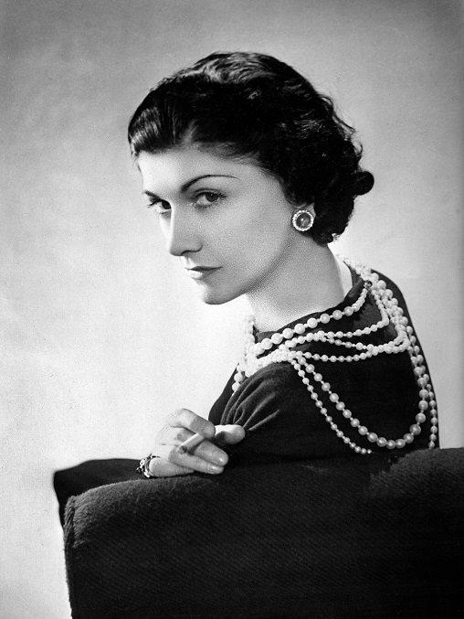

Overview of Chanel
Founded : 1910
Headquarter：in Paris
Founder : Gabrielle Bonheur Chanel (Coco Chanel)
Located : worldwide

Slide 28
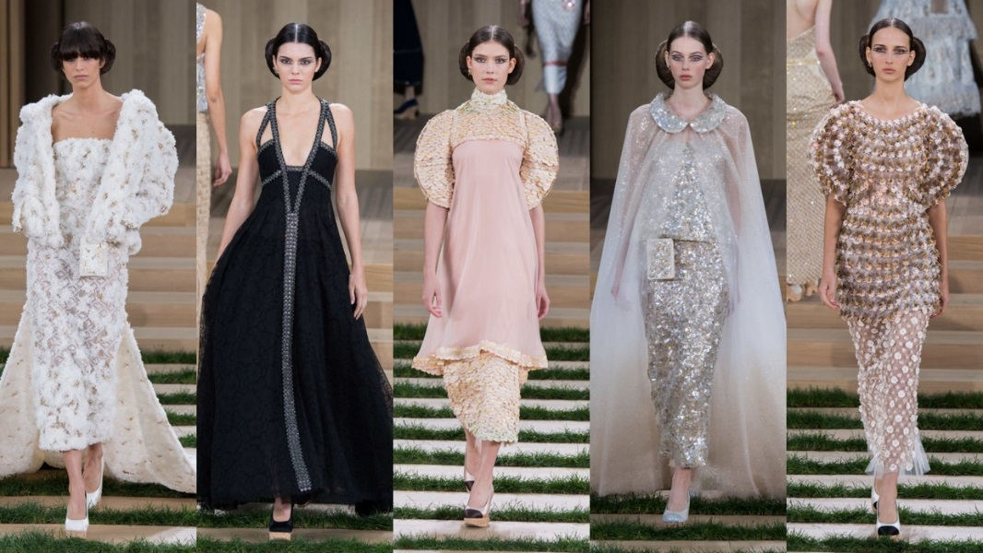
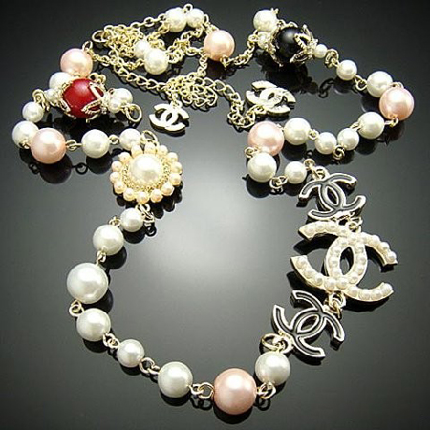
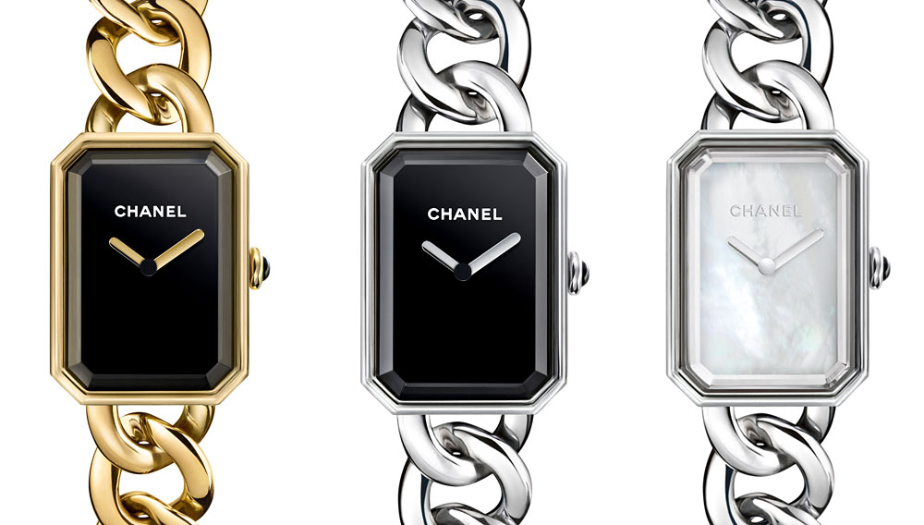
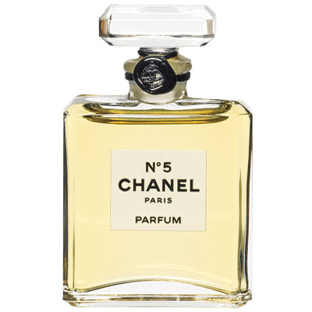
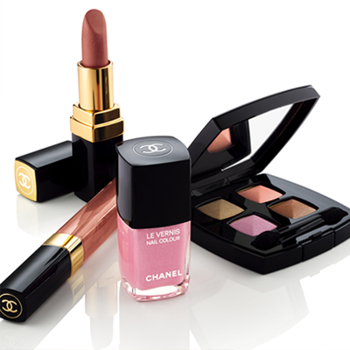

Products
Haute couture
Jewellery
Watches
Makeup
Skincare
Perfume

Slide 29
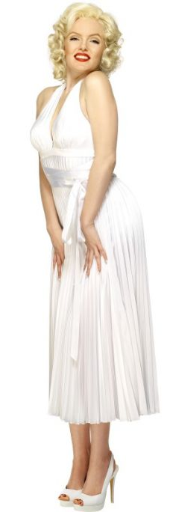
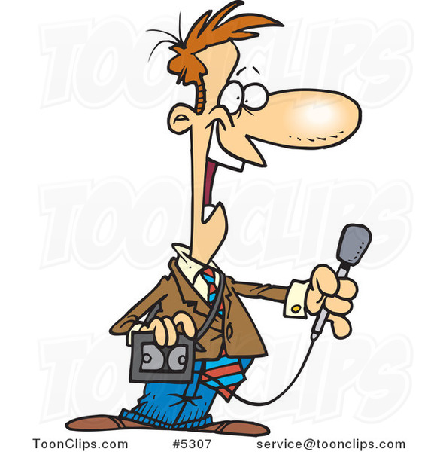
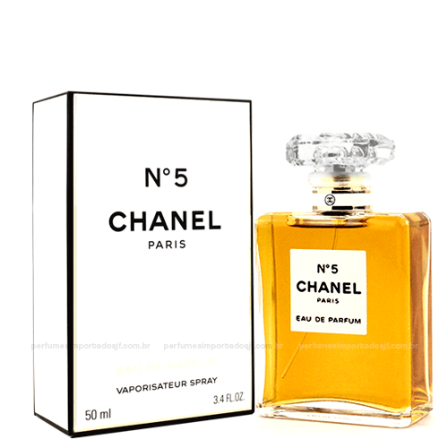
About Chanel No.5
What you wore to bed.
Chanel N°5
1921 Chanel N°5 was created.
Marilyn Monroe made Chanel N°5
become even more popular than before.
Chanel N°5 entered into the museum
of modern art of New York.

Slide 30
Future plan
Upgrade
Modernize

Slide 31
Conclusion
➢ Fashion
➢ Tourist attractions

Slide 32
Division of responsibility
08 Lucy | Profile of a representative company
19 Oriel | Economic and Industry/Travel
25 Abby | Festival/PPT file/Handout
27 Hsin | Economic and Industry/Dessert
37 GG | Overview of the country

Slide 33
Reference
Overview
https://zh.wikipedia.org/zh-tw/%E6%B3%95%E5%9B%BD
https://en.m.wikipedia.org/wiki/Languages_of_France
https://zh.wikipedia.org/zh-tw/%E6%B3%95%E8%98%AD%E8%A5%BF%E9%AB%94%E8%82%B2%E5%A0%B4
http://weather.zuzuche.com/c201.html
Festival
https://en.wikipedia.org/wiki/Menton
http://www.eatglobe.com/news/faiths-customs/1415-riviera-lemon-festival.html
Dessert
http://www.craftsy.com/blog/2015/07/what-is-dacquoise/
http://french.lovetoknow.com/Famous_French_Desserts

Slide 34
Reference
Travel
http://country.bridgat.com/big5/France.html
https://zh.wikipedia.org/zh-tw/%E5%B7%B4%E9%BB%8E%E5%87%AF%E6%97%8B%E9%97%A8
https://zh.wikipedia.org/zh-tw/%E5%8D%A2%E6%B5%AE%E5%AE%AB
https://zh.wikipedia.org/zh-tw/%E5%87%A1%E5%B0%94%E8%B5%9B%E5%AE%AB
https://zh.wikipedia.org/zh-tw/%E8%89%BE%E8%8F%B2%E7%88%BE%E9%90%B5%E5%A1%94
http://en.chateauversailles.fr/homepage
Economic and industry
http://www.studying-in-france.org/introduction-to-the-country-of-france/
https://www.eventbrite.com/e/introduction-to-the-wines-of-france-tickets-19059144414?aff=es2
The Chanel
https://en.wikipedia.org/wiki/Chanel
http://www.chanel.com/zh_TW/
https://en.wikipedia.org/wiki/Chanel_No._5

Slide 35

Thank you
for your listening!

Slide 36

Q&A

