Slide 1

Malaysia
Member:10129 Dragon
51 Wayne
10023 Amy
9934 Lisa
2016/05/18

Slide 2
Outline
Overview
Economic
Company
Conclusion
Q&A

Slide 3

Video

Slide 4
Overview
Geography
Weather
Population
Language
Religion
Currency
History

Slide 5
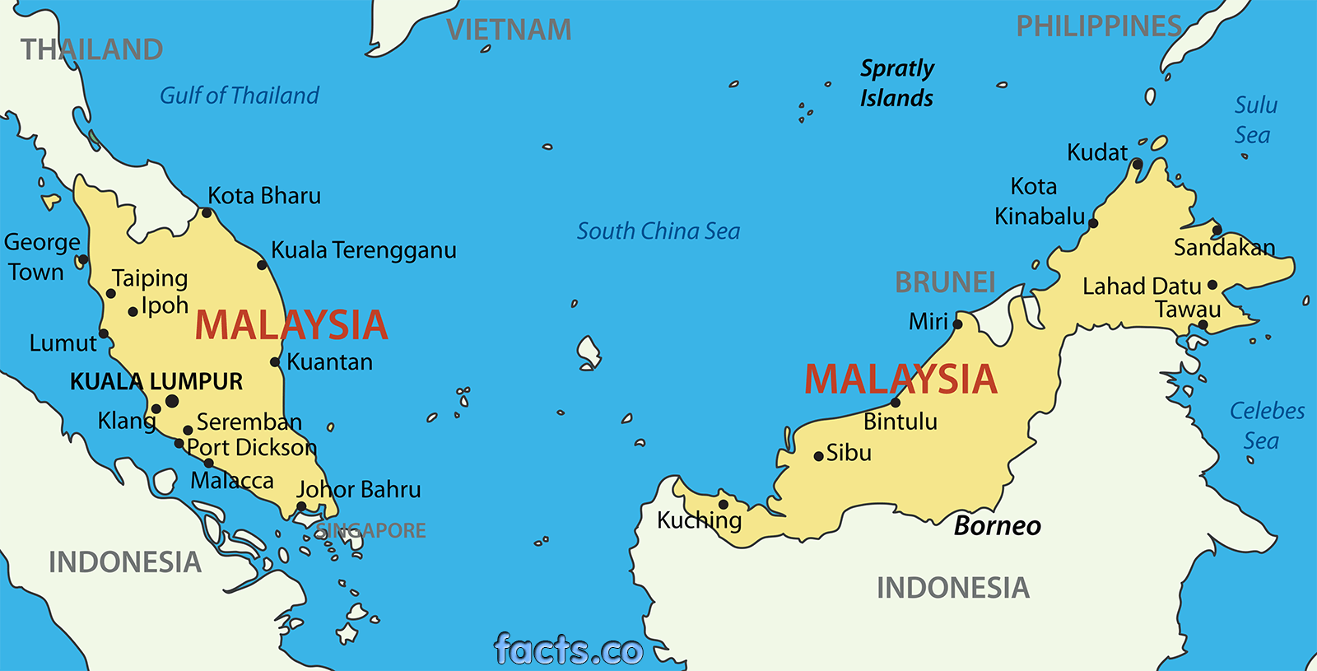
Geography

Slide 6
Weather

Slide 7
Population
Language : Bahasa Melayu . English
Religion

Slide 8
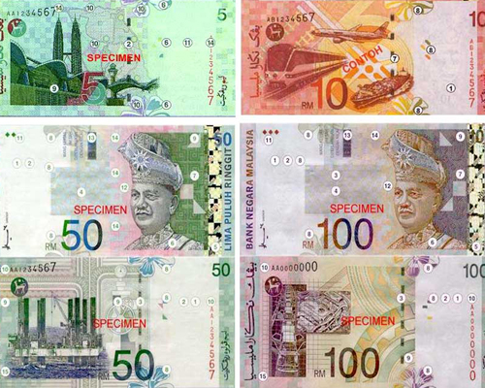
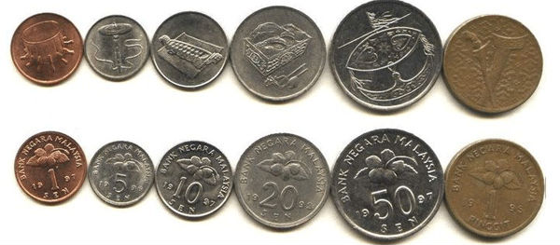
Currency
Currency : ”Ringgit”and NT is about 1: 8

Slide 9


History
1948 The Malayan Union disband
1948~1960 Malayan Communist Party v.s
UK
v.s.

Slide 10

1957/8/31 Malaysia independence
(national day)
1965 Singapore independence

Slide 11
Economic
Industry
Economic survey

Slide 12
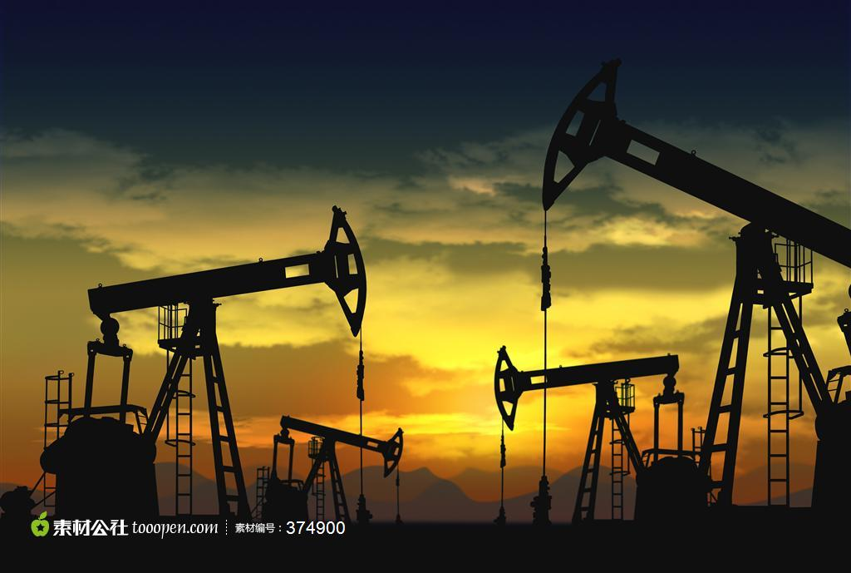
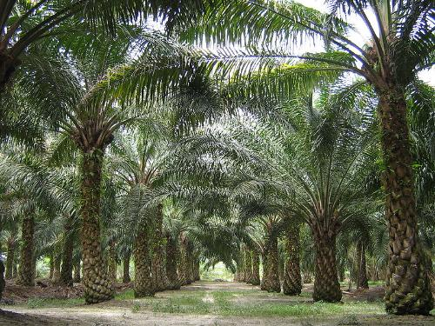
Industry
Agriculture : The world's largest palm oil producer.
Mining :
The most valuable export oil supplies

Slide 13
Economic survey

Slide 14

Company

Slide 15
Introduction
Set up:1974/8/17
CEO:Wan Ariffin
Headquartered:Petronas Twin Towers，
Kuala Lumpur City
Product: oil & natural gas
Fortune 500 2015: The 69th

Slide 16
Conclusion
Malaysia is a National Multicultural

Slide 17
Assignments
Information Search : Lisa
Integration : Wayne
Power point : Amy
Handout: Dragon

Slide 18
Reference
Wiki:https://zh.wikipedia.org/wiki/%E9%A9%AC%E6%9D%A5%E8%A5%BF%E4%BA%9A
Official:http://www.promotemalaysia.com.tw/
Company:https://zh.wikipedia.org/wiki/%E9%A6%AC%E4%BE%86%E8%A5%BF%E4%BA%9E%E5%9C%8B%E5%AE%B6%E7%9F%B3%E6%B2%B9

Slide 19

Terima kasih

Slide 20

Q&A

