Slide 1




Japan
04 呂怡萱 Shelly 12 朱敏瑄 Kelly
21 林心俞 Hsinyu
33 魏丞宏 Bryant
49 葉廷遠 Carlos
DATE：2016.5.25

Slide 2

Outline
Overview
Economy and Industry
Representative Company
Q&A

Slide 3
Video

Slide 4
Overview
Geography
Organization
Culture

Slide 5
Overview
Geography
Population
Temperature
Organization
Hotspots
Religions
Specialties
Lifestyles
Festivals

Slide 6
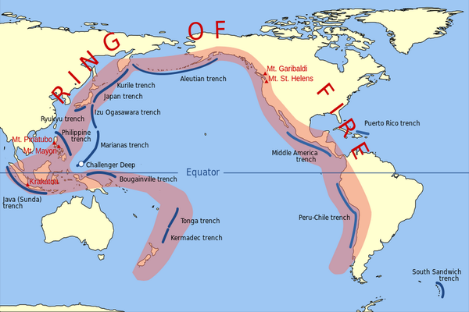
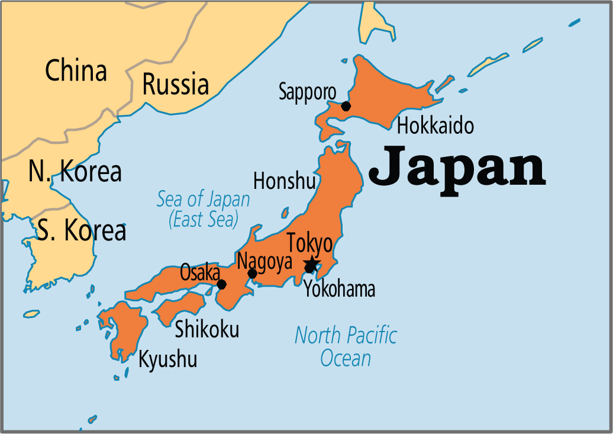

Slide 7
Population

Slide 8
Temperature

Slide 9
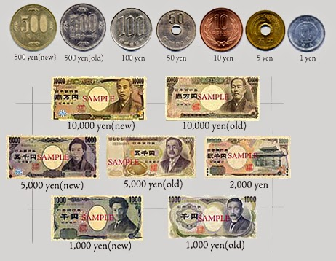
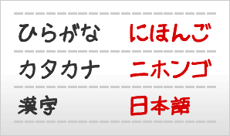
Language & Currency
Japanese
yen
$3.4 yen = $1 NT

Slide 10
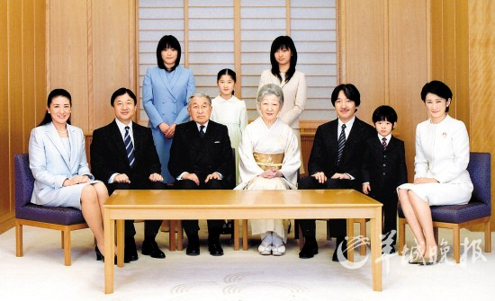
Government
Akihito 明仁天皇（あきひと）
The 125th emperor
Future: Female can inherit
皇室(こうしつ) ►

Slide 11



Symbol
Flag
Japan was created by Amaterasu
The emperor: Amaterasu's offsprings

Slide 12

Symbol
National Flower
Cherry blossoms
桜(さくら)►

Slide 13


Symbol
Crest
Chrysanthemum: the crest of imperial family
菊の御紋►
菊(きく)►

Slide 14
Transportation
Railway
Punctuality and safety
The largest metro system in the world

Slide 15
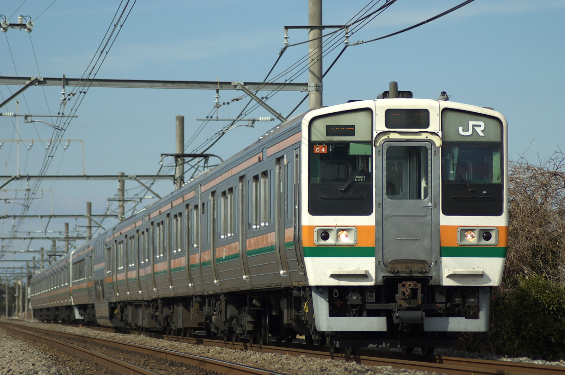
Transportation

Slide 16







Education
Nine-year compulsory education
Everything are free during compulsory education
Enroll in April
Graduate in March
nine-year
Elementary
Junior high
小學

Slide 17
Overview
Culture
Hotspots
Religions
Specialties
Lifestyles
Festivals

Slide 18
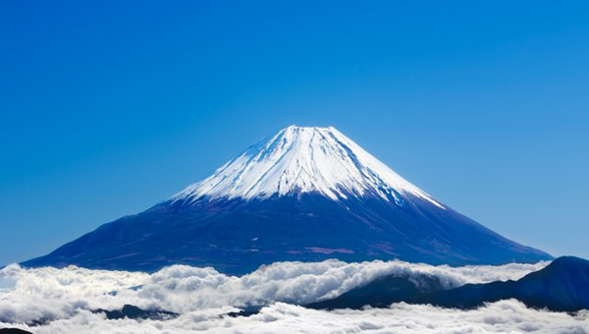
Hotspots
Mount Fuji
富士山(ふじさん)

Slide 19
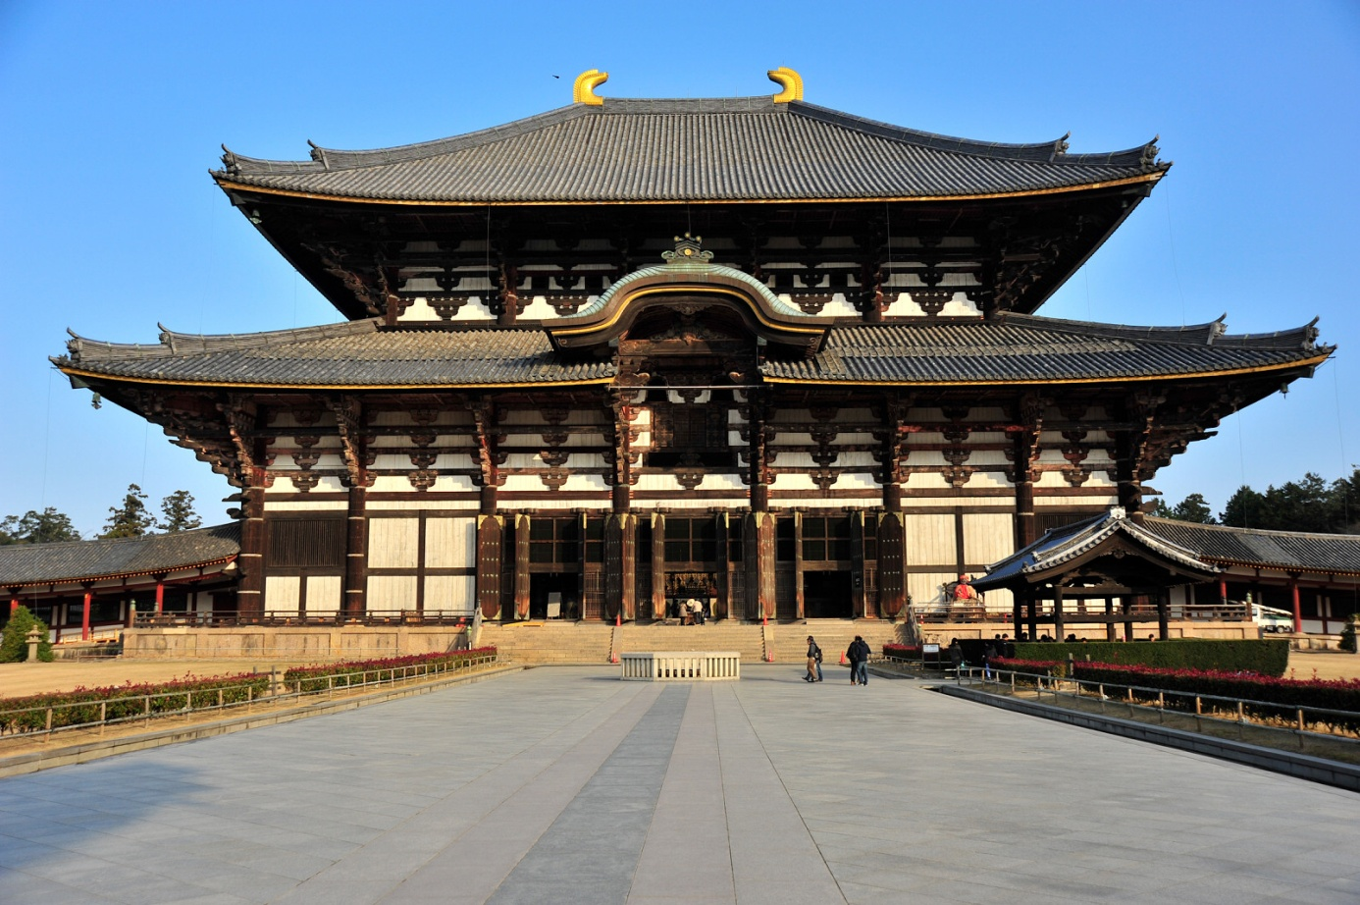
Hotspots
Todaiji
東大寺(とうだいじ)

Slide 20
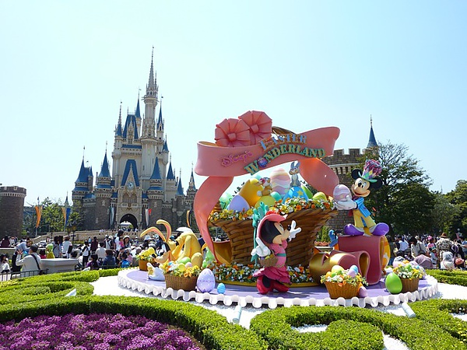
Hotspots
Disneyland In Tokyo
東京ディズニーランド►

Slide 21
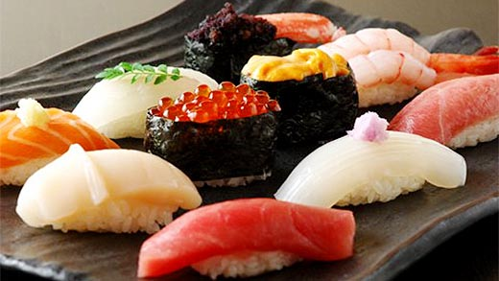
Specialties
Sushi
寿司、鮨、鮓、寿し(すし)

Slide 22
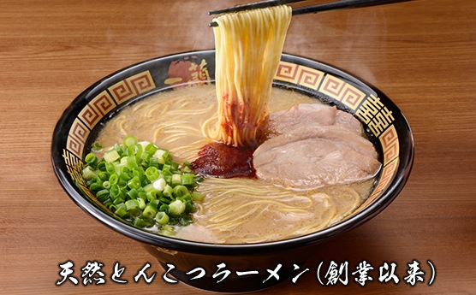
Specialties
Ramen
ラーメン

Slide 23

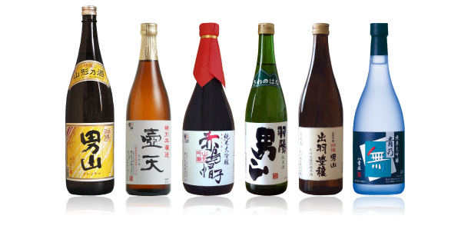
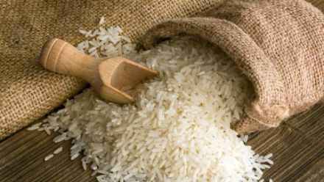
Specialties
Sa ke
Wine→Grapes
Sa ke→Rice
Sa ke→？
お酒

Slide 24
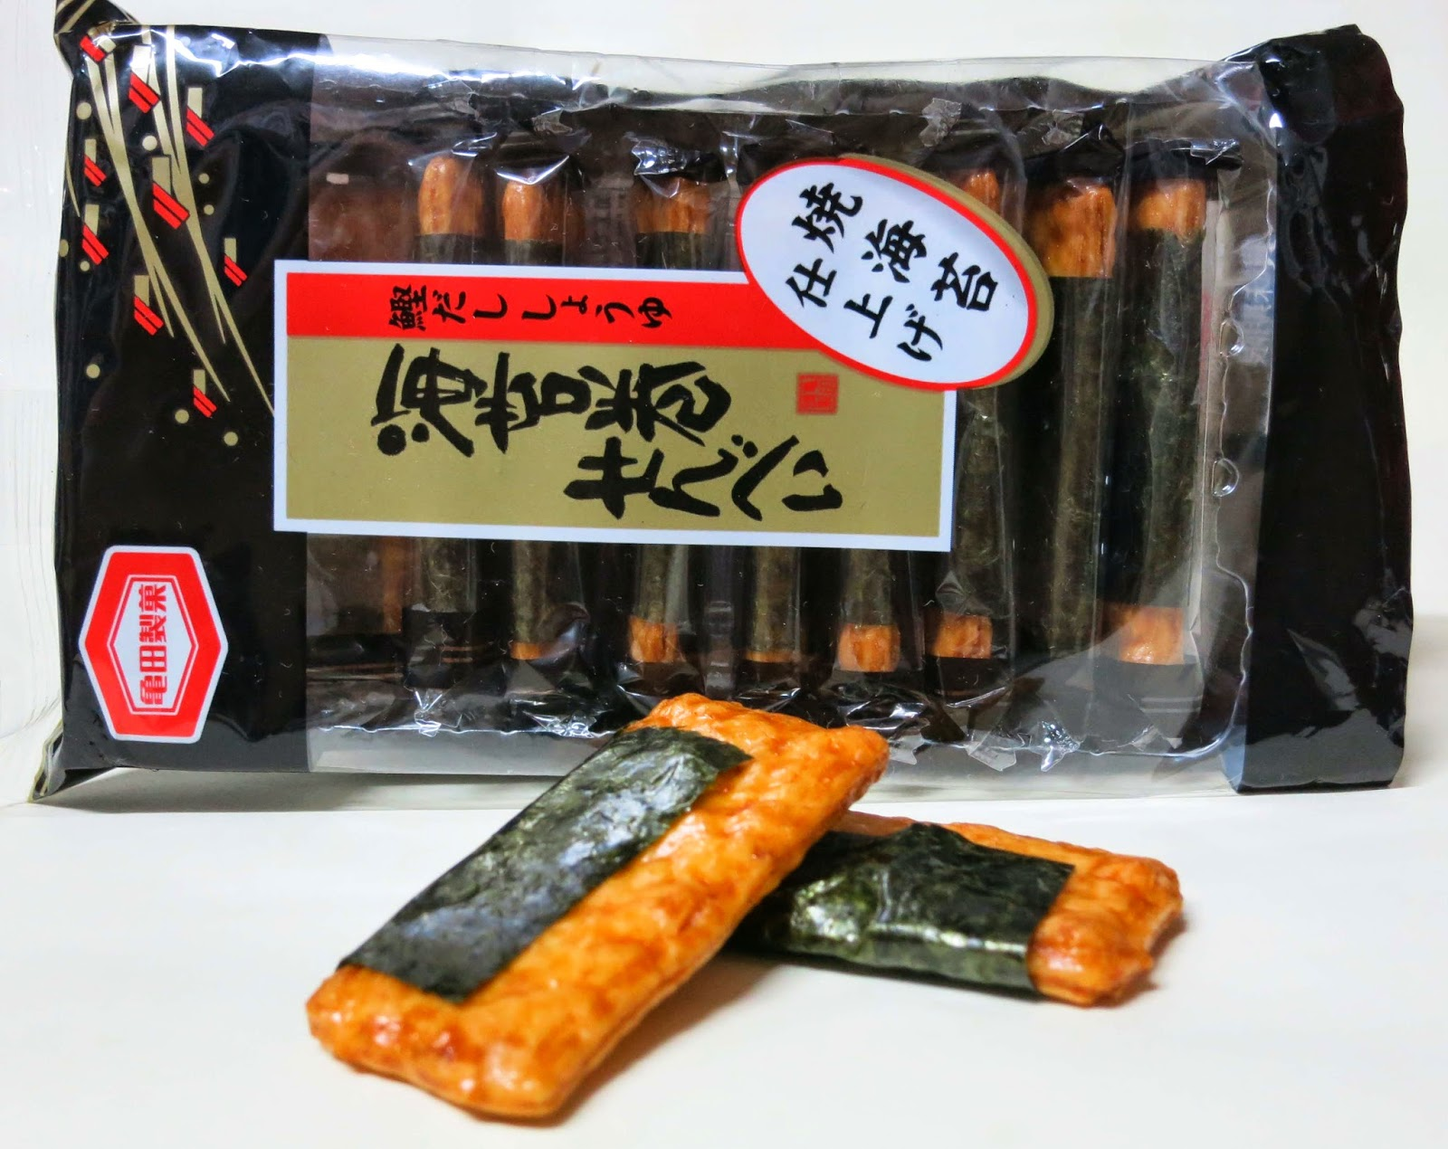
Specialties
Rice Cracker
あられ

Slide 25
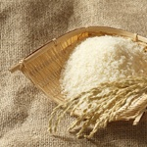

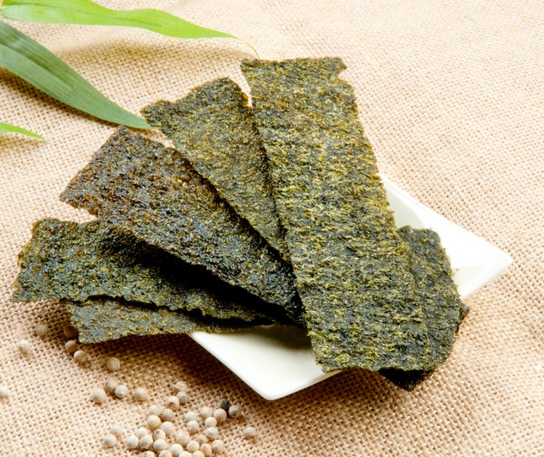

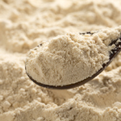
Rice Cracker
Ingredient
Paddy Rice
Soy-bean Sauce
Laver
Pepper
Sugar

Slide 26
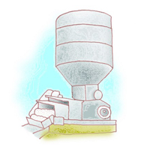
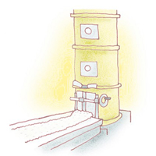
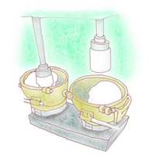
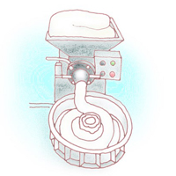
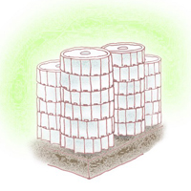
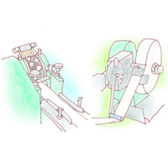
Rice Cracker
Process
Soak
Steam
Pound Up
Shape Up
Cold Storage
Cut

Slide 27
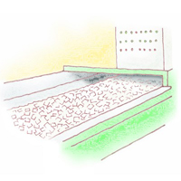
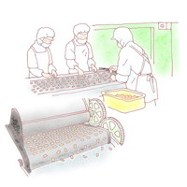
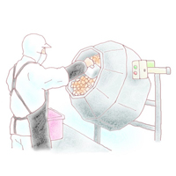
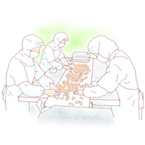
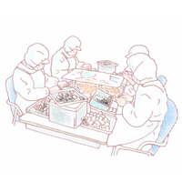
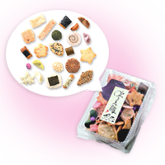
Rice Cracker
Process
Air-Dry
Bake
Flavor With
Select
Roll Up
Pack

Slide 28
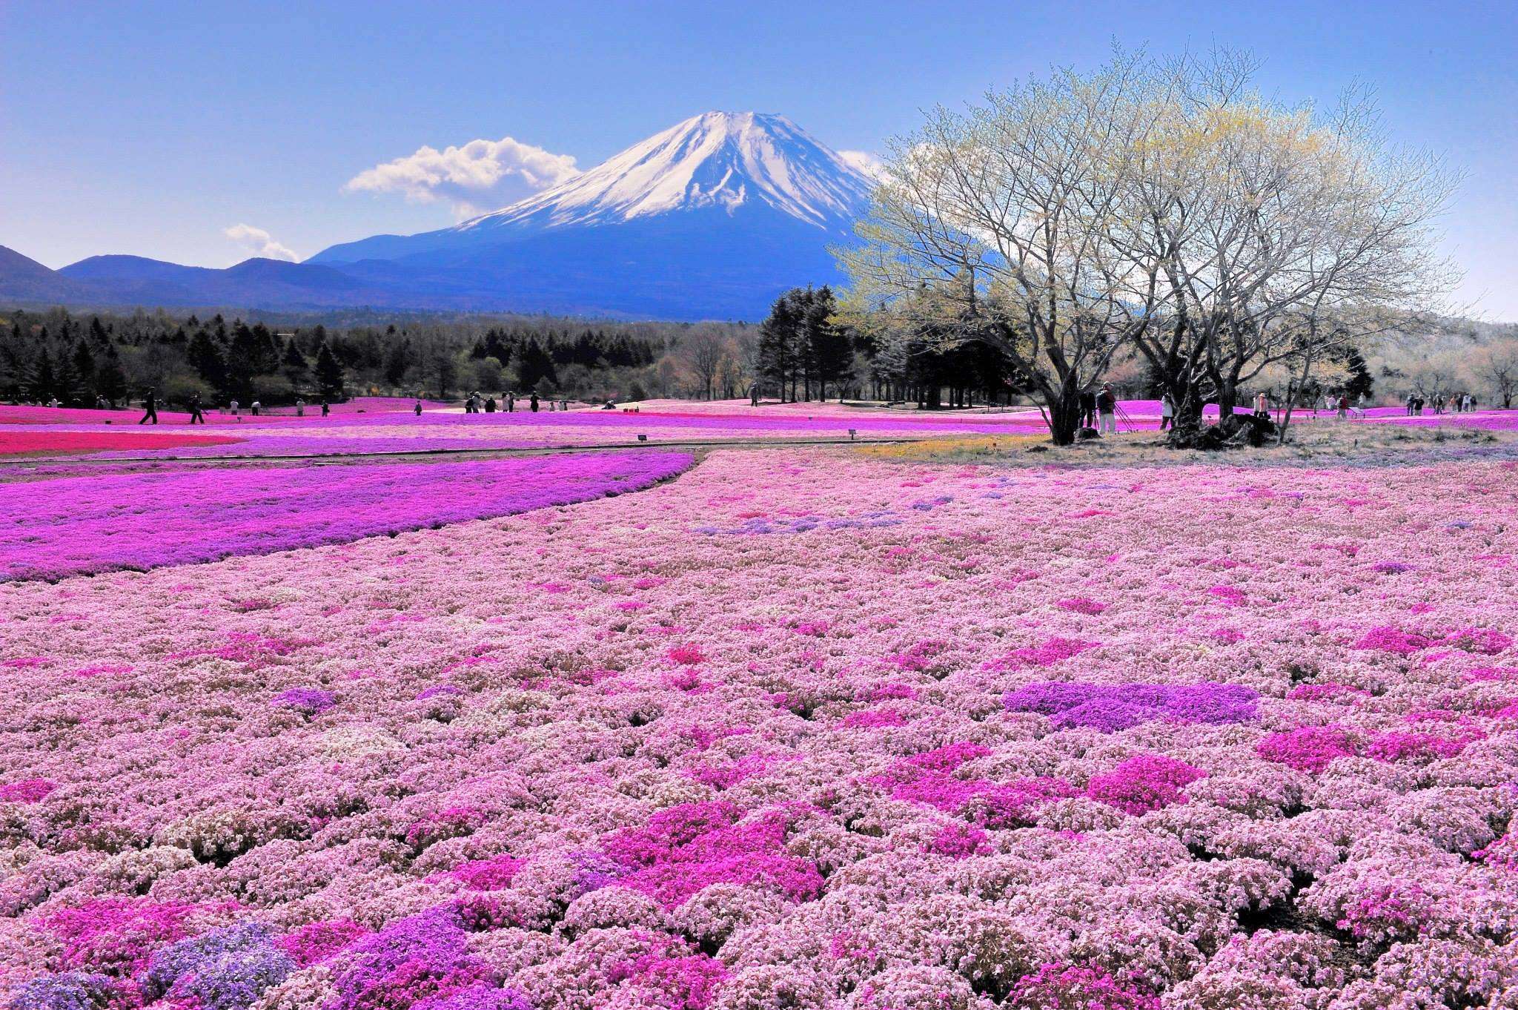
Festivals
Lucky Dream Day (1/2)
幸運の夢

Slide 29
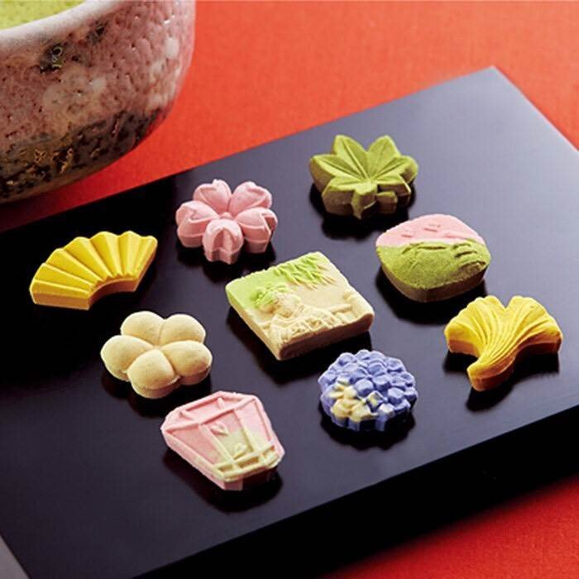
Festivals
Pastry Day (6/16)
ペストリーセクション►

Slide 30

Religions
Shinto
しんとう ►

Slide 31

Religions
Buddhism
仏教(ぶっきょう)

Slide 32

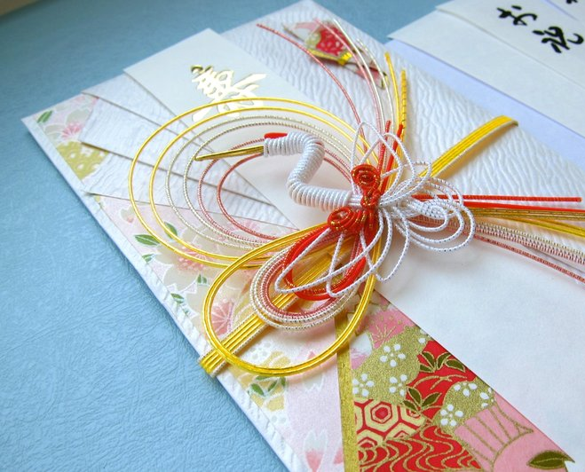
Lifestyles
Envelope
White envelope: God, pure and faultless
お年玉 (おとしだま) ►
Japan vs. Taiwan

Slide 33
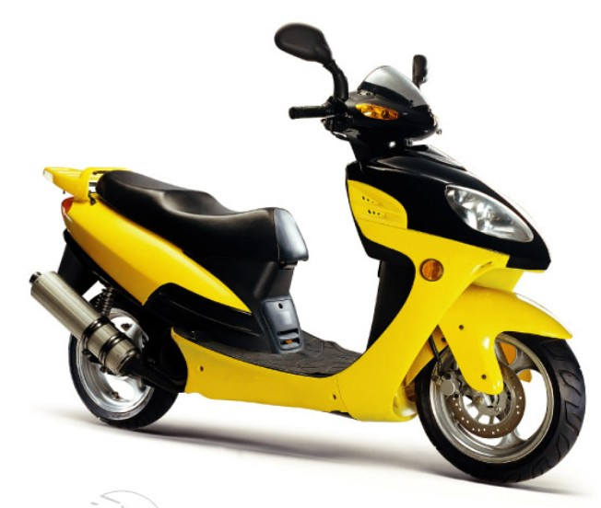
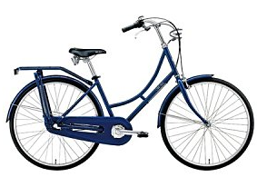
Lifestyles
Car Racing
レーシング ►
Japan vs. Taiwan

Slide 34
Economy and Industry
Trade Organizations
External
Sectors of the economy

Slide 35





Trade Organizations
APEC
WTO
OECD
G20
G8

Slide 36
Exports & Imports

Slide 37


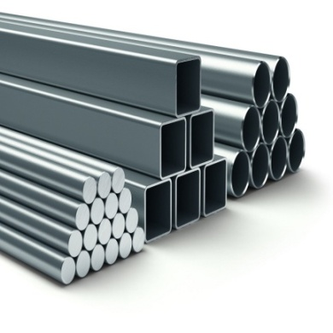
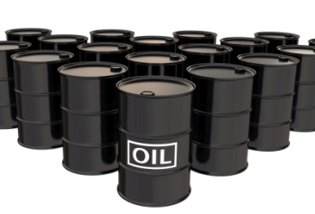
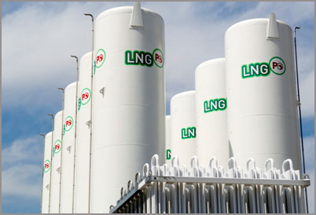
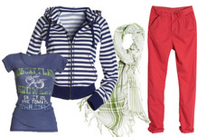
Exports & Imports
Exports
Motor Vehicles
Semiconductors
Iron and Steel Products
Imports
Petroleum
Liquid Natural Gas
Clothing

Slide 38
Exports & Imports

Slide 39
Sectors of The Economy

Slide 40
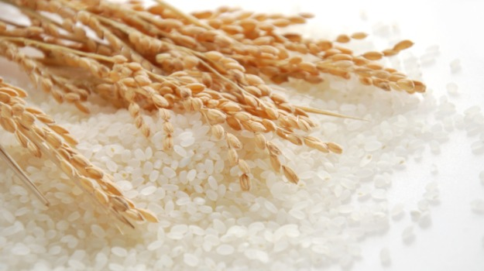
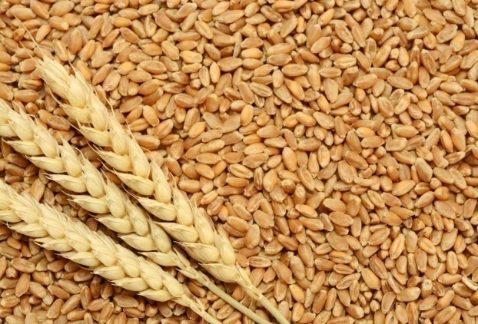
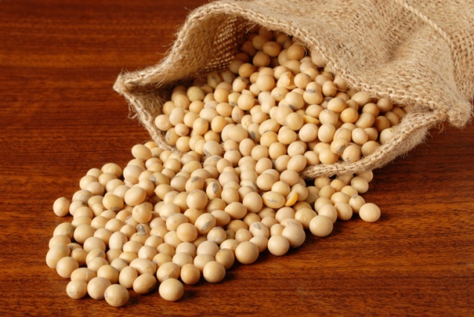
Agriculture
Self-sufficient: rice and wheat
Imports: wheat and soybeans
Rice
Wheat
Soybeans

Slide 41
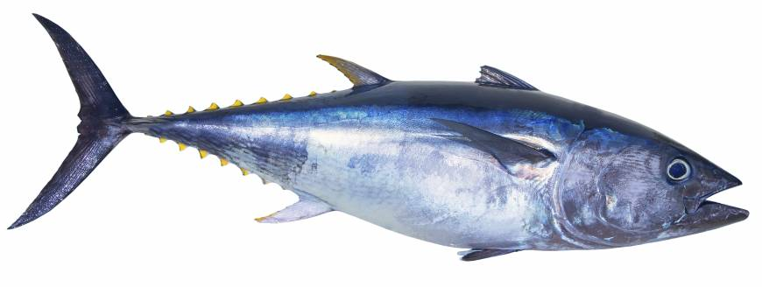
Fishery
Tonnage of fish caught: No.4
Tuna

Slide 42
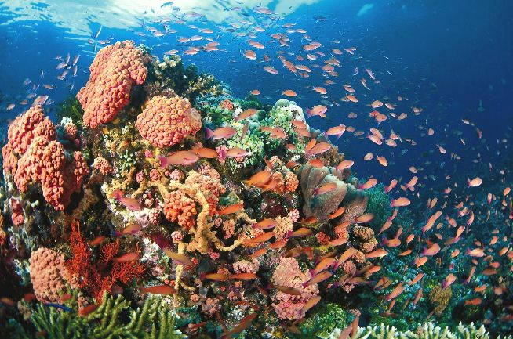
Fishery
Marine resources

Slide 43
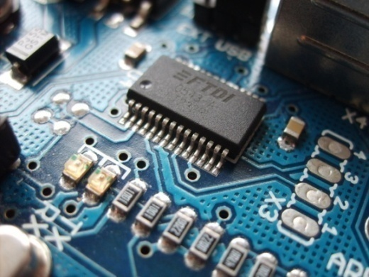

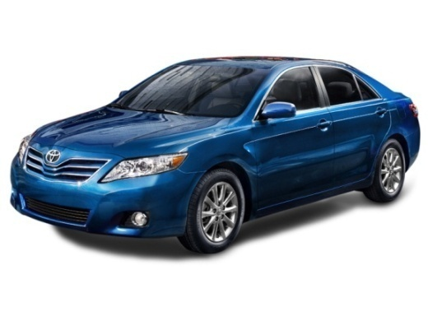

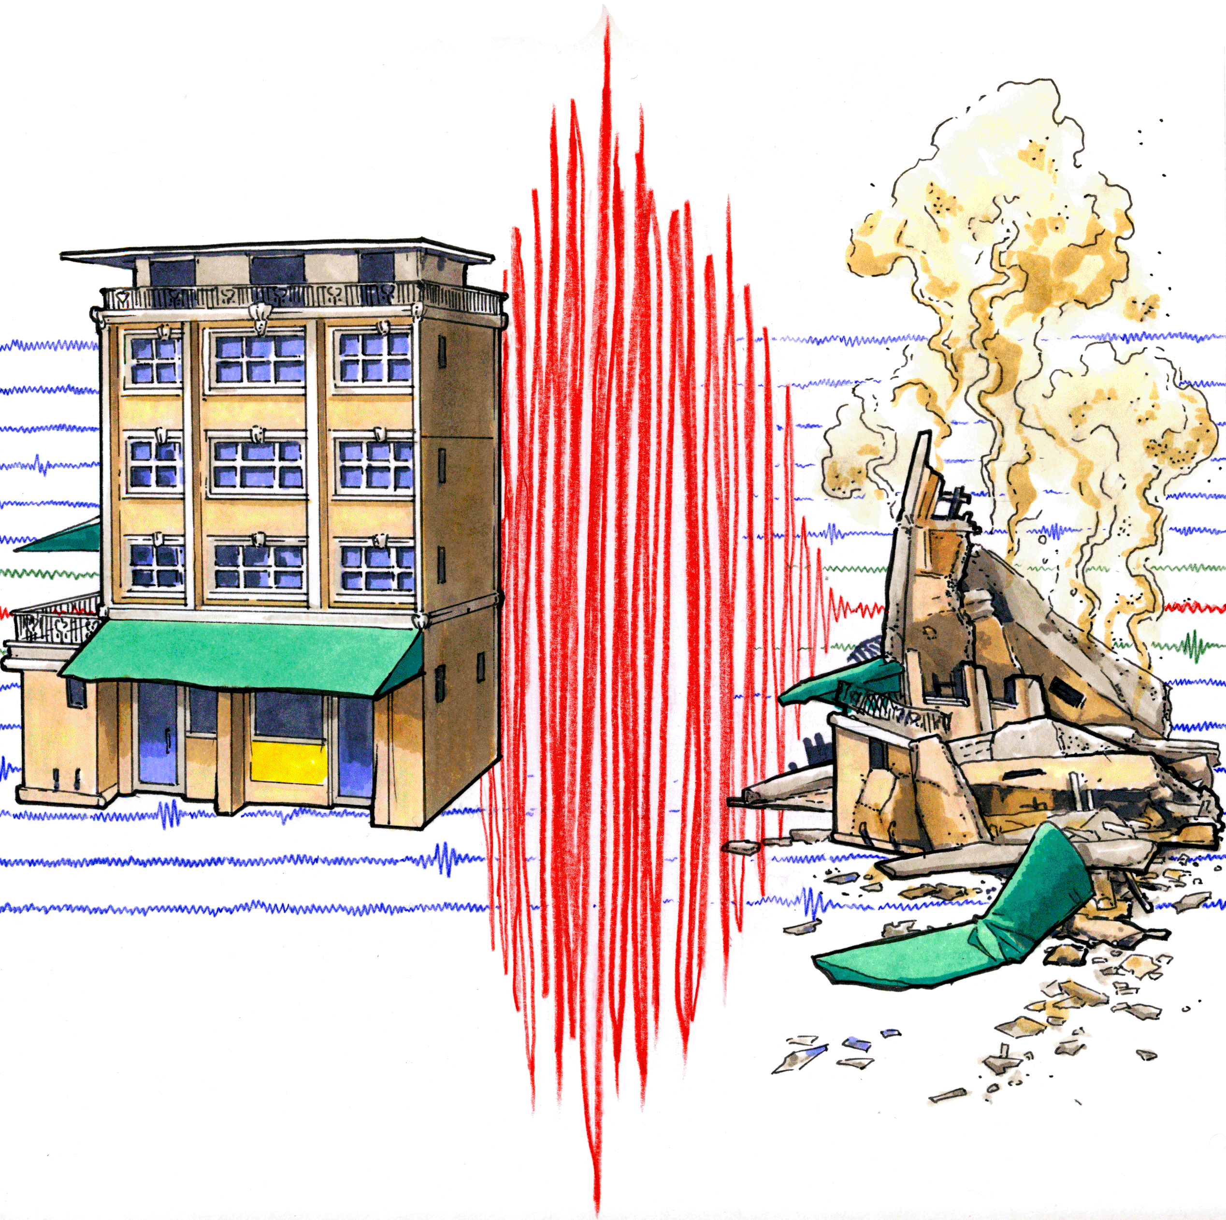
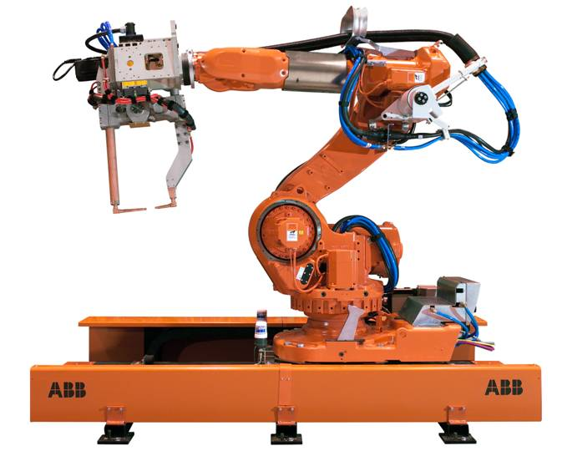
Science and Technology
Electronics
Optics
Automobiles
Machinery
Earthquake Engineering
Industrial Robotics
Semiconductors

Slide 44

Entertainment Industry
60% of world production
Animation Industry

Slide 45




Trademark

Slide 46





Industry
The third biggest producer of automobiles

Slide 47

Tourism
In Asia and the Pacific:
The fifth most visited country
2020 Summer Olympics►

Slide 48

Representative Company
SONY
Background
Products
Future Development

Slide 49
SONY
1946
1958
Sony
was established by Akio Morita and Masaru Ibuka
changed its name to "Sony"
Sonus and Sonny 2. Placard: "BE MOVED"

Slide 50
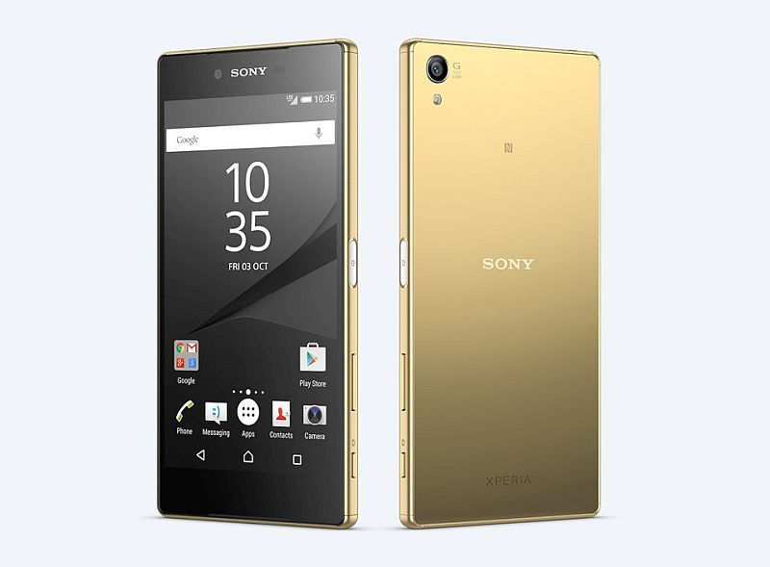
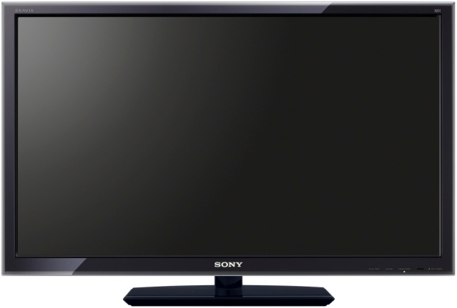
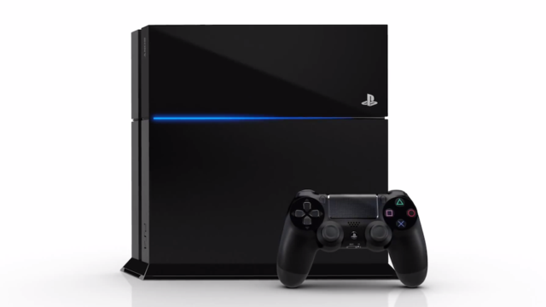





Products
Mobile Phone
TV
Game Machine
2G
2.5G
3G
4G

Slide 51

Products
Five consumer demand
Display
Camera
Music
Games
Cloud

Slide 52

Features
Pictures: photosensitive element Exmor in R

Slide 53

Features
Livedock: mobile phone→ computer
mobile phone→ video game

Slide 54

Features
Waterproof

Slide 55

Future Development
Make their PlayStation enter into
mobile device market

Slide 56
Conclusion
Unique Culture
Geographical Features
New Spots or Specialties
Japan
Climate
Industry
Future
Taiwan

Slide 57
Reference
Film – Youtube
https://www.youtube.com/watch?v=9tJlCpKXTcA
Overview – Wiki & Japannavi
http://www.e-japannavi.com/shop/products/foods/
http://www.zwbk.org/zh-tw/Lemma_Show/86980.aspx
https://zh.wikipedia.org/zh-tw/%E5%9B%BD%E8%8A%B1
https://zh-yue.wikipedia.org/wiki/%E6%97%A5%E6%9C%AC
Economy and Industry – Wiki & Buzzorange
https://en.wikipedia.org/wiki/Sony
http://buzzorange.com/techorange/2012/10/26/sony-closes-japan-
factory-cuts-2000-jobs/
Representative Company – Wiki & Cnyes
https://zh.wikipedia.org/wiki/%E6%97%A5%E6%9C%AC%E7%B6%93%E6%BF%9F
https://zh.wikipedia.org/wiki/%E6%97%A5%E6%9C%AC
http://www.cnyes.com/economy/macro/jp_economic.htm

Slide 58




Slide 59


