Slide 1
GERMANY
JUN 01.2016
Teacher：Shu-li Lai
Student ID | Member
13 | Soso
34 | Joanne
35 | Yo
36 | Jocelyn
42 | Alice

Slide 2
Outline
Overview
Economy and industry
Representative company—
Volkswagen Group

Slide 3
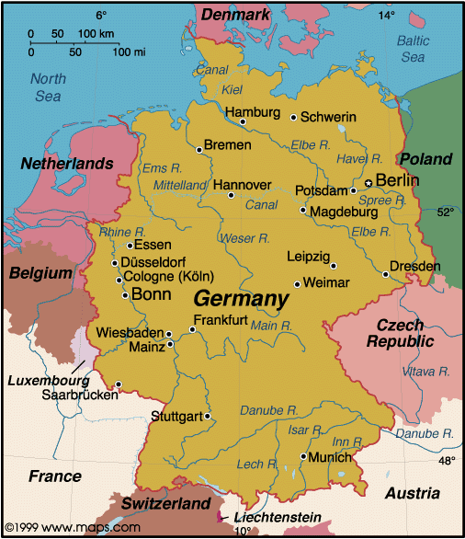

Geography
In west-central Europe
Covers 357,021km
$$c^{2}$$

Slide 4
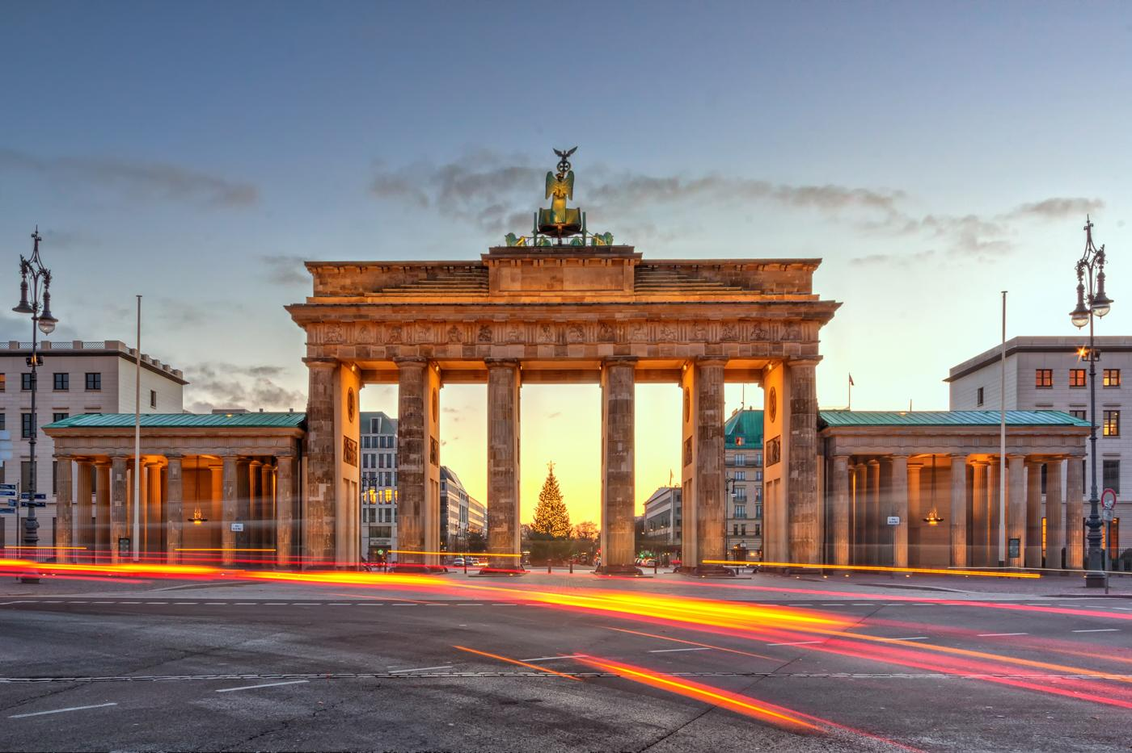
Capital
Berlin

Slide 5
Population
80 million on May 9, 2011
The 16th most populous country

Slide 6
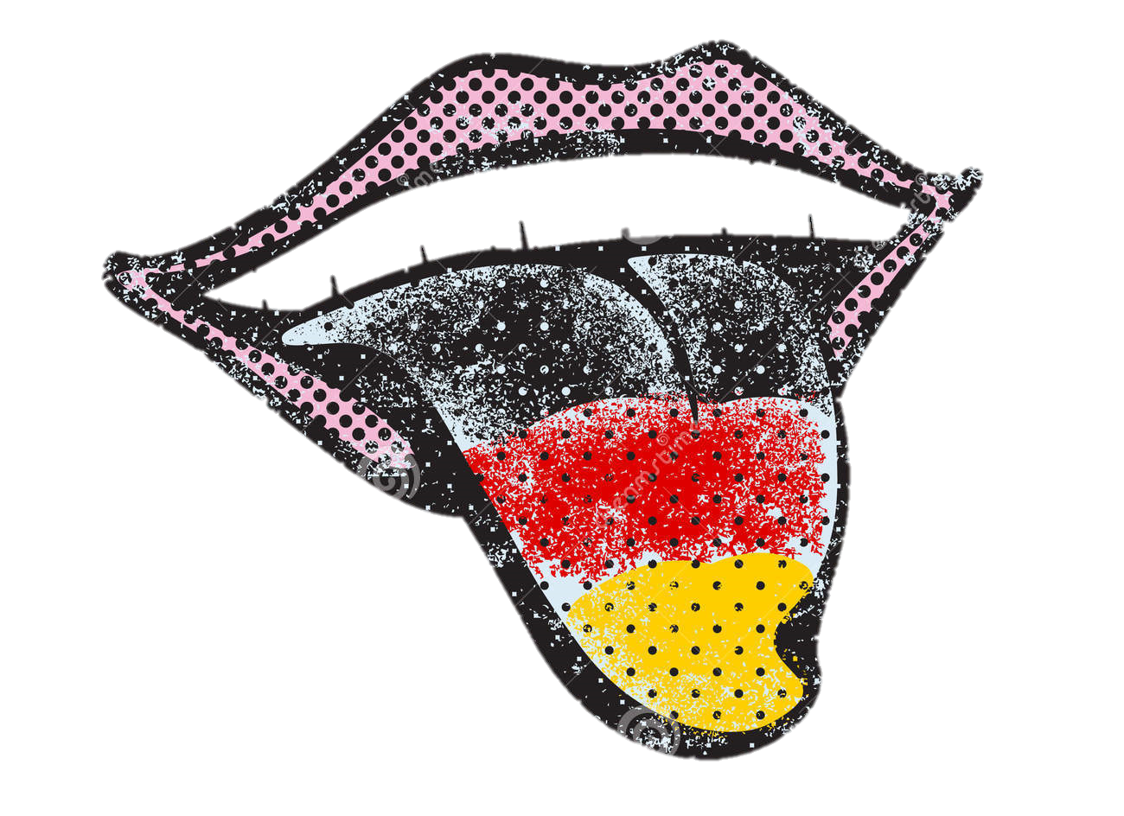
Language
German
Other German dialects

Slide 7
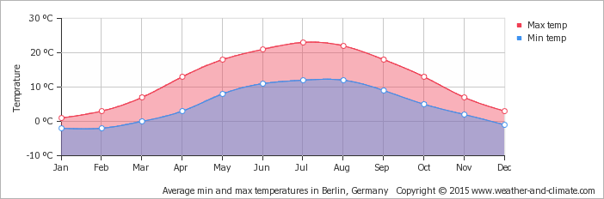
Weather
Comfortable in summer
Very cold in winter
Temperature

Slide 8
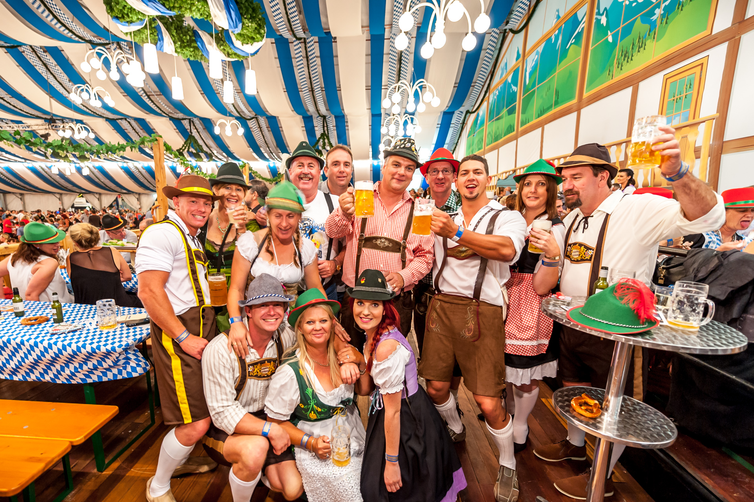
Festival

Slide 9
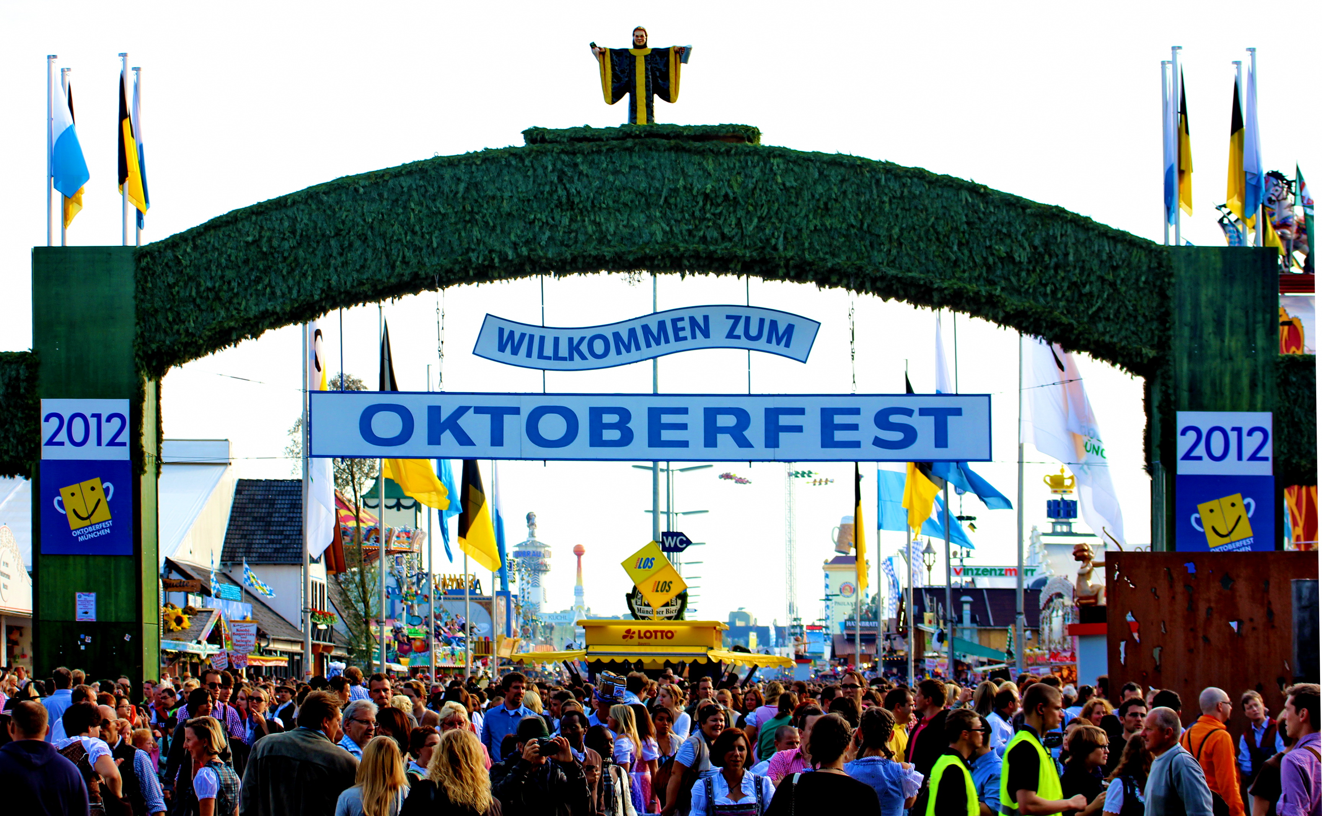
Festival
Oktoberfest
200 years
The largest Volk fest

Slide 10
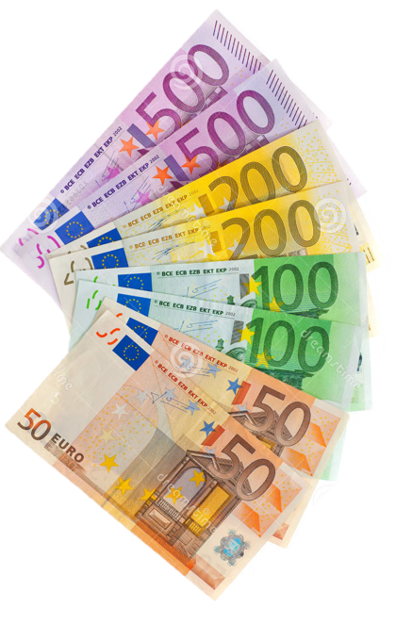
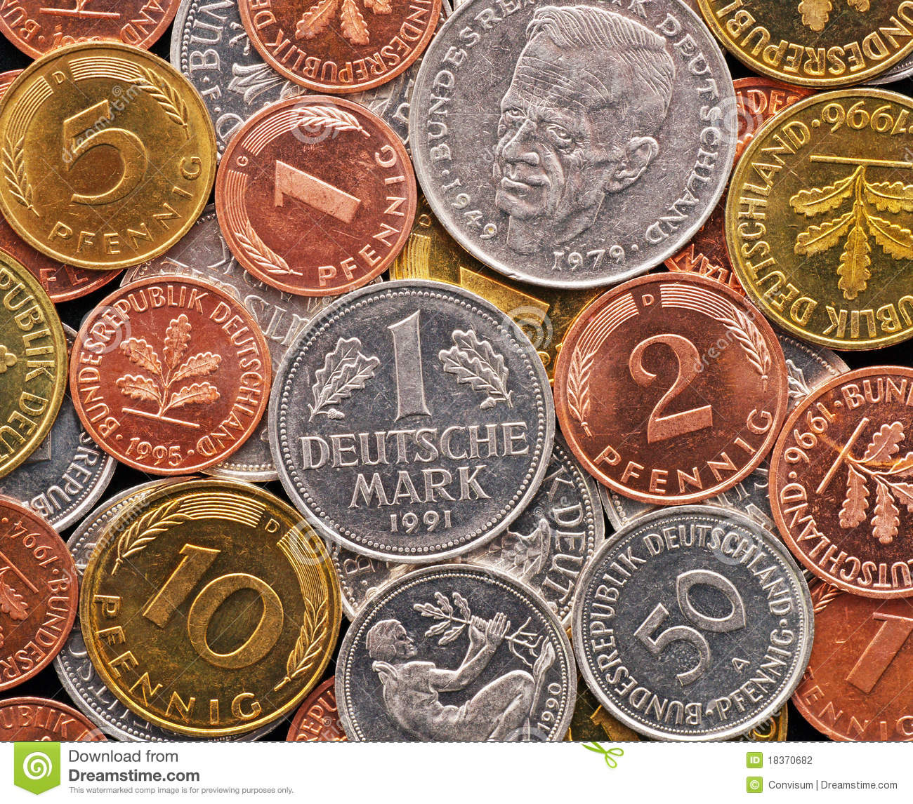
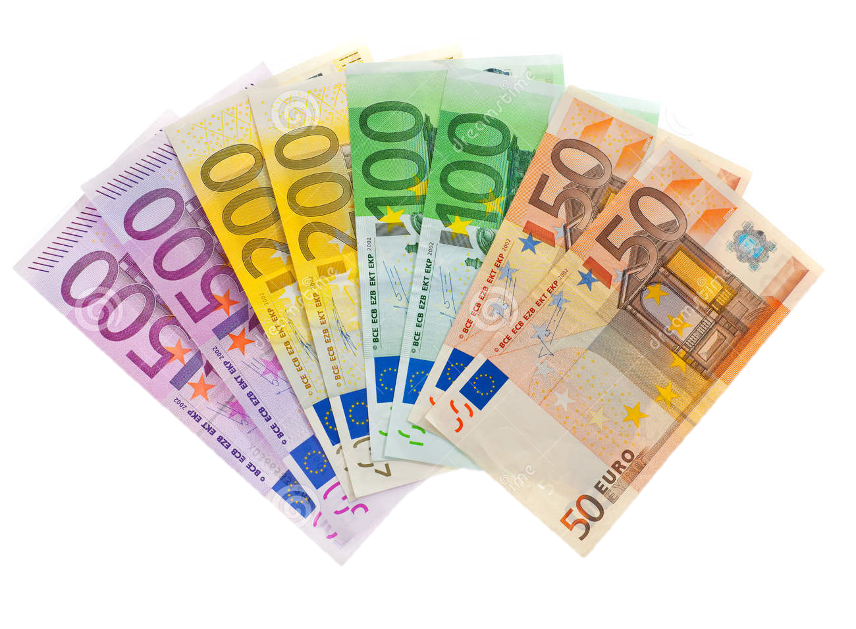
Currency
1999
2002

Slide 11
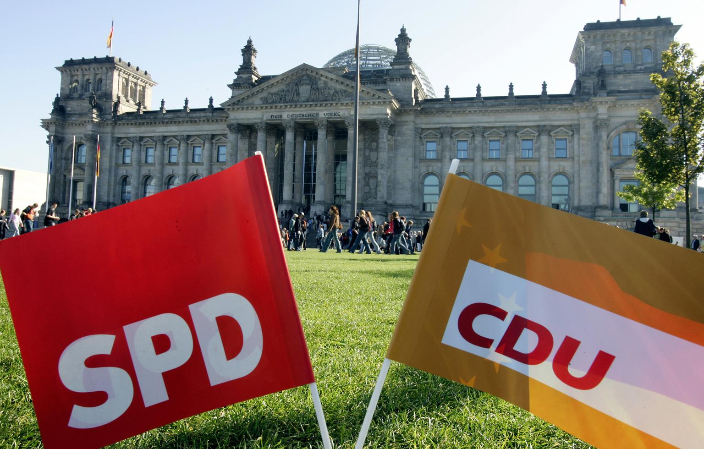
Politics
Federal Parliamentary Democracy Republic
Christian Democratic Union of Germany
Social Democratic Party of Germany

Slide 12
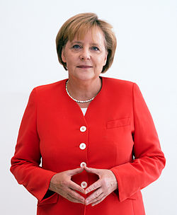
Prime Minister
Angela Dorothea Merkel
Graduated from Chemistry
Iron Lady
Triangle of Power

Slide 13
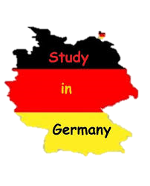
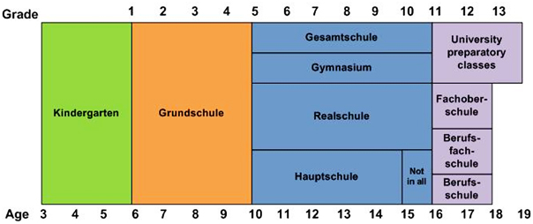
Education

Slide 14
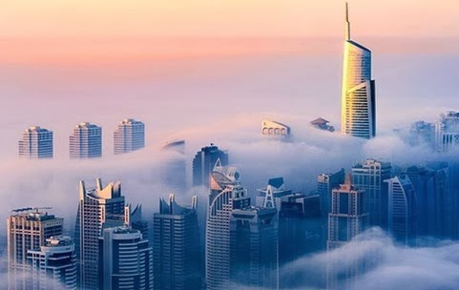
Economy of Germany
Social structure
Economic construction

Slide 15

Social Structure
Low corruption record
High innovation
Large automotive industry
The third largest export
Low unemployment rate

Slide 16
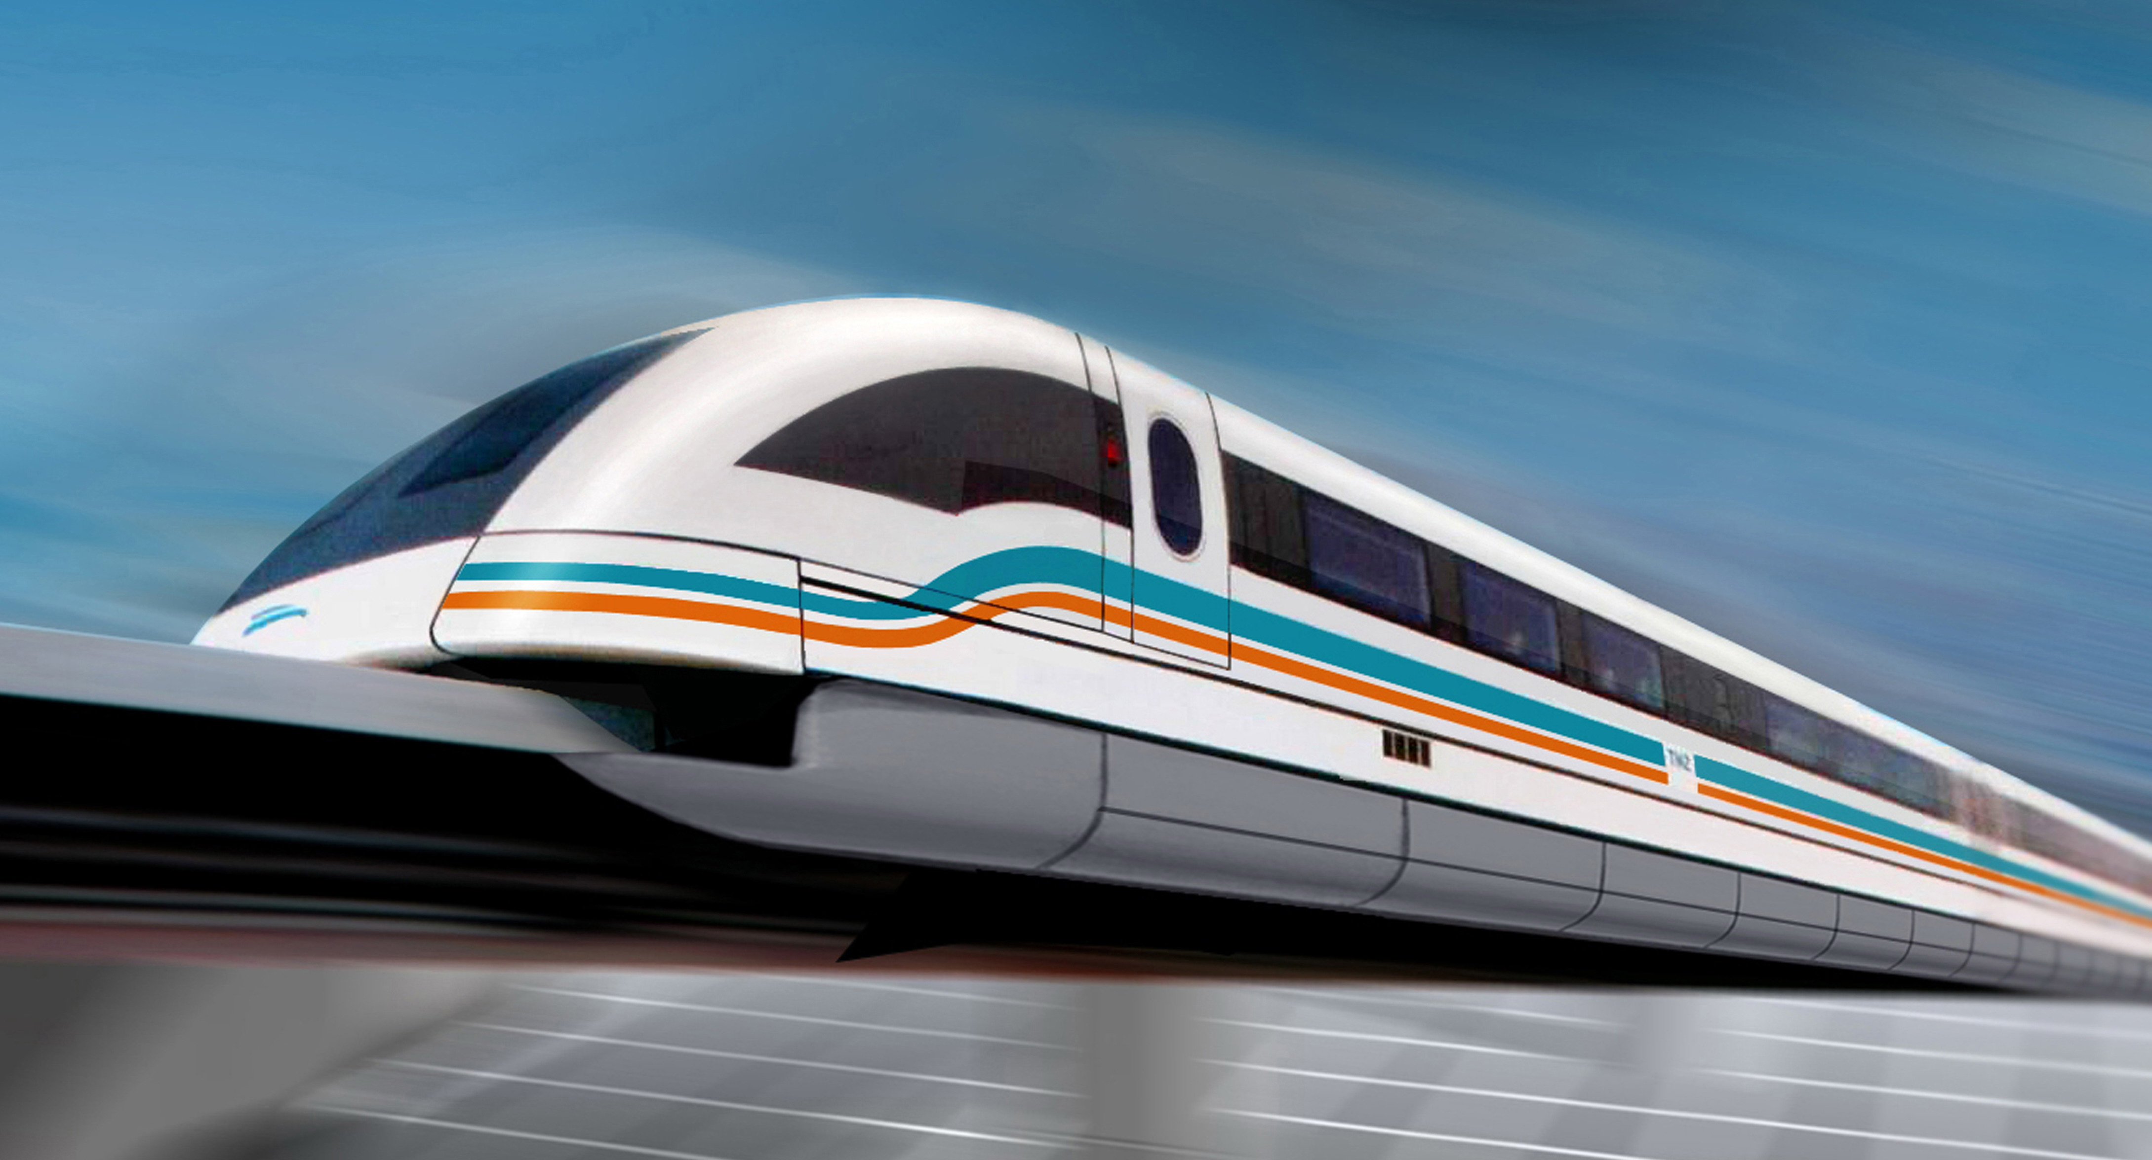
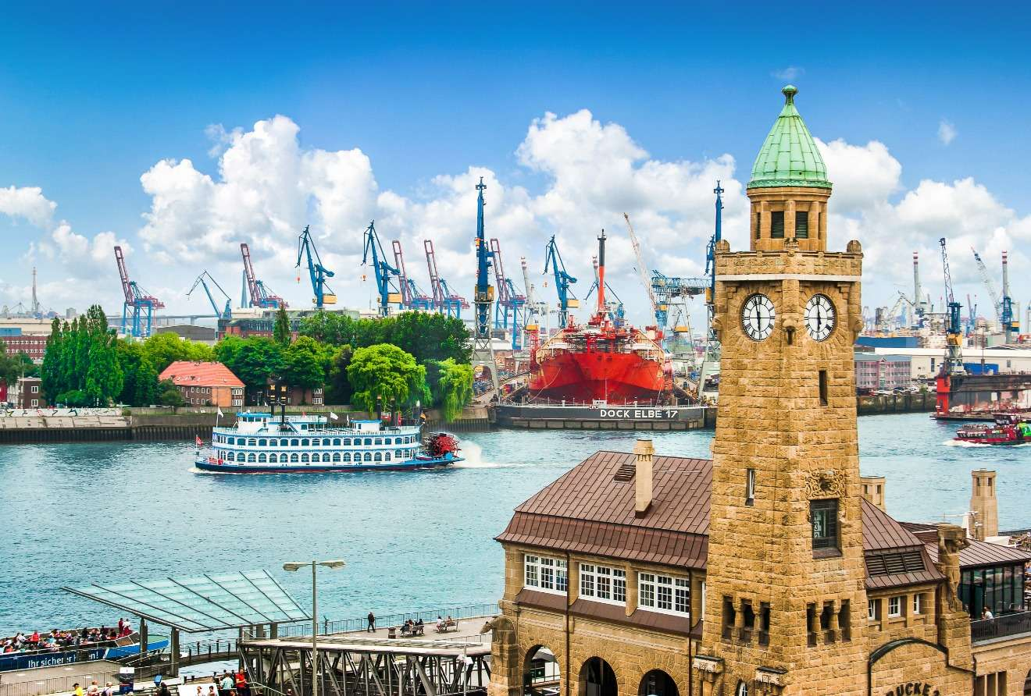
Economic Construction
Road network
Port of Hamburg---the country’s “Gatewat to the World”

Slide 17
The largest German companies by revenue
2011
Rank | Name | Headquarters | Revenue (bil. $) | Profit (bil. $) | Employees (World)
1. | Volkswagen AG | Wolfsburg | 168,041 | 9,053 | 399,381
2. | E.ON SE | Düsseldorf | 129,481 | 5,957 | 260,100
3. | Daimler AG | Stuttgart | 127,379 | 6,693 | 151,338
4. | Siemens AG | Berlin, München | 125,064 | 7,752 | 85,105
5. | BASF SE | Ludwigshafen am Rhein | 102,657 | 5,268 | 402,700
6. | BMW AG | München | 89,081 | 1,126 | 252,258
7. | Metro AG | Düsseldorf | 84,597 | 6,036 | 109,140
8. | Schwarz Gruppe | Neckarsulm | 82,674 | 2,245 | 246,777
9. | Deutsche Telekom AG | Bonn | 80,099 | 4,262 | 95,453
10. | Deutsche Post AG | Bonn | 76,220 | 3,208 | 46,915

Slide 18


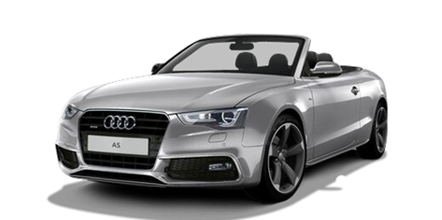
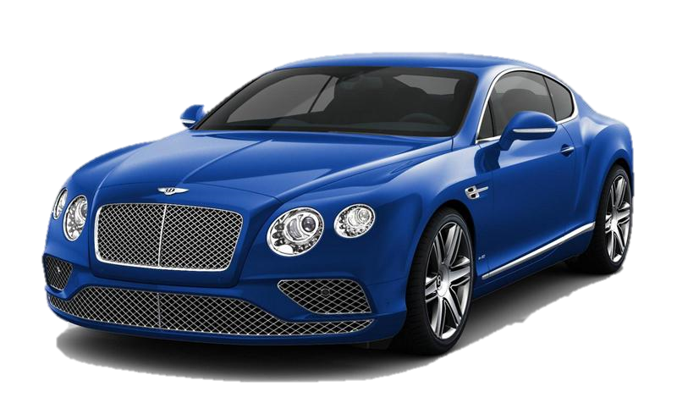
Brands

Slide 19


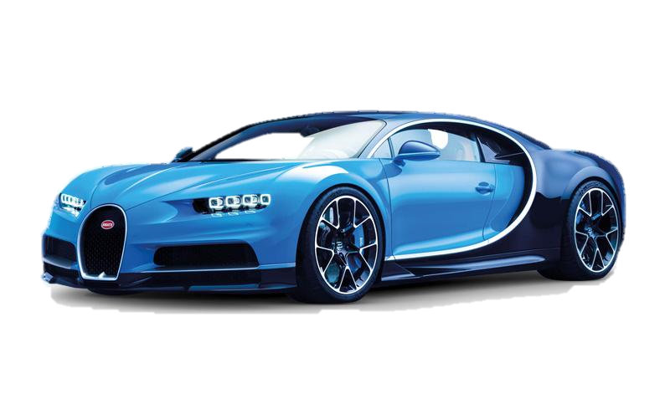
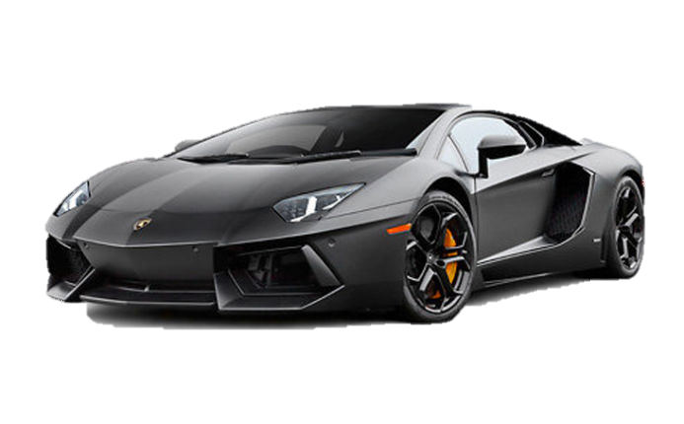
Brands

Slide 20


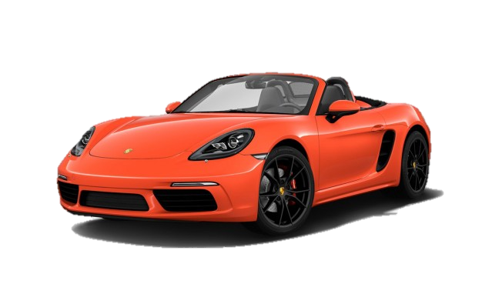
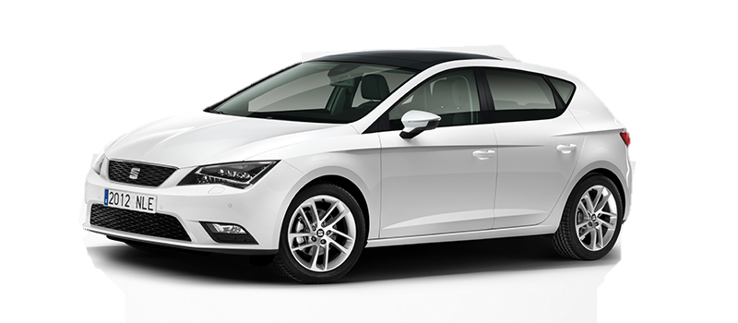
Brands

Slide 21


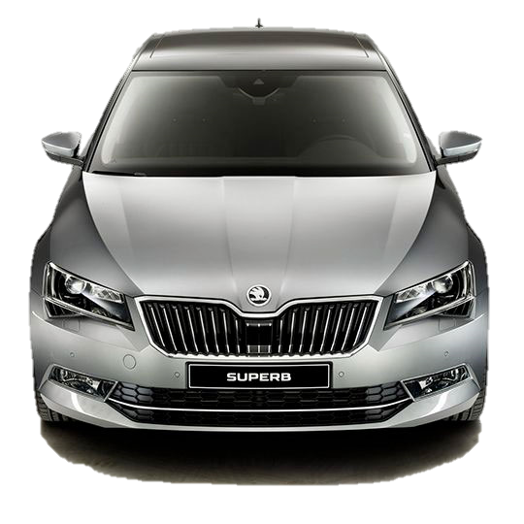
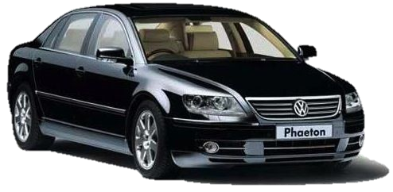
Brands

Slide 22


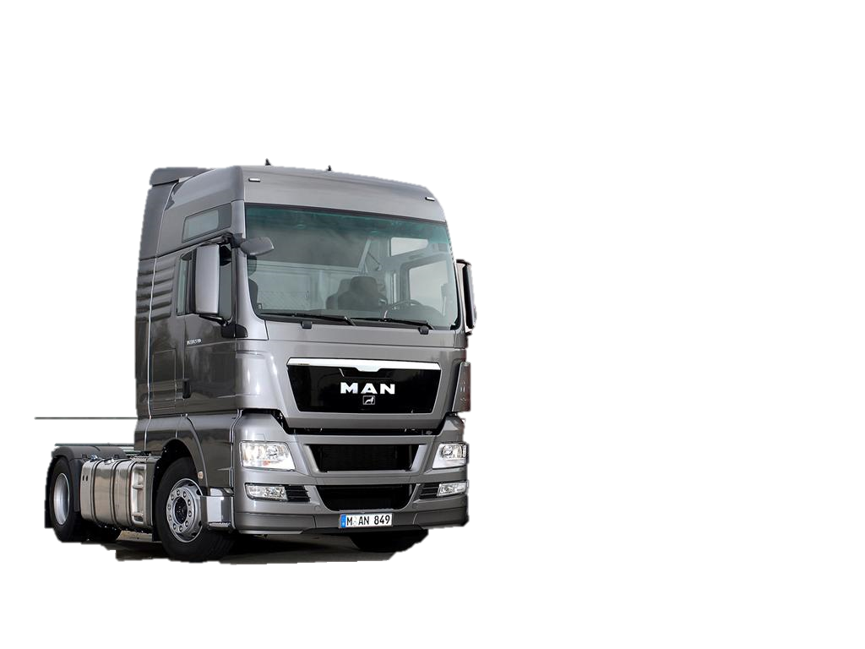
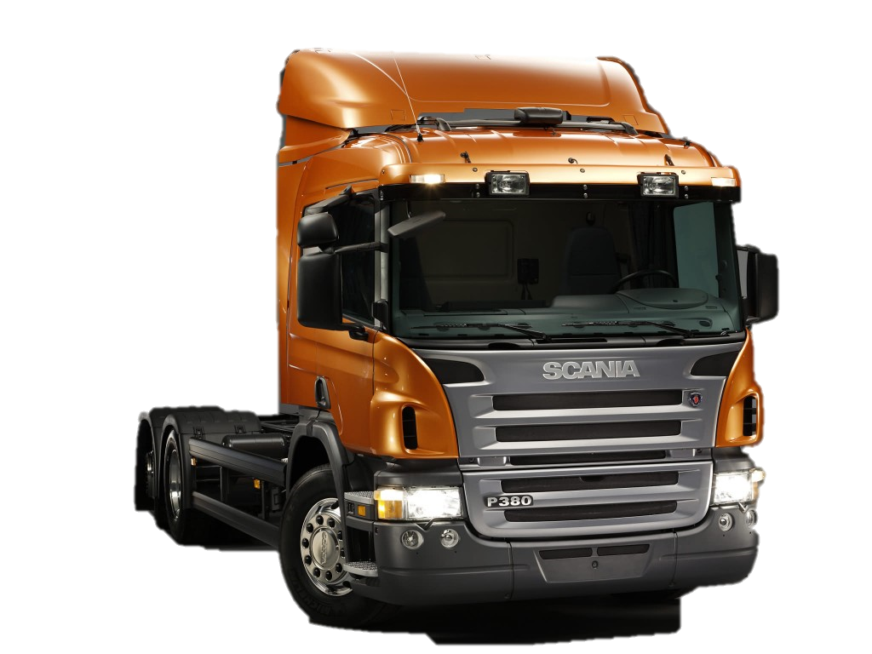
Brands

Slide 23

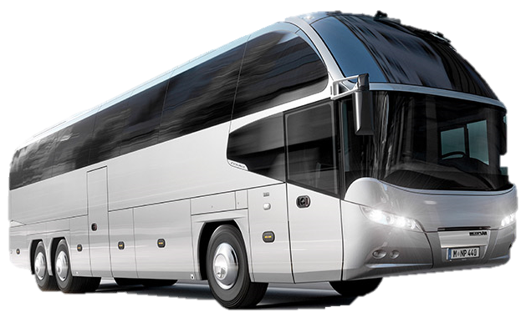
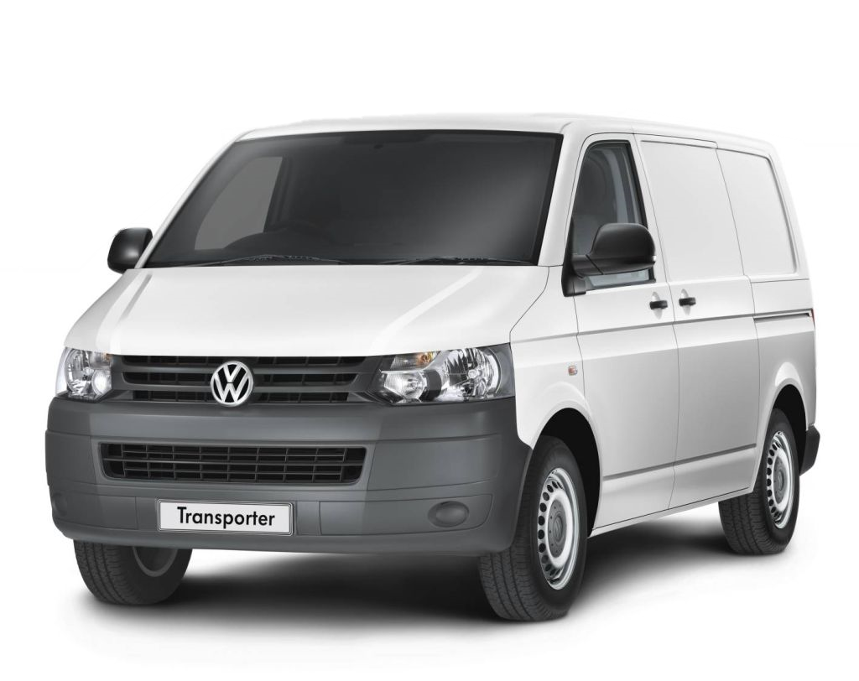
Brands

Slide 24
Company Introduction
Volkswagen Group
=Volkswagen Aktiengesellschaft
= VW AG
Headquarters :
Wolfsburg, Lover Saxony, Germany

Slide 25

Designs/Manufactures/Transports
Passenger and Commercial vehicles
Motorcycles
Engines
Turbo machinery

Slide 26
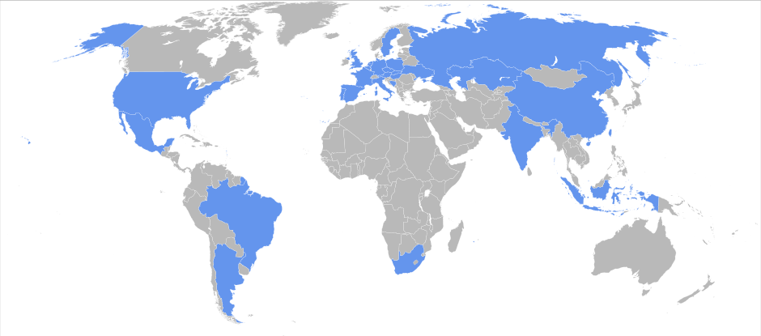
Factories of the World
61 production factories.
370,000 employs.
26,600 cars daily output.
sale in 150 countries.

Slide 27

Factories of the World
2012
2013
2014
2015
Top 3 automakers 2012 by global volume:
Reached production output of 10.14 million vehicles.
The Fortune Global 500 list of the world's largest companies.
The largest automaker
in the world.
Group | Units
Toyota | 10,104,424
G.M. | 9,285,425
Volkswagen | 9,254,742
Based on OICA data

Slide 28
Future Plans
Digitalization
Design activities
Setting “Volkswagen Group Future Centers”
Forging ahead with electro mobility

Slide 29
Mission
To make best in class in terms of customer
Experience
Interface design
Operating logic
New interior concepts
Infotainment.

Slide 30
Thanks
for
Listening

