Slide 1
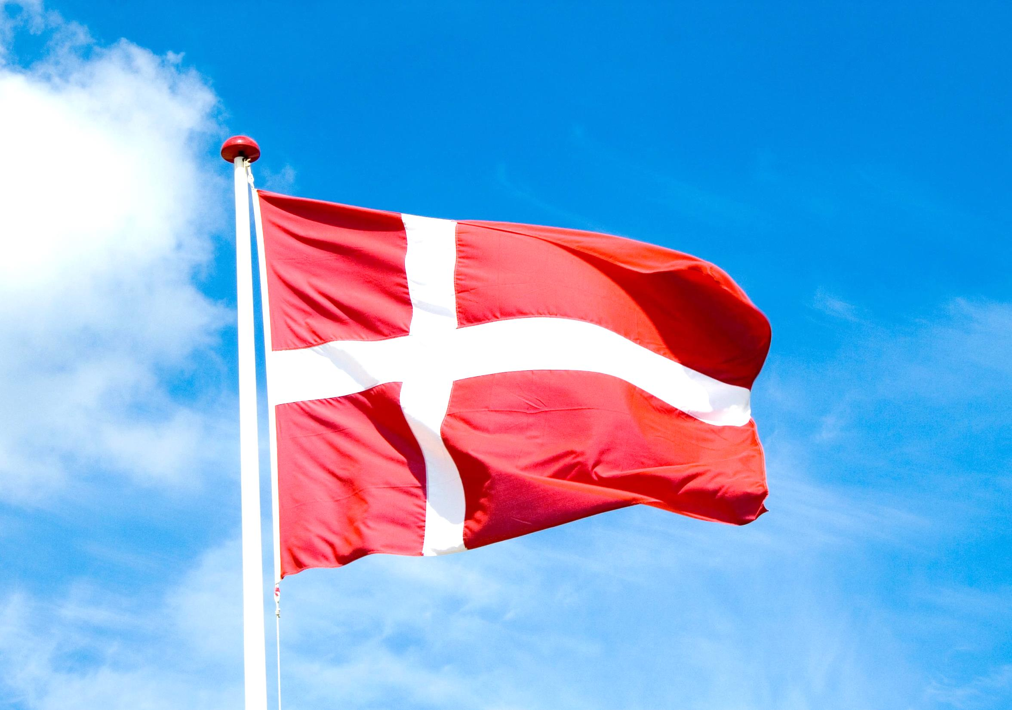
Group2
Denmark
10344044 Tina
10444012 Eleanore
10444017 Elly
10444026 Jessie
10444032 Zavi

Slide 2
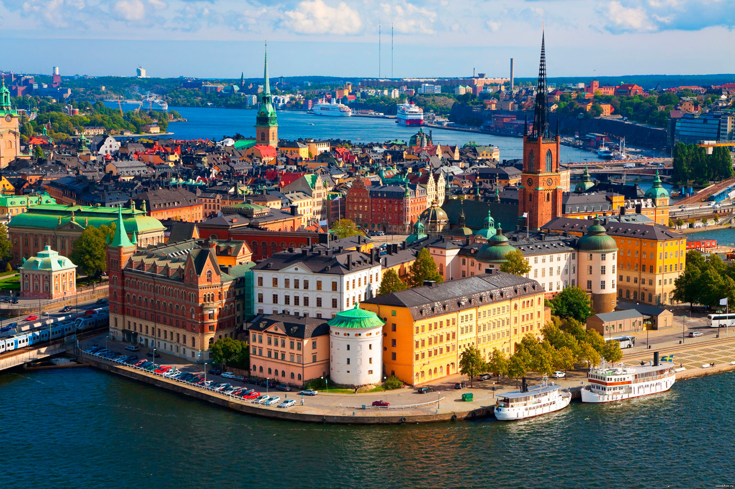
Outline
Overview of Denmark
Economy and Industry
Representative company

Slide 3
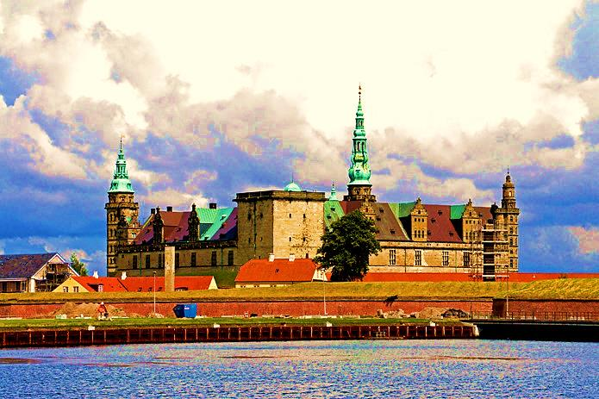
Overview of Denmark
Location
Capital
Population
Weather
Language
Currency
Politics
Culture

Slide 4
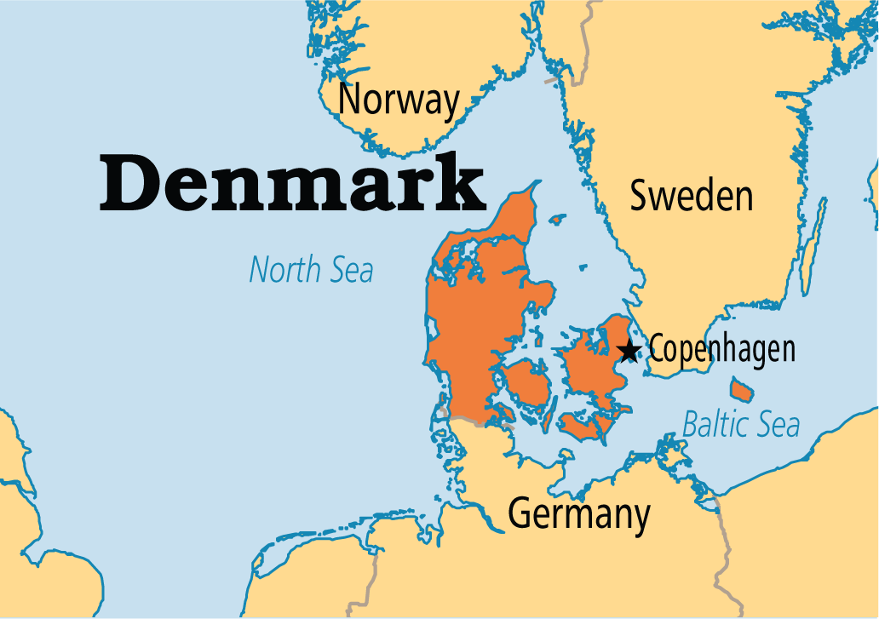
Location

Slide 5
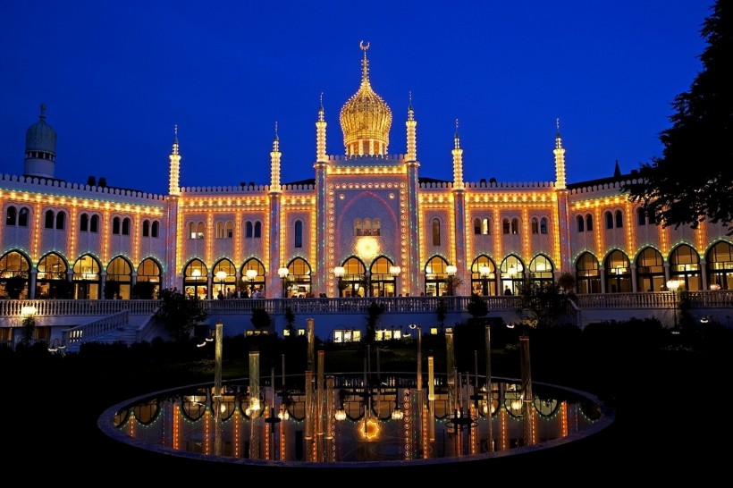

Slide 6
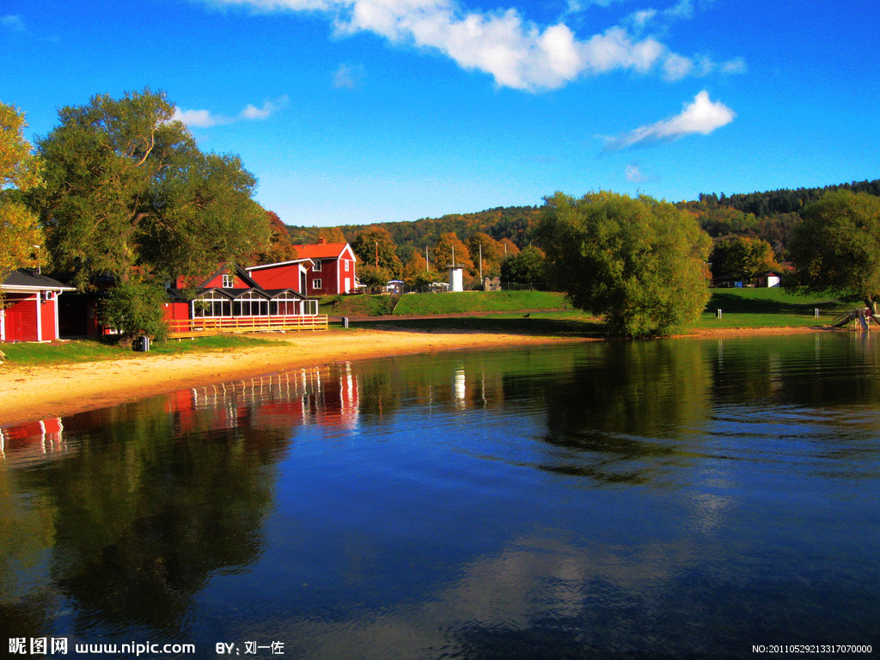

Slide 7
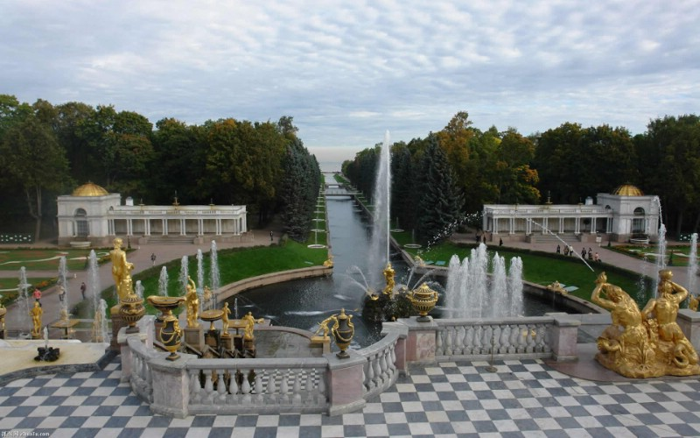

Slide 8
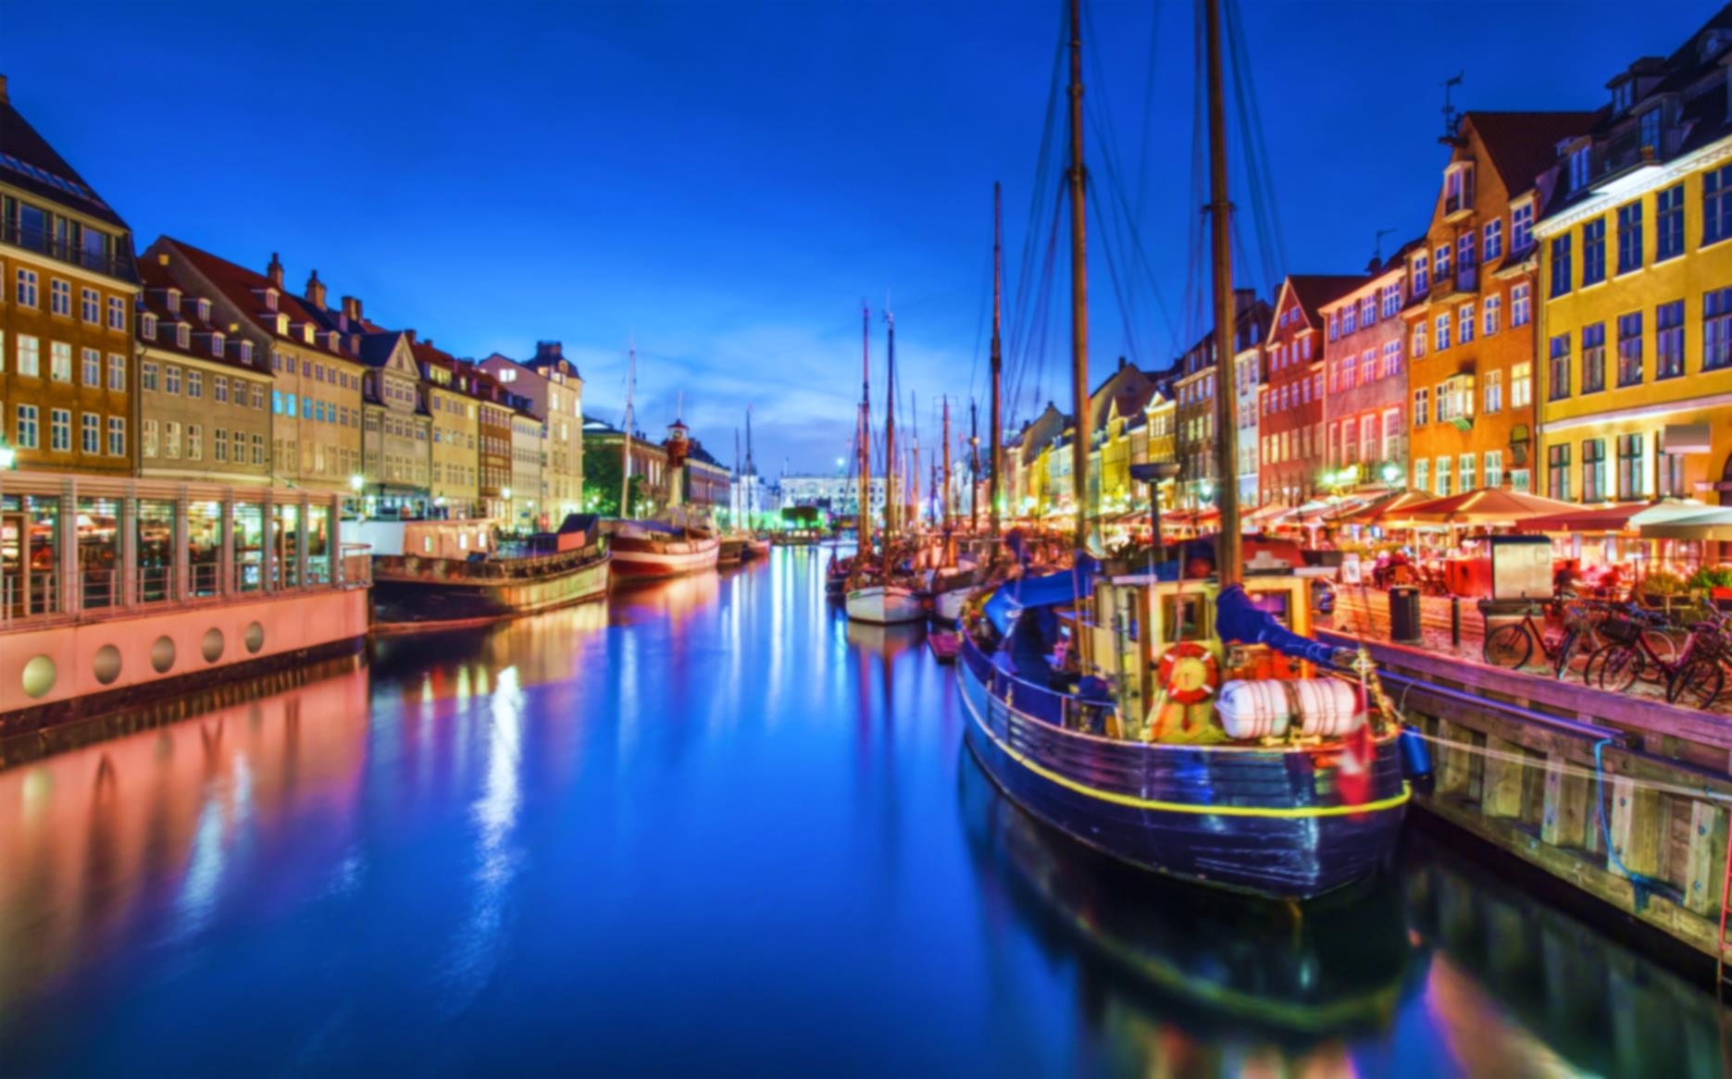
Capital

Slide 9
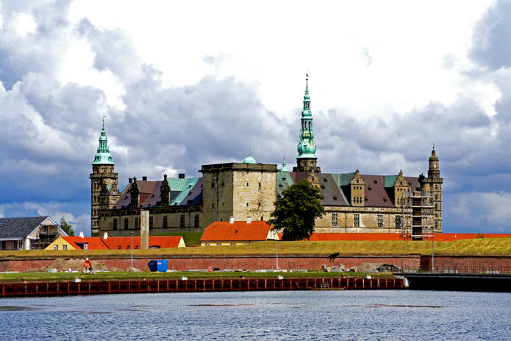

Slide 10
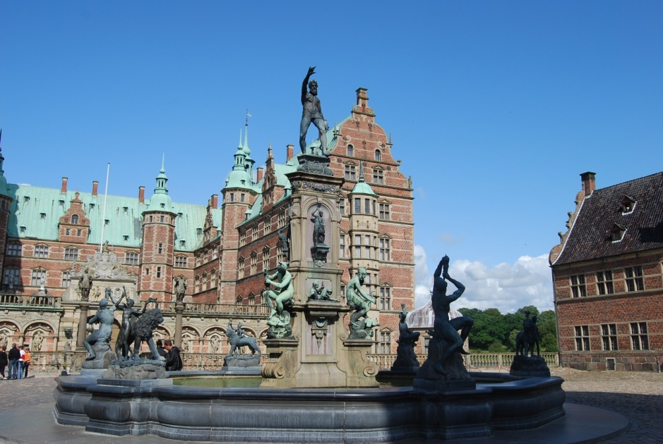

Slide 11
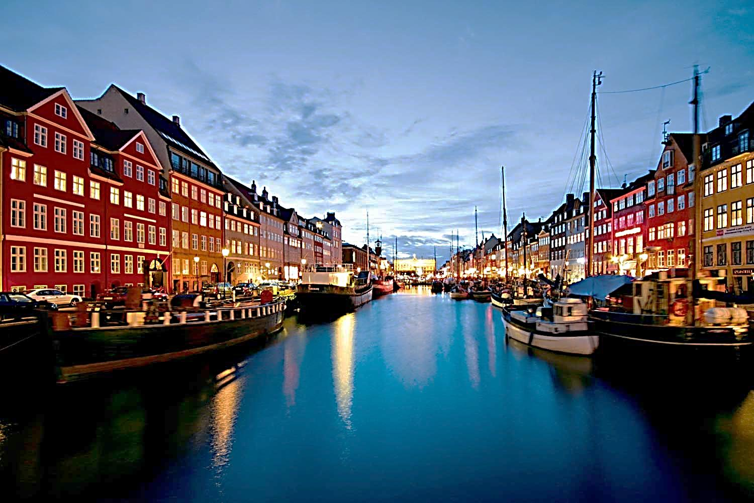
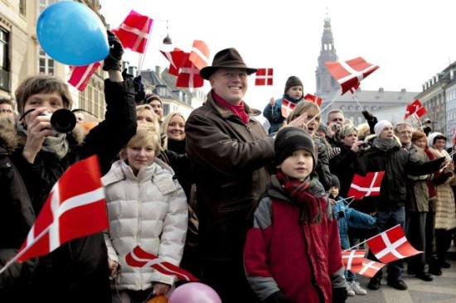
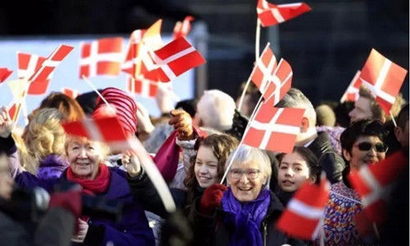
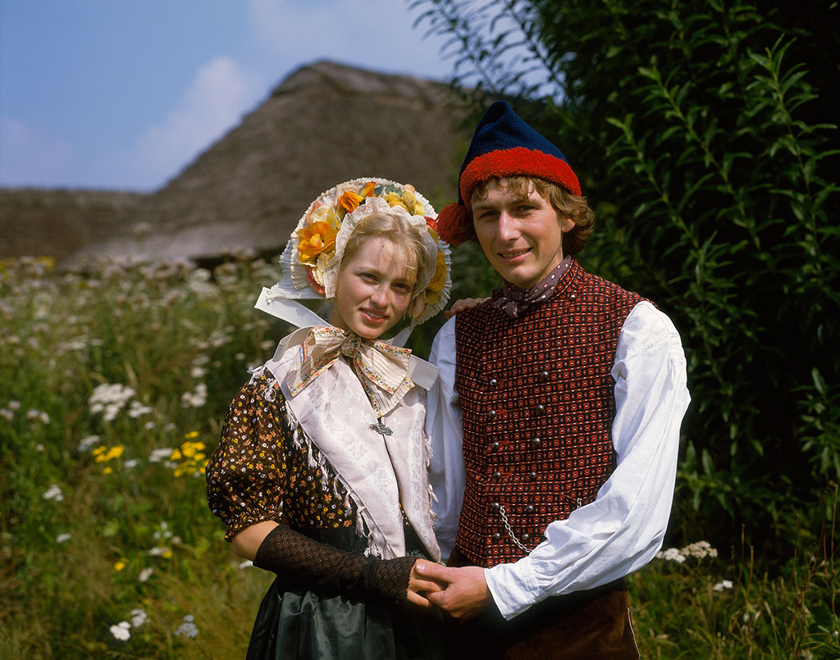
Population
5.66 million
113th in the world

Slide 12
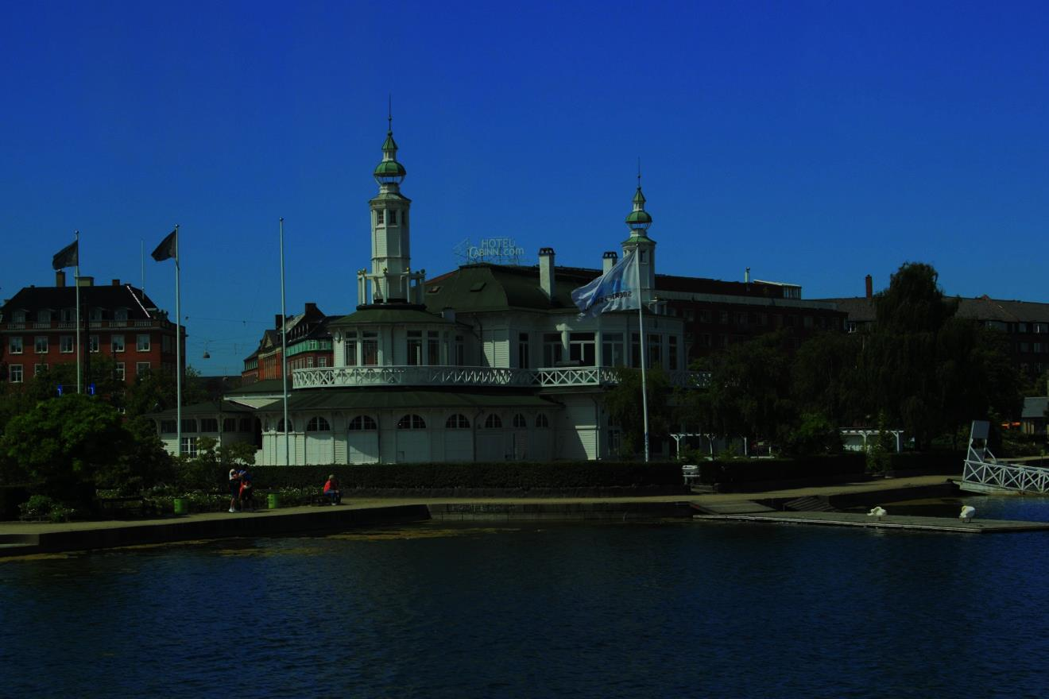
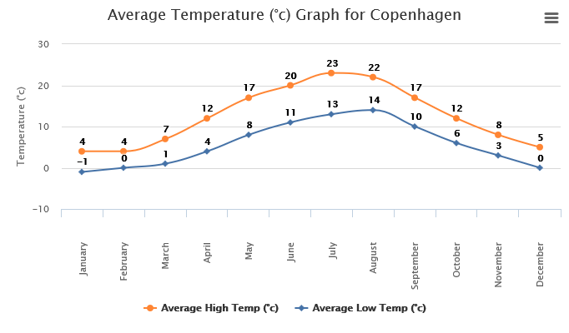
Weather
Temperature

Slide 13
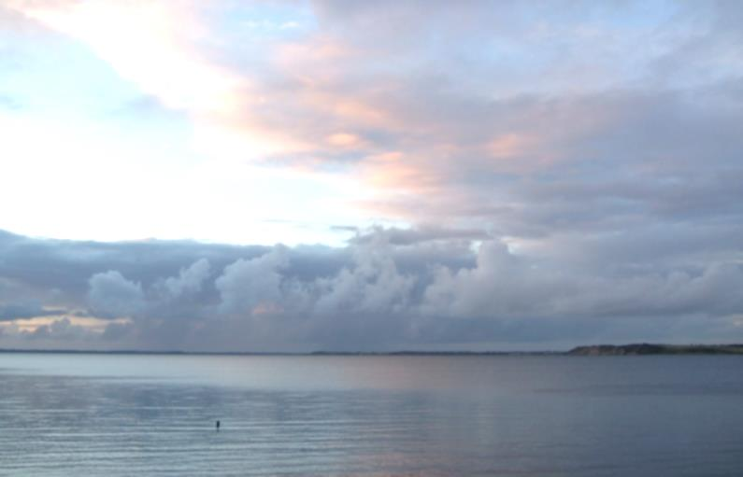
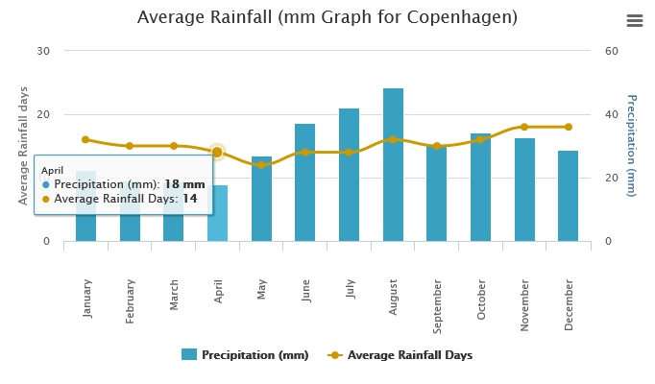
Weather
Rainfall

Slide 14
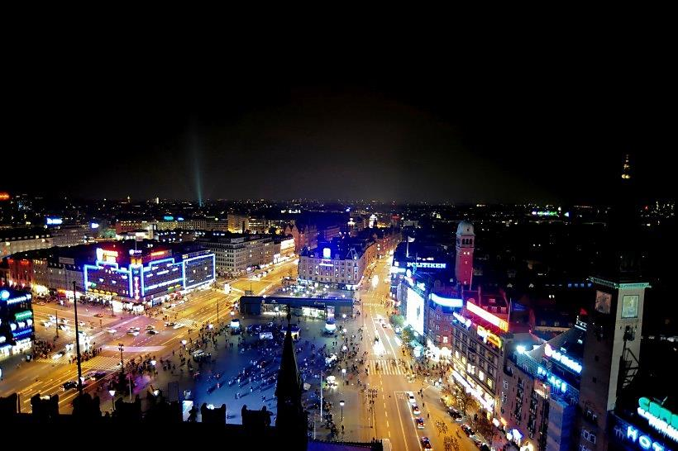
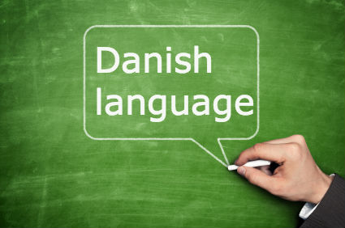
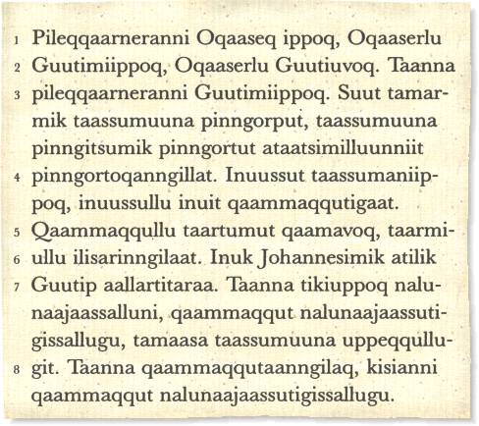
Language
Danish

Slide 15
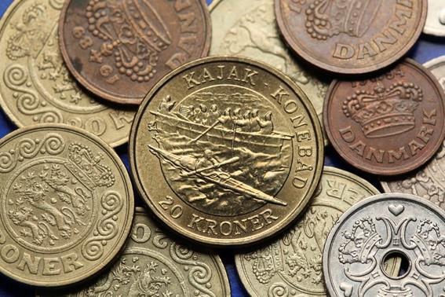
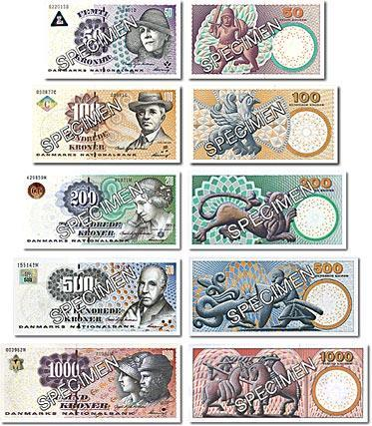
Currency
Krone

Slide 16
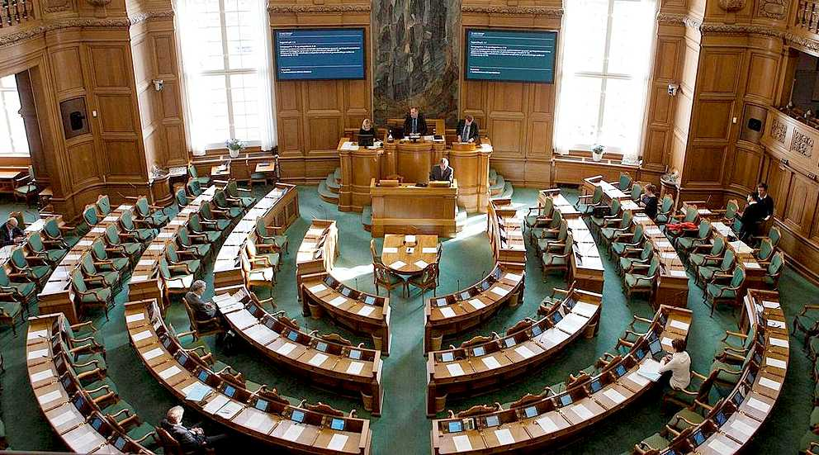
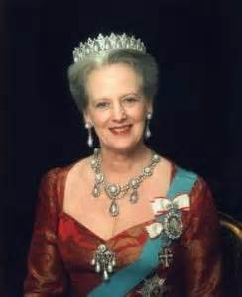
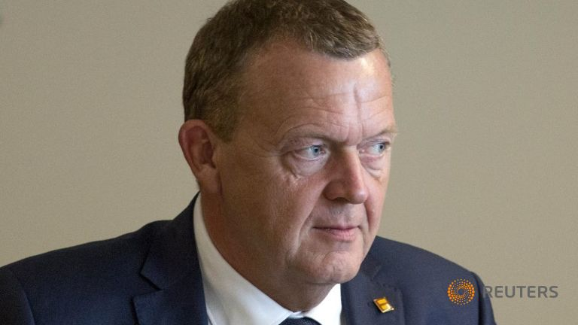
Politics
Queen Margrethe II
Prime ministerLars Løkke Rasmussen

Slide 17
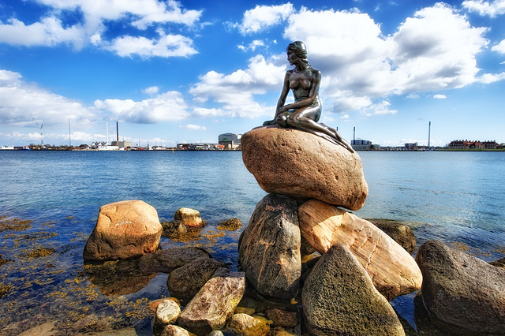
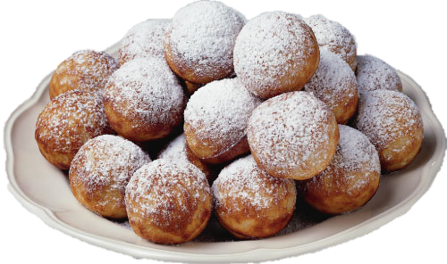
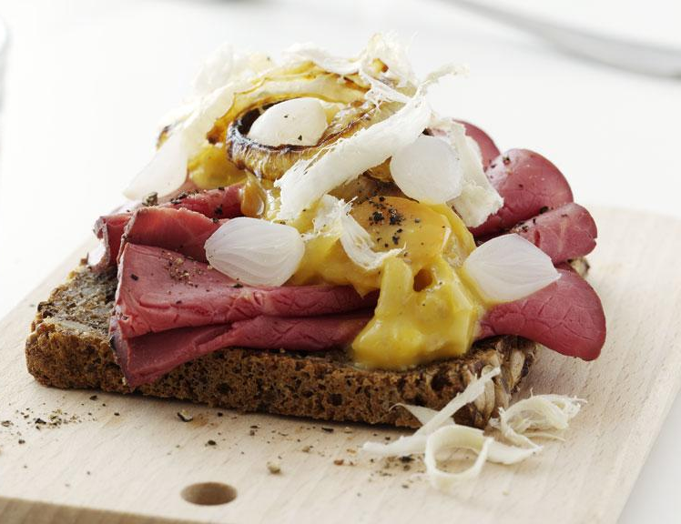
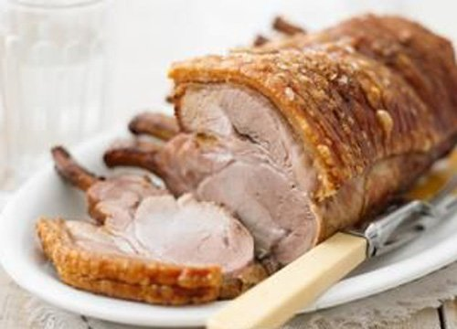
Culture
æbleskiver
smørrebrød
Roast pork with crackling

Slide 18
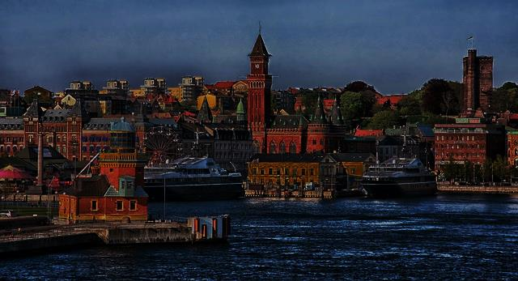
Economy and Industry
Agriculture
Fish Industry
Food Industry
Heavy/Light Industry
Software
International Trade

Slide 19
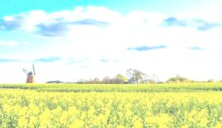

Agriculture
An agricultural giant

Slide 20
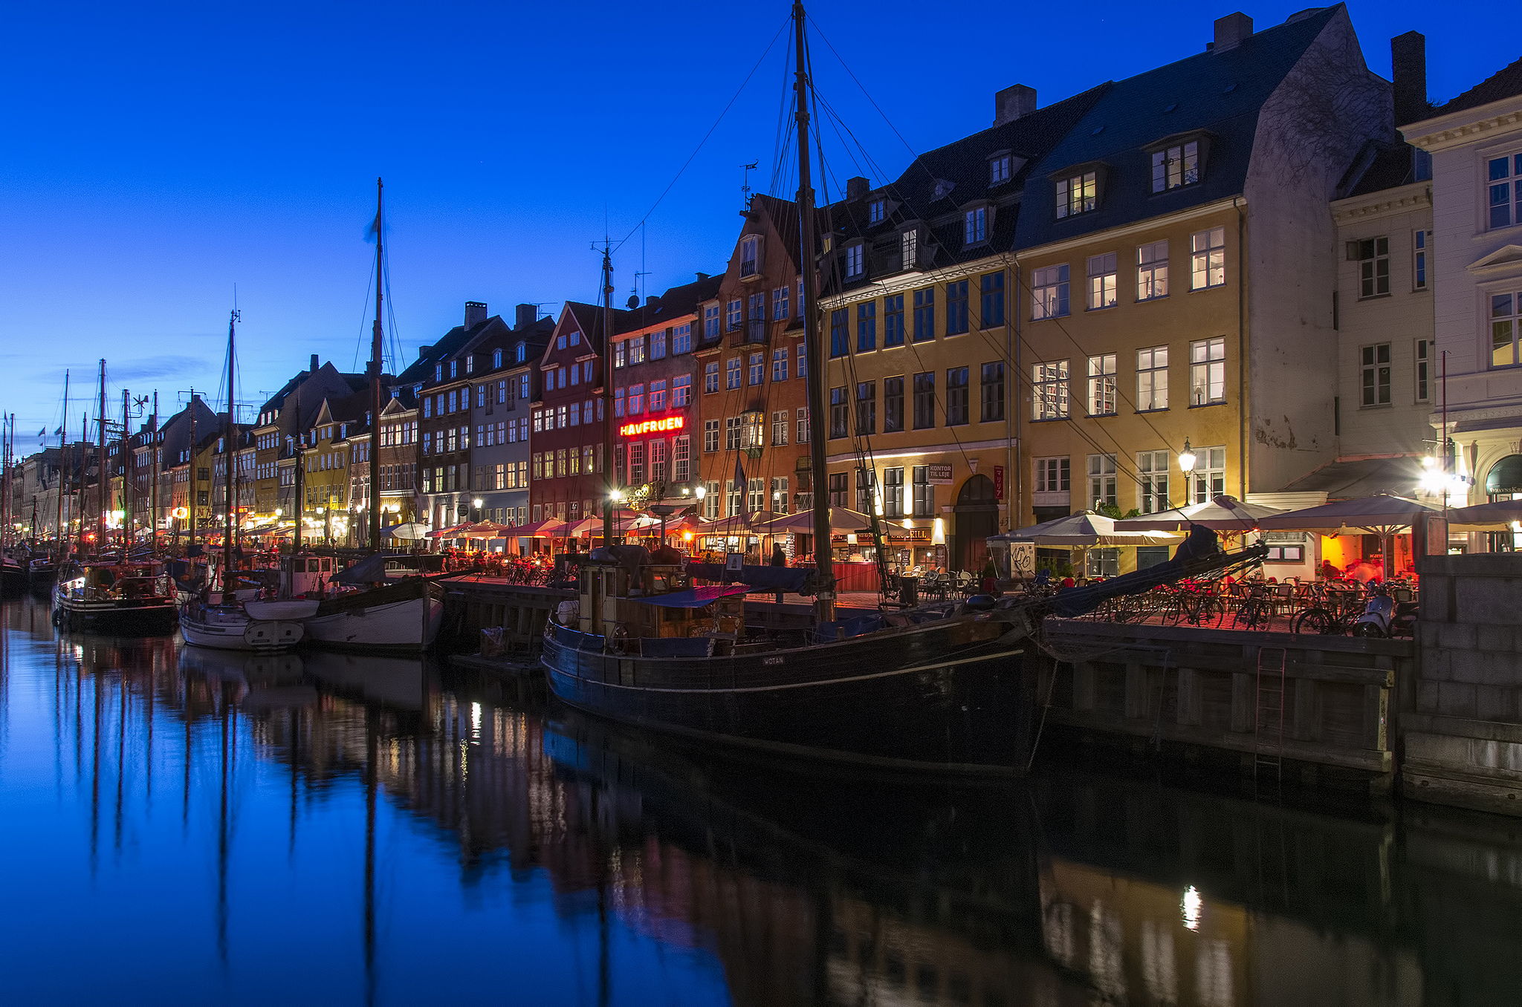
Farm products
made up 20% of the good exports
in 2011

Slide 21
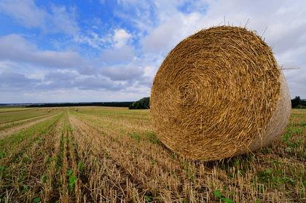
The value of food exports
22
16
4
EURO

Slide 22


Why
in a post-industrial economy,
is the food industry still thriving?

Slide 23
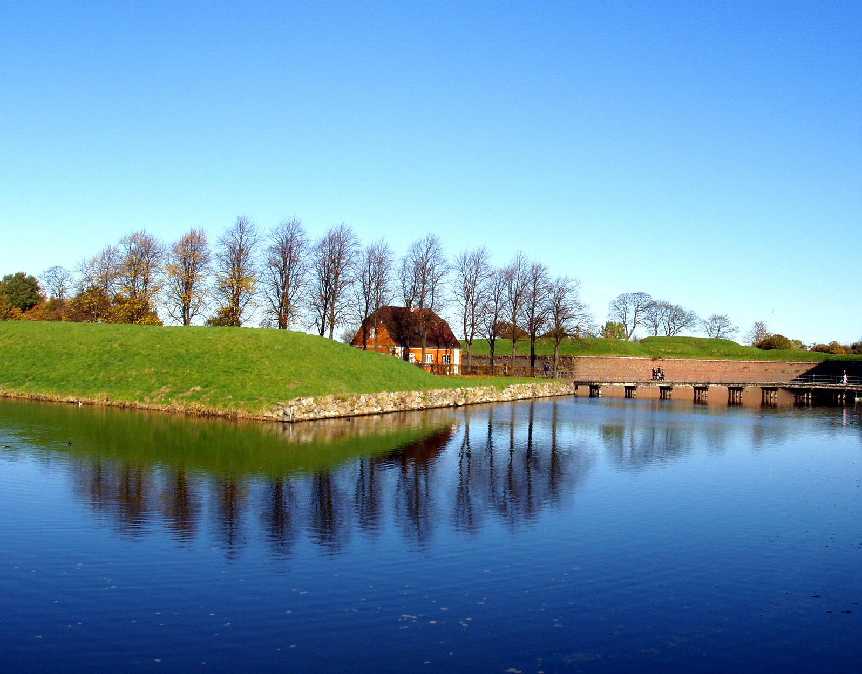




Slide 24
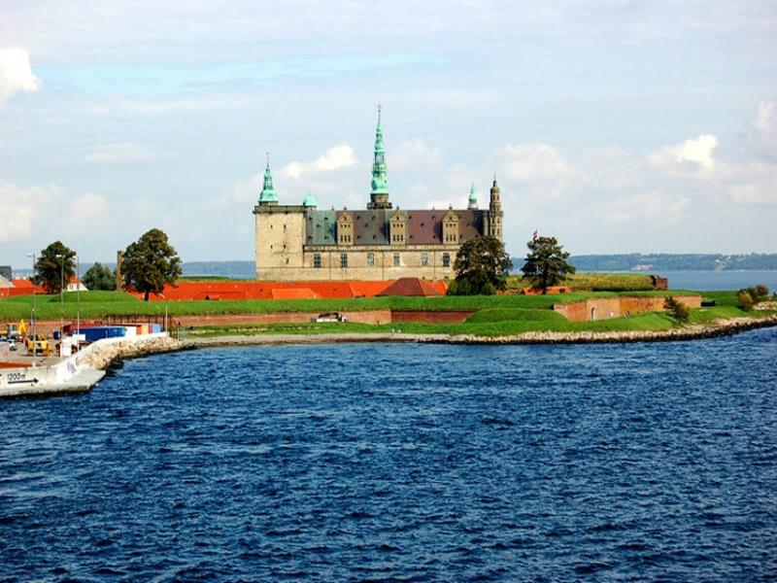

Fish Industry
Good Quality

Slide 25
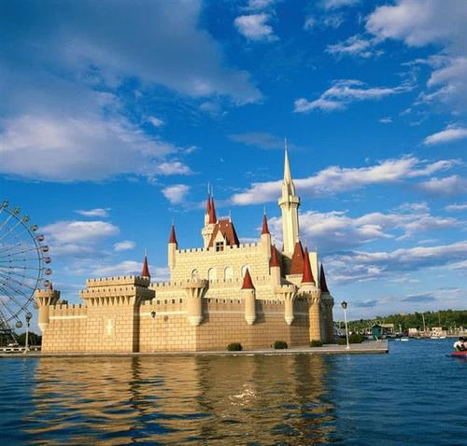

They make efforts to…
Scientific
research
Reform of the production history
Climate issue
Improving of fishing gear
diversity

Slide 26
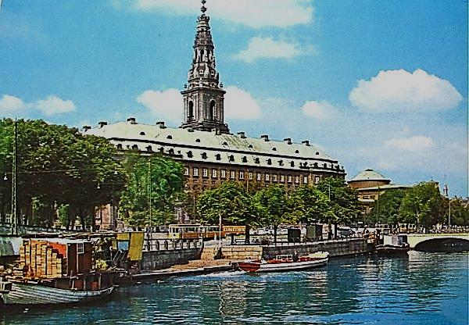
Heavy/Light Industry
Shipbuilding
Oil exploration
Power generation
Bridge construction
Furniture
Pharmaceuticals

Slide 27
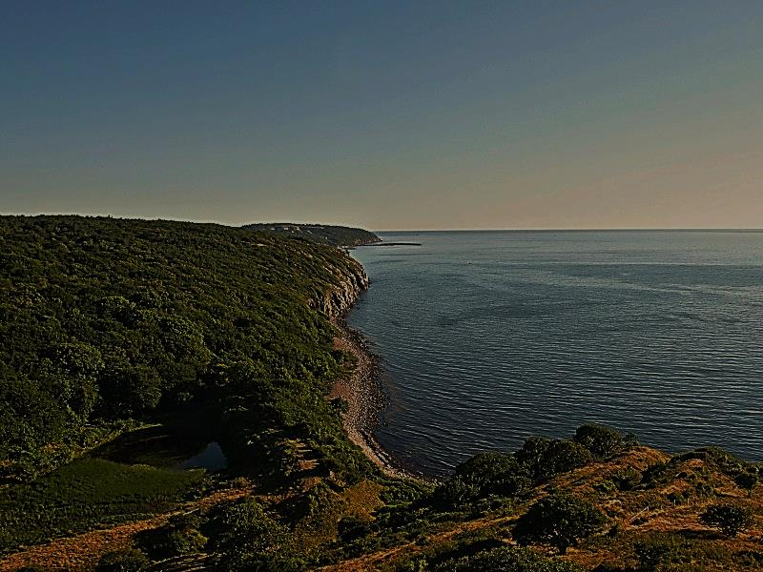
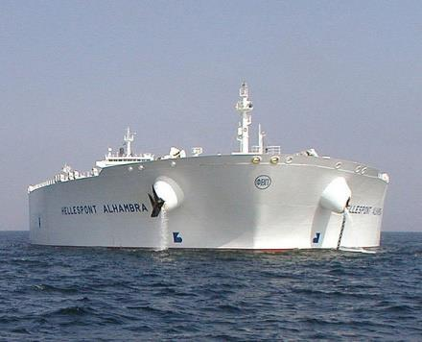
Shipbuilding
Collect-packing
Marine Technology
Supertanker
A.P.Moller-Maersk Group

Slide 28
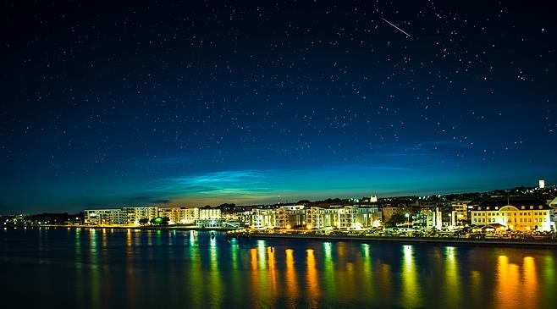
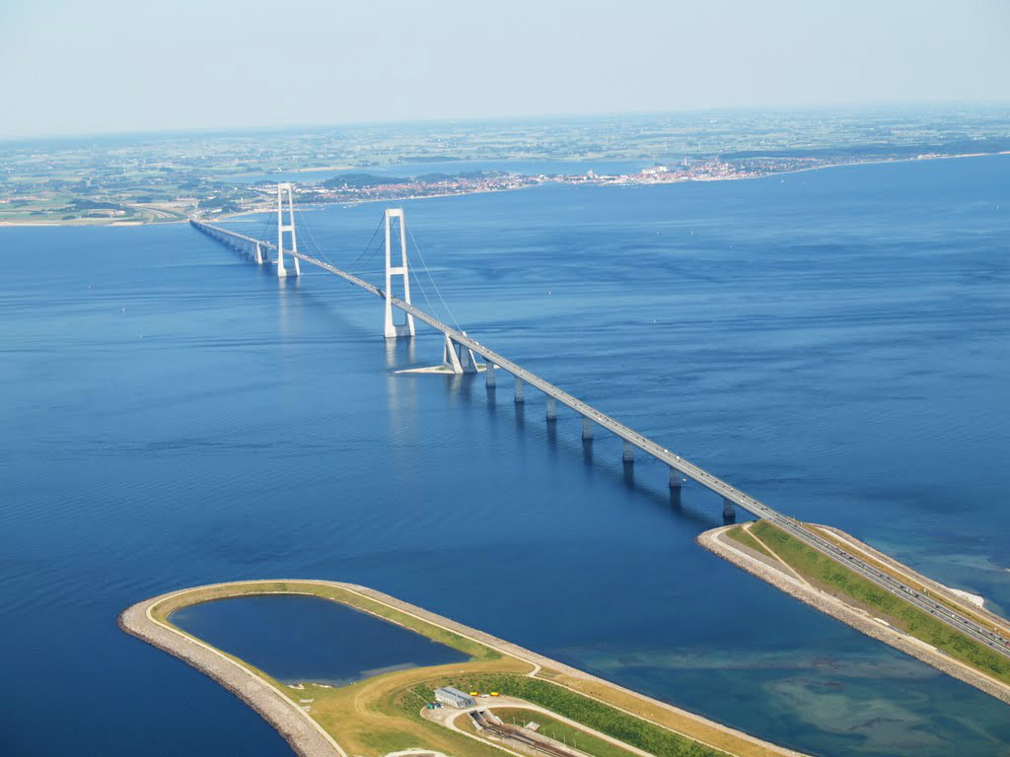
Bridge Construction
1624m
No.2
Storebæltsbroen

Slide 29

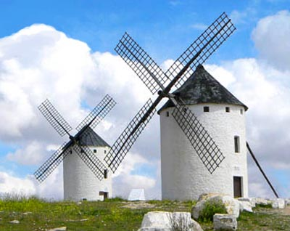
Energy Industry
Wind Power
film
Vesta +Siemens=40%

Slide 30






Sweden
Ireland
Norway
England
Germany
U.S.

Slide 31

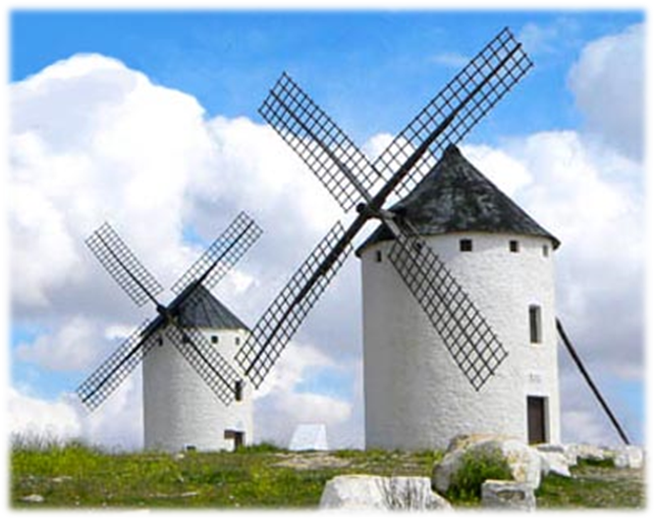
Wind Power
<0.03EUR/MW

Slide 32
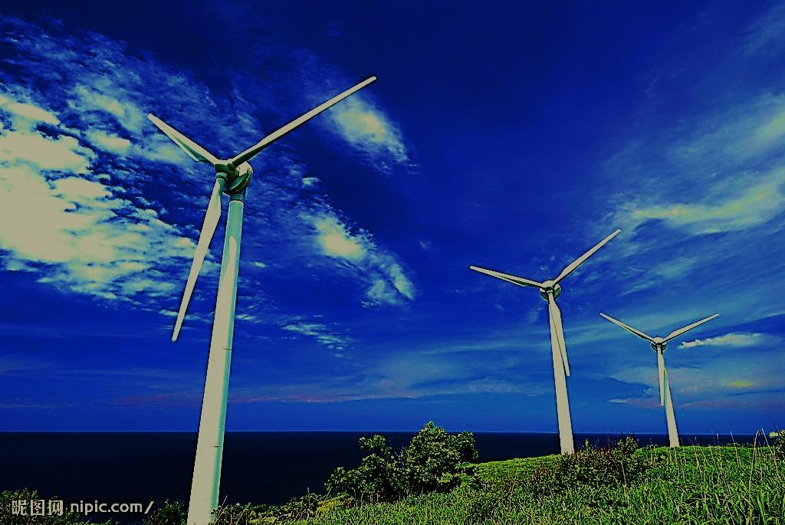
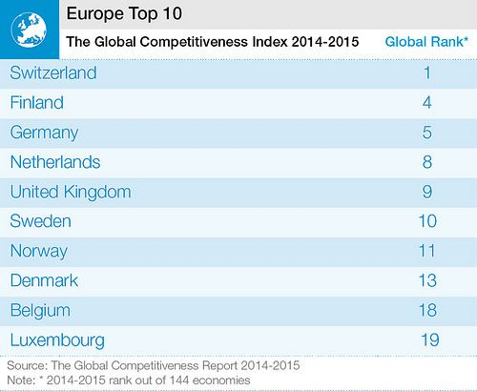

Slide 33

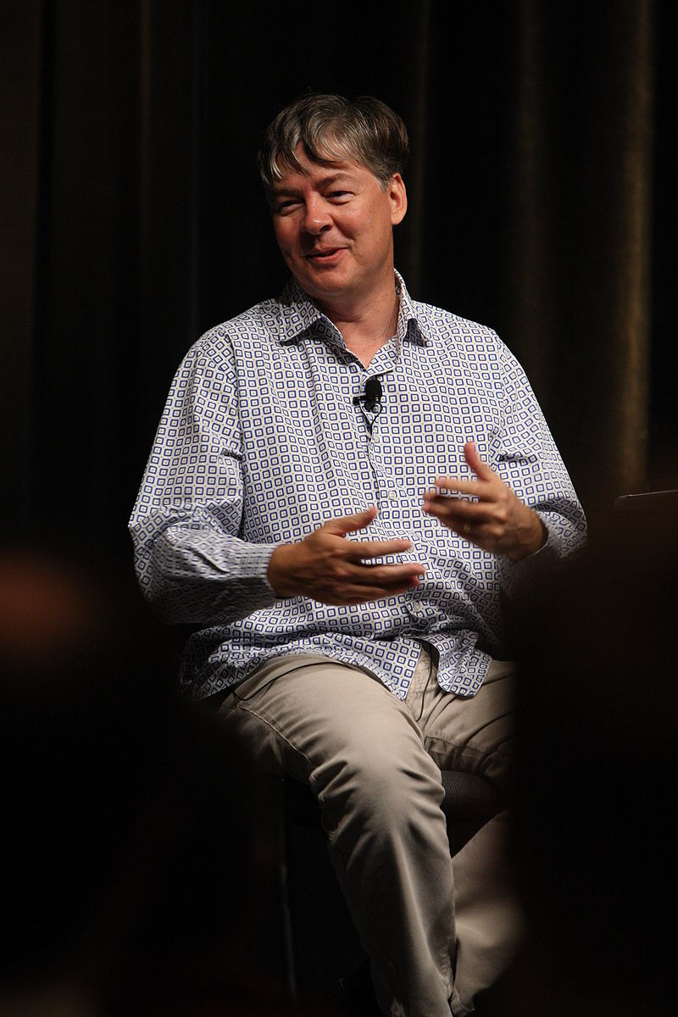
Software
C++ – Bjarne Stroustrup
PHP – Rasmus Lerdorf – Apply to Facebook,
Wikipedia,Wordpress,etc.
C# –Anders Hejlsberg

Slide 34

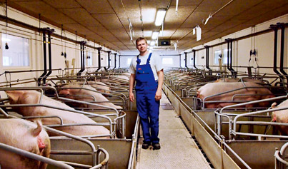
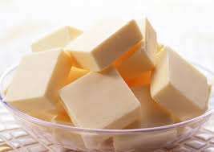

International Trade
EXPORT
Pork
Butter
Energy

Slide 35

Export

Slide 36

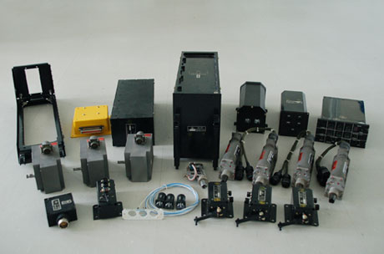

International Trade
IMPORT
Chemical
Electromechanical
Transportation

Slide 37

Import

Slide 38

Representative Company
The Founder
Profiles
Headquarter & Branches
Major Products
Relating Products
Number of Employees
Current & Future Plans

Slide 39



Slide 40

https://www.youtube.com/watch?v=fBvr289G3w8

Slide 41




The Founder
Ole Kirk Christiansen

Slide 42


Profiles
Founded in 1934
Lego ⇨ “Leg godt” ⇨ play well
Motto: “Only the best is good enough”
One of the world’s leading manufacturers of play materials

Slide 43







Headquarter＆Branches

Slide 44







Major Products

Slide 45






Relating Products

Slide 46


Number of Employees
17,294

Slide 47






Current ＆ Future Plans

Slide 48

Reference
https://www.google.com.tw/url?sa=i&rct=j&q=&esrc=s&source=images&cd=&cad=rja&uact=8&ved=&url=https%3A%2F%2Fwww.printsome.com%2Fblog%2F2016%2Fwork-uniforms-examples%2F&psig=AFQjCNFrgYoXZhQkYpl8c7S0fVXzDhVqFQ&ust=1462326528884254
http://www.lego.com/zh-cn/aboutus/news-room/2016/march/2015-annual-result
https://zh.wikipedia.org/wiki/%E6%A8%82%E9%AB%98%E9%9B%86%E5%9C%98
https://zh.wikipedia.org/wiki/Category:%E6%A8%82%E9%AB%98
http://www.aoyou.com/gaoduan/ProductDetail/85596
http://www.artisan.com.tw/blog/blog_article.aspx?article=120

Slide 49
https://en.wikipedia.org/wiki/Ole_Kirk_Christiansen
https://en.wikipedia.org/wiki/Lego#Robotics_themes
https://www.youtube.com/watch?v=fBvr289G3w8
http://lego.wikia.com/wiki/LEGO
https://en.wikipedia.org/wiki/The_Lego_Group
http://www.lego.com/en-us
http://tv.qpx.com/donghuazixun/62948.html
http://article.yeeyan.org/compare/393278
https://www.ofdc.org.tw/webs/fishinfoDetail.aspx?sn=37244

