Slide 1
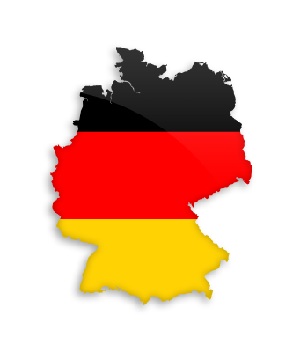
GERMANY
Emilia 10444003
Vicky 10444031
Fion 10444014
Jenny 10444034
Cora 10444035

Slide 2
Outline
Location
Industry
Export
Climate
Festival & Food
Education
History
Celebrity
Economy
Import
Representative Company

Slide 3
Location

Slide 4
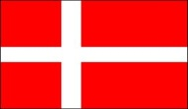
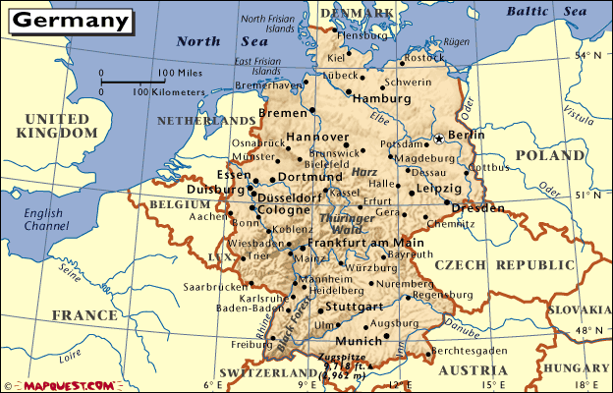


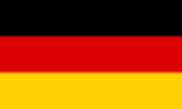
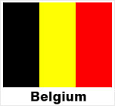






Slide 5
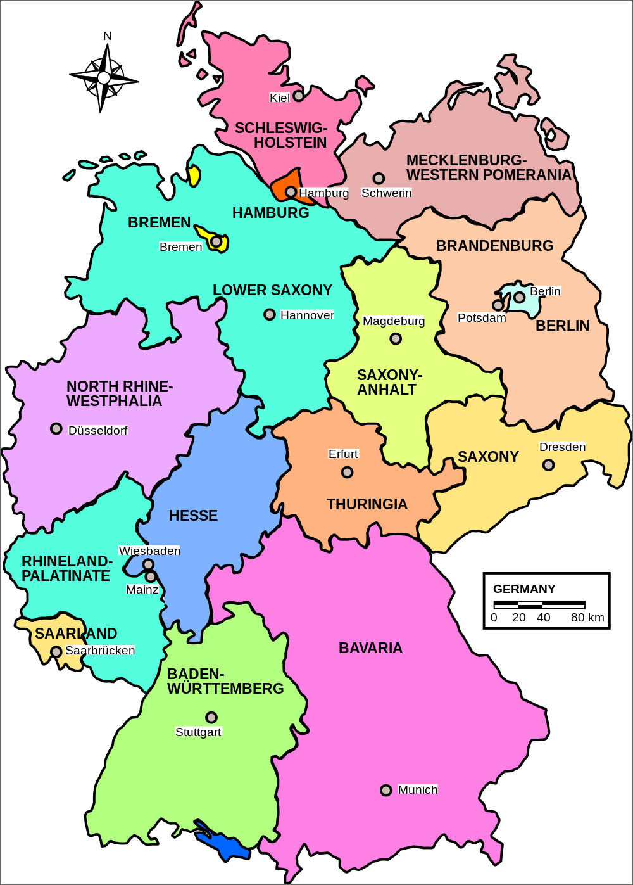
Berlin
Hamburg
Cologne
Munich
Frankfurt

Slide 6
Climate

Slide 7
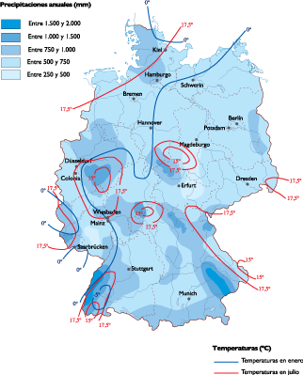
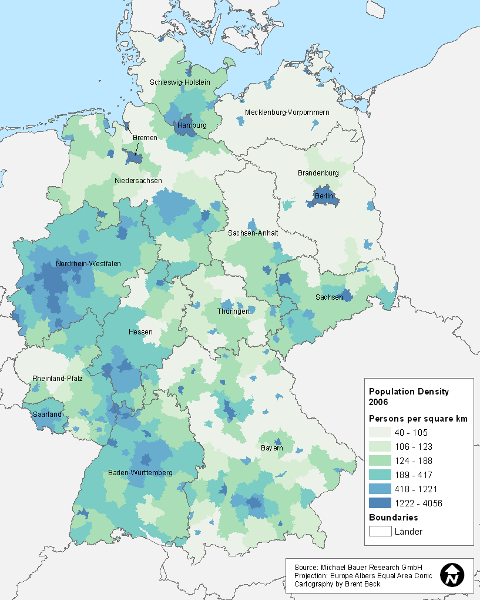
Rainfall

Slide 8

Average temperature
City/month | Jan | Feb | Mar | Apr | May | Jun | Jul | Aug | Sep | Oct | Nov | Dec
Berlin | 2 | 3 | 8 | 13 | 19 | 22 | 24 | 23 | 19 | 13 | 7 | 3
Hamburg | 2 | 3 | 8 | 13 | 18 | 22 | 23 | 23 | 19 | 13 | 7 | 4
Frankfurt | 3 | 5 | 11 | 16 | 20 | 23 | 25 | 24 | 21 | 14 | 8 | 4
Munich | 1 | 3 | 9 | 14 | 18 | 21 | 23 | 23 | 20 | 13 | 7 | 2

Slide 9
Festival & Food

Slide 10
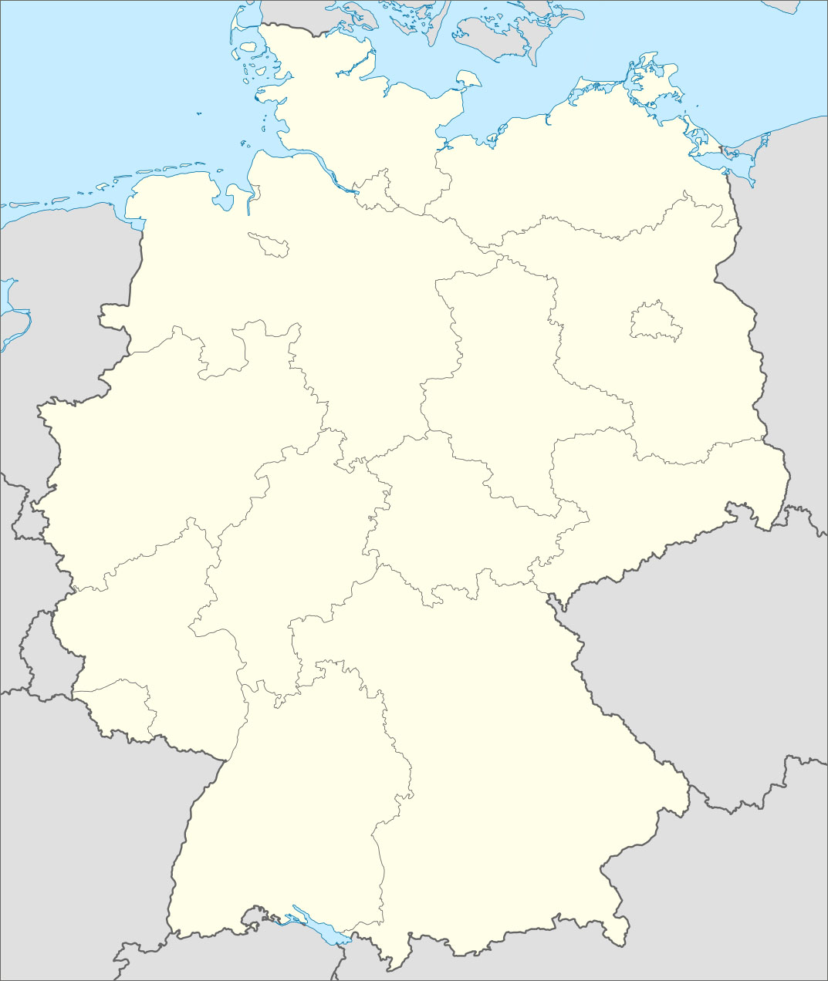
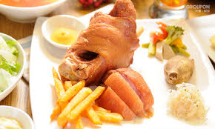
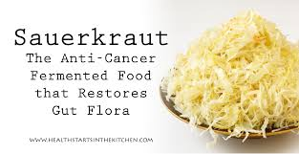
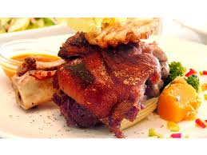
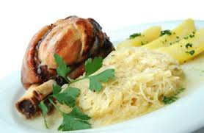
Eisbein
Sauerkraut
Schweinshaxe

Slide 11
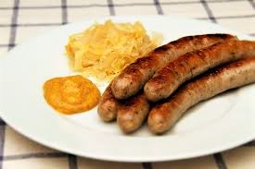
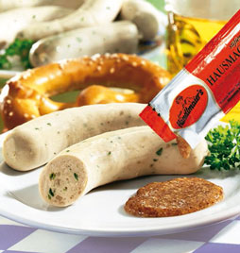
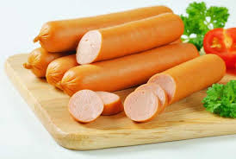
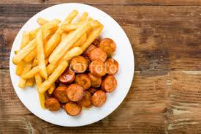
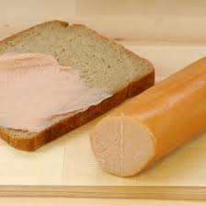
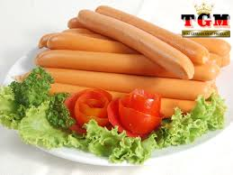
German sausage
Bratwurst
Weisswurst
Bockwurst
Currywurst
Teewurst
Frankfurter

Slide 12
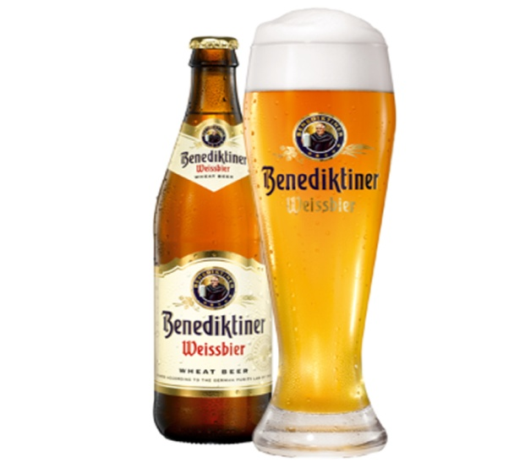
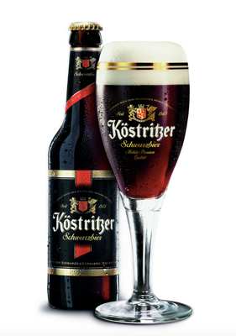
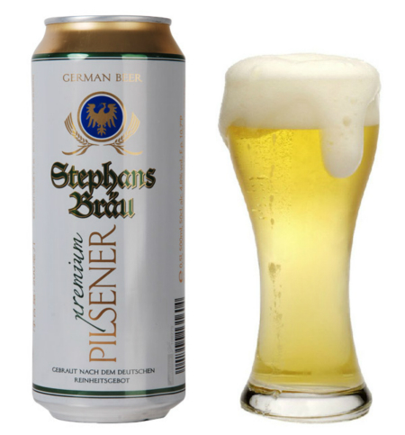
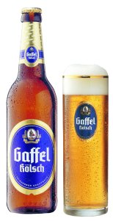
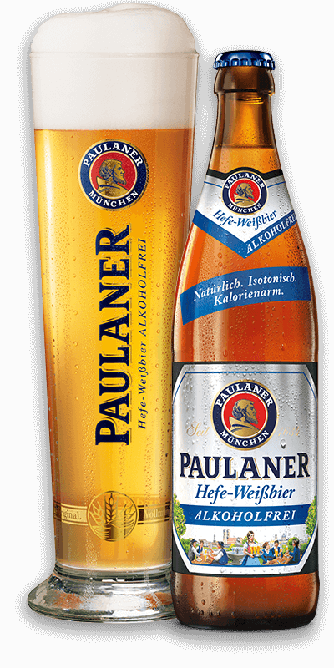
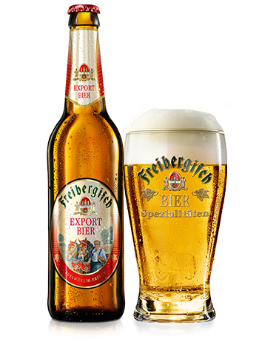
German beer
Weizenbier
Schwarzbier
Pils
Kolsch
Exportbier
Alkohofreies bier

Slide 13
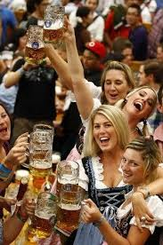
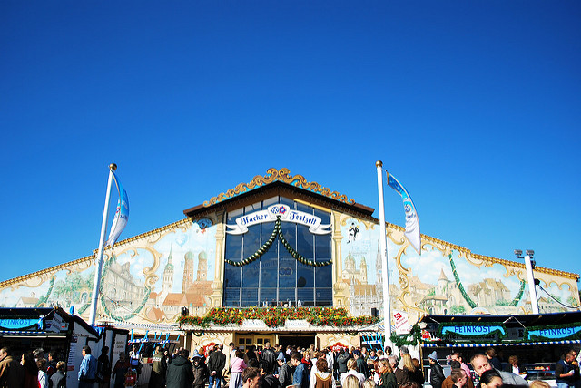
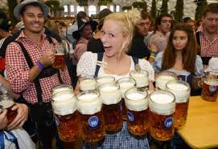
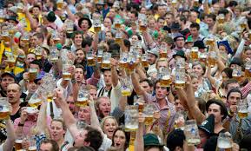
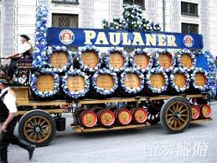
Munich Beer Festival

Slide 14

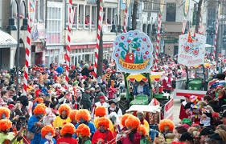
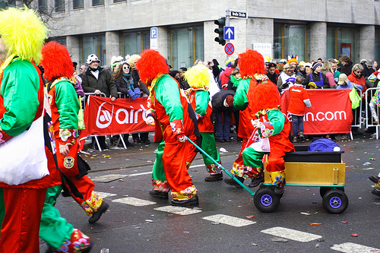
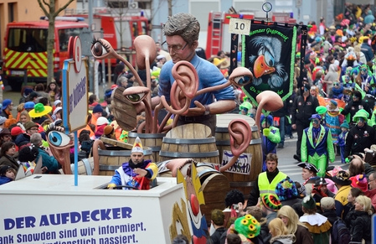
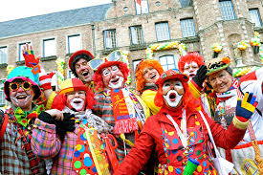
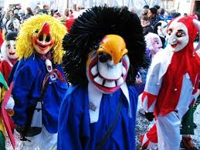
Cologne Carnival

Slide 15
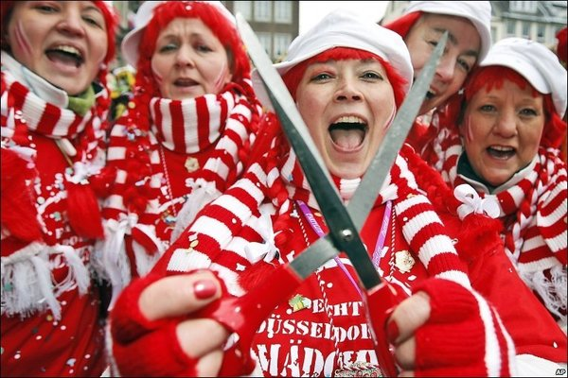
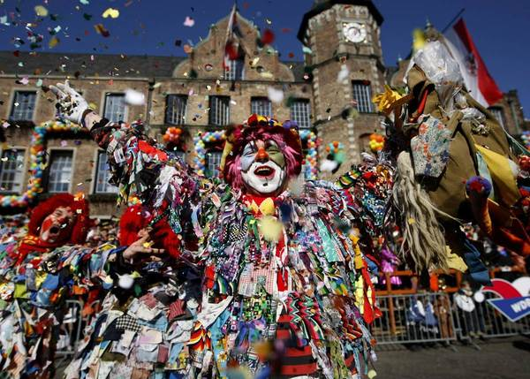
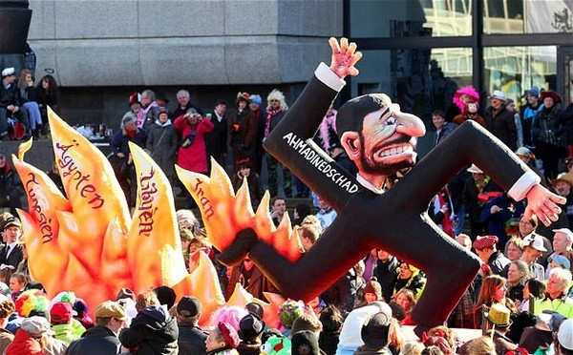
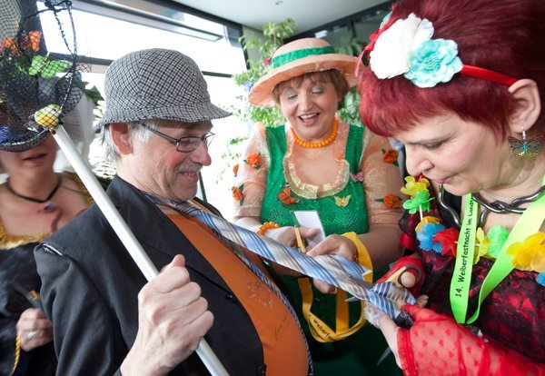
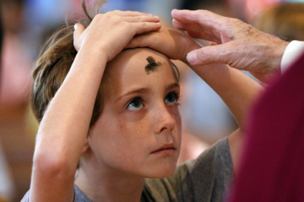
Women’s Carnival Day
Rose Monday
Ash Wednesday

Slide 16
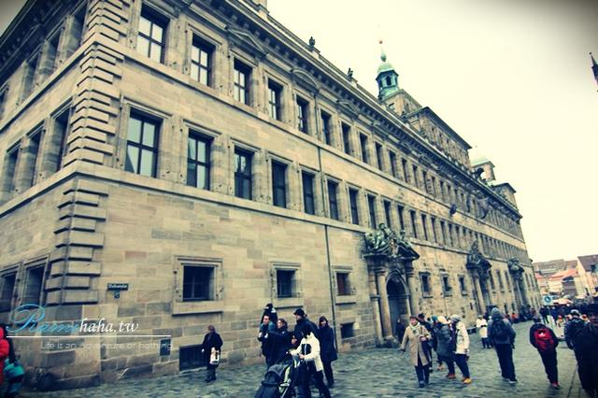
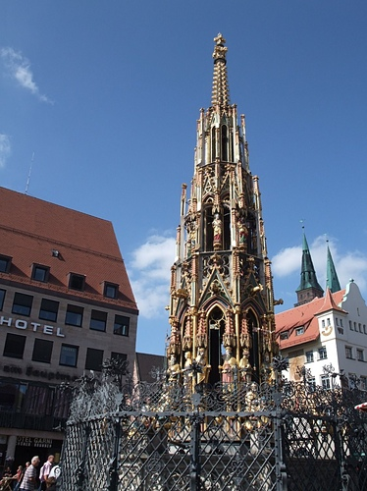
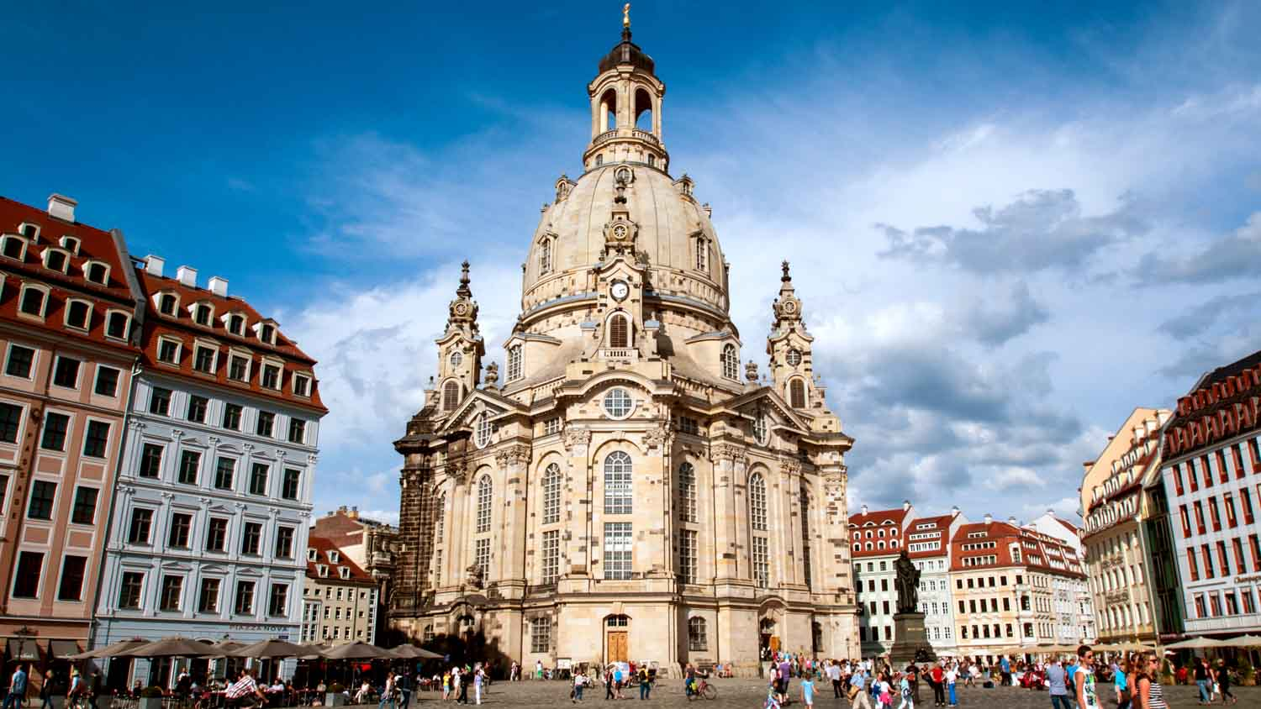
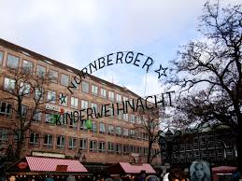
Nurnberg Christmas Market
Schöner Brunnen
Frauenkirche

Slide 17
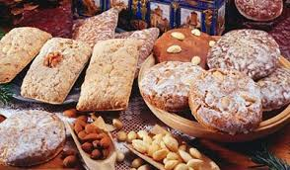
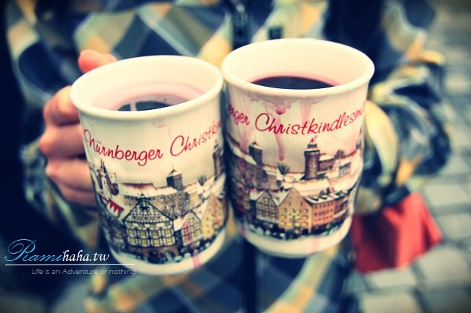
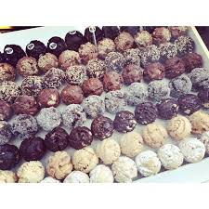
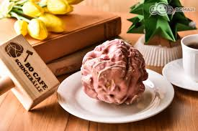
Glühwein
Glühwein ohne Alkohol
Lebzelten
schneeballe

Slide 18
Education

Slide 19


Slide 20



Slide 21

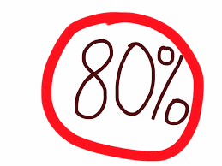

Hauptschule
(general school)
5 years

Slide 22
Gymnasium
(a type of school with a strong emphasis on academic learning)
5~10 grade
compulsory education
11~13 grade
non-compulsory education

Slide 23

Realschule
(a type of secondary school in Germany)
Professional college
Gymnasium
University

Slide 24


6 years

Slide 25


University
University of Applied Science
The academy of music and art

Slide 26
History

Slide 27
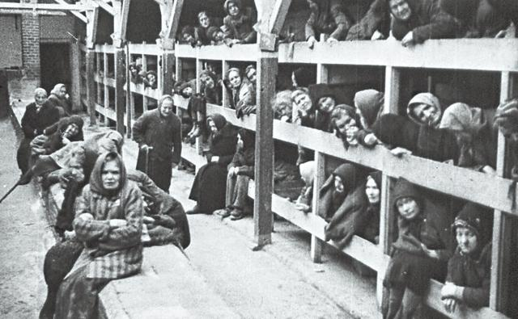
The Holocaust
Adolf Hitler's Nazi Germany and its collaborators killed about six million Jews.
The victims included 1.5 million children and represented about two-thirds of the nine million Jews who had resided in Europe.

Slide 28

Mein Kampf
My struggle is an autobiography by the National Socialist leader Adolf Hitler, in which he outlines his political ideology and future plans for Germany.

Slide 29


Berlin Wall

Slide 30
Celebrity

Slide 31

Albert Einstein
He was a German-born theoretical physicist. He developed the general theory of relativity, one of the two pillars of modern physics (alongside quantum mechanics)

Slide 32

Angela Dorothea Merkel
A German politician and former research scientist. Merkel has been the Chancellor of Germany since 2005, and the leader of the Christian Democratic Union (CDU) since 2000.

Slide 33
Economy
the largest national economy in Europe.
The forth largest exporter in the world.
Trade organizations: EU, WTO, UN,NATO,OSCE,IMF,G8
Germany is Europe 's largest industrial countries

Slide 34

GDP

Slide 35



Slide 36
Germany-Industry
Notes:
Agriculture: potatoes, wheat, barley, sugar beets, fruit, cabbages; milk products; cattle, pigs, poultry
Industries: among the world's largest and most technologically advanced producers of iron, steel, coal, cement, chemicals, machinery, vehicles, machine tools, electronics, automobiles, food and beverages, shipbuilding, textiles

Slide 37
Automobile Industry
Audi
Alpina
Benz
BMW
Maybach
Porsche

Slide 38

Germany-Export
Exports:
$1.292 trillion (2015 est.)
$1.492 trillion (2014 est.)
country comparison to the world: 4
Exports - commodities:
motor vehicles, machinery, chemicals, computer and electronic products, electrical equipment, pharmaceuticals, metals, transport equipment, foodstuffs, textiles, rubber and plastic products

Slide 39
Exports – partners
2014

Slide 40

Germany-Import
Imports:
$983.9 billion (2015 est.)
$1.188 trillion (2014 est.)
country comparison to the world: 4
Imports – commodities:
machinery, data processing equipment, vehicles, chemicals, oil and gas, metals, electric equipment, pharmaceuticals, foodstuffs, agricultural products.

Slide 41
Imports – partners
Netherlands 13.8%
France 8%
China 6.6%,
Belgium 6.3%
Italy 5.4%
UK 4.8%
Poland 4.6%
Czech Republic 4.4%,

Slide 42

Bavarian Motor Works
BMW

Slide 43



Industry & Product - Automotive, motorcycle
Predecessor - Bayerische Flugzeugwerke AG
Founded in Munich ,1917
Founder - Franz Josef Popp
Key person - Norbert Reithofer
Acquisition of Rover Group in 1994
Acquisition of Rolls-Royce in 2003

Slide 44



History
1917
1923
1929
Treaty of Versailles
NT$4,170,000
NT$610,000

Slide 45

SoldCars in brands
BMW | 1,743,194
Mini | 358,965
Motorcycles | 136,963
RollsRoyce | 1,015
Total | 2,247,485
Total Revenue (€) | 92,175,000,000

Slide 46


Employees
In Germany | 95,973
In International | 26,271
Total Employees | 122,244

Slide 47

Research&Develpoment

Slide 48

Sold Cars in regions

Slide 49






Impressive Cars & Motor

Slide 50




Impressive Cars & Motor

Slide 51





Slide 52

Future Plan
Mobility → versatile and tailor-made
Connectivity → second nature
Technology → human
Energy → emission-free
Responsibility → diverse

Slide 53
Reference
https://en.wikipedia.org/wiki/Germany
http://www.young-germany.de/topic/study/the-german-school-system-explained
http://www.economywatch.com/world_economy/germany/export-import.html
https://en.wikipedia.org/wiki/BMW

Slide 54


