Slide 1
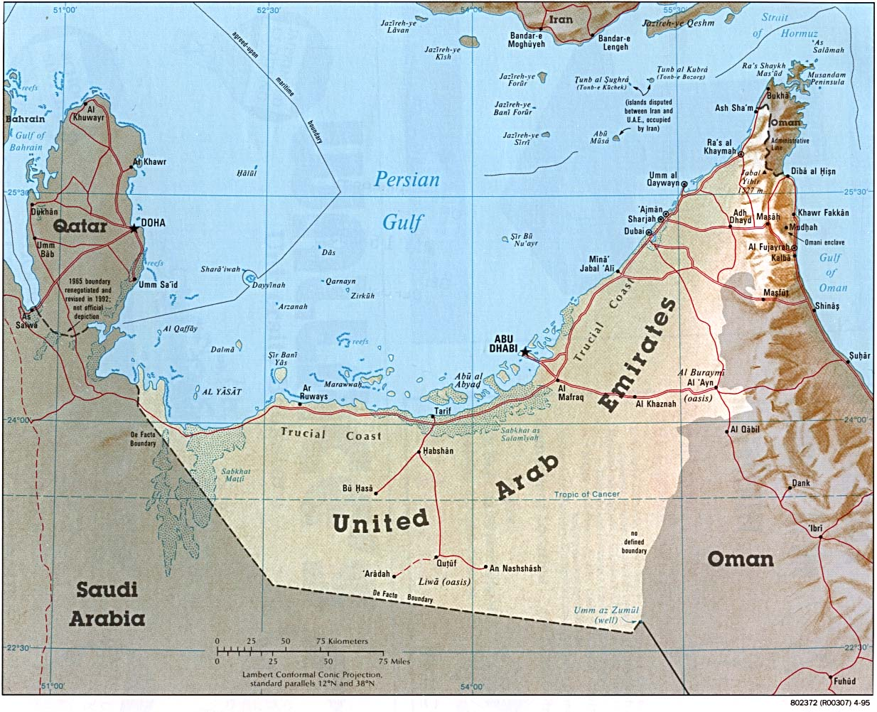
United Arab Emirates
Members：
10044050 高嘉宏 Kartal
10444005 曾若瑄 Audrey
10444018 李婕瑜 Teresa
10444024 黃詩婷 Tina
10444028 陳雯宣 Ritisy

Slide 2
Outline
Overview
Economy
Representative company-Emirates
Reference

Slide 3
Overview
Tina
Ritisy

Slide 4
Overview
Structure
Capital
Weather
Population
Language
Geography
Politics
Religion

Slide 5
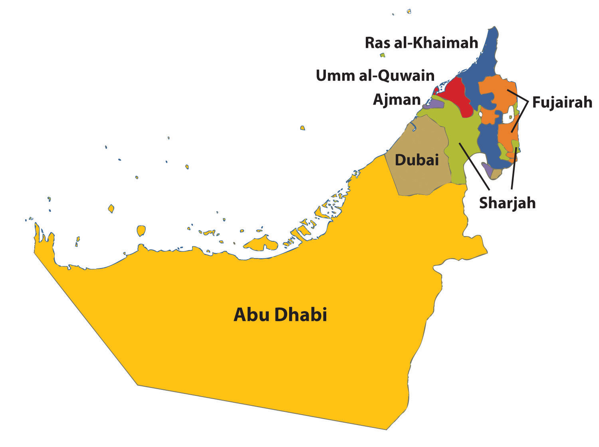
Structure
a federation of seven emirates

Slide 6
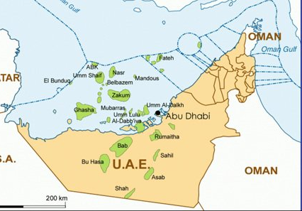
Capital - Abu Dhabi
the largest emirate by area
the largest population
the largest oil production
90%

Slide 7
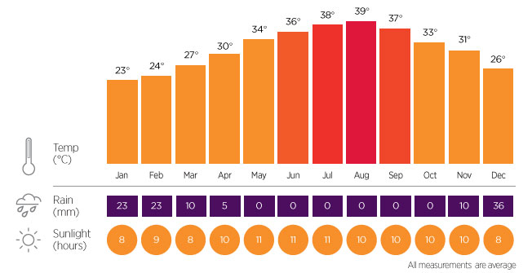
Weather
Notes:
https://en.wikipedia.org/wiki/Climate_of_Dubai

Slide 8
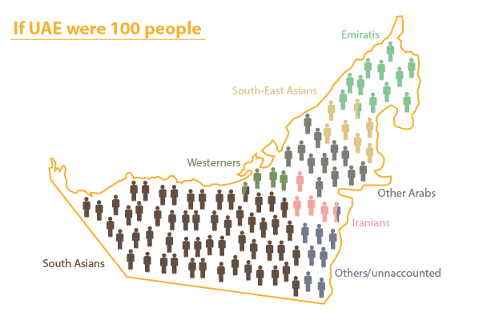
Population

Slide 9




Language
Arabic
English
Arabic English

Slide 10
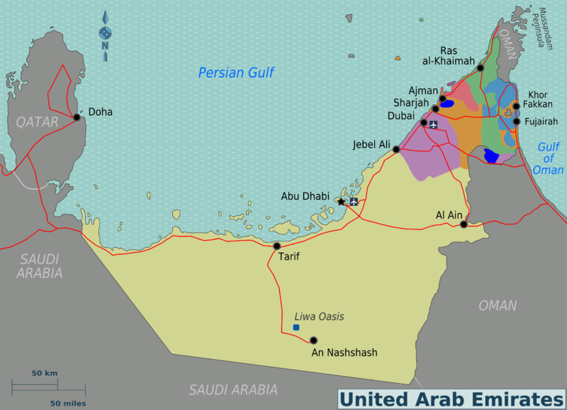
Geography
situated in Middle East
bordering the Gulf of Oman and the Persian Gulf
between Oman and Saudi Arabia
Desserts. Dune. Mountain

Slide 11

Politics
Constitutional monarchy
Responsibilities are reserved to the emirates
Autocracy

Slide 12
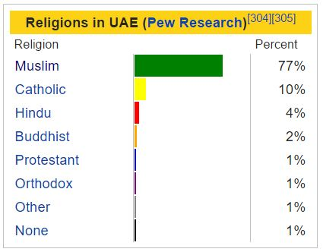
Religion

Slide 13
Economy
Audrey
Teresa

Slide 14
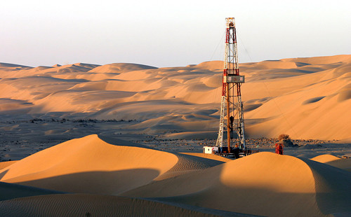
Currency
Petroleum And Natural Gas
GDP
The World’s Third Largest Re-export Center

Slide 15
Main Economic Indicators
98.3%
 | 2013 | 2014 | 2015
Population | 30,000,000 | 30,100,000 | 31,400,000
GDP(hundred mil) | 7,440 | 7,520 | 3,490
Average GDP(USD) | 24,816 | 24,454 | 20,677
GDP Growth Rate(%) | 2.7 | 3.6 | 3.0
Inflation Rate(%) | 3.5 | 2.7 | 2.0
Export(hundred mil) | 3,759.01 | 3,423.24 | 2,217.87
Export Growth Rate(%) | -3.2 | -8.9 | -35.2
Import(hundred mil) | 1,533.44 | 1,584.62 | 1,587.49
Import Growth Rate(%) | +8.1 | +3.3 | +0.2
Exchange Rate(%) | 3.75 | 3.75 | 3.75

Slide 16
Trade
Industry Diversification
GCC (Gulf Cooperation Council)

Slide 17
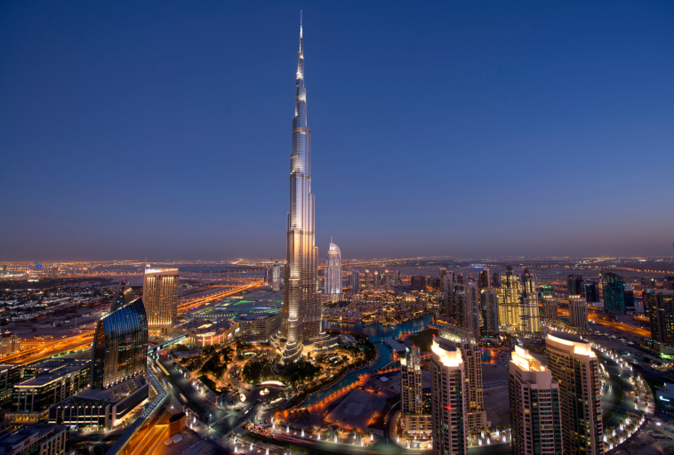
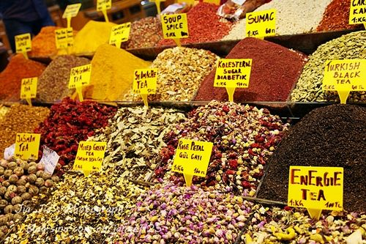
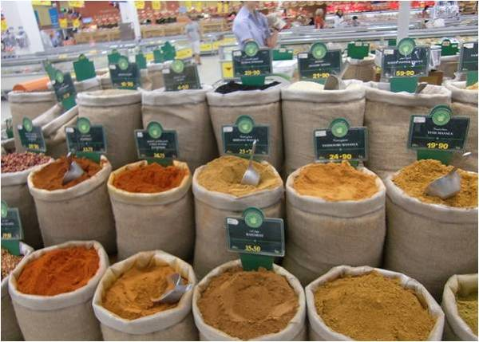
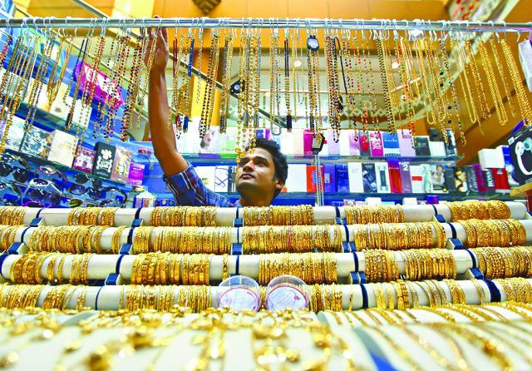
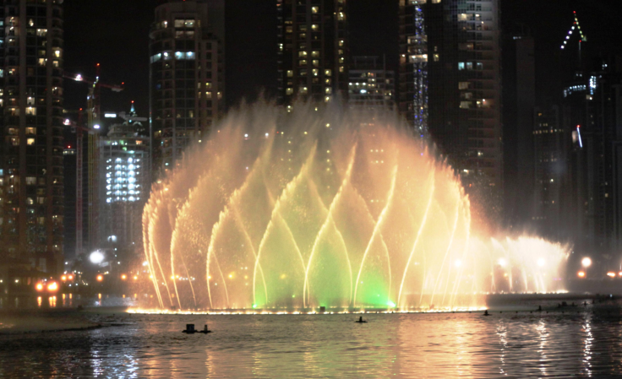
Tourism-Dubai
Burj Khalīfa
Spice Bazaar
Gold
Dubai Fountain

Slide 18
Representive company
Emirates
Kartal

Slide 19

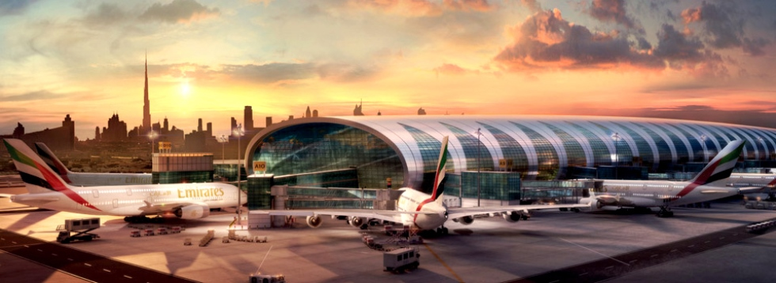
1985

Slide 20
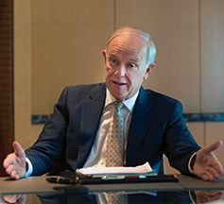
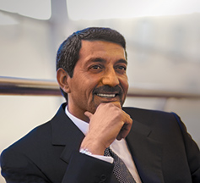
CEO
Chairman
Tim Clark
Sheikh Ahmed bin Saeed Al Maktoum

Slide 21
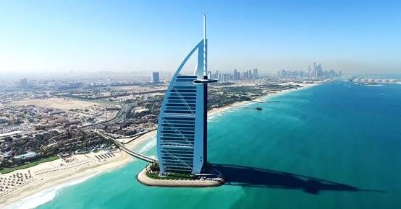
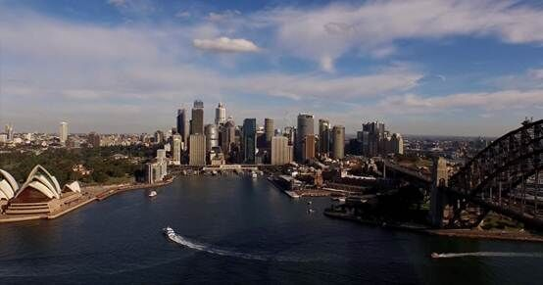
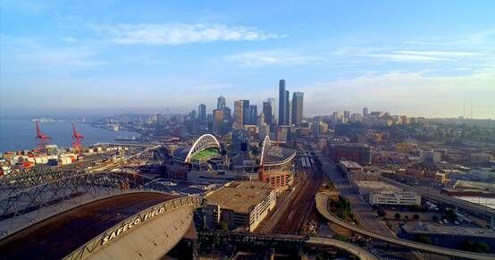
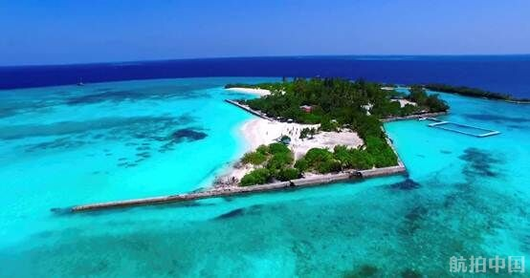
Navigable city
142 cities

Slide 22
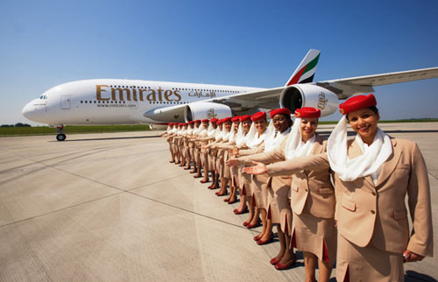
Company slogan
Fly Emirates. Hello Tomorrow.

Slide 23
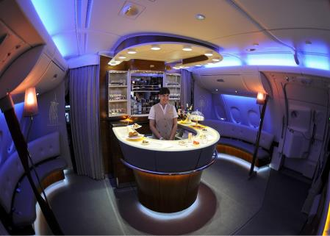
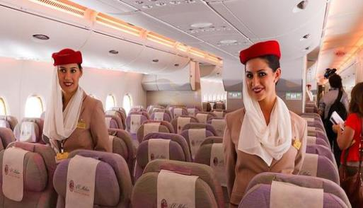


Why Emirates can success?
The industry's best quality of service

Slide 24
Reference
http://www.eximclub.com.tw/countries/information-02c.asp?idno=2216&continen=4&country=%AA%FC%A9%D4%A7B%A4j%A4%BD%B0%EA
http://www.emirates.com/cn/chinese/about/#/2308592
http://blog.xuite.net/tva0379/twblog/237096624-267
https://zh.wikipedia.org/wiki/%E9%98%BF%E8%81%94%E9%85%8B%E8%88%AA%E7%A9%BA
https://www.youtube.com/watch?v=LMg-J4v8vr8

Slide 25
Thanks for your attention!

