Slide 1

Italy
Group 5
Members:
10444001 Willy, 10444007 Anny
10444008 Candy, 10444039 Sylvia
10444040 Janice
Date: 105/05/24

Slide 2





Slide 3
Outline
Overview – Willy & Janice
Let’s Learn Italian – Candy
Economy – Anny
Industry – Anny & Candy
Representative Company – Sylvia
Conclusion – Sylvia

Slide 4
Overview

Slide 5
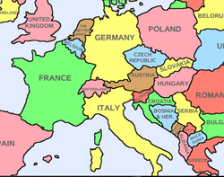

Borders
Switzerland
Austria
ITALY
France
Slovenia

Slide 6
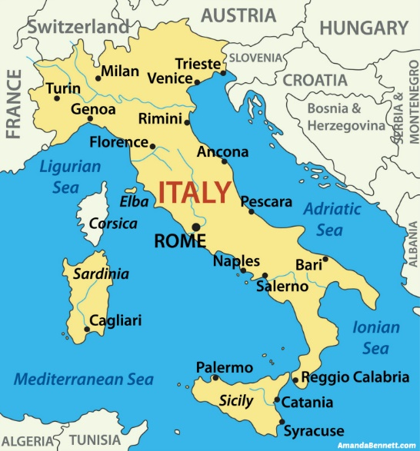
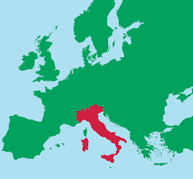
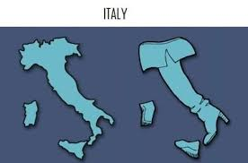
Geography

Slide 7
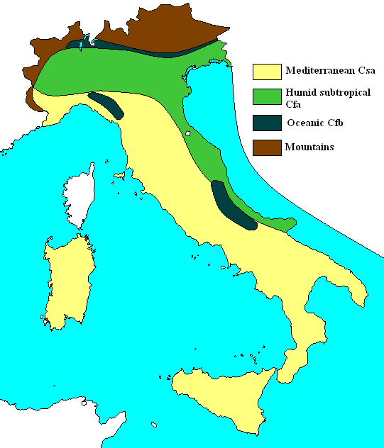
Climate
Coastal areas
Northern areas

Slide 8
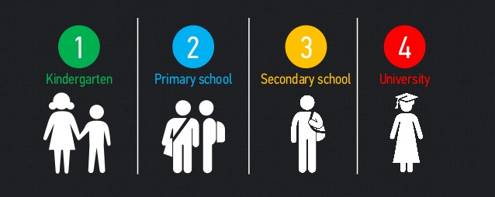
Education

Slide 9
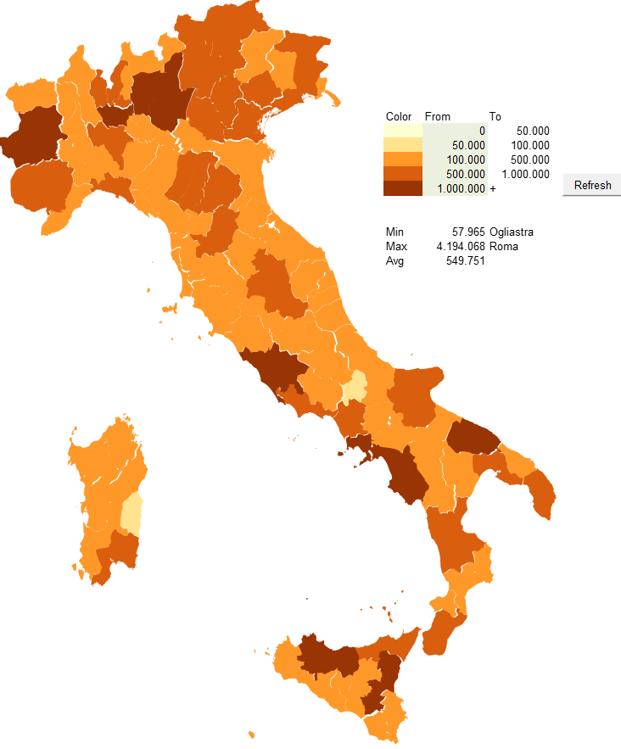

Population
Population: 59,801,000
Density: 203 per Km²
Urban area: 70.5 %
Immigration: 4%

Slide 10
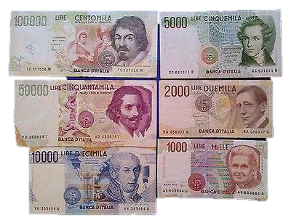
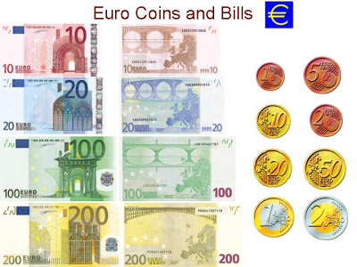
Currency
Lira
Euro

Slide 11
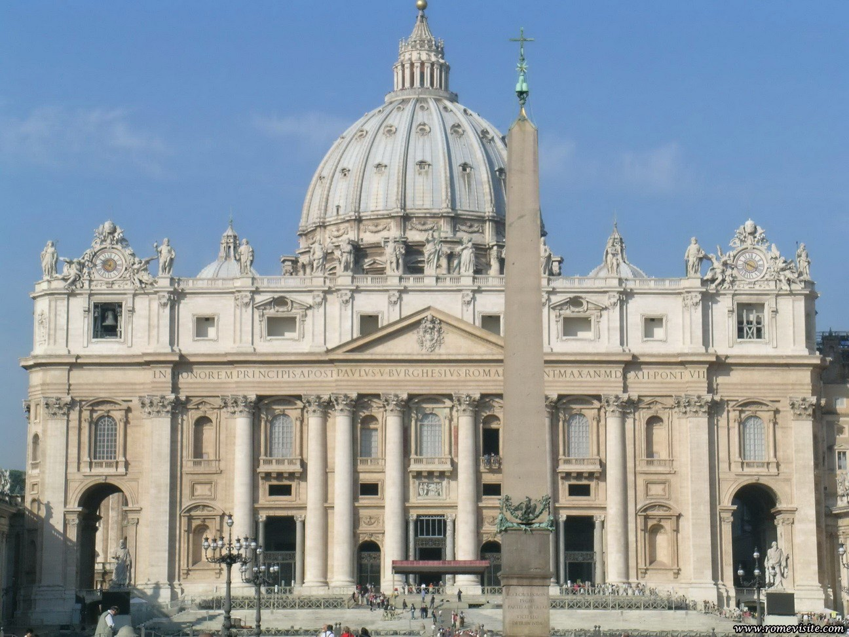
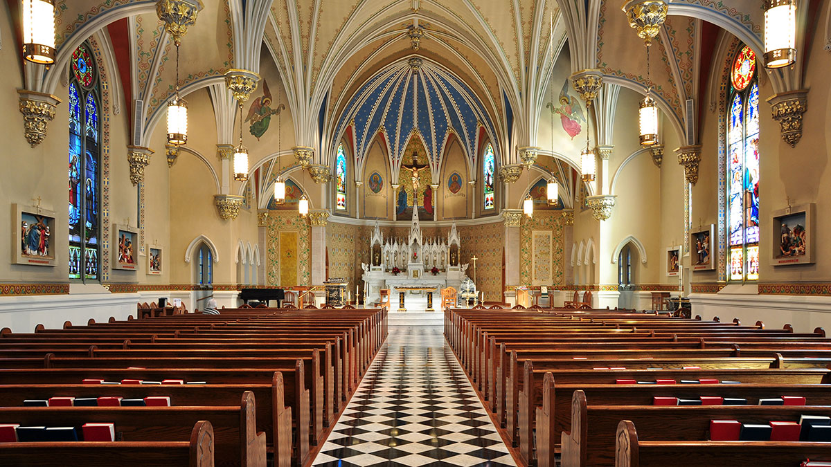
Religion

Slide 12




Language
Official language: Italian
Secondary language:
  German
  French
  Slovenian

Slide 13
Let’s Learn Italian

Slide 14

Mi chiamo…
Come stai?
Bene grazie, e tu?
Molto bene!

Slide 15
Economy

Slide 16
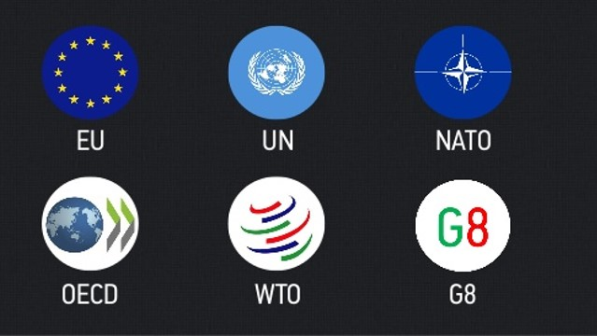
Custom Unions

Slide 17
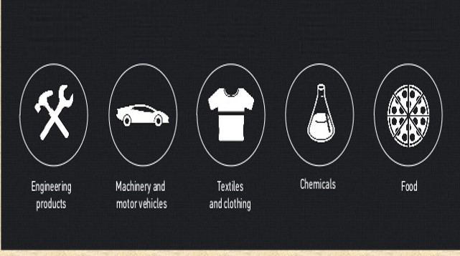
The Main Exports
Engineering
products
Machinery and
motor vehicles
Textiles
and clothing
Chemicals
Food

Slide 18
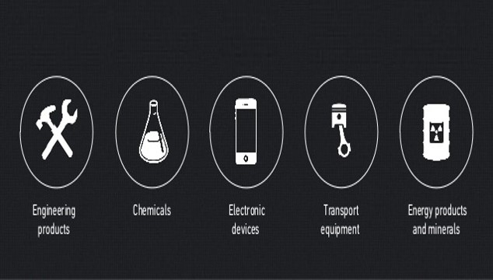
The Main Imports
Engineering
products
Chemicals
Electronic
devices
Transport
equipment
Energy products
and minerals

Slide 19
Industry

Slide 20
The Major Industries
tourism | machinery
iron and steel | chemicals
food processing | textiles
motor vehicles | clothing
footwear | ceramics

Slide 21

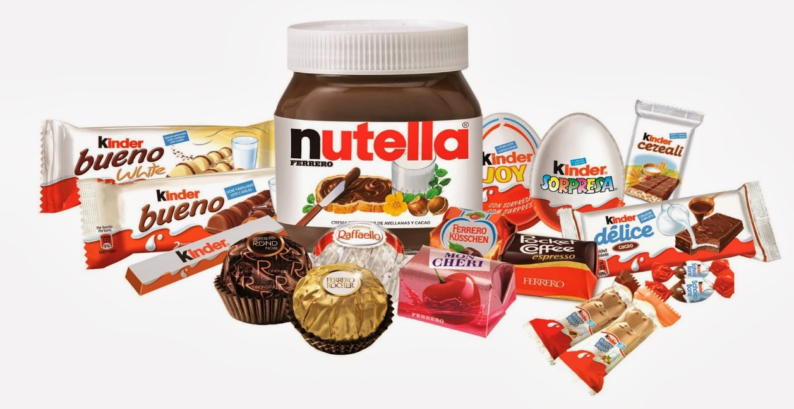
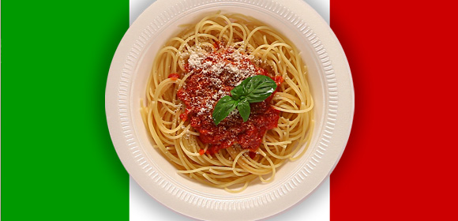
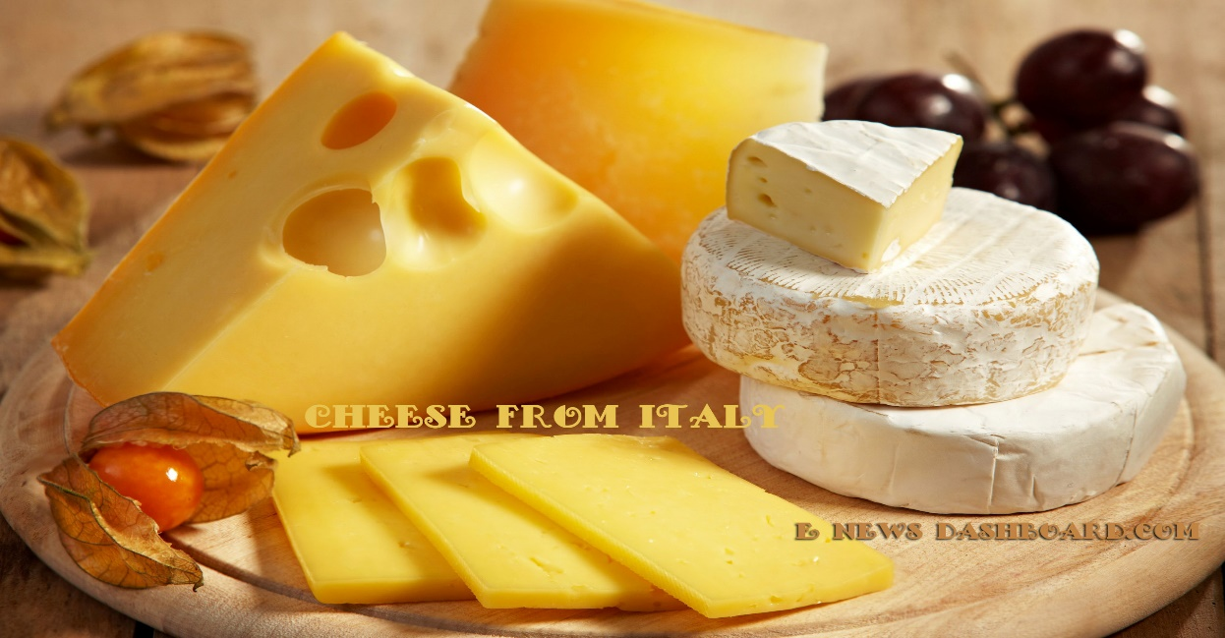
Food Industry

Slide 22
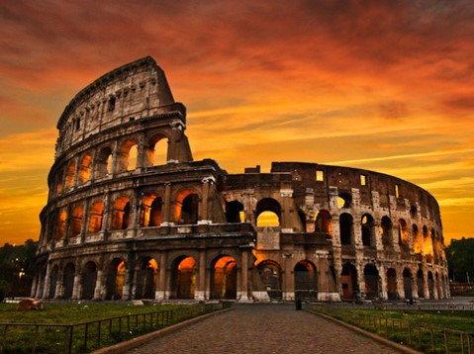
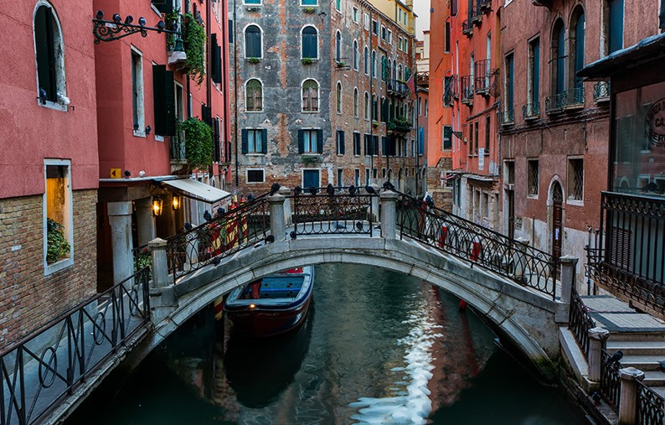
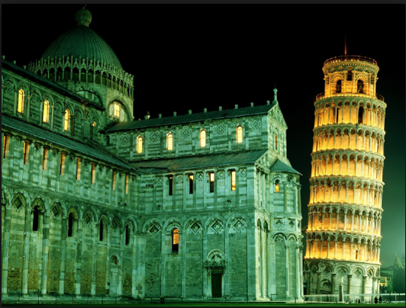
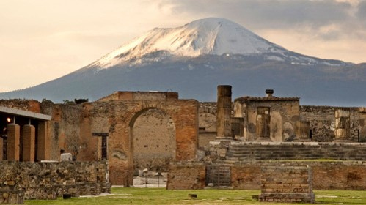
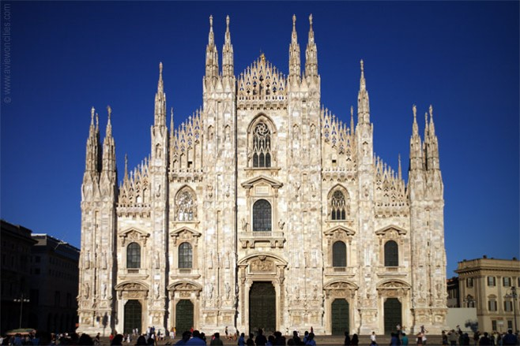
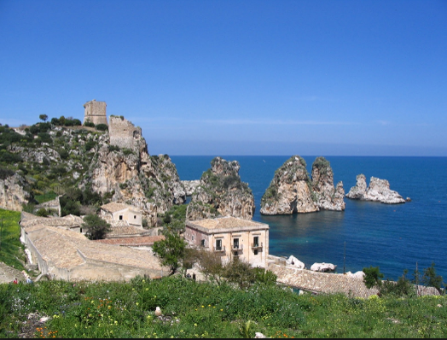
Tourism

Slide 23




Fashion Industry

Slide 24


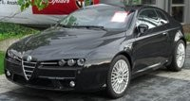
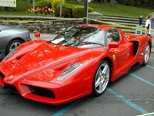

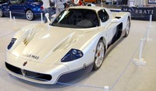
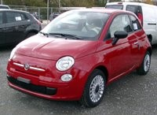


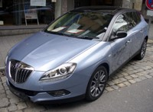
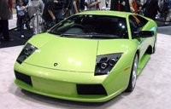

Automobile Industry

Slide 25
Representative Company

Slide 26
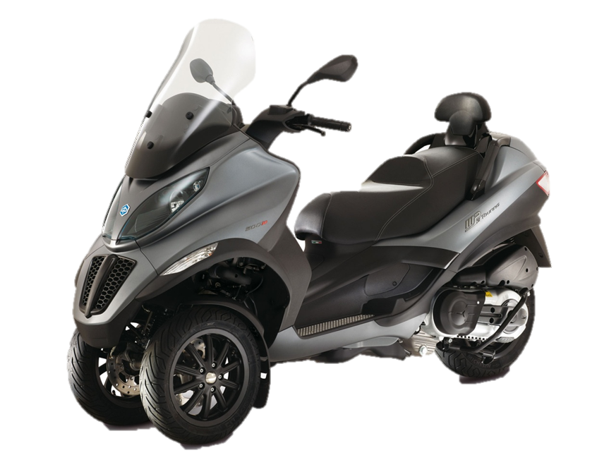
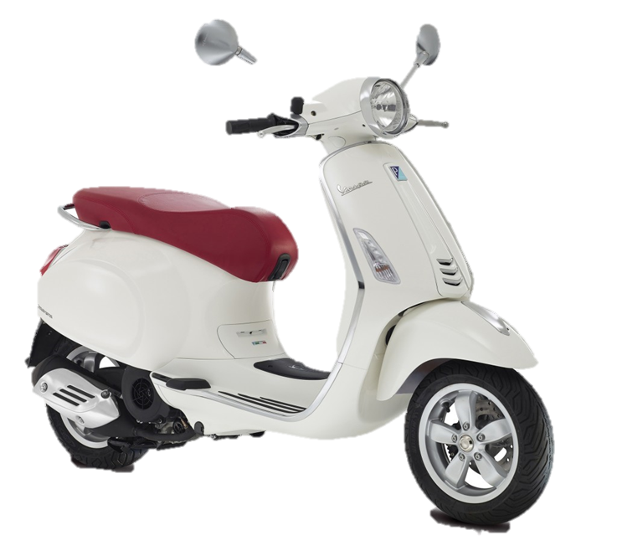

Slide 27

Profile
Founded: Jan.24, 1884
Founder: Rinaldo Piaggio
Headquarter: Pontedera, Italy
Number of employees: 7510

Slide 28
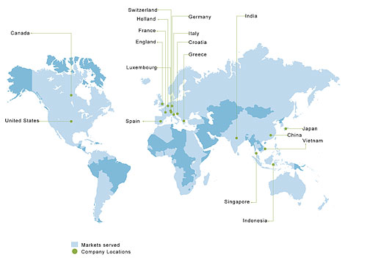
Switzerland
Holland
Germany
India
Canada
France
Italy
England
Croatia
Greece
Luxemburg
United States
Spain
Japan
China
Vietnams
Singapore
Indonesia
Markets served
Company Locations

Slide 29
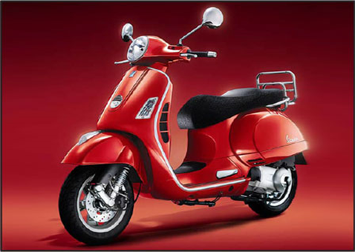

Major Product
“Not just a scooter, a way of life”

Slide 30

Video

Slide 31
Plans
Current | Future
To leverage the leadership in Europe. A production hub for 3- and 4-wheel light commercial vehicles. | Rise mid-size bike market. Expansion of sales worldwide.

Slide 32
Conclusion

Slide 33
Reference
presentationgo.com
http://alwaysbeready.com
italiangen.org
http://www.alpswine.net/Slovenia.html
www.cnnexpansion.com
taylorgraceauthor.wordpress.com
onedayinitaly.com
thegatewayonline.ca
currencies.wikia.com
http://www.ubbcentral.com
https://www.youtube.com/watch?v=UvApJ6jpic0

Slide 34
Reference
logodatabases.com
http://www.made-in-italy.com/italian-fashion/designers-and-brands
http://www.italianlegacy.com/italian-cars-2.html
http://italiano.adeleliu.com/?mc_tk=Yih7ZXZ5EBEfRhFDQENNGUwNXENMEgIJBQ==#sthash.R73ykx4x.dpbs
https://www.zainoo.com/en/italy/economy#
https://en.wikipedia.org/wiki/Economy_of_Italy#Economic_sectors
http://www.slideshare.net/AbdullaevAmir93/italy-final
http://www.ask.com/geography/industries-italy-f5607be3a7837ded?qo=questionPageSimilarContent

Slide 35


THANKS FOR YOUR LISTENING.

