Slide 1

Belgium
10444006 Kelly
10444009 Eileen
10444011 Teresa
10444015 Iris
10444021 Wendy

Slide 2
Outline
Overview
Culture
Economy & Industry
Representative company

Slide 3
Overview
Introduction
History
Geography & Population
Weather
Official languages

Slide 4
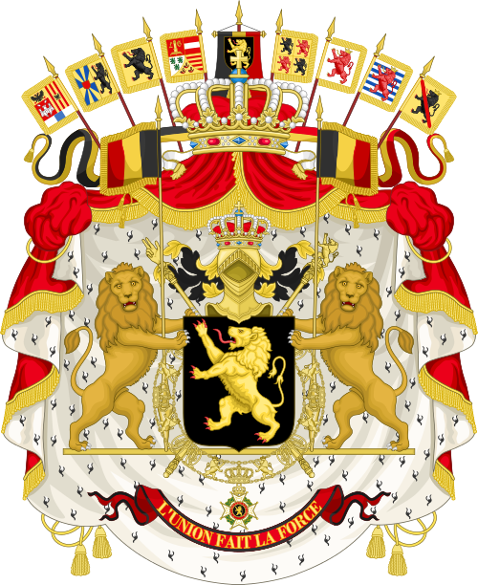

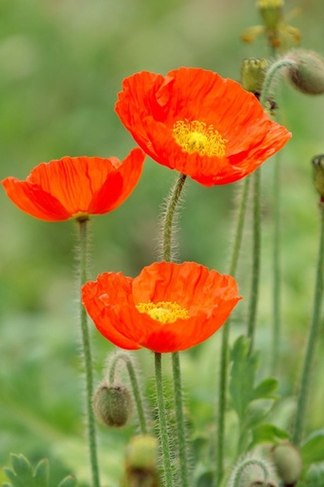
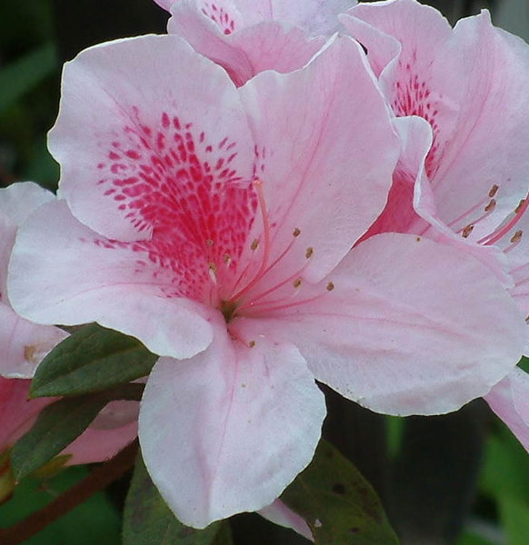
Introduction
Motto:
Strength through Unity

Slide 5
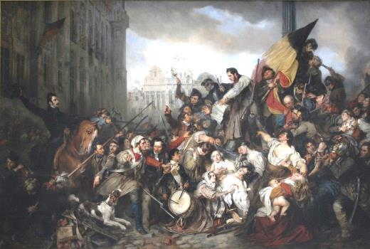
History

Slide 6
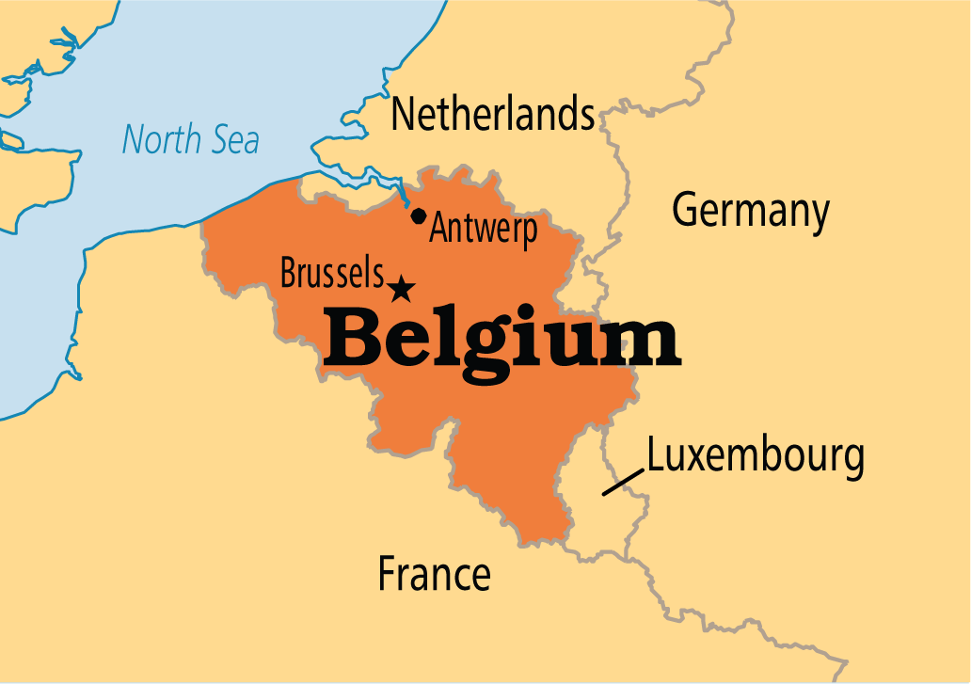
Geography & Population
Area:30,528km²
Population:11 million
Density:346/km²

Slide 7
Weather - Climate
(℃)

Slide 8
Weather - Rainfall

Slide 9
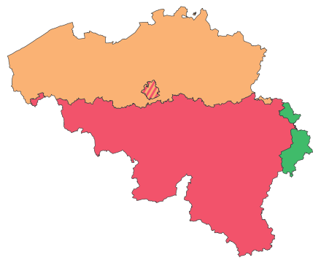
Official Languages
59%
40%
Regions | Language
Flemish Community | Dutch
Walloon Community | French
Brussels (Capital) | Bilingual
East Walloon | German
1%

Slide 10
Overview
Capital
Currency
Politic
Brussels National Palace
Administrative area
College

Slide 11
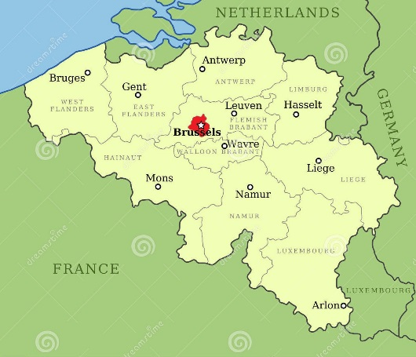
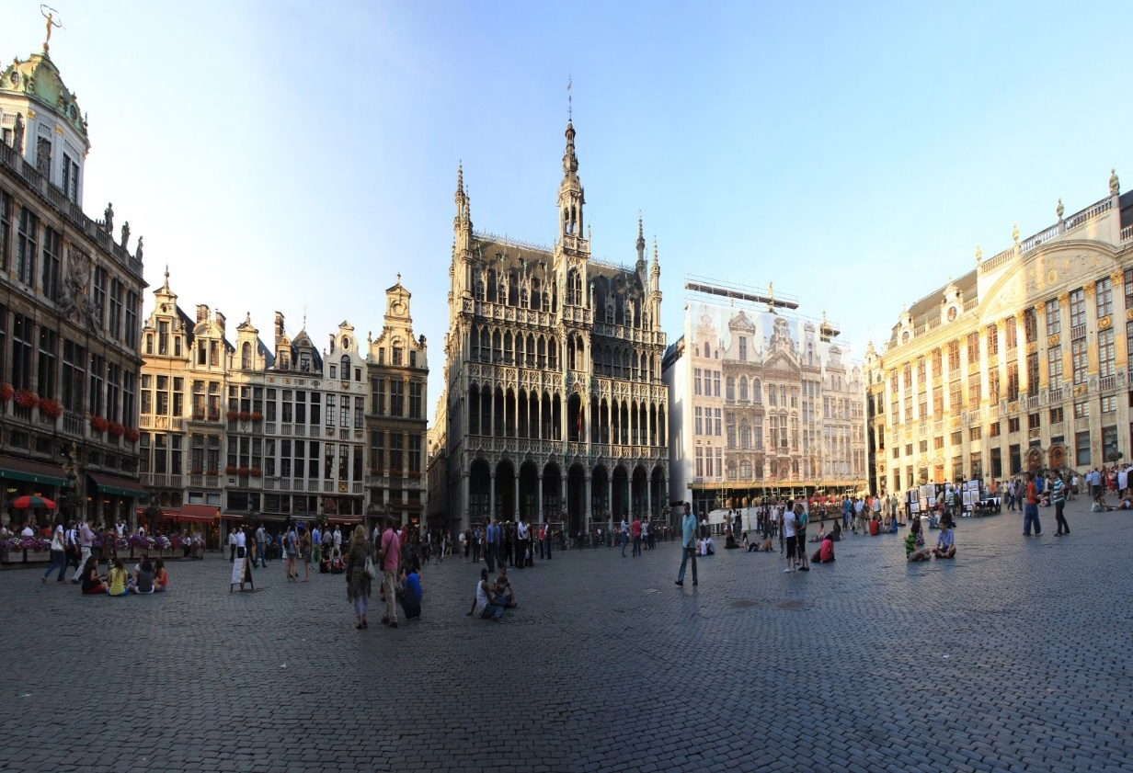
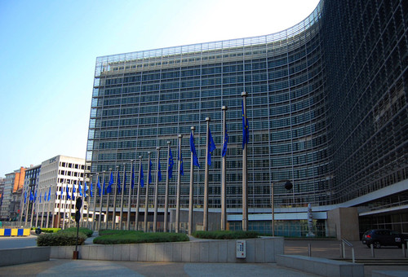
Capital

Slide 12
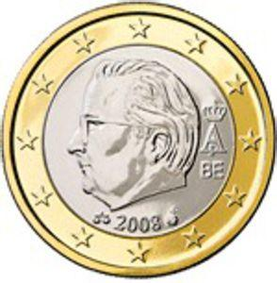



Currency
1 euro cent
10 cents
1 Euro

Slide 13
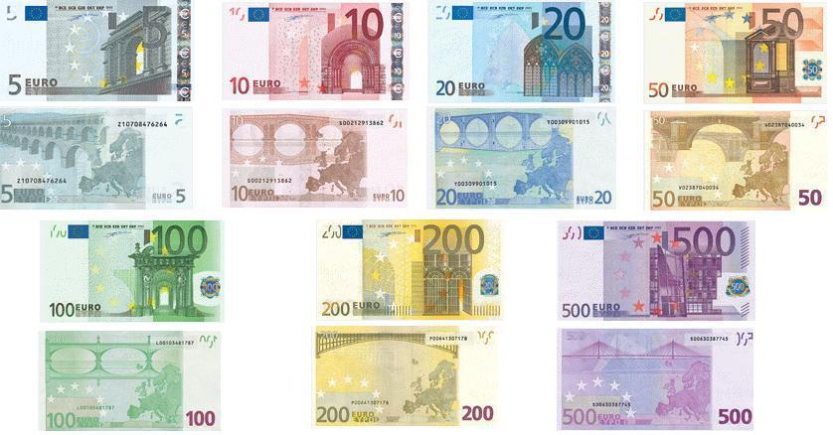
Currency

Slide 14
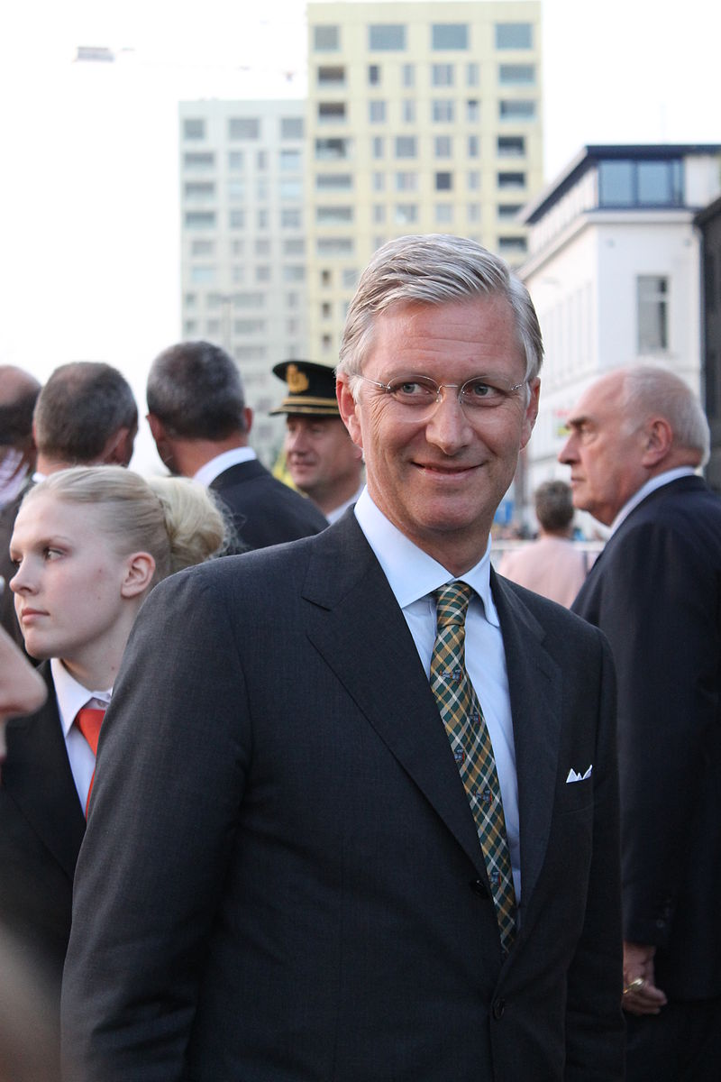
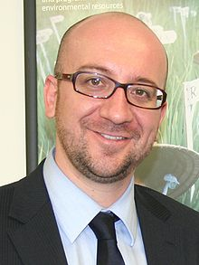
Politics
Philippe
Charles Michel

Slide 15
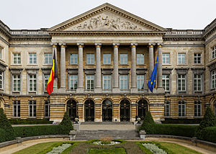
Brussels National Palace

Slide 16
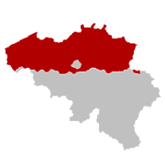
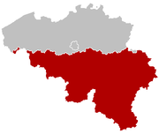
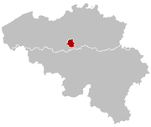
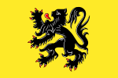


Administrative area
Flemish Region
Wallonia
Brussels

Slide 17
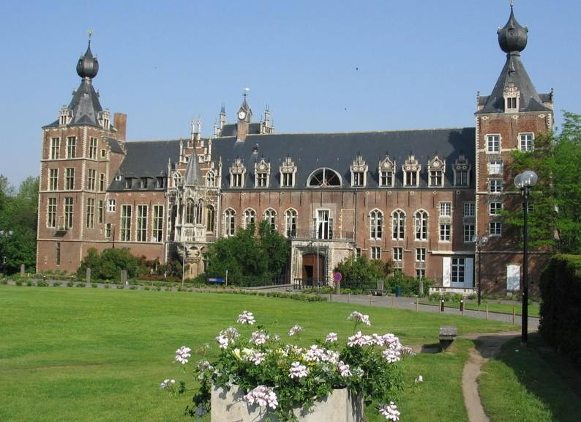
College
Catholicism University of Leuven

Slide 18
Culture
Religion
Festival
Tourist attraction

Slide 19
Religion

Slide 20
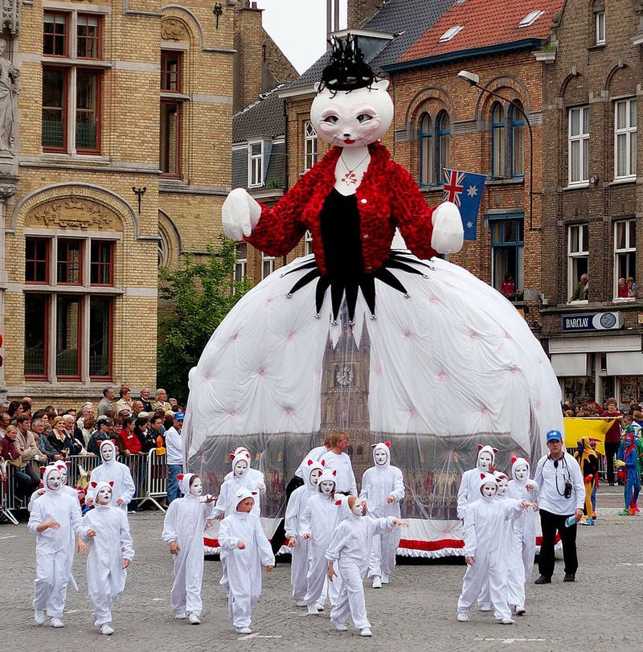
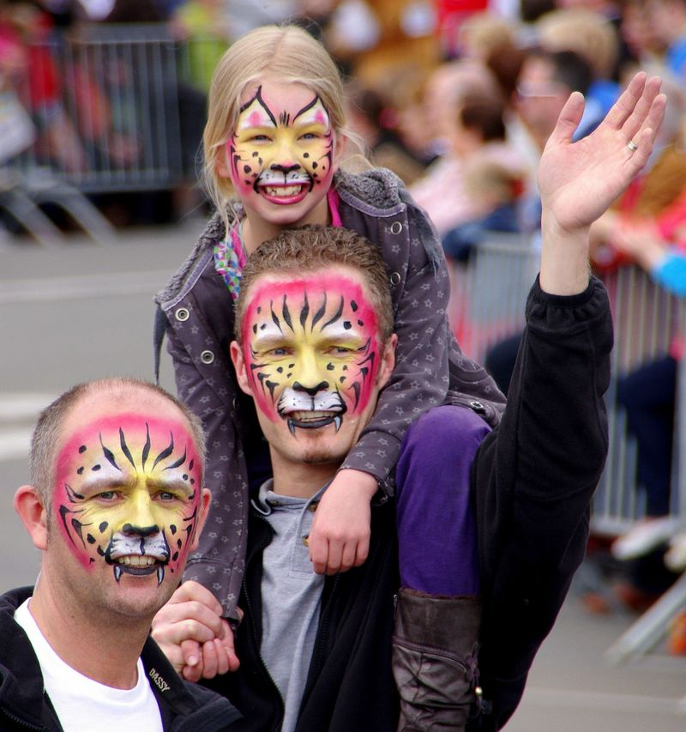
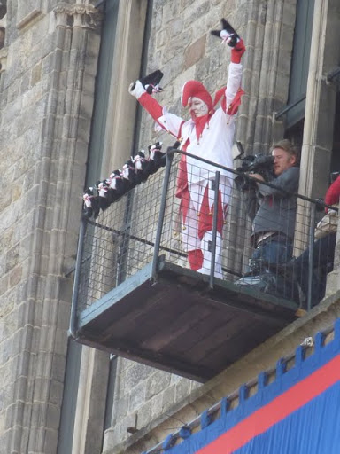
Cat festival
a parade in Ypres
second Sunday of May
hold every three years

Slide 21
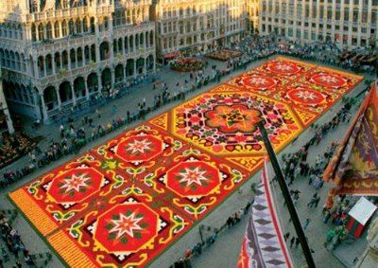
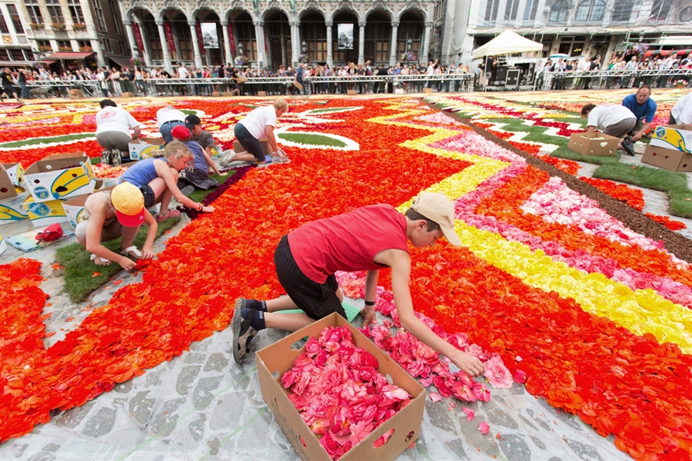
Brussels Flower Carpet
hold every two years
at the middle of August
in Brussels
Begonias

Slide 22
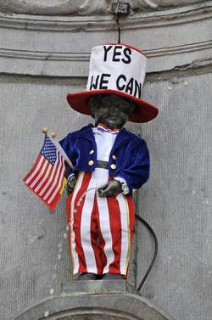
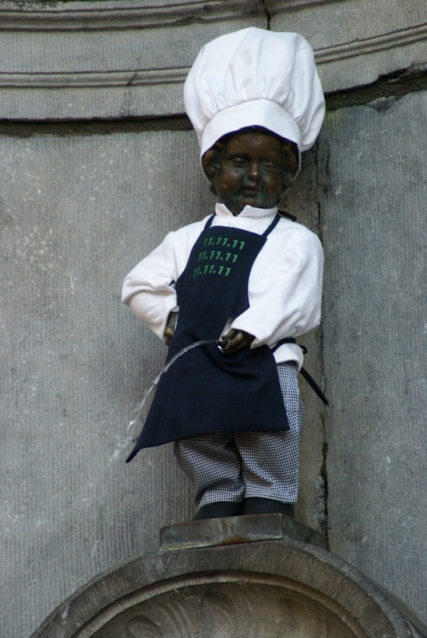
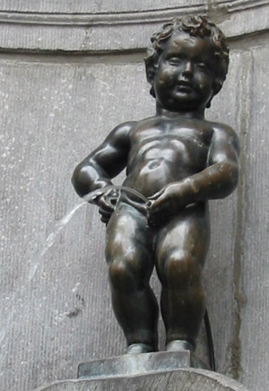
manneken pis
Brussels’ landmark
Over 400 years
It is dressed in costume at festival

Slide 23
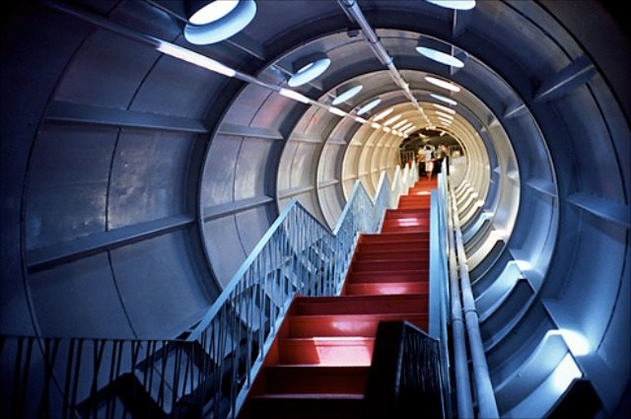
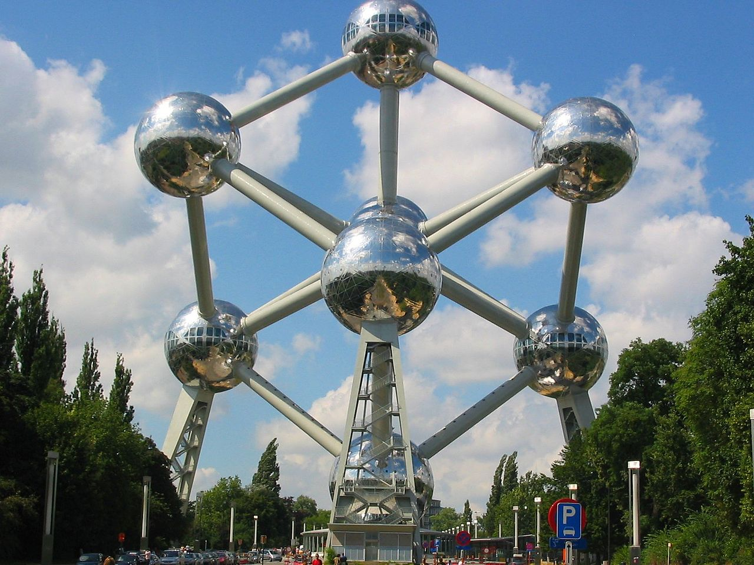
Atomium
World's Fair in 1958
a unit cell of an iron crystal
9 stainless steel clad spheres
9 city in Belgium

Slide 24
Economy & Industry
International trade status
GDP rate
The main Import and export country
The main export product

Slide 25
International trade status

Slide 26
GDP rate

Slide 27
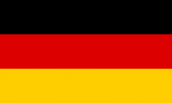

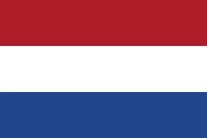

The main
International trade country
Germany
France
Holland
Italy

Slide 28
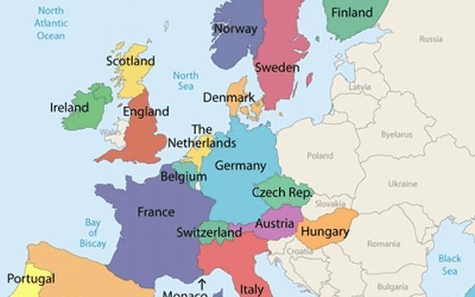
The main
International trade country

Slide 29



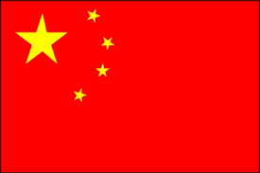
The main
Import and export country
England
America
India
China

Slide 30
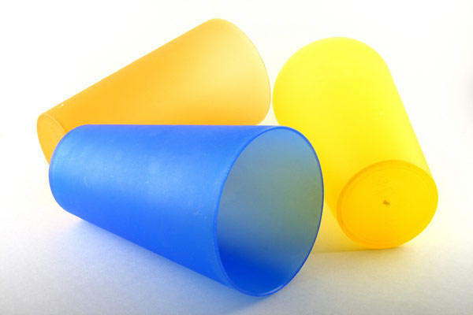
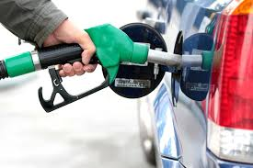
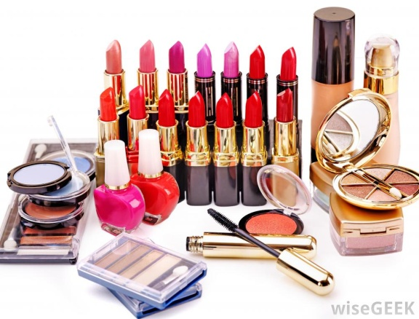
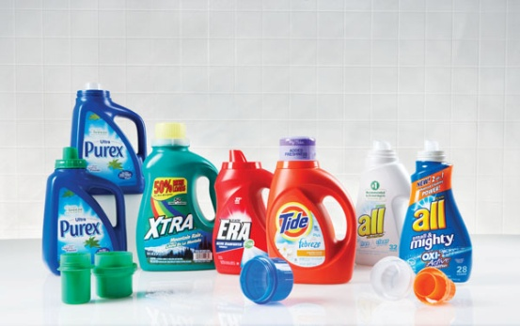
The main export product
Petrochemical Industry
plastics
detergents
petroleum
natural gas
gasoline
Cosmetics…

Slide 31
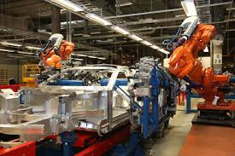
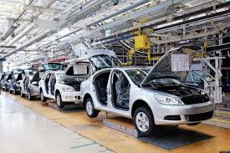
The main export product
Automobile industry

Slide 32
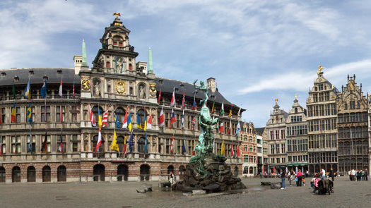
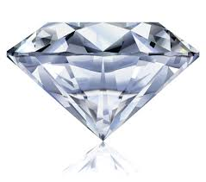
The main export product
Diamond-at Antwerp

Slide 33
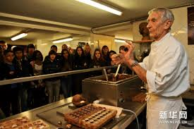
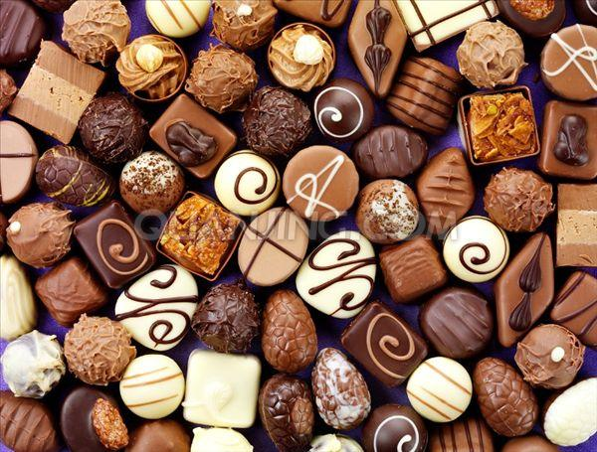
The main export product
Chocolate

Slide 34

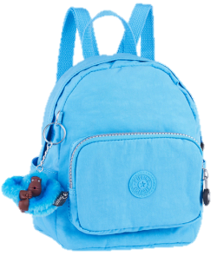
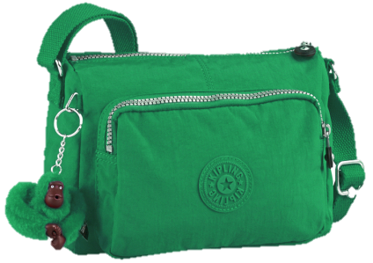
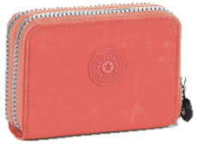
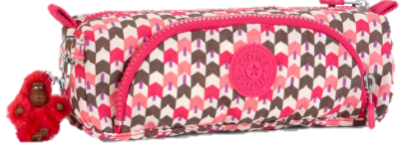
Representative Company

Slide 35
Kipling
The Origin of Its Name
The Foundation of Kipling
About kipling
The Mascot of Kipling - Monkey

Slide 36
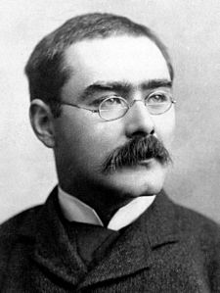
The Origin of Name
Rudyard Kipling

Slide 37
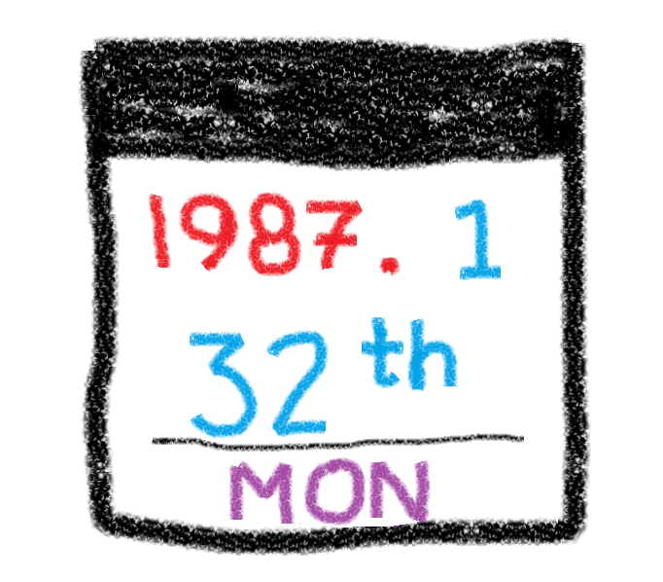
The foundation of Kipling
When

Slide 38
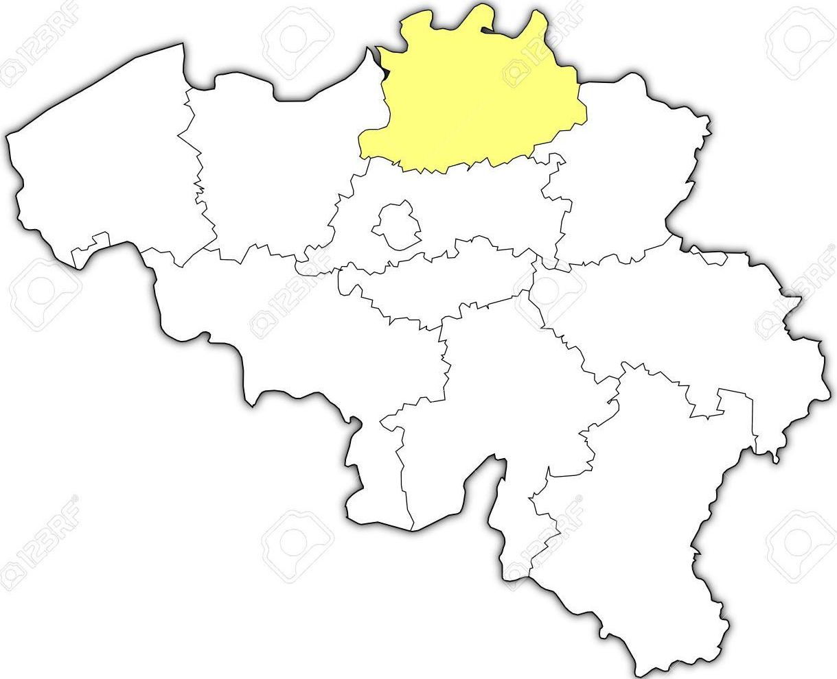
The foundation of Kipling
Where
Antwerp

Slide 39

The foundation of Kipling
Who

Slide 40

The foundation of Kipling
!!!
Why

Slide 41

About Kipling
0~100 years old,
Male & Female
lightweight, colorful, lasting
65 countries
16 bags/minute
30 millions people
More than Belgium
population

Slide 42


Monkey key-hanger
The Jungle Book

Slide 43










Slide 44

Video

Slide 45
Reference
1. http://www.operationworld.org/belg
2. http://www.mapsofworld.com/flags/belgium-flag.html
3. https://en.wikipedia.org/wiki/Belgium
4. http://www.eueueu.com/Downloads/HighlightsBE2014.pdf
5. https://zh.wikipedia.org/wiki/%E6%AF%94%E5%88%A9%E6%99%82%E5%9C%8B%E5%BE%BD
6. http://www.cwb.gov.tw/V7/climate/monthlyMean/World_meantxmin.htm
7. http://www.cwb.gov.tw/V7/climate/monthlyMean/World_meantxmax.htm
8. http://www.cwb.gov.tw/V7/climate/monthlyMean/World_precp.htm
9. https://en.wikipedia.org/wiki/Communities,_regions_and_language_areas_of_Belgium
10. https://en.wikipedia.org/wiki/Kattenstoet
11. https://en.wikipedia.org/wiki/Manneken_Pis
12. https://en.wikipedia.org/wiki/Atomium
Video
https://www.youtube.com/watch?v=sqHndSE0eXA

Slide 46
Thank you for your listing

