Slide 1

Switzerland
Group 8
Georgina
Joyce
Penny
Betty
Emily

Slide 2
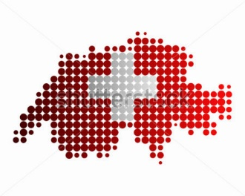
outline
Overview
Economy
Representative Company
—— Rolex
Reference

Slide 3
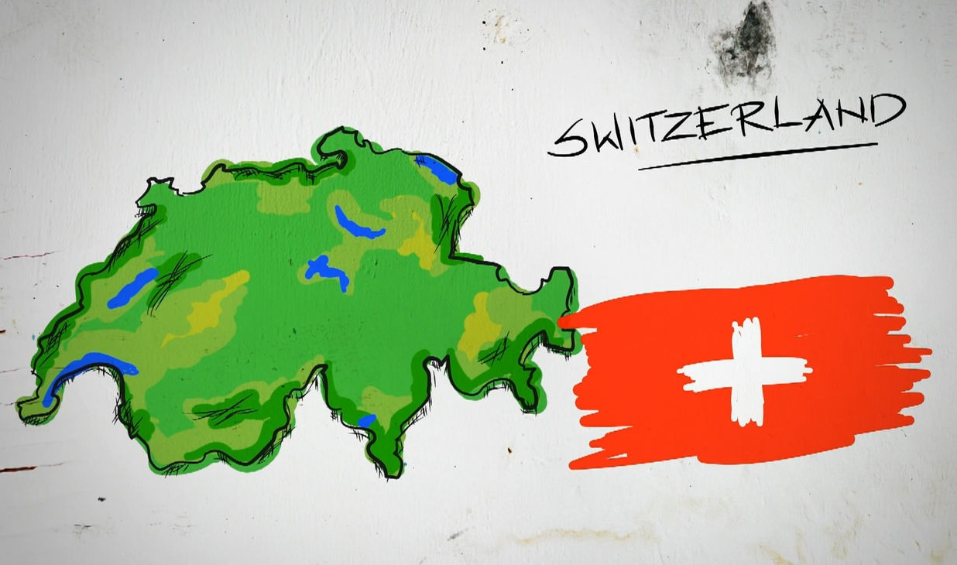
overview
Geography
Politics
Currency
Weather
Population
Language
Religion
View

Slide 4
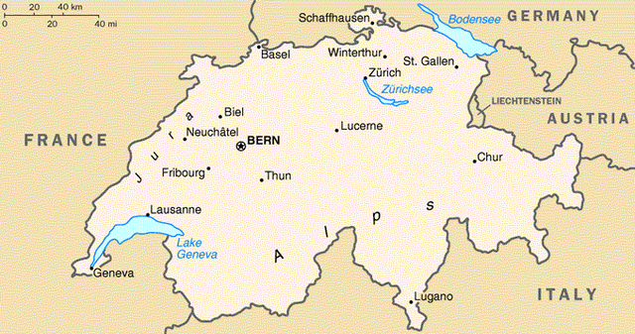
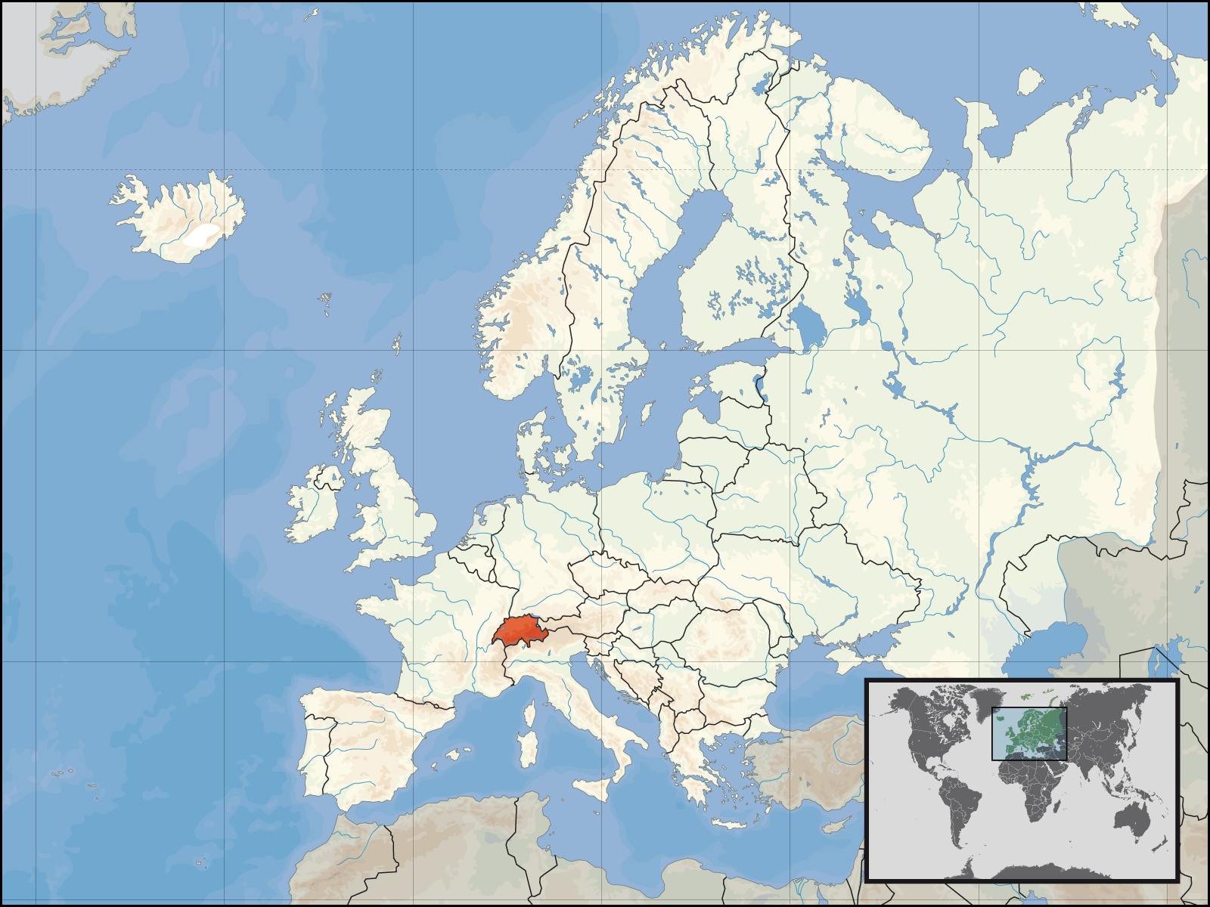
geography

Slide 5
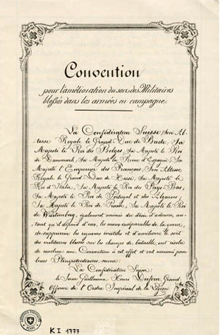
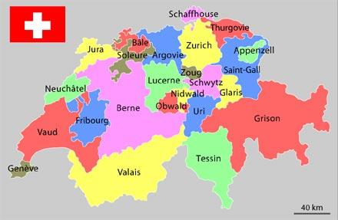
politics
States: 26
Capital: Bern

Slide 6
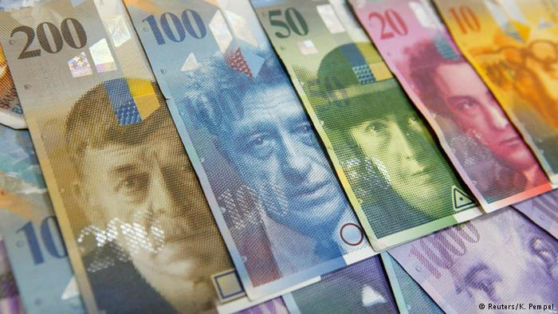
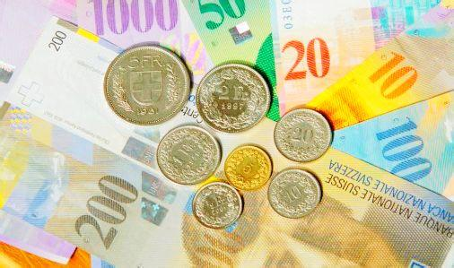
Currency
CHF: TWD 1:33.6
CHF: USD 1:1.04

Slide 7
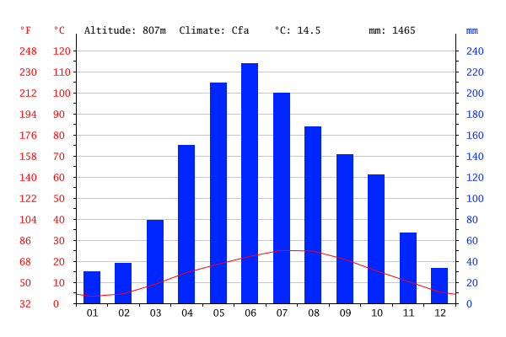
Weather
Max: July, 25.1 °C
Min: January, 3.3 °C

Slide 8
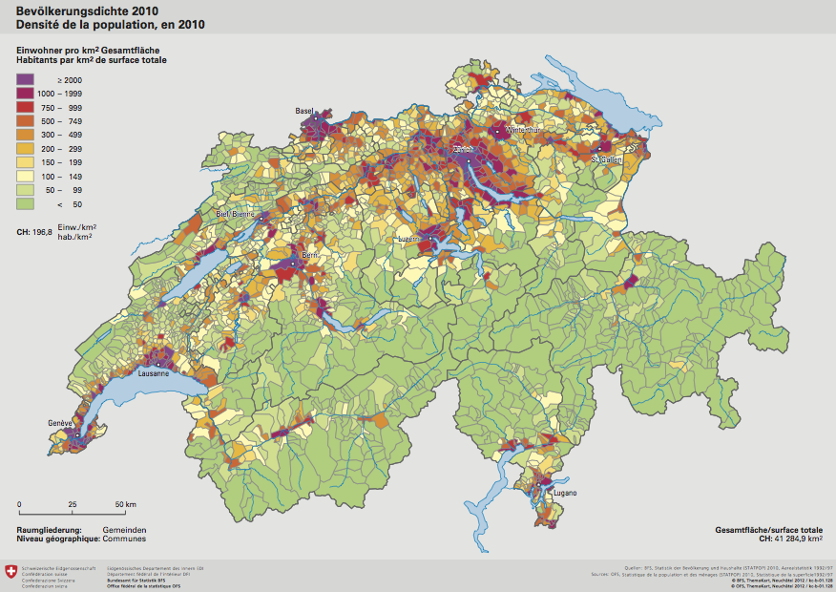
Population
Total: 8 million

Slide 9
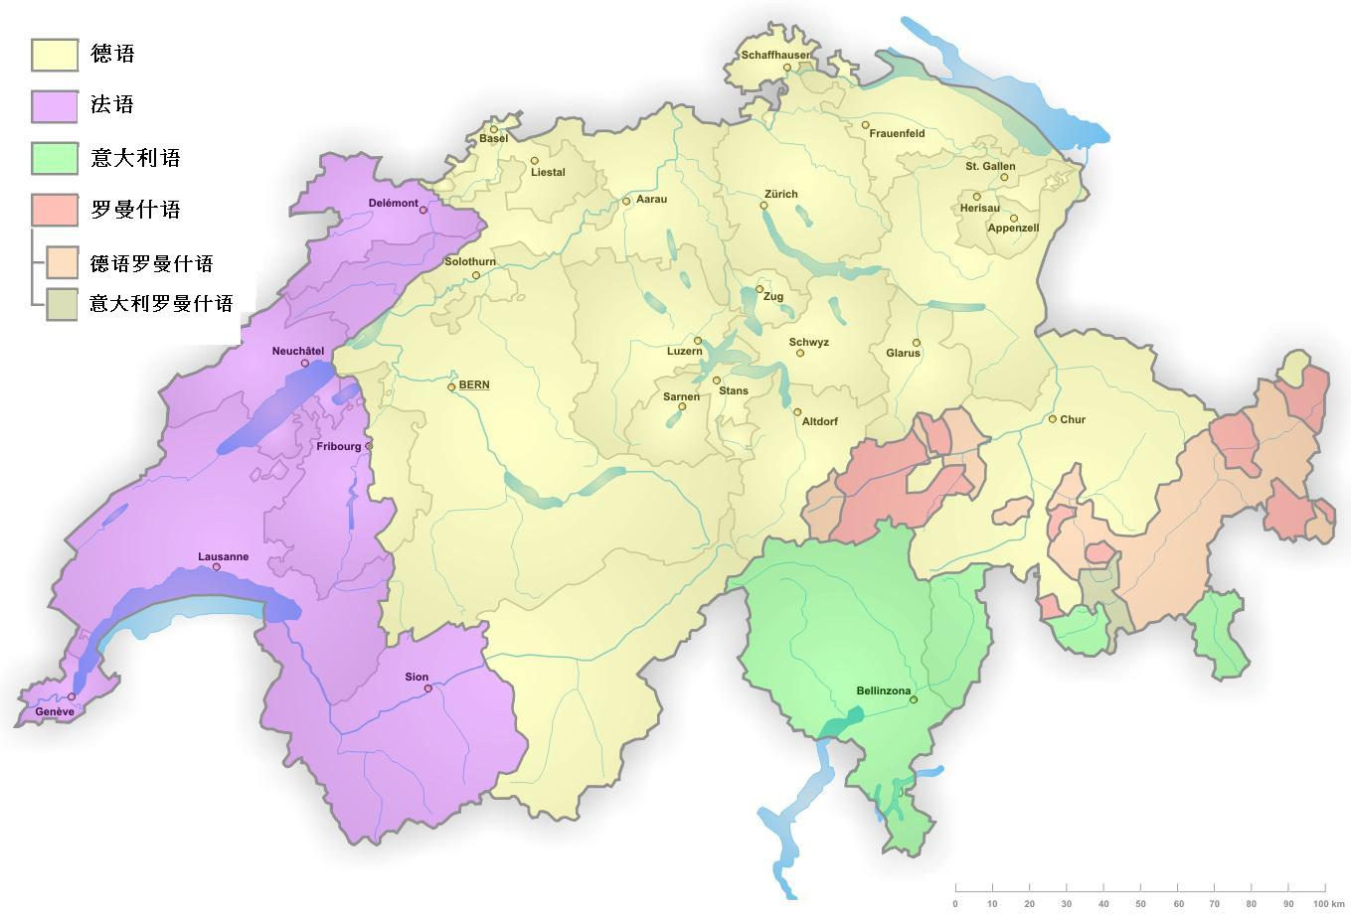
language
German
French
Italian
Romansh

Slide 10
Religion

Slide 11
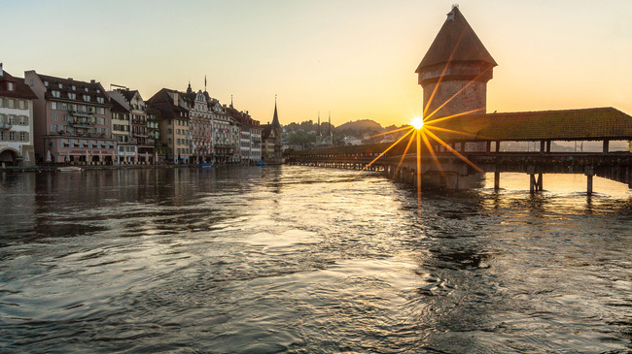
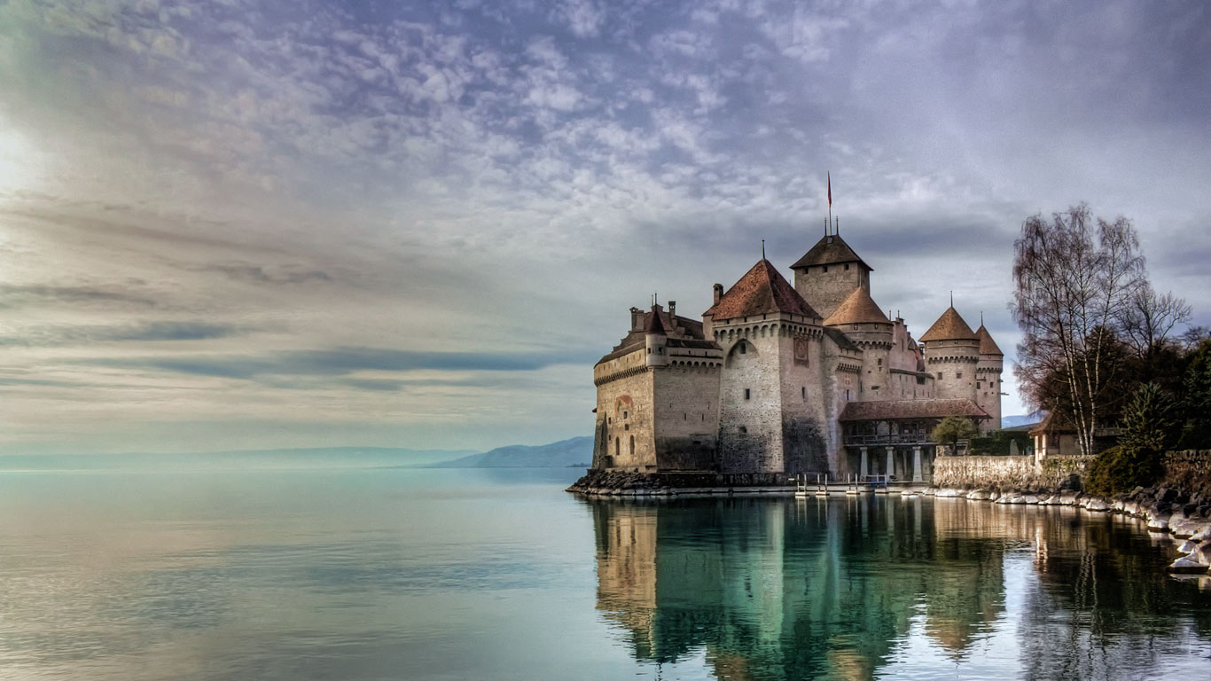
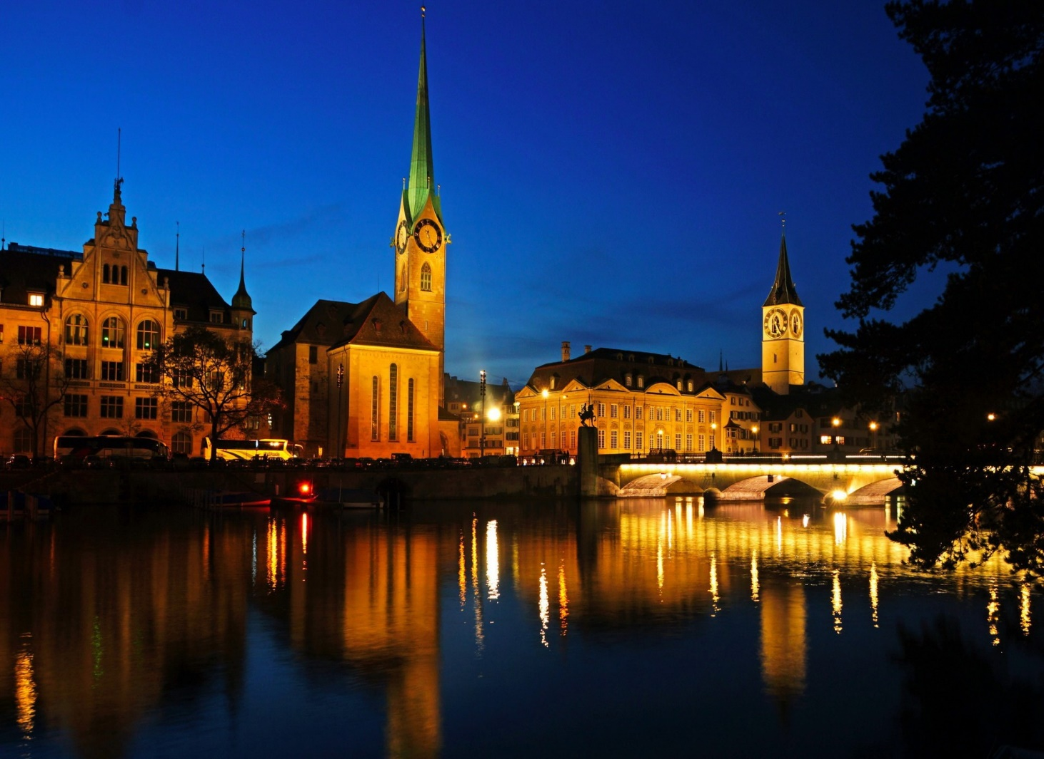
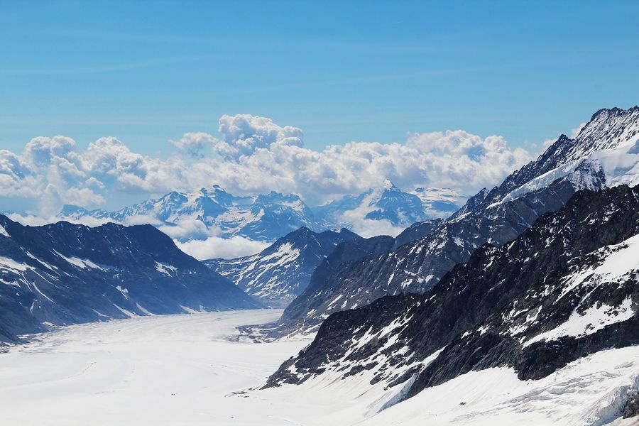
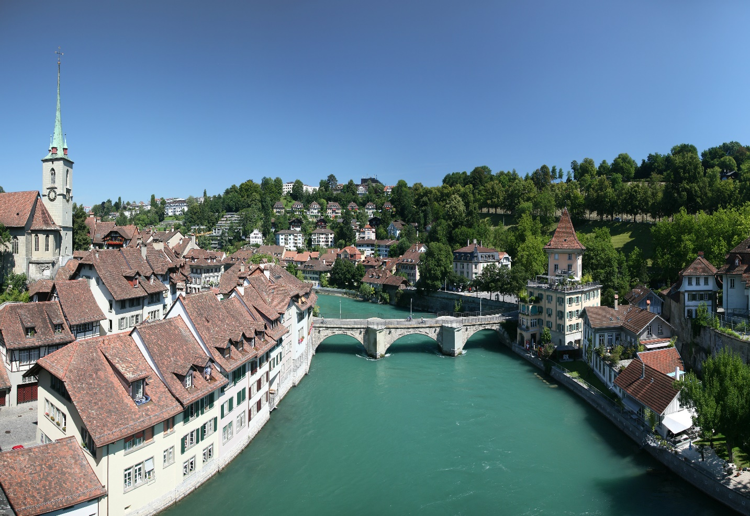
View

Slide 12
Economy
Economics
Trade
Industry
Economic Sectors
Agriculture
Manufacture
Tourism

Slide 13

Economics
One of the world’s most stable economies
Rank first in the world in the 2015 Global
Innovation Index
Industry and trade are the keys to Switzerland’s
economic livelihood

Slide 14

Trade
The 20th largest exporter
The 18th largest importer
Largest trading partner is Germany
The majority of exports include: precision or ‘high tech’ finished products
Main imports include: medicaments, cars, precious jewelry

Slide 15
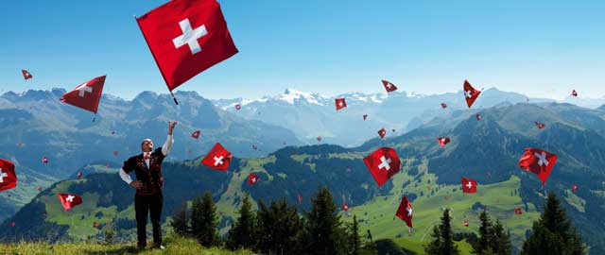
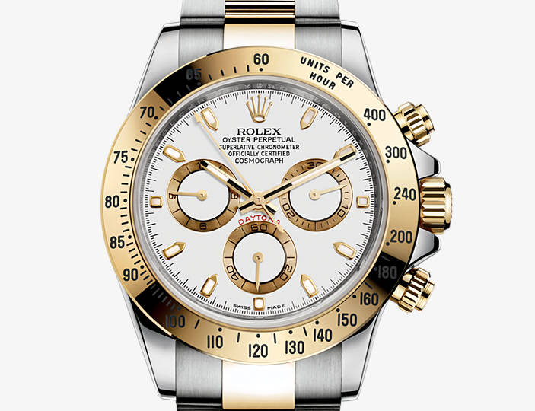
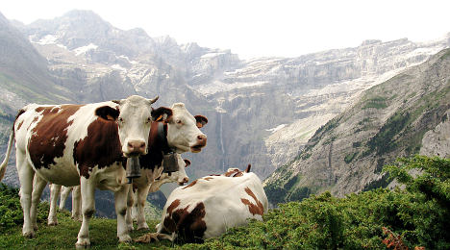
Industry

Slide 16
Economic Sectors

Slide 17
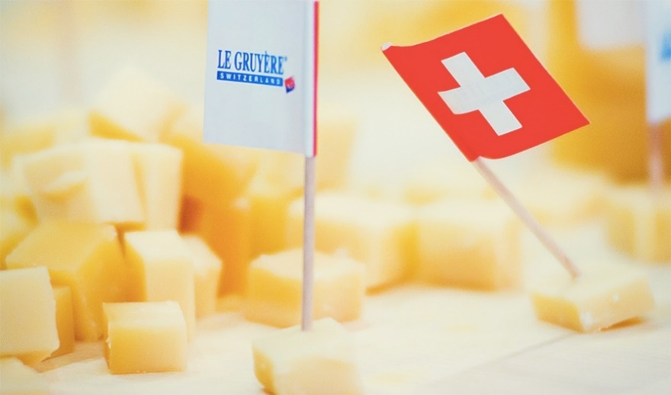
Agriculture
Protective of its agricultural industry
Potatoes, pork, cattle and most milk products

Slide 18

manufacture
19.3 billion
One of the leaders in exports of high-end watches
The exports of watches mainly go to Asia(55%) and Europe(29%).

Slide 19
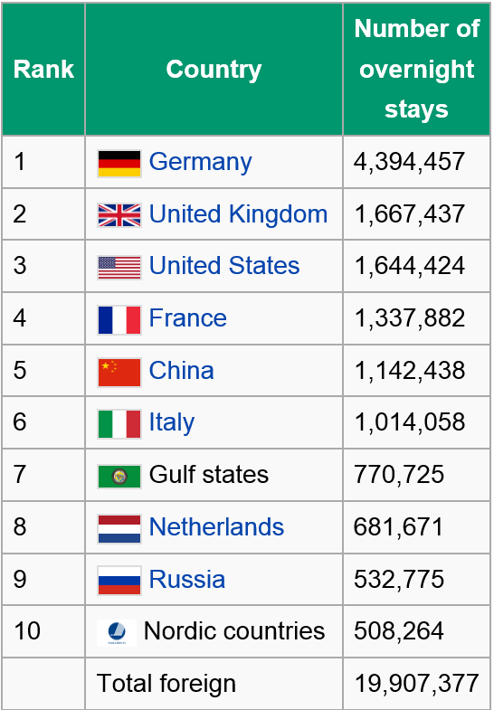
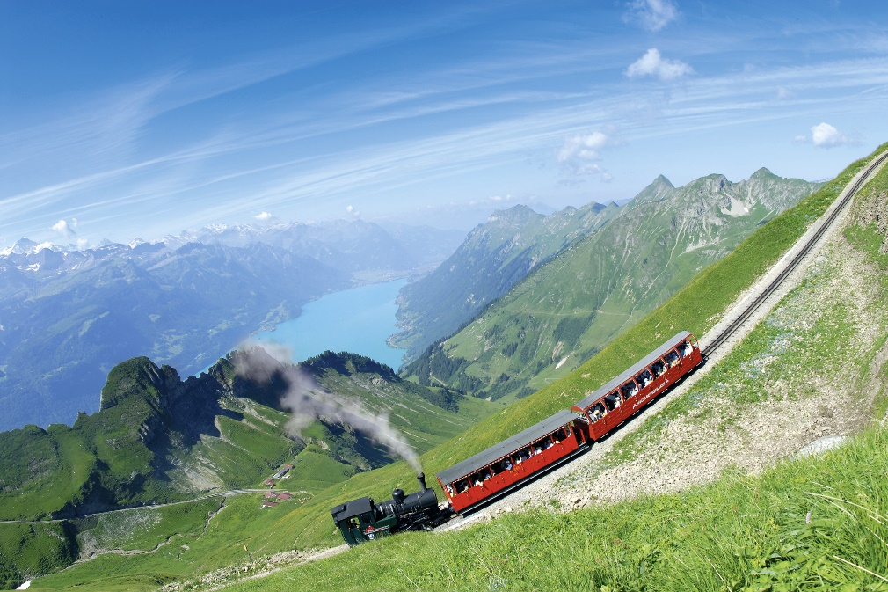
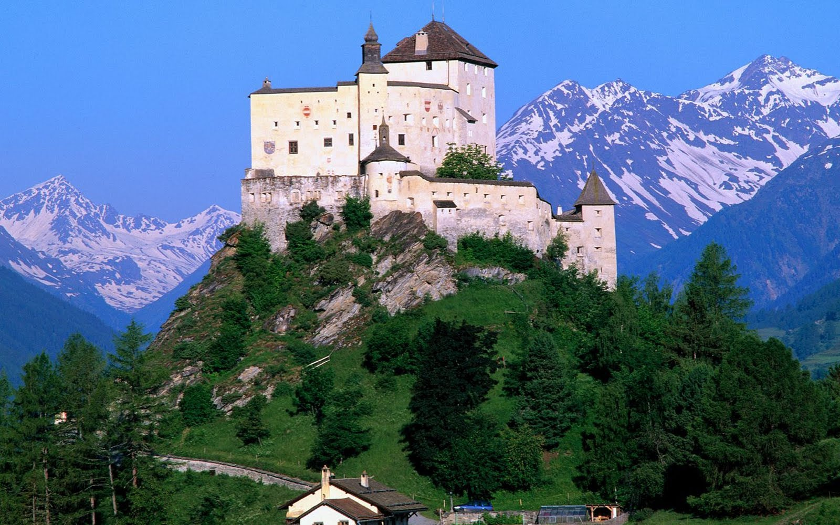
Tourism
a highly developed tourism infrastructure
Provides a total of 144,838 full time equivalent jobs

Slide 20
Representative company
Basic Information
Technology
Products
Brand Goal

Slide 21
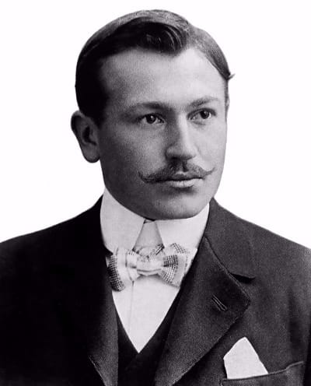
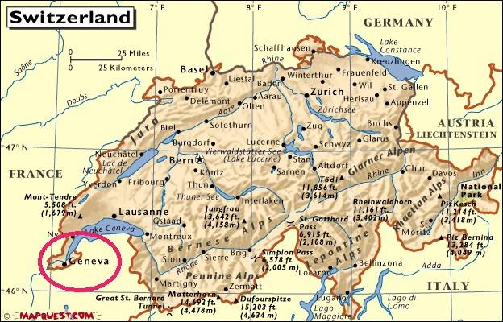
Basic information
Formed：
1905
Founders :
Hans Wilsdorf& Alfred Davis
Location :
Geneva
Hans Wilsdorf

Slide 22
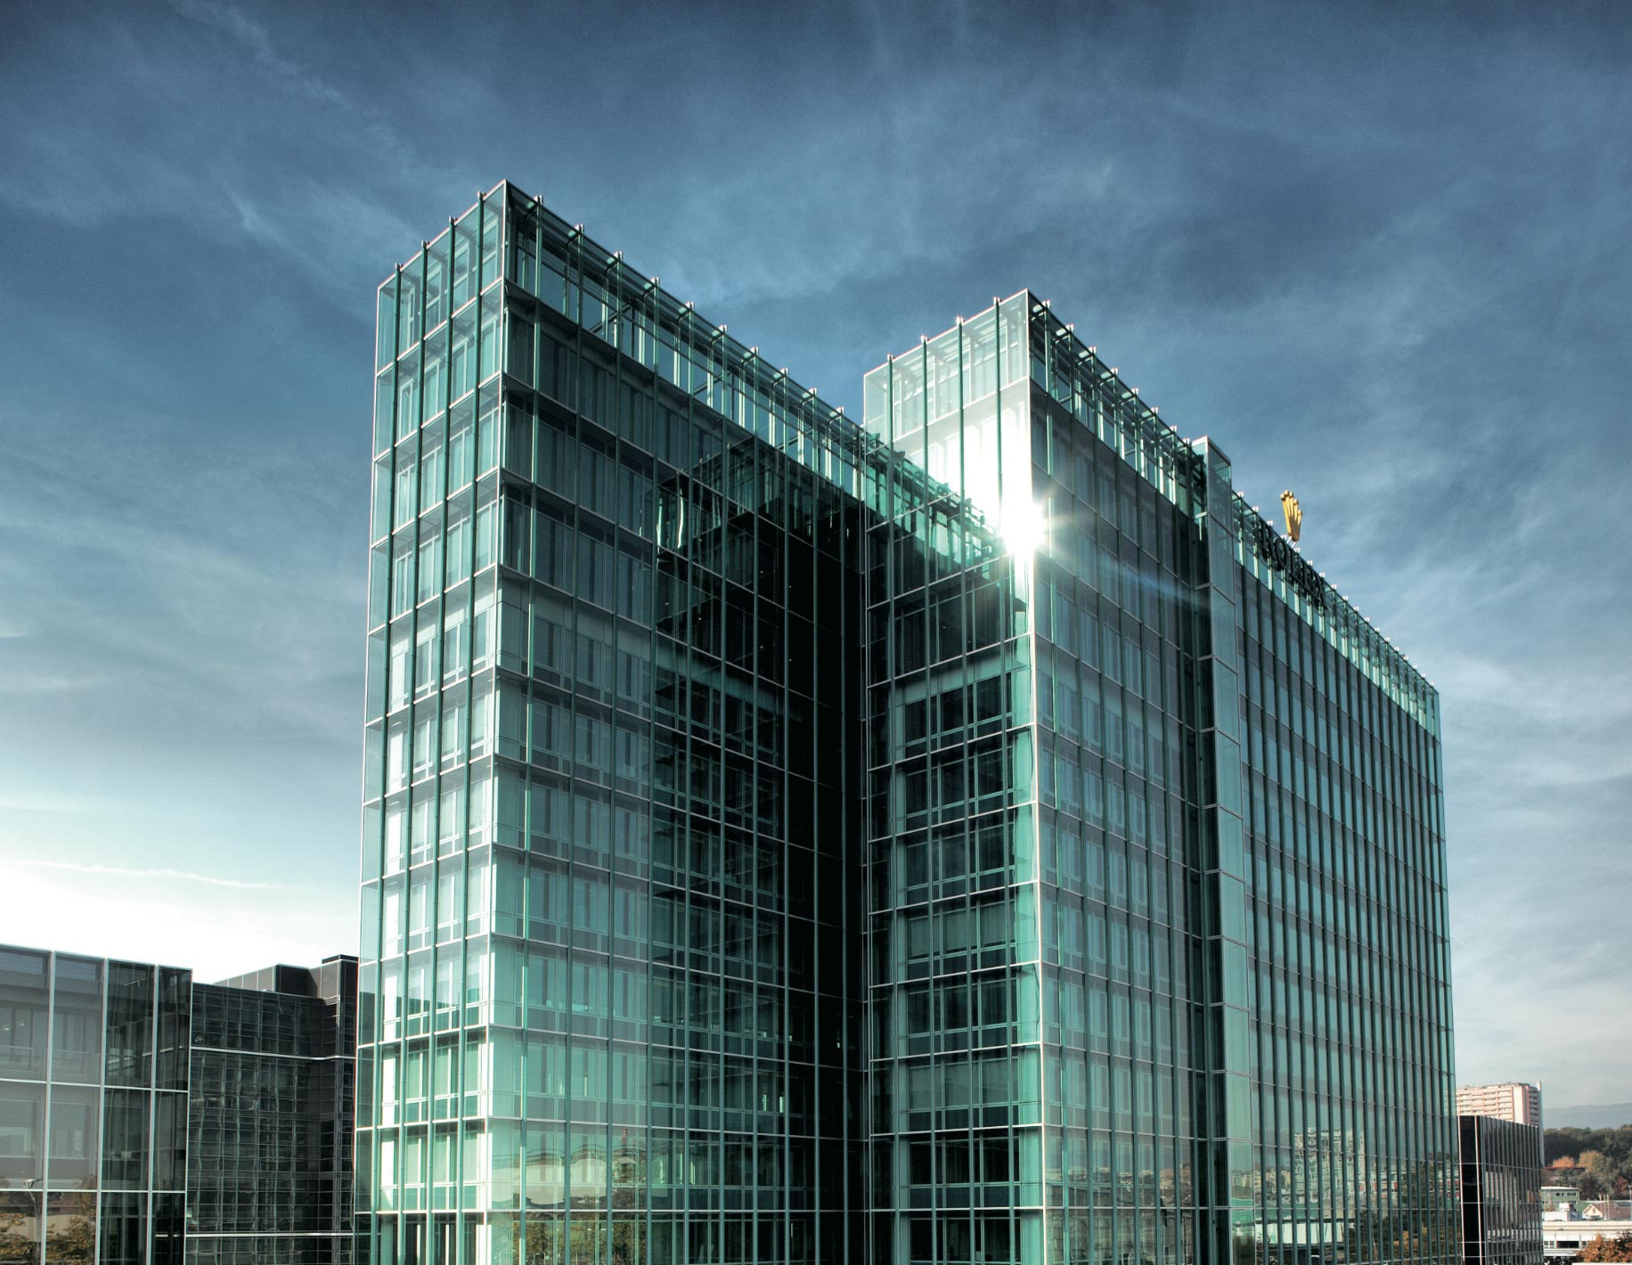
Basic Information
28 branch allover the world
14 Retail in Taipei
About 6000 employee

Slide 23
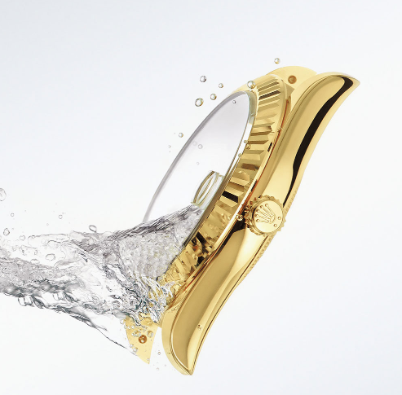


Technology
Oyster
DateJust
GMT-Master

Slide 24
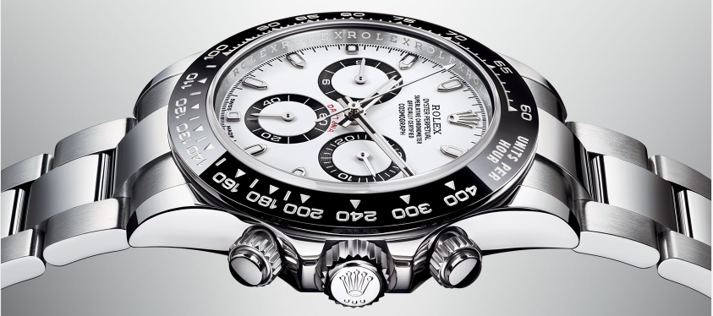
Products
Oyster Perpetual
Cosmograph
Daytona 904L

Slide 25

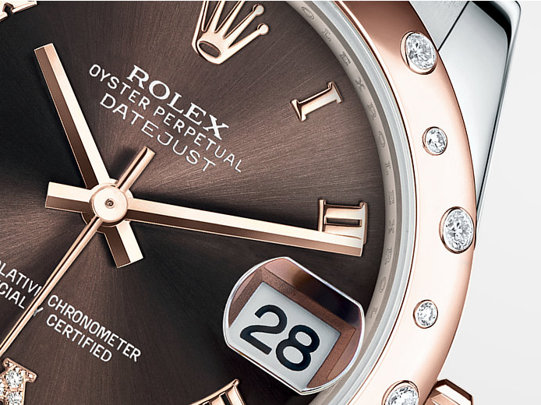
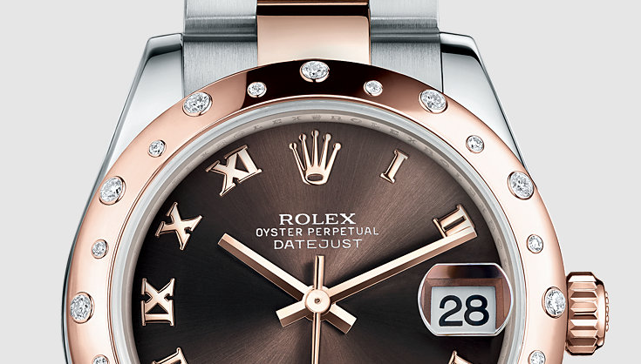
Products
Oyster Perpetual Datejust 31

Slide 26
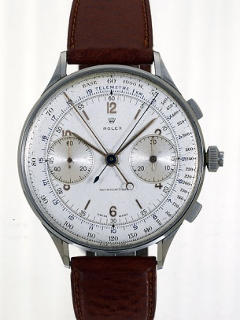
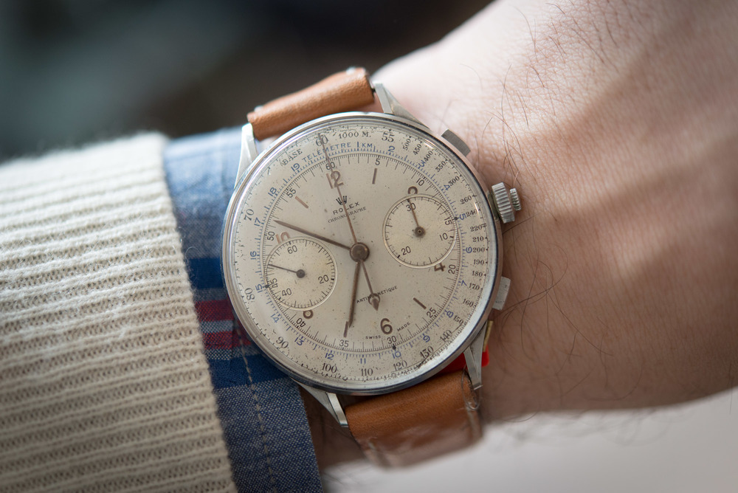
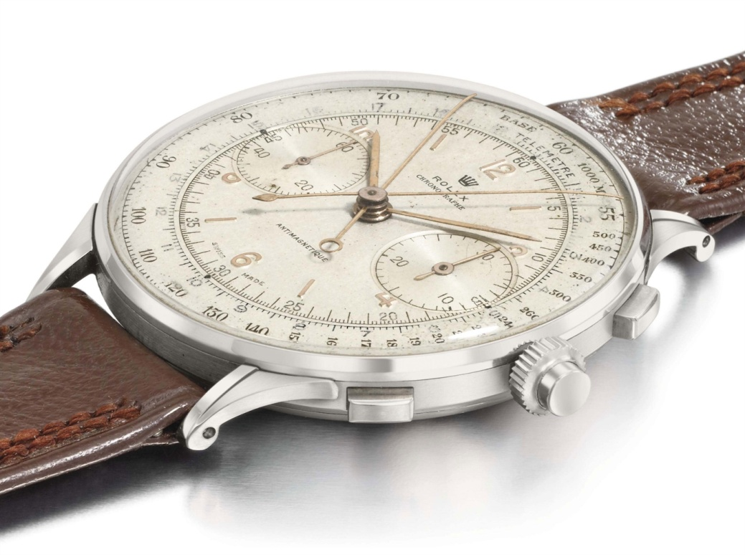
Products
1942 Rolex Chronograph

Slide 27

Brand Goal
For life’s defining moments
Eternal perfection

Slide 28
Reference
https://zh.wikipedia.org/wiki/Portal:%E7%91%9E%E5%A3%AB 瑞士歐洲位置
http://bbs.hupu.com/1580543-159.html 瑞士行政區
http://lovegeo.blogspot.tw/2015/08/blog-post_46.html 瑞士相對位置
http://hk.aboluowang.com/2015/0117/501175.html 瑞士紙幣
http://forex.hexun.com/2015-01-23/172695377.html 瑞士貨幣
http://zh.climate-data.org/location/993911/ 瑞士氣溫
http://www.fhschools.com/bbs/read.asp?id=6851 瑞士語言分布
http://www.swissinfo.ch/chi/%E7%9C%8B%E5%9B%BE%E8%AF%B4%E8%AF%9D_%E4%BB%8E9%E5%BC%A0%E5%9B%BE%E8%A1%A8%E7%9C%8B%E7%91%9E%E5%A3%AB%E4%BA%BA%E5%8F%A3%E5%8F%98%E8%BF%81-%E5%A4%9A%E5%8F%98%E5%8C%96-%E8%80%81%E9%BE%84%E5%8C%96/41126140
https://zh.wikipedia.org/wiki/%E7%91%9E%E5%A3%AB#.E6.B0.94.E5.80.99
http://www.myswitzerland.com/zo-tw/destinations/nature-parks-unesco.html

Slide 29
reference
https://www.youtube.com/watch?v=Hp5isXYhlaU
https://www.youtube.com/watch?v=l0D9OWiQAx4
http://www.rolex.com/zh-hant
https://zh.wikipedia.org/wiki/%E5%8A%B3%E5%8A%9B%E5%A3%AB
http://www.appledaily.com.tw/appledaily/article/forum/20150825/36740542/
http://ww.daliulian.net/cat79/node1044368

