Slide 1
ESL Podcast
How do you like the website?
What can you do with this website?

Slide 2

Google Syntax

Slide 3




Web Search Engine
Do you use a search engine?
What can a search engine do?
A web search engine is a software system that is designed to search for information on the World Wide Web.
  (1998)

Slide 4

Group Discussion
Do you use Google to locate information (Google Search)?
If yes, how do you find the information you need?
Form into groups and share your experience.
  What do you usually do with Google search?
  Please give examples.

Slide 5

Tips
You already use Google, but using clever tips will save you time and give you more accurate results.
Use a special syntax to tell Google that you want to restrict your searches.

Slide 6
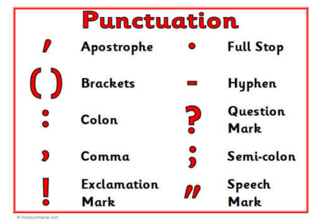
Two kinds of syntax
Punctuation & Symbol
Search operators

Slide 7
Reminder
Google Search usually ignores punctuation, except for the examples listed on their website.

Slide 8
Punctuation
“ “
Look for exact words or phrase.
When you put a word or phrase in quotes, the results will only include pages with the same words in the same order as the ones inside the quotes.

Slide 9
Example
English listening
“English listening”
English listening
  ( 227,000,000)
“English listening”
  (443,000)

Slide 10
Example
“linking in English pronunciation“
https://www.youtube.com/watch?v=23waYQrmo6w

Slide 11
*
asterisk
Add an asterisk as a placeholder for any unknown or wildcard terms.

Slide 12
Example
Please comment ______ the blog posts.
How to _________ my life
He is upset_____ his mother….
Look forward to ___________
我期待……
  聽到你的消息.

Slide 13
Operator
site:
related:
filetype:

Slide 14
Site:
Get results from certain sites or domains.
  Site:
    http://www.cnn.com
    http://www.taipeitimes.com
    http://www.bbc.co.uk
  Domain
    Edu, gov, org
    Nation: jp, tw, hk, id, sg, de, ph…etc.

Slide 15
Examples
Jeremy Lin from NBA
Jeremy Lin from TaipeiTimes
Taipei 2015 from CNN news
“self-driving car” from Japan

Slide 16
related
Find sites that are similar to a web address you already know.
聯合新聞網
http://udn.com

Slide 17

related
www.cnn.com

Slide 18
Review
Look for Podcast which is design for EFL (English as a foreign language learners)
Yesterday, there was ______ rain.
The lake is so ______.
His mom hit him _______.

Slide 19
Review
Taiwan and China presidents
  http://www.cnn.com
News from china website

Slide 20
filetype
pdf
jpg
bmp
ppt

Slide 21
filetype
“effective presentation”
“self-driving car”
filetype:pdf
2015
jpg/bmp (pumpkin farm)
video
Domain
  jp
  de

Slide 22
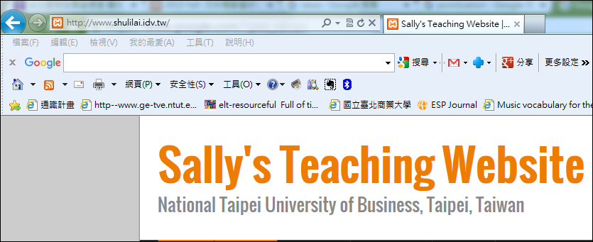
Google Toolbar
http://www.google.com/intl/zh-TW/toolbar/ie/index.html

Slide 23
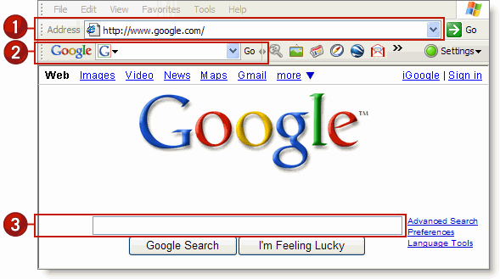
Google Toolbar

Slide 24

Your turn
Try out more keywords and syntax and see how they work.

