Slide 1
Unit One: Introduction to Computer Assisted Language Learning
Written by Phil Hubbard

Slide 2
The Writer
http://web.stanford.edu/~efs/callcourse2/CALL1.htm
Who is the writer of this article?
Who maintains this website?
What is the website for?
Link: http://web.stanford.edu/~efs/phil/

Slide 3
An Introduction to CALL
What is CALL?
Acronyms and attitudes
A thumbnail sketch of CALL history
The scope of CALL

Slide 4
When did Internet become popular?
The World Wide Web was invented in 1989. The first website was launched in 1990. But during all of that, most people didn't know about the internet.

Slide 5
When did Internet become popular?
The internet became well known with the launch of Windows 95 in 1995, but most people didn't get it in their homes until 1997 and 1998. In fact, the percent of households with internet access only reached 50 percent in 2000! Some people didn't see any usefulness in the internet or simply didn't want to pay the high prices. Remember that there was no YouTube, Facebook, or even Google in the earliest days of the internet.

Slide 6
When did Internet become popular?
Also keep in mind that home computers didn't become popular themselves until around 1995. Windows 95 was the first highly anticipated product-- before then, many products just faded into popularity.

Slide 7
What is CALL?
CALL is the acronym for computer-assisted language learning.
Definition of CALL:
  Any endeavor (attempt) to involve the computer and the associated technologies of all types--desktops, laptops, tablets, smart phones, mp3 players, interactive whiteboards, etc.-- in some significant way in language teaching and learning.

Slide 8
Two functional Roles
Computer as a tutor
  The computer in some way has a teaching function
  The computer as a machine to deliver interactive language learning and practice materials
Computer as a tool
  The computer has no overt teaching function
  Computer as a means for learners to experience the authentic language and communication opportunities.

Slide 9
Computer as a tutor
  Grammar Exercise
    https://learnenglish.britishcouncil.org/en/grammar-exercises
  Listen & Watch
    https://learnenglish.britishcouncil.org/en/word-street/history-scene-1

Slide 10
Computer as a tool
Email program
Web search engine (Google)
Word processor
Facebook
Line

Slide 11
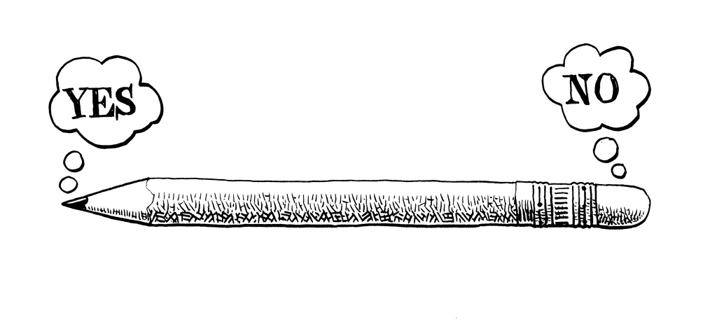
Are these to opposing philosophies?
As a tool
As a tutor

Slide 12
Different names
CALL
CELL
TELL
TALL
DLL
MALL

Slide 13
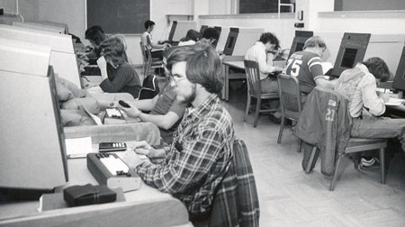
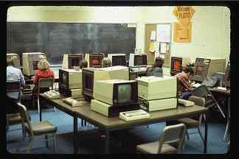
CALL History
CALL began in 1960s.
The University of Illinois Plato System.

Slide 14
1980s
Microcomputer
Most language program was written by teacher developers.
Commercial programs were expensive at that time.
Traditional labs were replaced by computer labs.

Slide 15
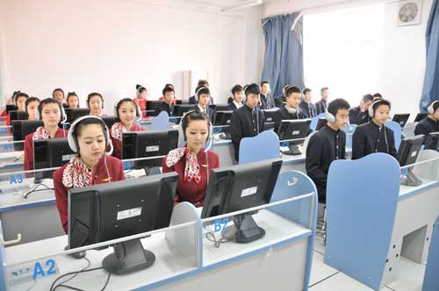
Multimedia Language Lab

Slide 16
In the late 80s and 90s
The use of computer as a tool increased.
  Apple Macintosh
  PC
Using email and word processors into writing class.
CMC: computer mediated communication
  E-pal project
  Cross culture communication

Slide 17
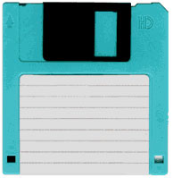

In the mid-1990s
Two major changes
  Commercial multimedia for language learning
    Because CD ROMs became standard in home computers.
  development of the world wide web (www).
1.44 MB
700 MB

Slide 18

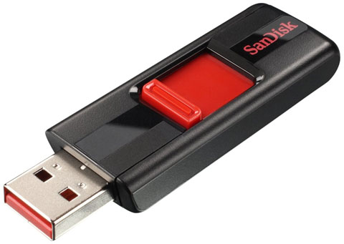

The 21 century
Smart phone
  App
  Go online everywhere
Social media
  Facebook
  Skype
  Line
Gamification
  Online games

Slide 19


