Slide 1


Slide 2
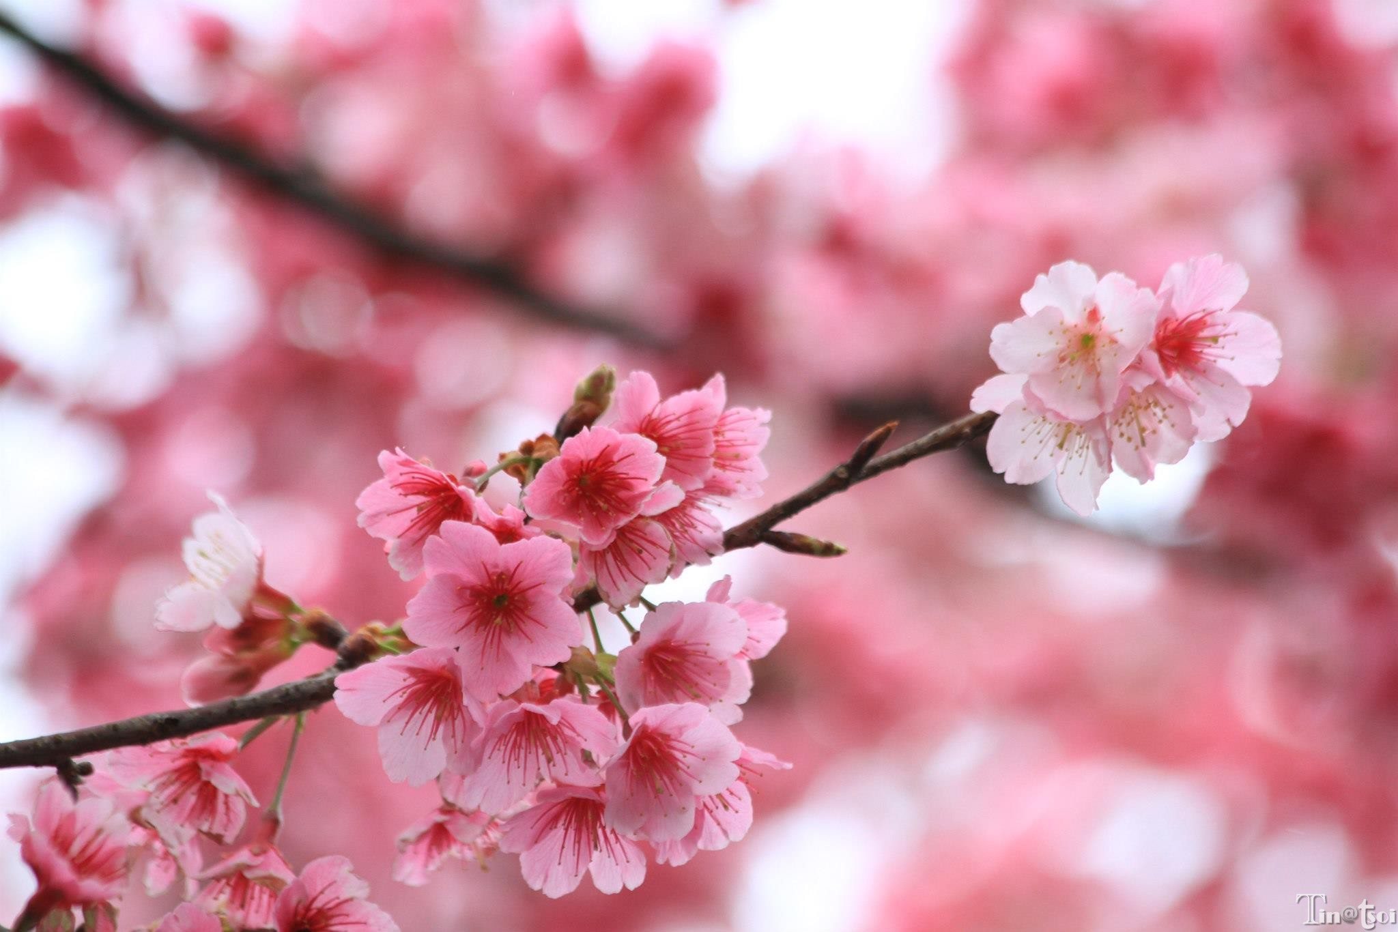
Cherry blossoms

Slide 3


Slide 4
Orientation
Textbook
  Reach Out
Outside reading and listening
  Studio Classroom
Syllabus

Slide 5

How was your winter vocation?
How was your winter vocation?
How was your Chinese New Year?
Did you go anywhere?
Did you visit anyone?
Is there anything special or interesting that you would like to share with your classmates?

Slide 6

Group Discussion
Please form into a group of 3 and discuss these questions.
15 minutes

Slide 7

Your turn…
Please prepare a one-minute sharing about your winter vocation, or about your Chinese New Year!
We’ll draw lots to decide who would come up here to share next.

