Slide 1
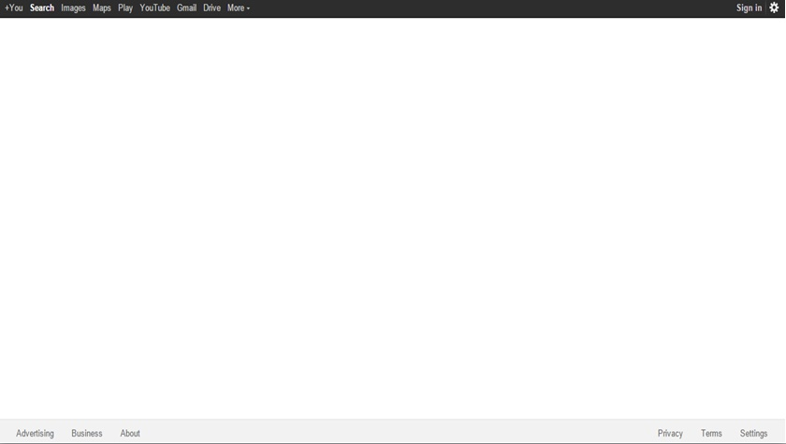

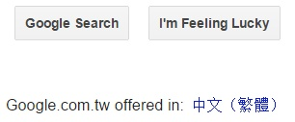
Google Syntax
3/31
林麗瑛 | Rina | 10244006
鄭宇涵 | Eva | 10244029
馮 雅 | Amber | 10244032
邸筠捷 | Trista | 10244037
潘璿如 | Melody | 10244039

Slide 2
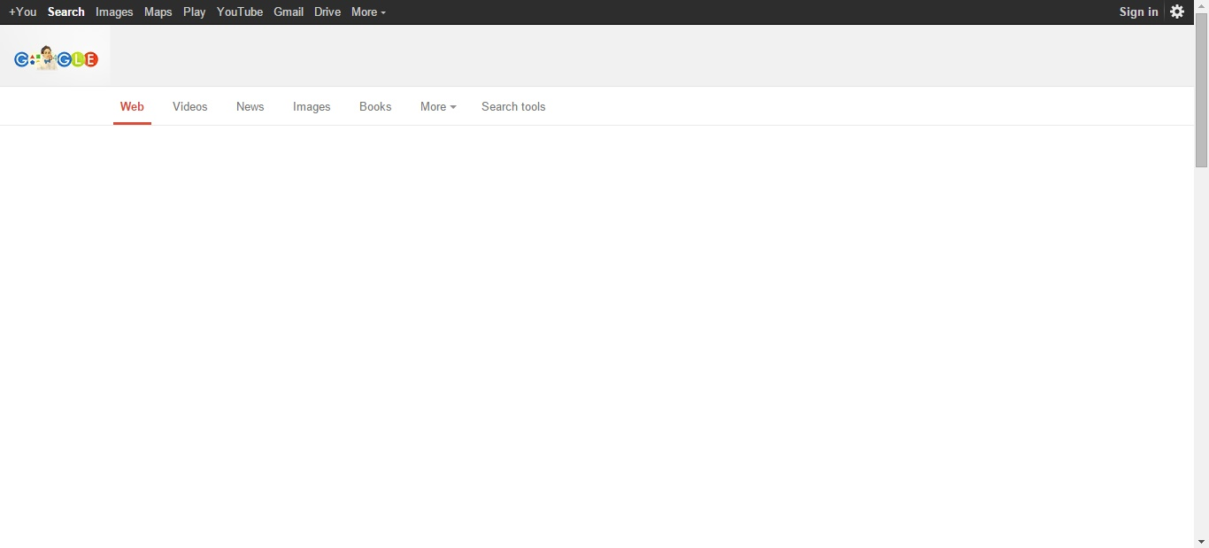

Contents
General syntax
General Domain
General Search Operators
Functions of Google toolbar and Download Google toolbar
Practices

Slide 3

General Syntax
「”“」Search completed sentences.
「 *」 Use Wildcards

Slide 4
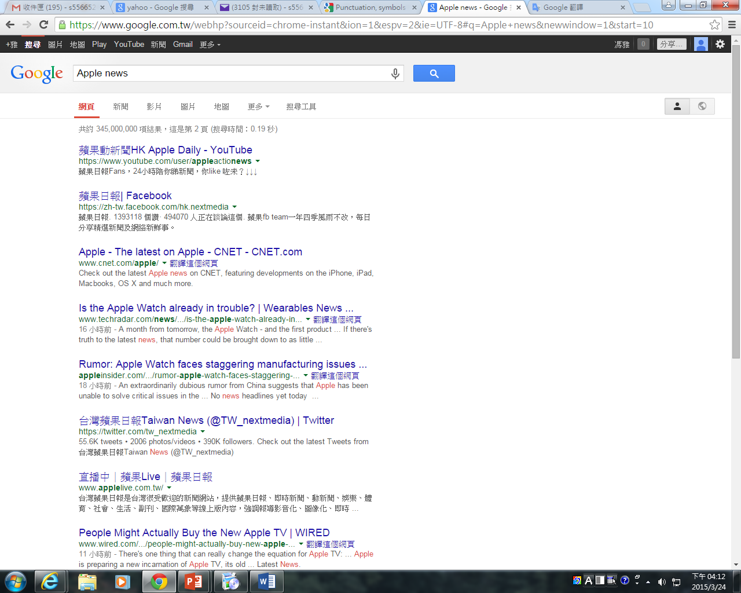
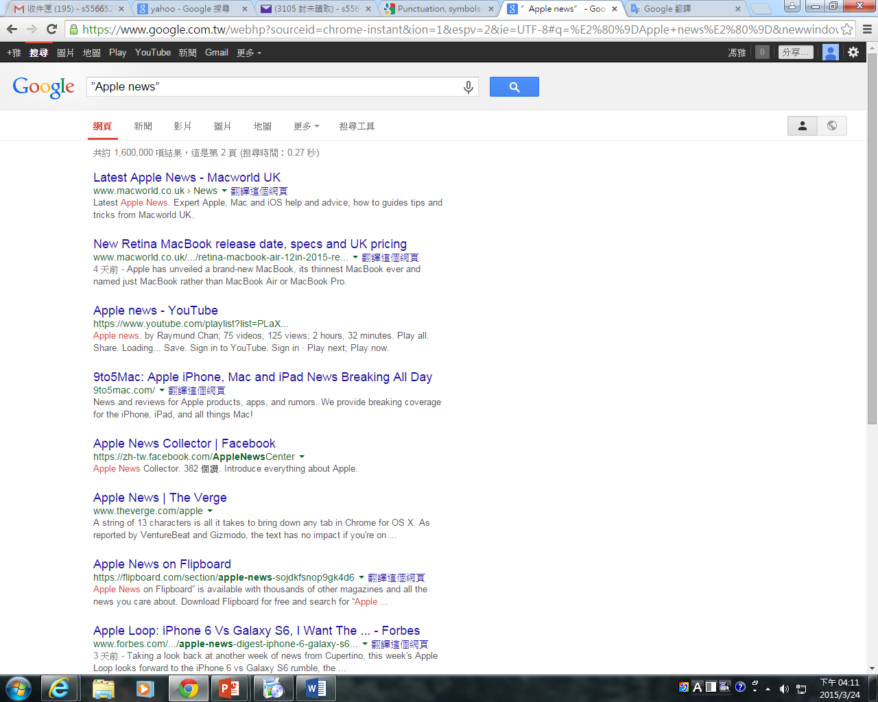
「 ”“ 」
General Syntax
「”“」Search completed sentences.
For example, ”Apple news”

Slide 5
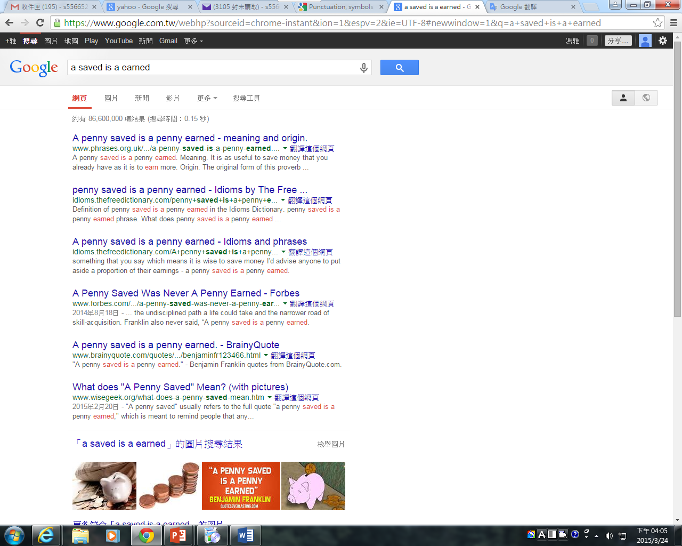
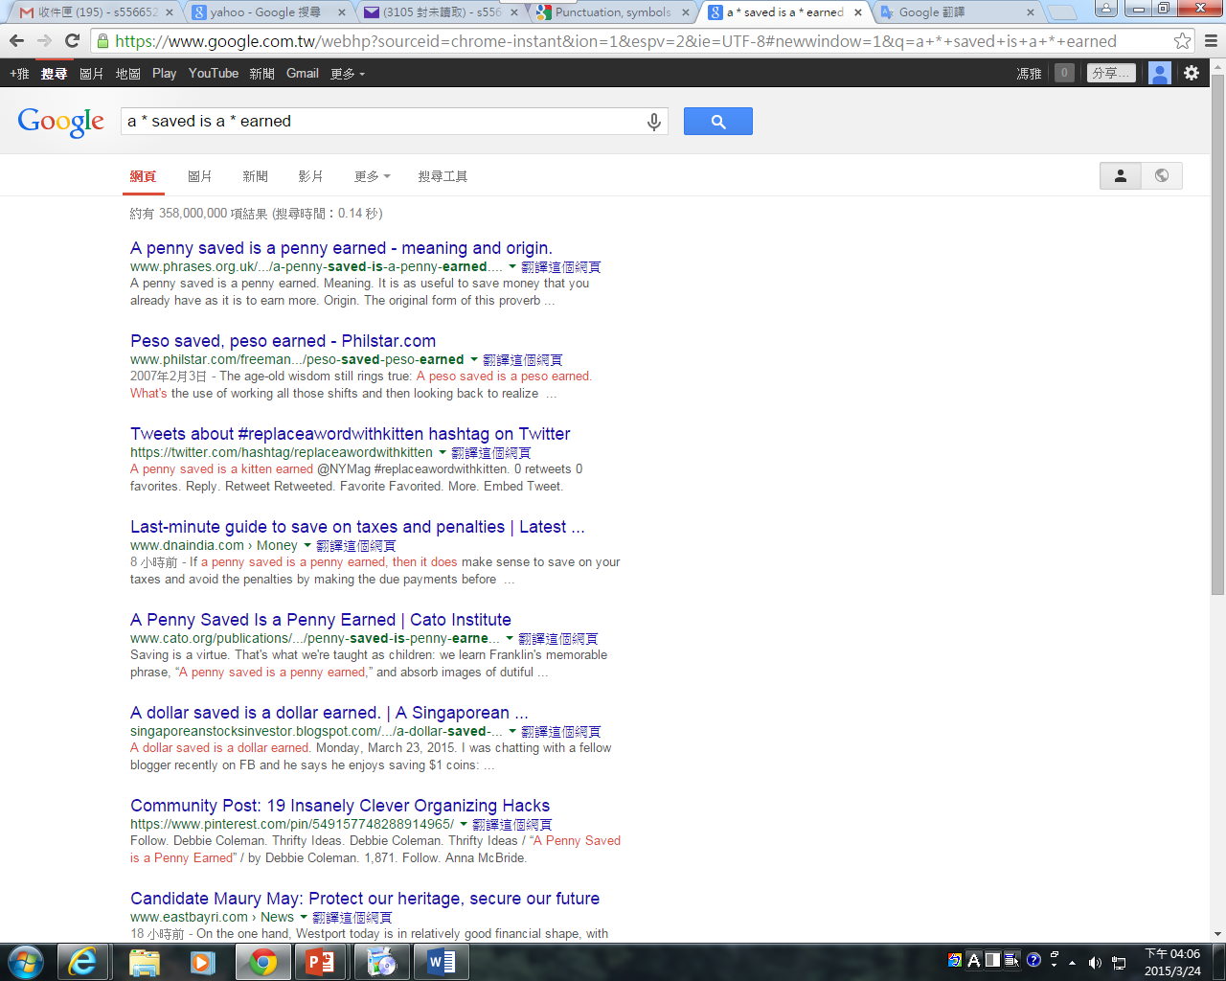
「 * 」
General Syntax
「 *」Use wildcards
For example, a * saved is a * earned

Slide 6
General Domain
「.tw」 | Taiwan. | 「.com」 | Commercial organization.
「.cn」 | China. | 「.org」 | Organization.
「.jp」 | Japan. | 「.edu」 | Educational institutions.
「.uk」 「.gb」 | England. | 「.gov」 | Educational institutions.
「.us」 | USA.(Usually Omission)

Slide 7

General SearchOperators
「 site 」 ：Search specific sites or domains.
「related」：Find sites that are similar to a URL you already know.
「filetype」：Search the specific type.

Slide 8
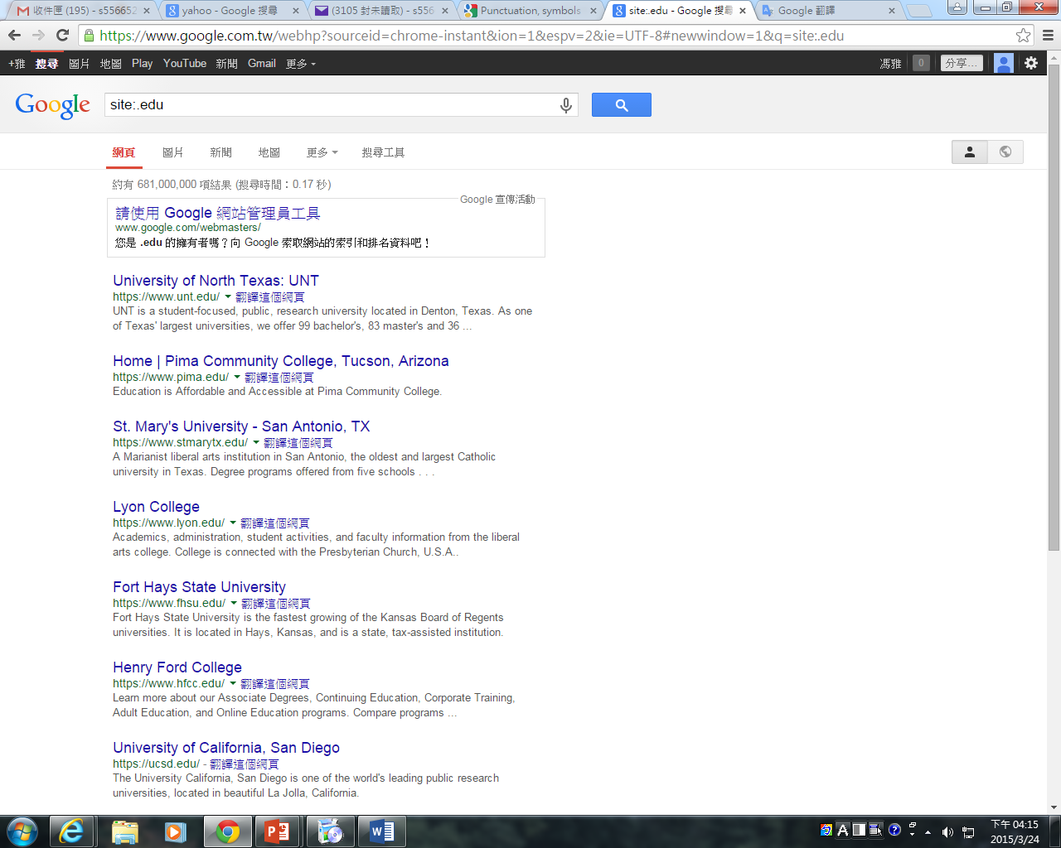
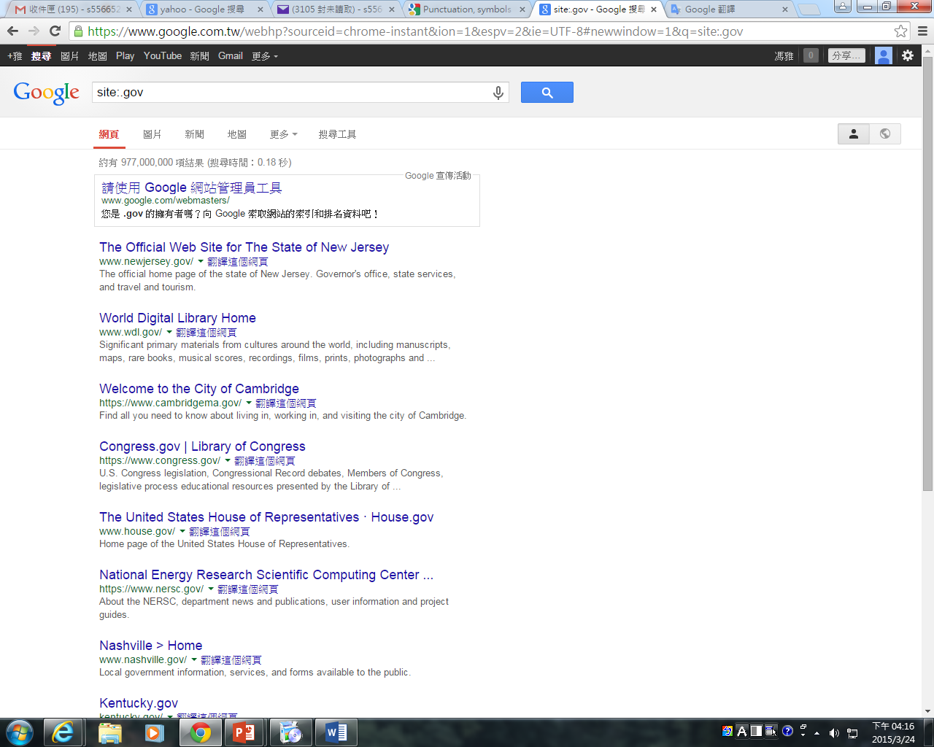
「 site 」
General Search Operators
「site」：Search specific sites or domains.
For example, site:.edu、site:.gov

Slide 9
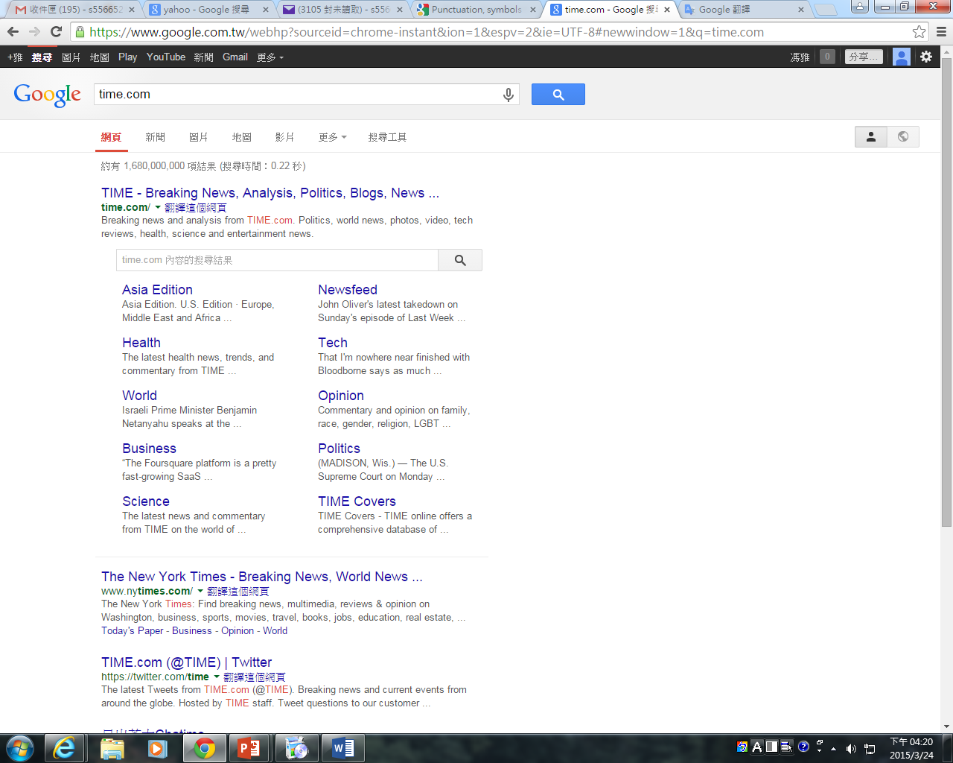
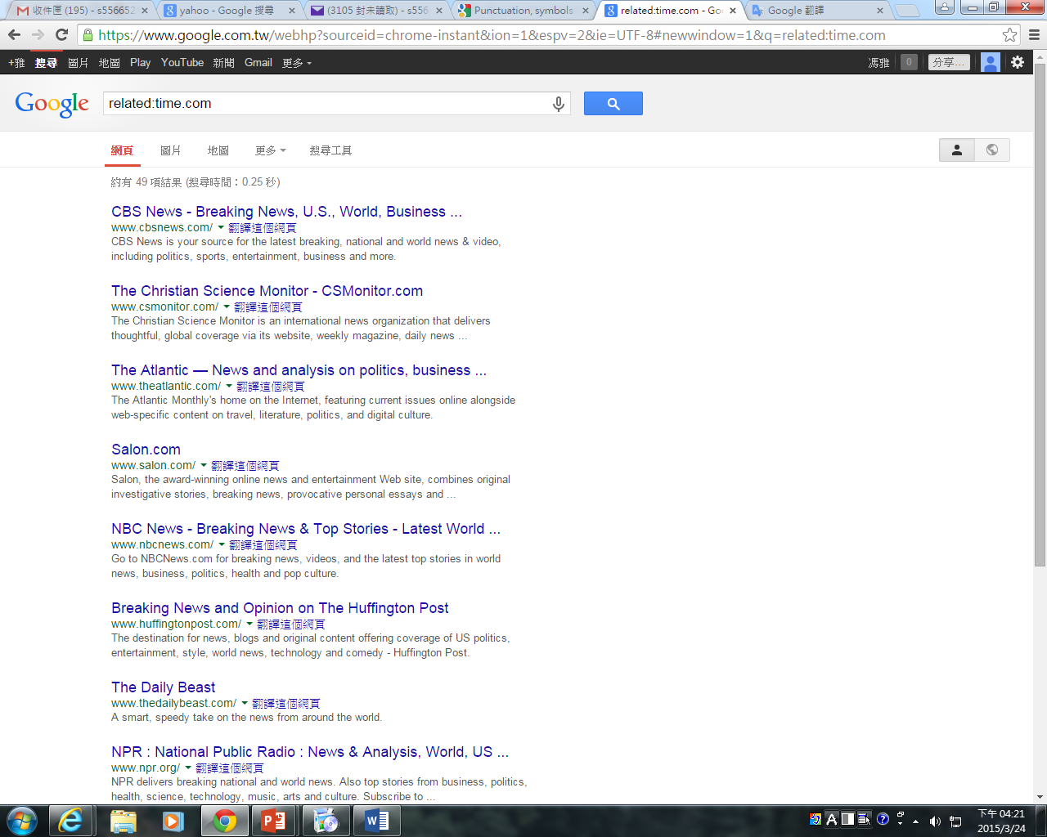
「related」
General Search Operators
「related」：Find sites that are similar to a URL you already know.
For example, related:time.com

Slide 10
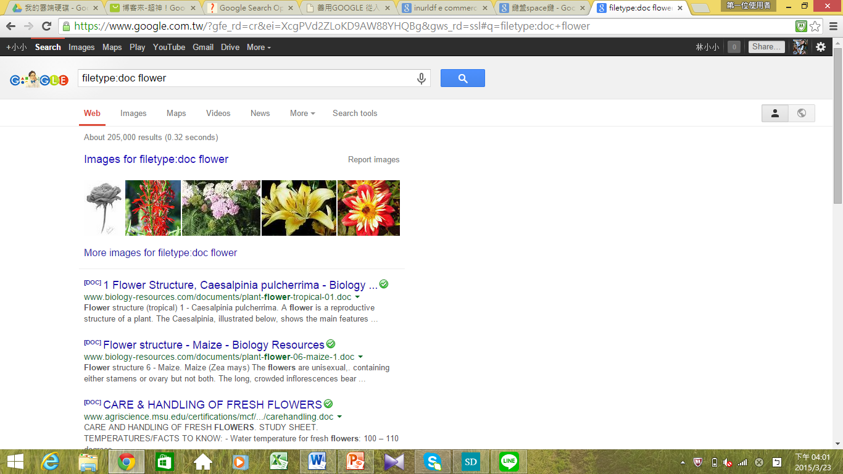
「filetype」
General Search Operators
「filetype」：Search the specific type.
For example, filetype:doc flower

Slide 11
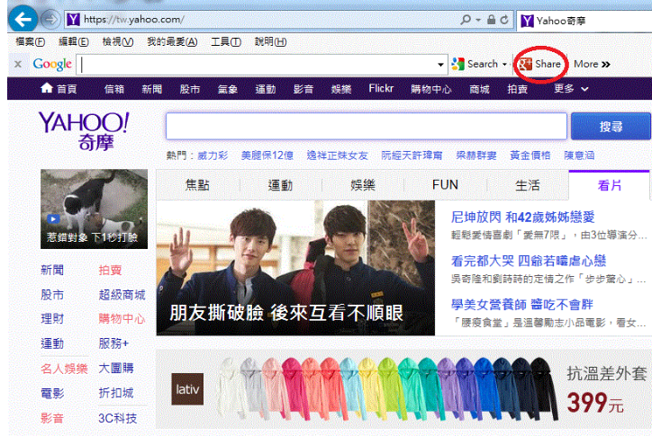
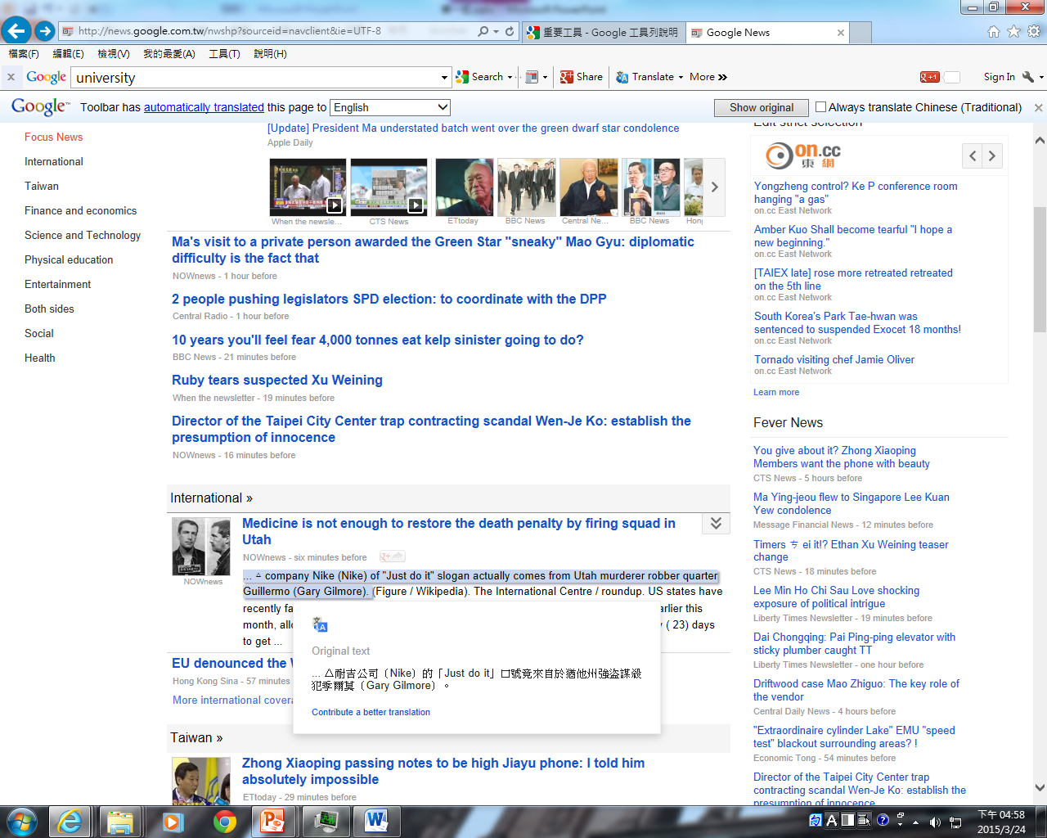
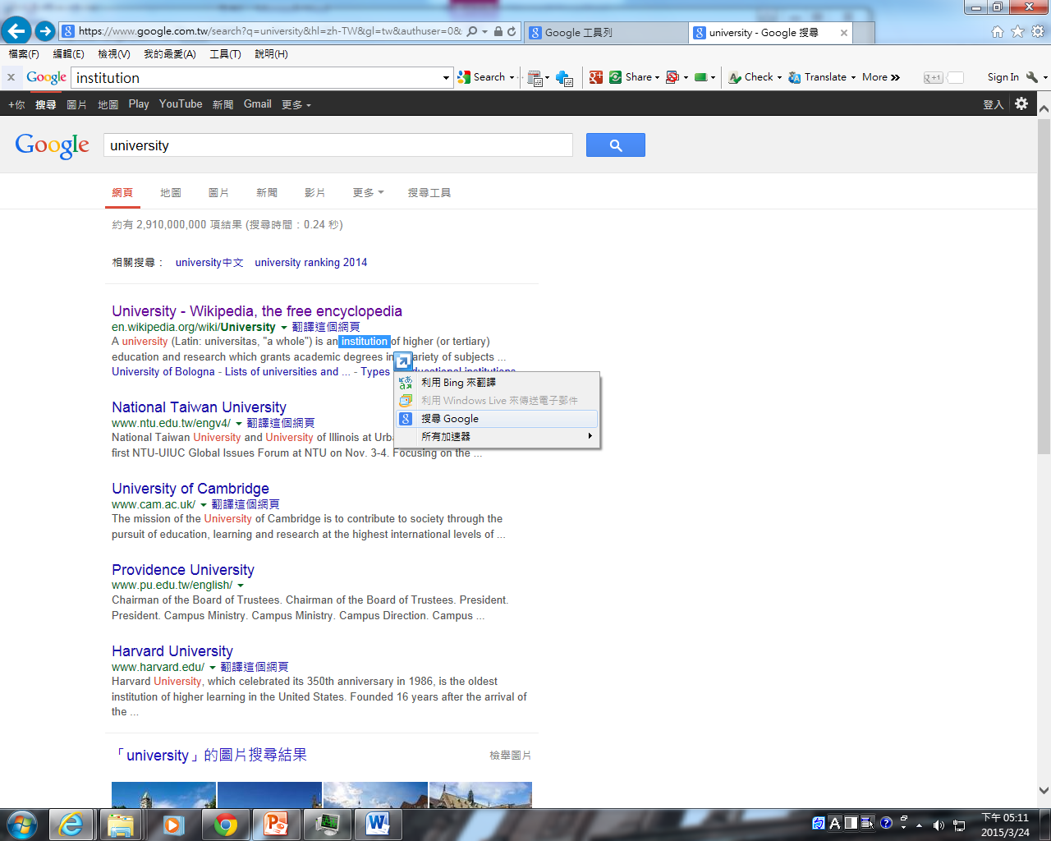
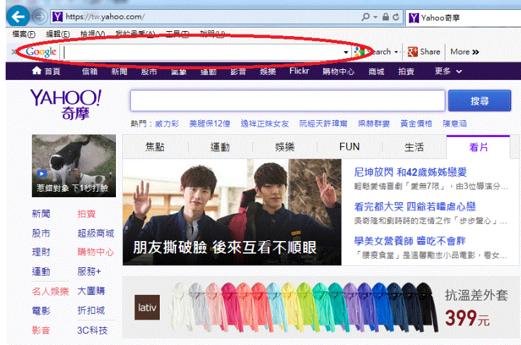
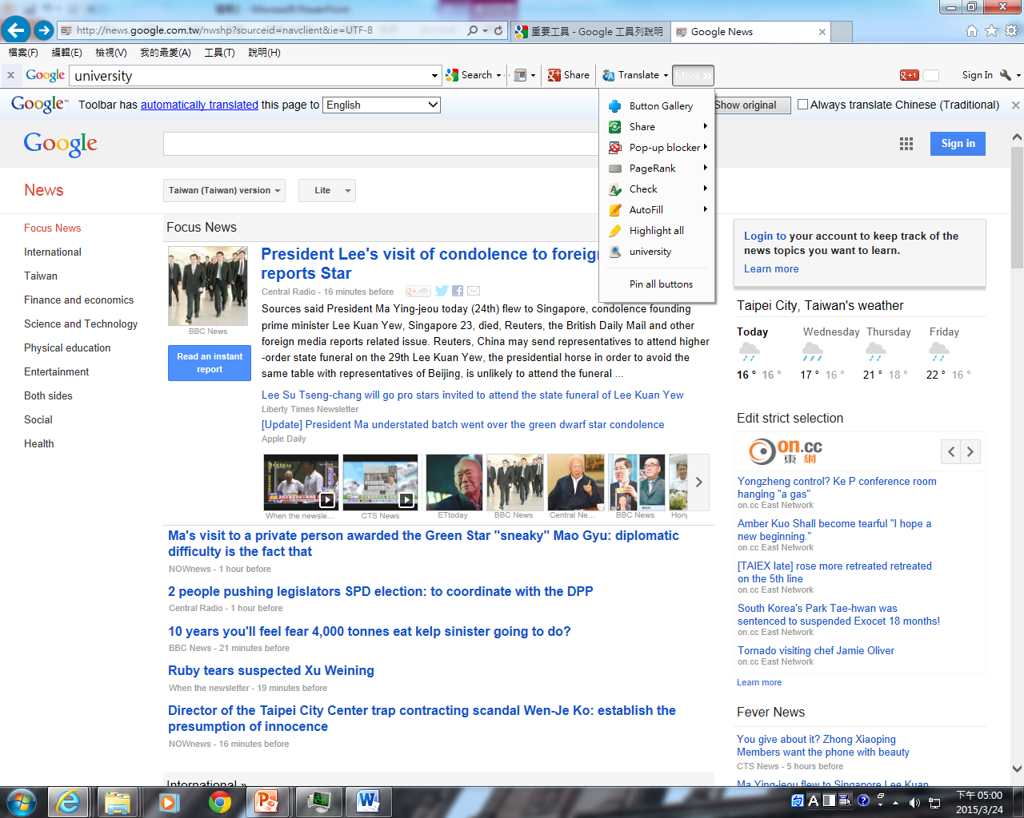





Functions of the Google toolbar
Search with Google anywhere
Make your browser your own
Browse the whole web
Share your web
Find things faster

Slide 12
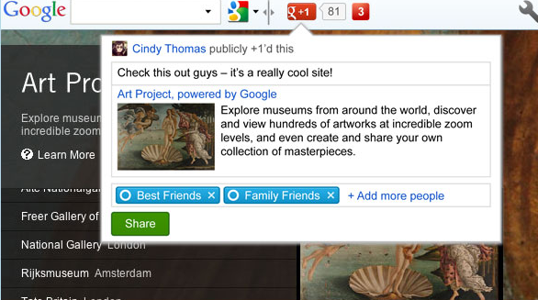
Download Google toolbar

Slide 13

Practices
If I want to find only 7-11 news, how to do it?
If I want to find 「.us」site, how to do it?
If I want to find about star’s document, how to do it?
Download google toolbar
Try function of the google toolbar

Slide 14

thanks for attention

