Slide 1
Steve Jobs’ 2005
Stanford Commencement Address
10244007 張祐綺 Yuki
10244011 林于靖 Jessica
10244027 彭昕婷 Bonnie
10244028 陳韋蓉 Alice
10244030 王奕淳 Winnie
10244042 賴宜絹 Jane
10244045 沈虹廷 Karen

Slide 2
Content
About the speech.
Background of Steve Jobs.
The three stories from his life.
Concepts of the stories.
Learning English from YouTube.
How to download videos.

Slide 3
Brief introduction
It is a speech for Standford University
graduates on June 12, 2005.
He shared three stories from his life :
connecting the dots
love and loss
death

Slide 4
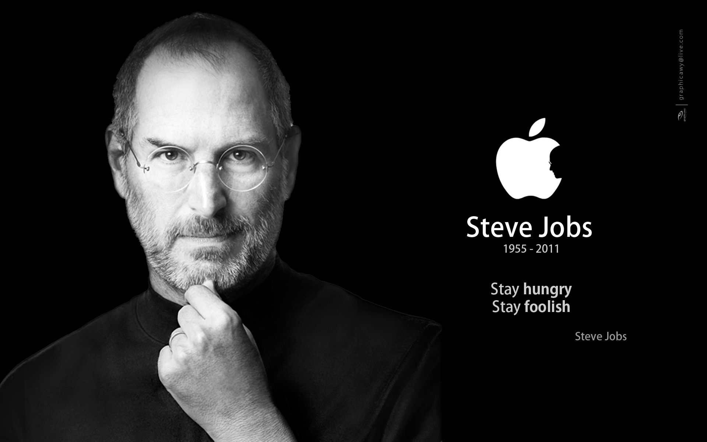

Slide 5

STEVE JOBS
CEO of Apple and Pixar Animation.
Founder of NeXT and Pixar.
Successful products – iPOD 、iPad、iPhone、
iTunes、iMac.
Died of tumor.
After he died, his life was published
as a book(Steve Jobs).

Slide 6
Connecting the dots
drop out
follow interests
connect the dots
You can't connect the dots looking forward;
you can only connect them looking backwards.

Slide 7
Love and loss
In his thirties, he got fired
Establish Next and Pixar
Find favorite and love what you do

Slide 8
Death
There is no reason not to follow your
heart.
Your time is limited, so don't waste it
living someone else's life.
Stay Hungry. Stay Foolish.

Slide 9
Concepts
Do the things you like.
A crisis is a chance.
Have the courage to follow your heart and intuition.

Slide 10
Learning from YouTube.

Slide 11


Slide 12
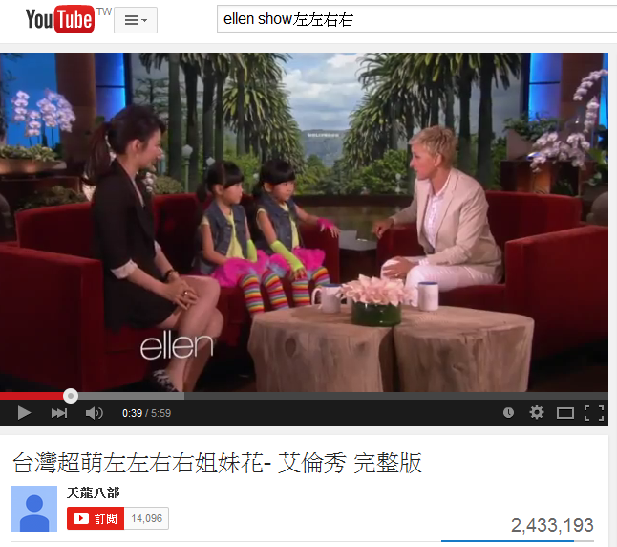

Slide 13


Slide 14
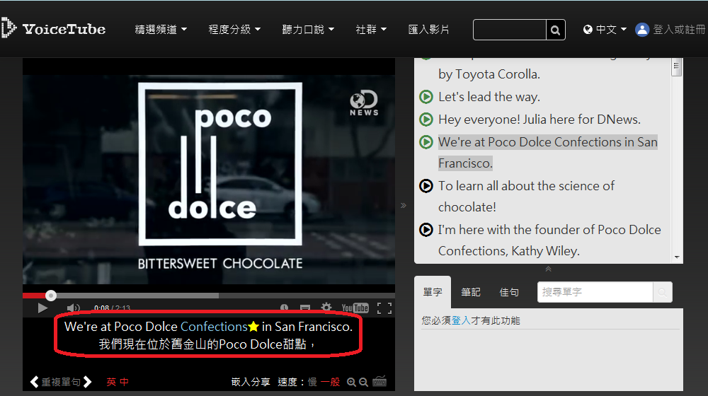

Slide 15
How to download videos?

Slide 16
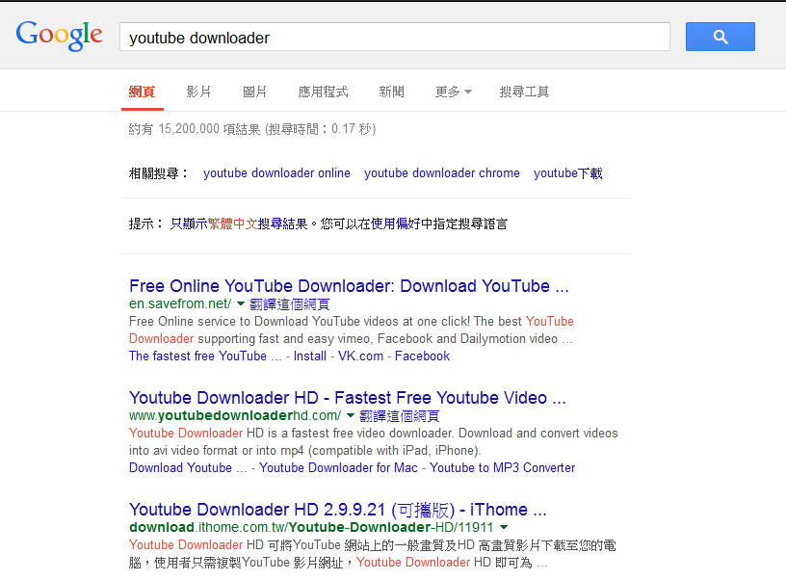

Slide 17
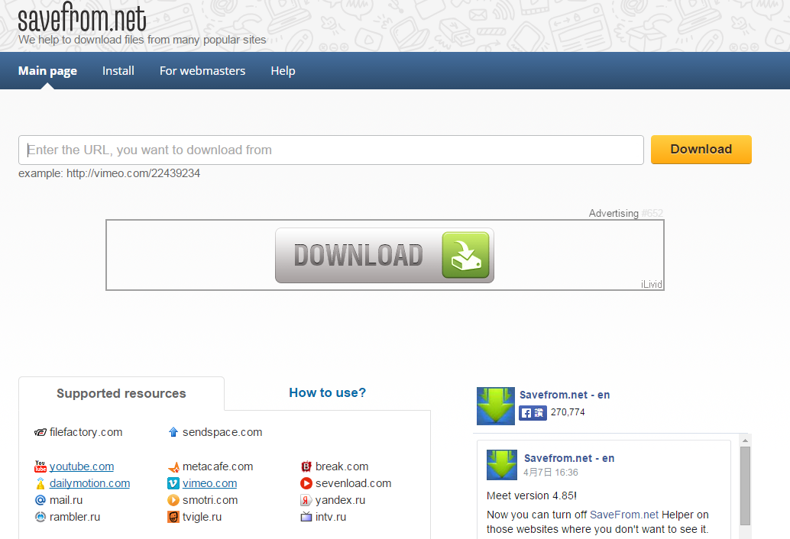

https://www.youtube.com/watch?v=iBEhvBF_DJY

Slide 18
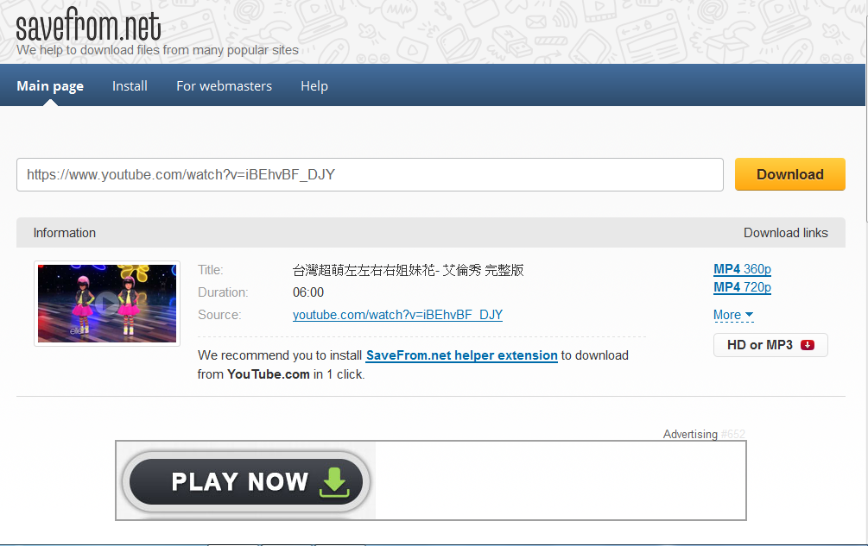

Slide 19
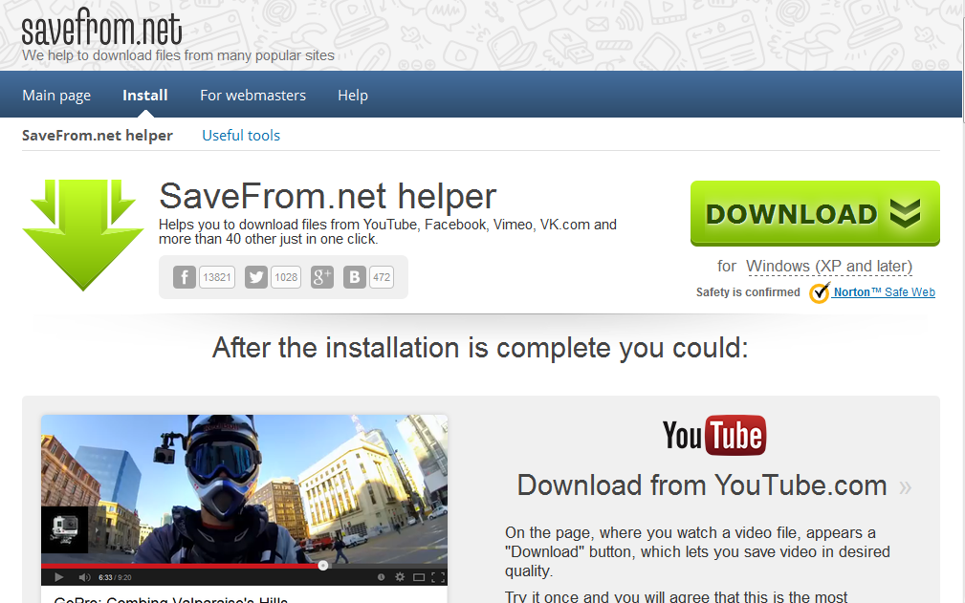

Slide 20
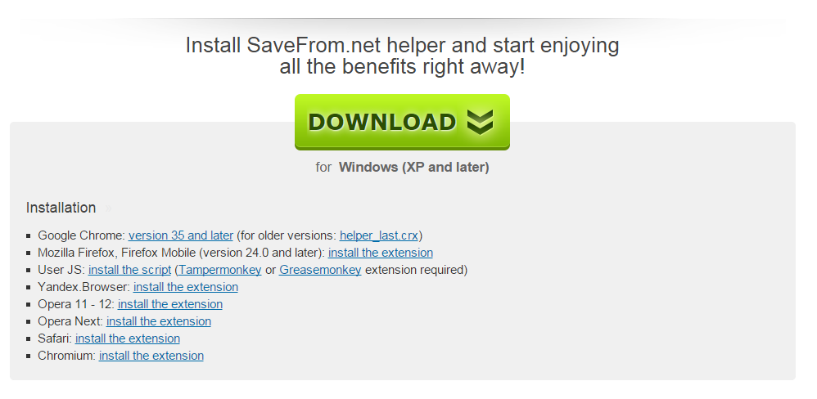

Slide 21
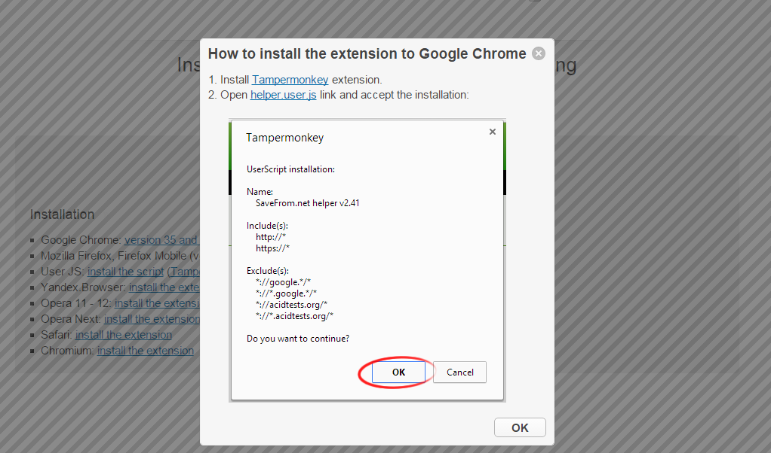

Slide 22


Slide 23
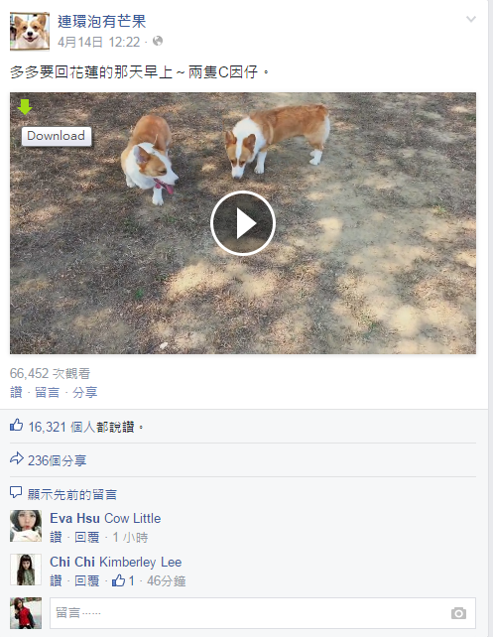

Slide 25
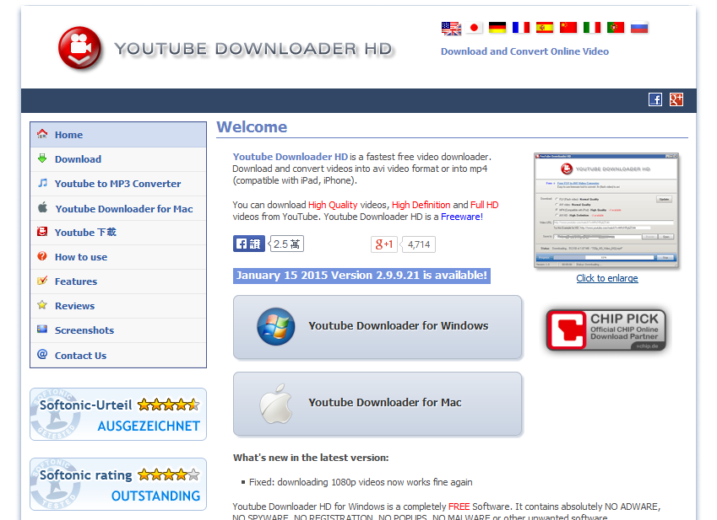

Slide 26
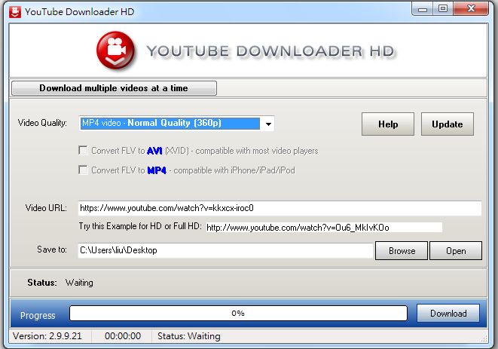

Slide 27


