Slide 1




Evaluation of an Interactive English Learning CD
邱庭瑩 10242025 Tini
江若嫚 10242027 Mandy
陳佳盈 10242039 Amy
林映汝 10242052 Ruby
廖欣瑜 10245013 Crystal
詹珮欣 10245031 Irene
陳 暐 10245034 Jano
2015/05/05

Slide 2

Outline
Studio Classroom
Super CD
Website
Study Tips
Comments

Slide 3
Studio Classroom
Focus: Using practical English to speak on a variety of topics.
Difficulty: Intermediate English level.
Audience: High school students
Content: Covers such topics

Slide 4
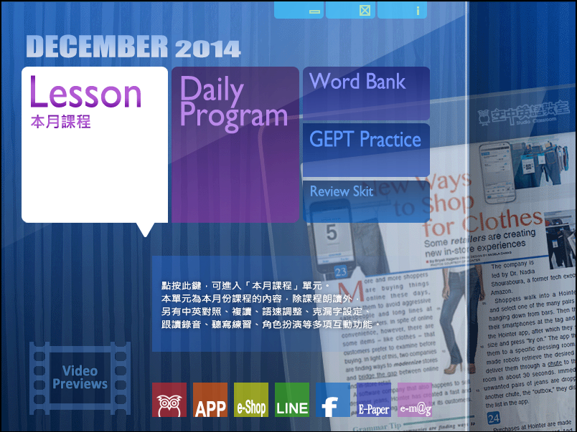

Lesson

Slide 5
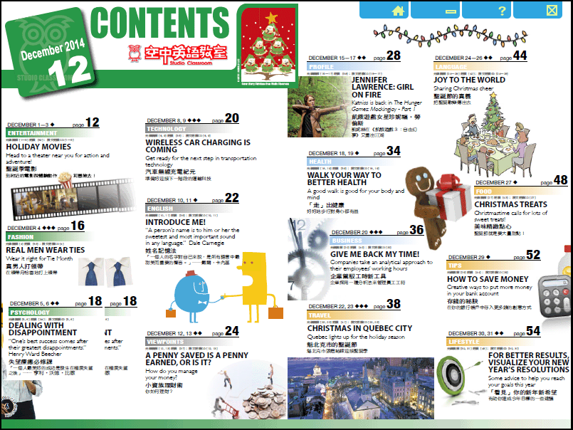

Slide 6
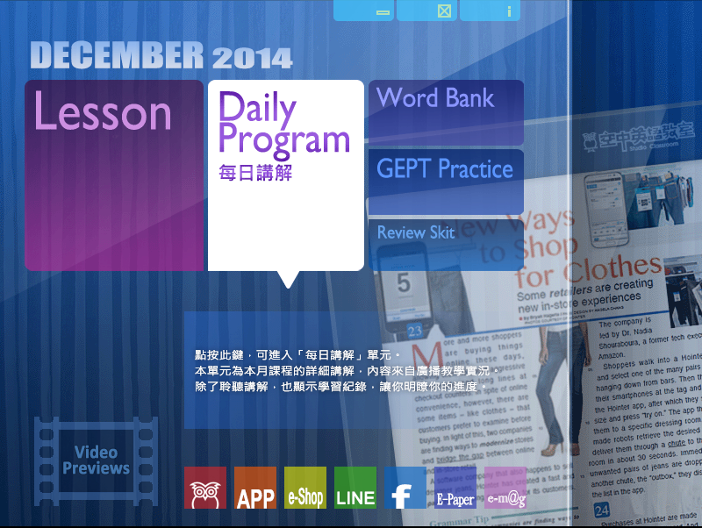
Daily Program

Slide 7
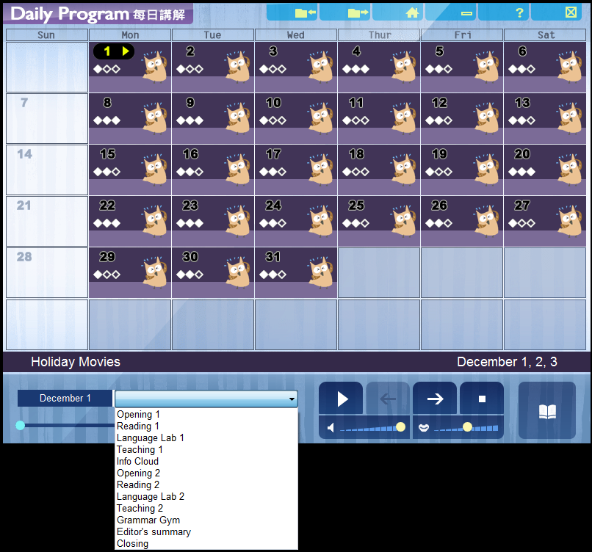

Slide 8

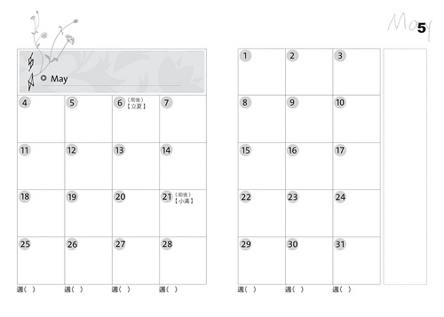
Daily Program
Opening
Reading
Language Lab
Teaching
Grammar Gym

Slide 9

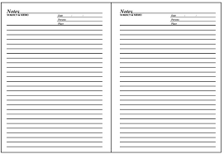
Daily Program
Info Cloud
Review Skit
Editor’s summary
Closing

Slide 10
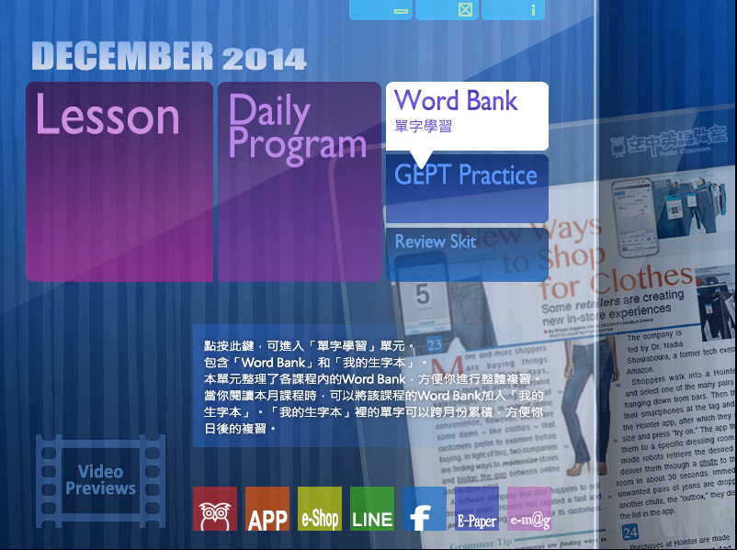
Word Bank

Slide 11
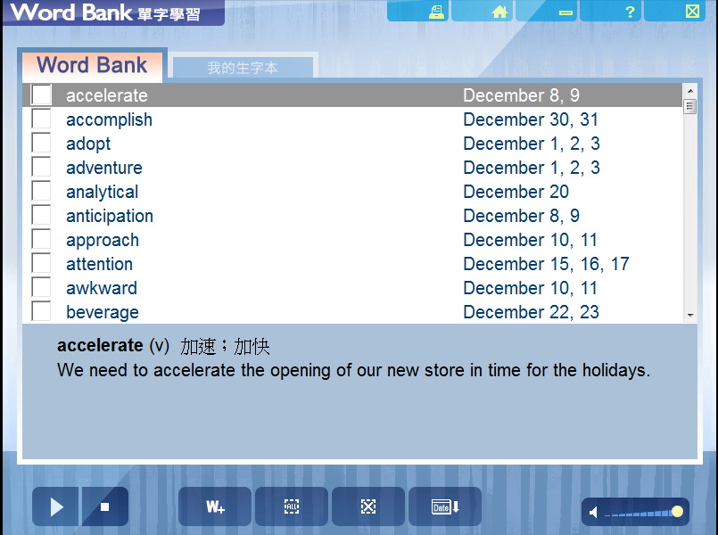

Slide 12
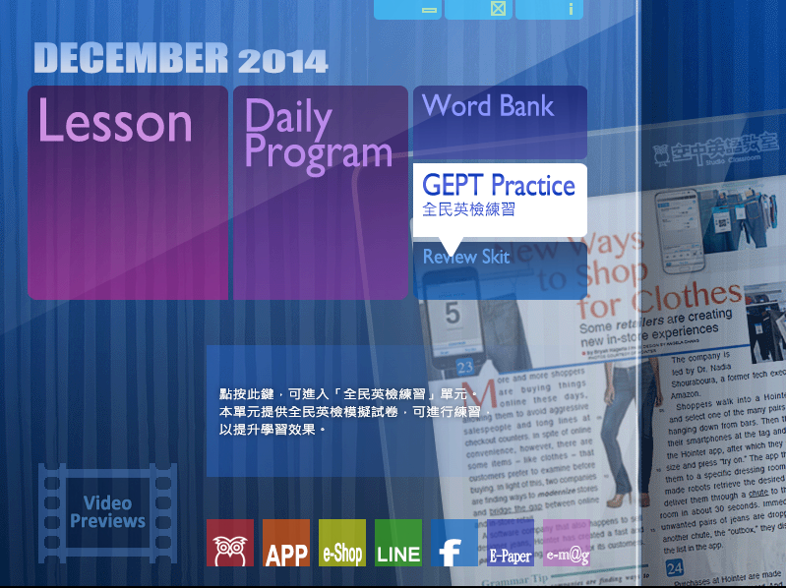
GEPT Practice

Slide 13
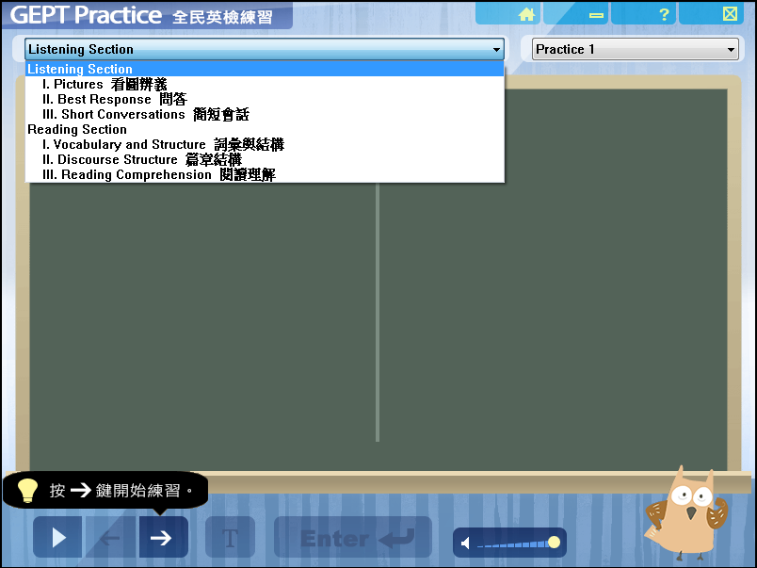

Slide 14
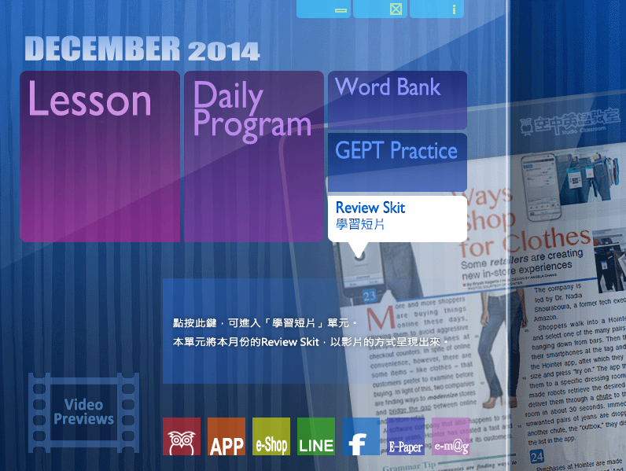
Review Skit

Slide 15
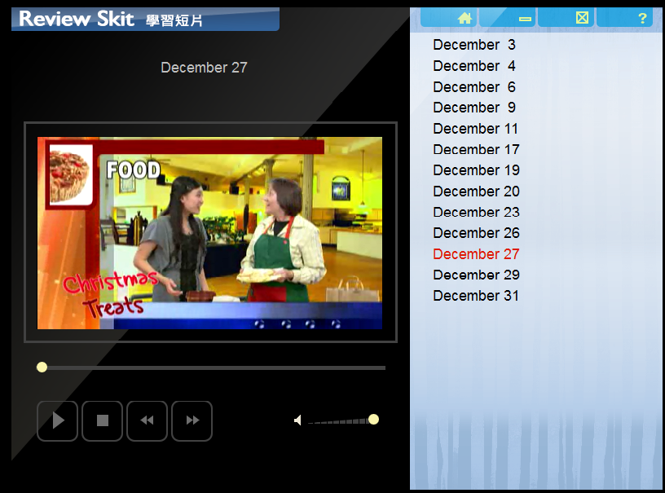

Slide 16
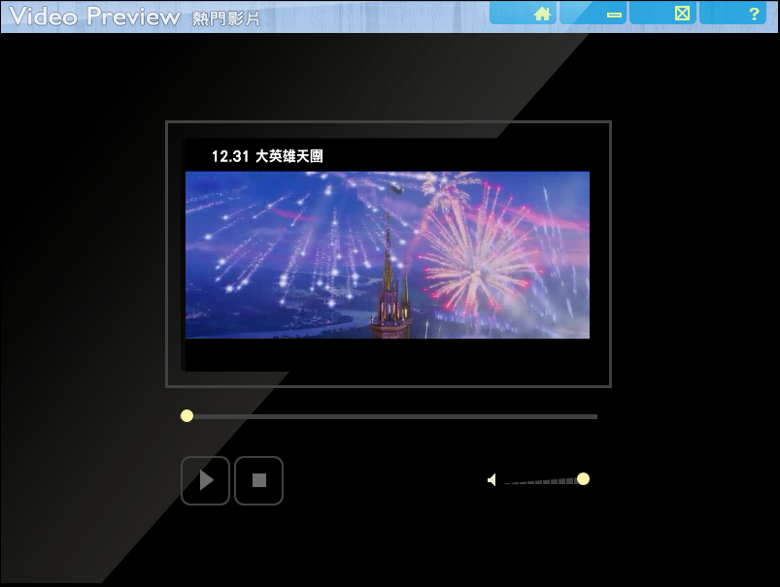

Slide 17

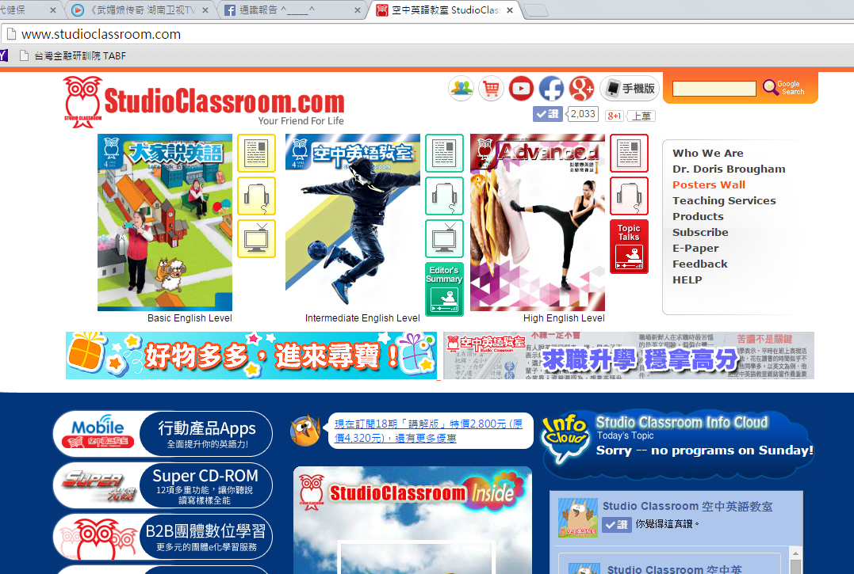
Website

Slide 18


Slide 19
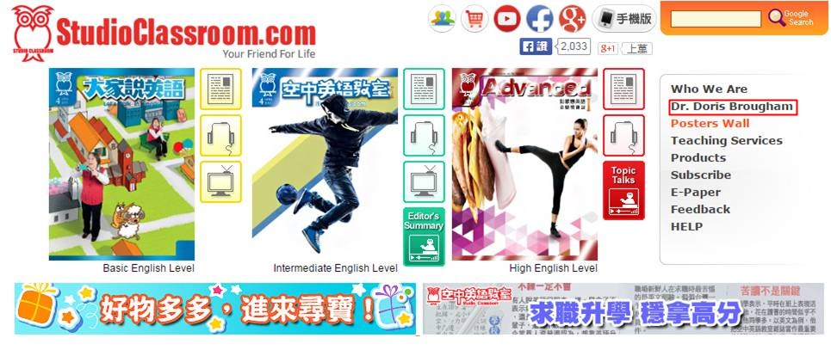

Slide 20


Slide 21
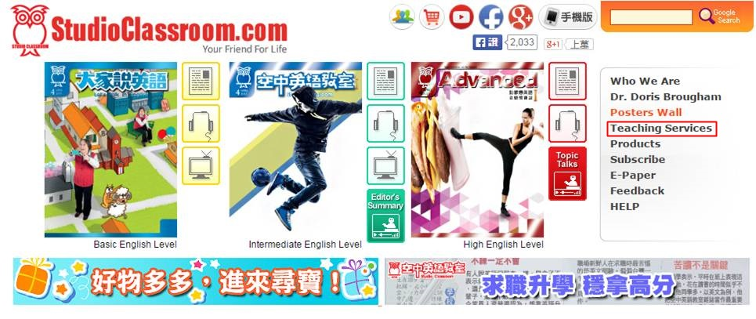

Slide 22
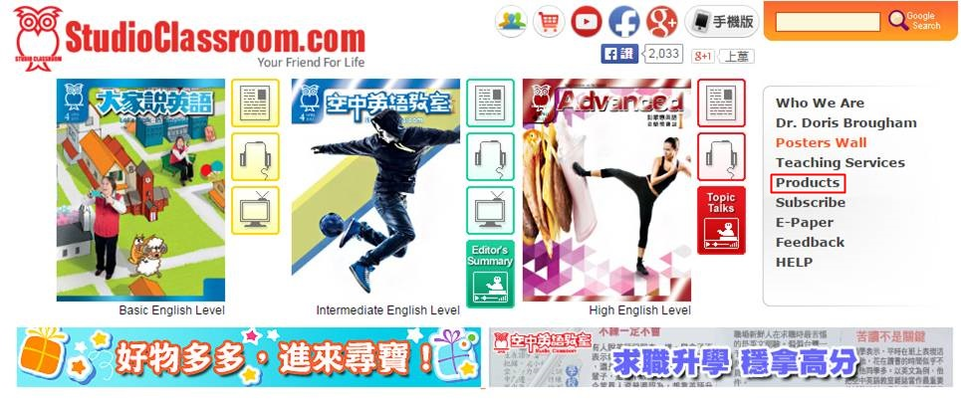

Slide 23
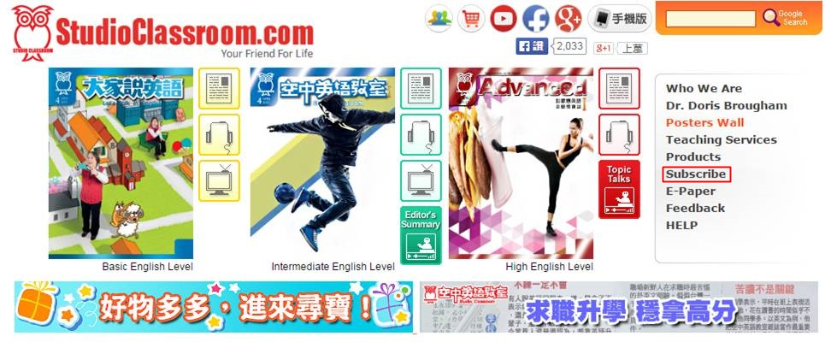

Slide 24


Slide 25
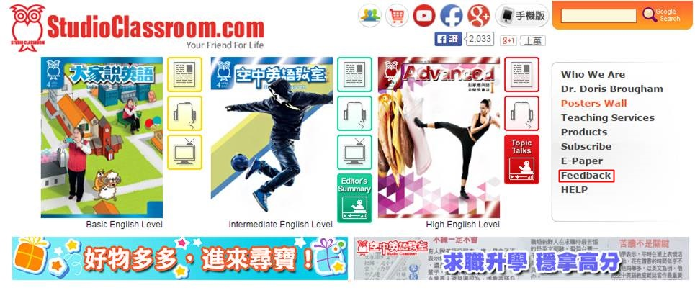

Slide 26
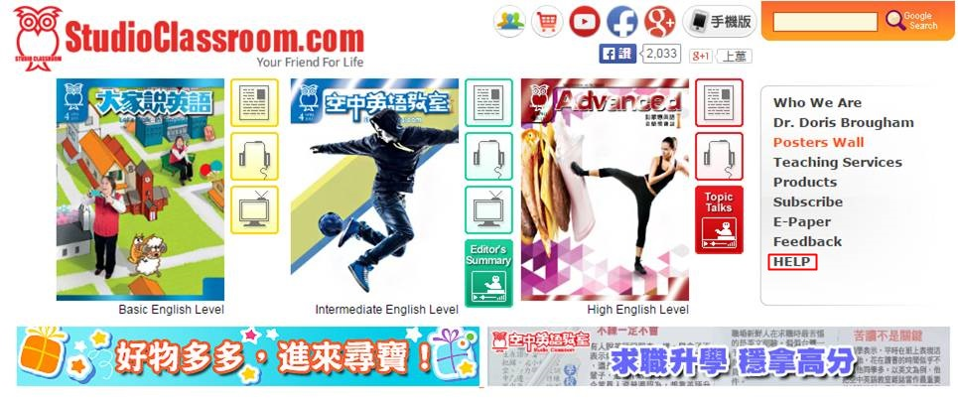

Slide 27


Slide 28


Slide 29


Slide 30


Slide 31




Other
Radio
TV
Facebook @Studio Classroom 空中英語教室
Line @linedailyeng

Slide 32
Study Tips
Before the program
During the program
After
the program

Slide 33

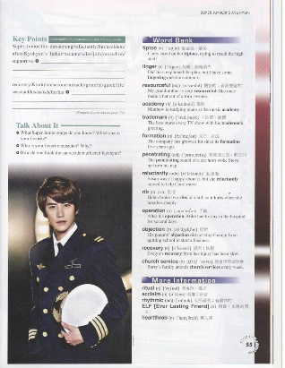
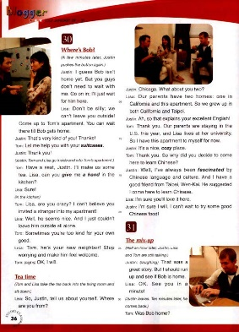
Before the program
Read the article in English
Read the Chinese translation first
Guess the meaning of vocabulary words
Find problem areas

Slide 34

During the program
Read along with teacher
Listen to the lesson
Listen carefully to the explanations
Answer the Questions

Slide 35

After the program
Look up words in the dictionary
Read lesson again aloud to yourself
Listen to it again

Slide 36
Comments
Strengths
Learn English with current events
Repeat listening and practicing
Weaknesses
Info Cloud doesn’t have the English subtitles.
Limit by tools. Can’t use it everywhere.

Slide 37

Thank you

