Slide 1
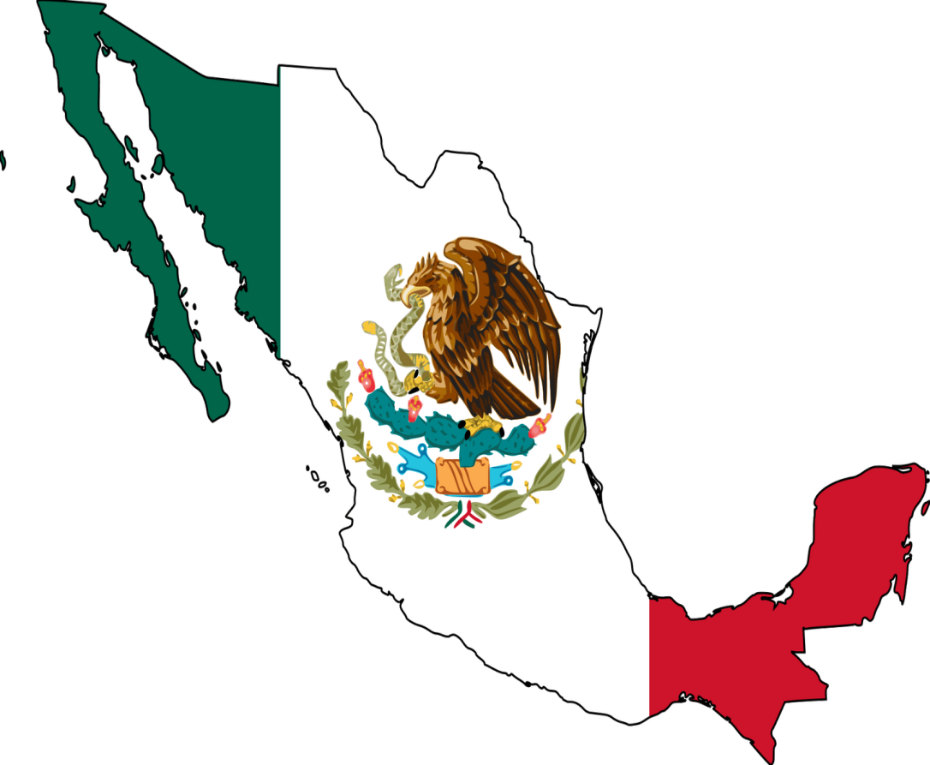
Mexico
Sunny 05
Betty 12
Carlo 14
Nancy 21
Chainal 23
2015/05/26

Slide 2
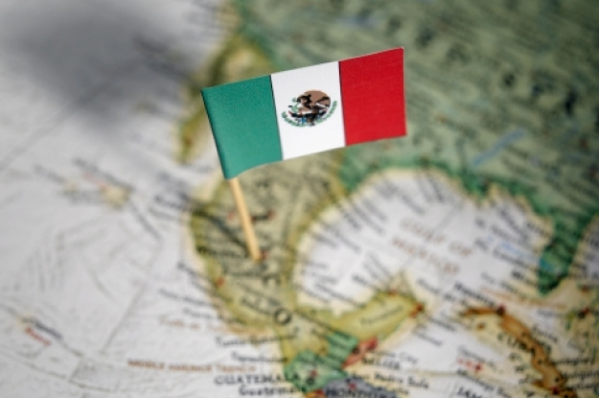
Outline
Mexico Overview
Mexico of the Economic
Mexico of the Representative Company

Slide 3
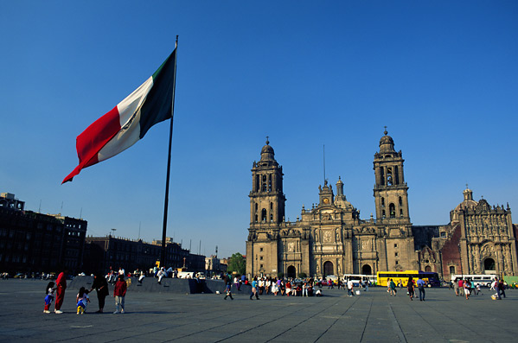
Mexico Overview

Slide 4

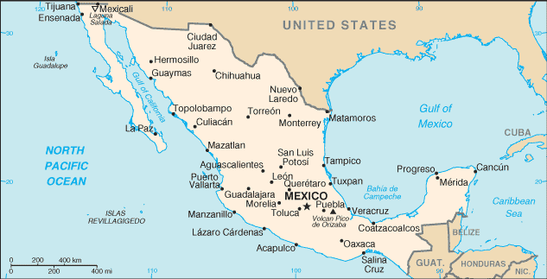
Mexico overview
Capital: Mexico City
Population: 1.13billion people
National Flower: cactus
Official language: Spanish
Weather:
cactus
The tropical desert climate
The tropical rain forest climate

Slide 5
Mexico overview
Geography：
    Located in the southern portion of north America.
    over 3,200 km in length.

Slide 6
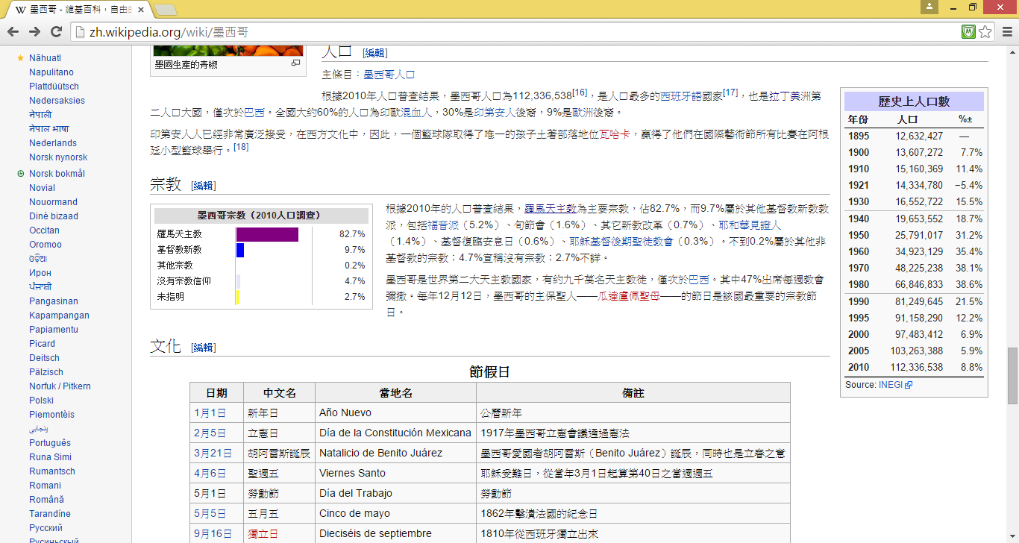
Mexico overview
Religion:
Mexico’s religion (at 2010 years)
Roman Catholic
Protestantism
Other religious
Atheist
Unspecified
The Roman Catholic is most people religious belief.

Slide 7
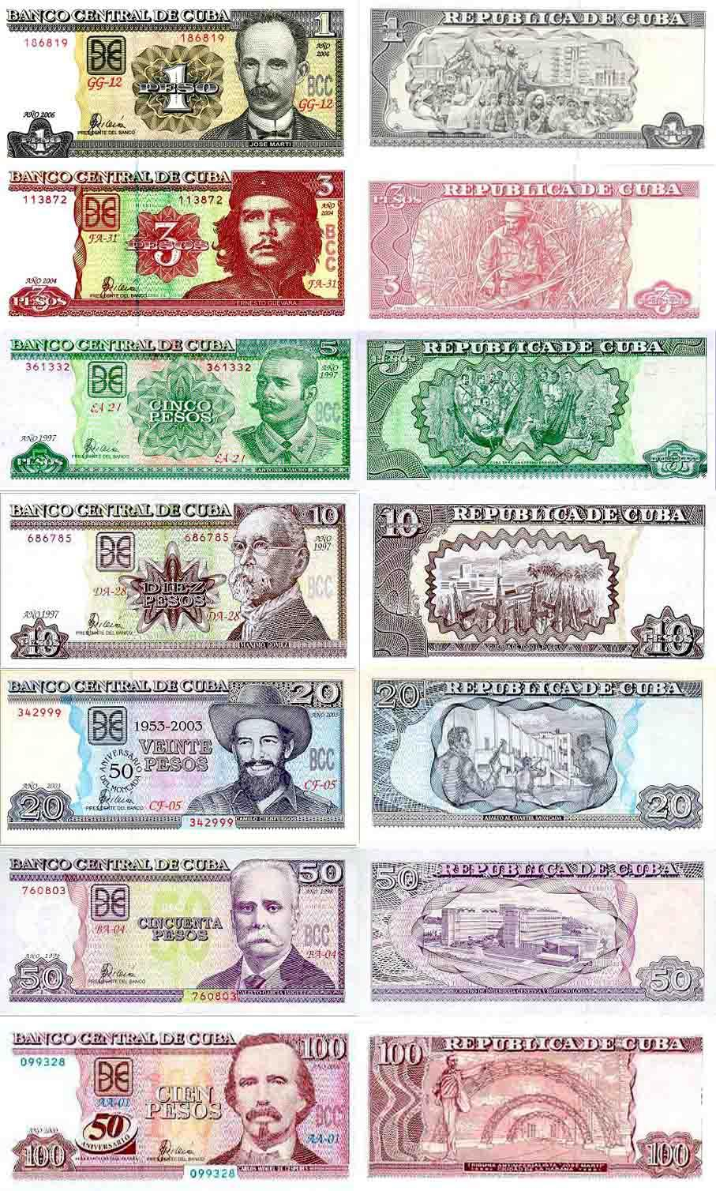
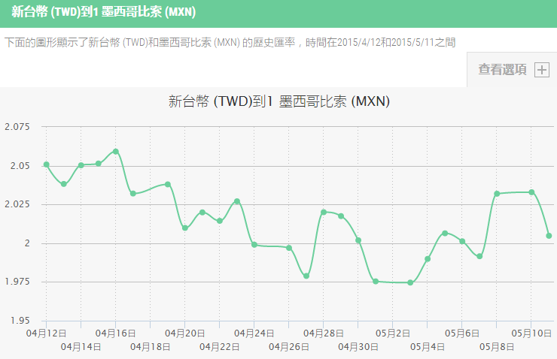
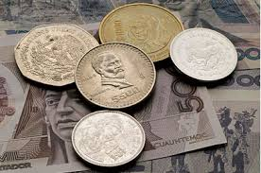
Currency
Mexico peso
Exchange rate

Slide 8
Education System
Preschool Education
High School Program
Post-secondary Education
Junior high school
Senior high school
University
research institute

Slide 9
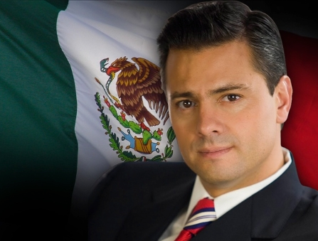
Politics
Politics classification： Presidential System
President：Enrique Pena Nieto
Local Government：Federal System

Slide 10
Culture
Food：Mexican major ingredients are Tortillas、Frijoles and Chiles.
 Burrito
 Soup
 salsa

Slide 11
Culture
Historic Relics：
 Chichen Itza
 Lkkik Cenote

Slide 12
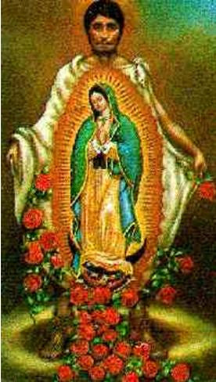
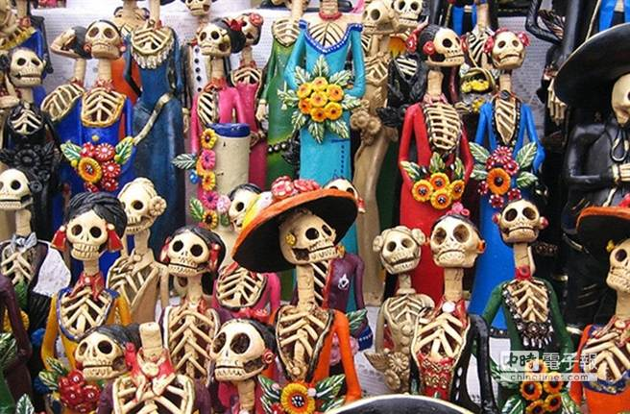
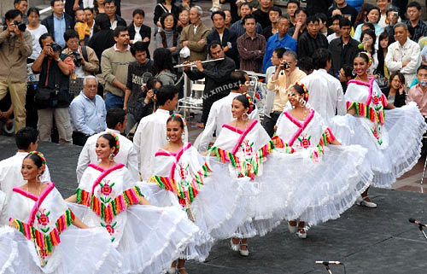
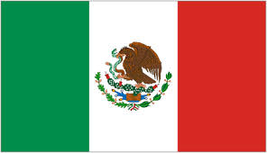
Holiday
Encuentro International de Mariachi y la Charreria：
the end of August～the first of September
Independence Day：9/15
Day of the Dead：11/1、11/2
Day of Our Lady of Guadalupe：12/12

Slide 13

Mexico of the Economic

Slide 14
Mexico Economy
Developing countries
Own modern industry and agriculture
Develop its consumer markets in America
Join NAFTA (North American Free Trade Agreement)

Slide 15
Mexico Industry
Petroleum industry：
    The ninth biggest crude oil hoard in the world
Leading company：PEMEX
Automobile and manufacturing industry
    The seventh biggest manufacturer and exporter in the world
    More and more multinational corporation invest automobile industry

Slide 16

Mexico Industry
Mining industry：
    Important mineral-production country in the world
    Gold yield ranked 7th in the world

Slide 17
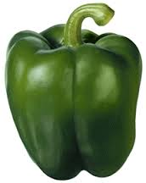
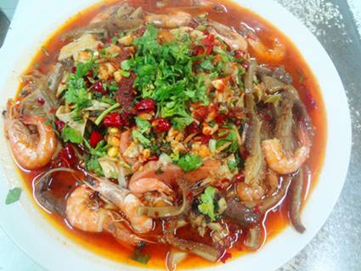
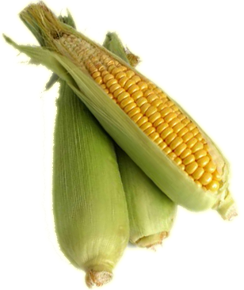
Mexico agriculture
Primary productions：
    Green peppers
    Corns
    Beans
NAFTA：
    Affects agriculture in Mexico
    Corn prices dramatically decrease
    Membership：Canada、Mexico、United States
    The agreement came into force on January 1, 1994

Slide 18

Representative Company

Slide 19

PEMEX
Formed time : May, 18 , 1938
President : Emilio Lozoya Austin
Location : Mexico City, Mexico
Major products : Petrochemical products
★ Within the top ten Petrochemical companies

Slide 20
Relevant things about PEMEX
The number of employee：138,215
The number of offices :
    Four independent subsidiaries
Future plans :
    PEMEX will cooperate with Oilbank company
Current news：
    PEMEX exploded in 2013 → 14 people died and 80 people hurt

Slide 21

Q&A

Slide 22
Thanking for listening

