Slide 1


France
Group1：71Nick、72Shaina、80Patty、81Tina、83Jim
Date：2016.5.12

Slide 2

Outline
Overview of France- Patty , Tina
Economy& Industry- Nick ,Jim
Representation Company- Shaina
Conclusion
Q&A

Slide 3
Overview of France
Geography
Currency
Weather
Language
Flag
Population
Religion
Food
Patty
Tina

Slide 4
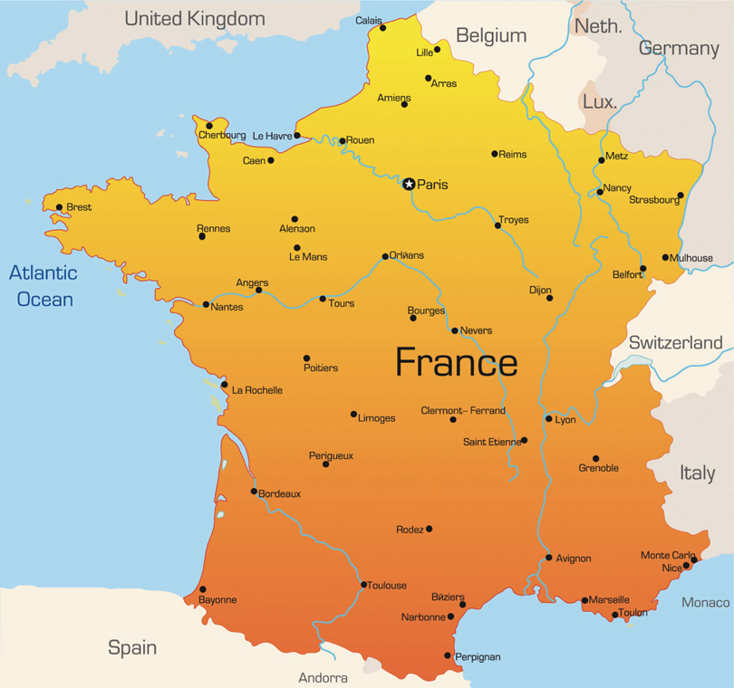
Geography

Slide 5
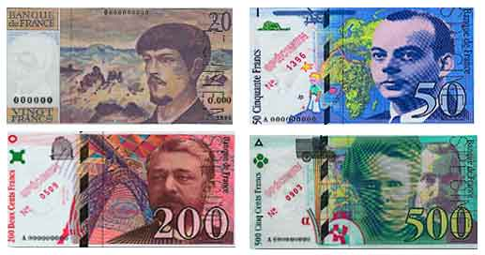
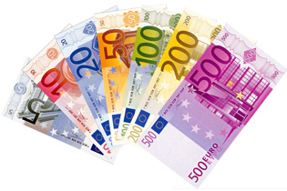
Currency
Now : Euro
Before : franc

Slide 6

Weather
15°C
7°C

Slide 7

Language
Youtube
https://www.youtube.com/watch?v=dxUbzPJfX9Y

Slide 8

Flag of the country
freedom
equality
brotherhood

Slide 9
Population

Slide 10
Marriage in France

Slide 11
Population

Slide 12

Religion

Slide 13

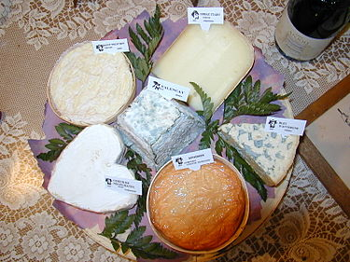
Food
grape wine
cheese

Slide 14
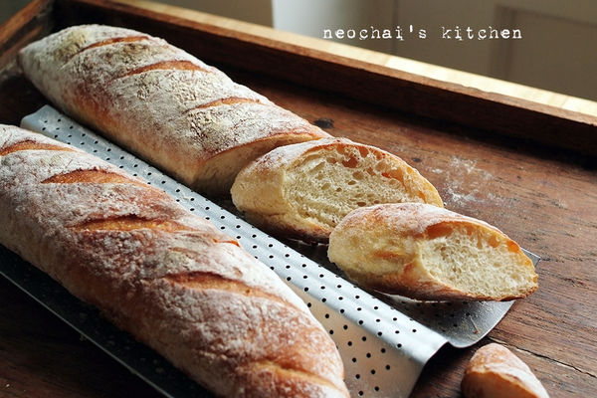

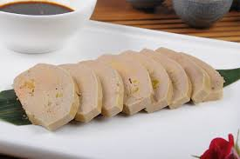
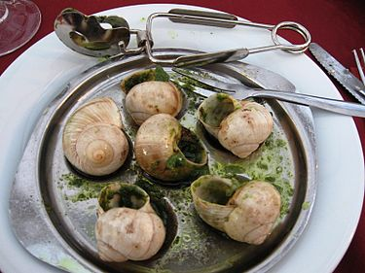
baguette
croissant
foie gras
escargot

Slide 15

Economy & Industry
Economy about France
Fashion industry
  The origin of fashion
  Fashion direction
Tourism

Slide 16


Economy about France

Slide 17
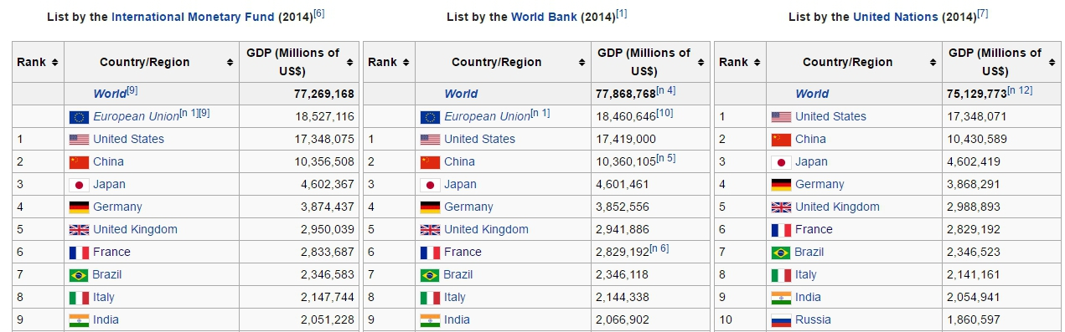

Slide 18

Fashion industry
Fashion

Slide 19
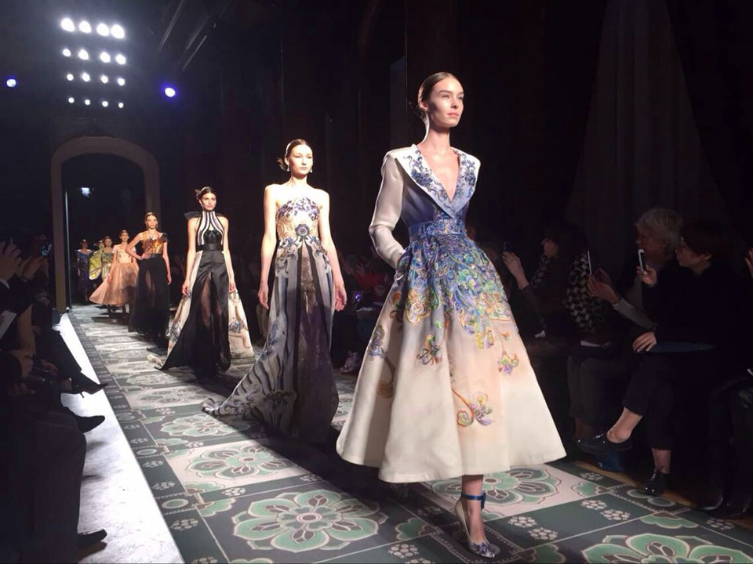
Fashion industry
Fashion

Slide 20

The origin of fashion
King
Noble
Community

Slide 21

Fashion direction
Designers
Manufacturers
Retailers
Experts

Slide 22

Tourism

Slide 23
International tourism, receipts
(currency US$)

Slide 24
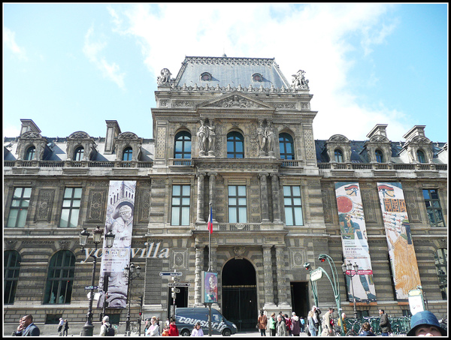

Louvre museum

Slide 25
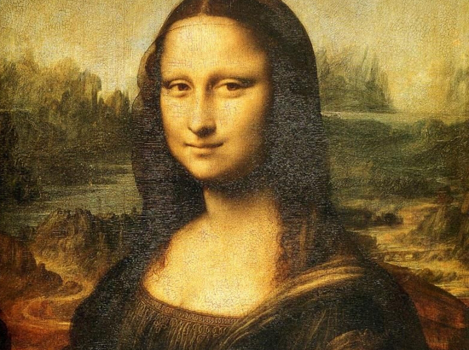
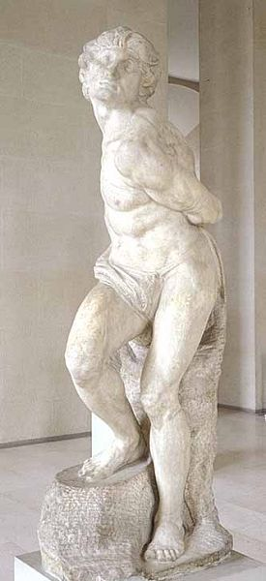

Slide 26
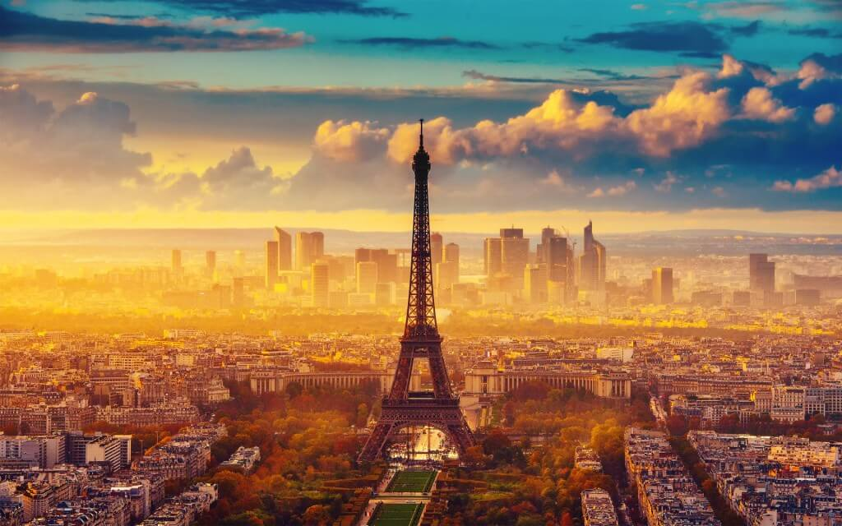
Eiffel Tower

Slide 27
BUT DO YOU KNOW THAT?

Slide 28
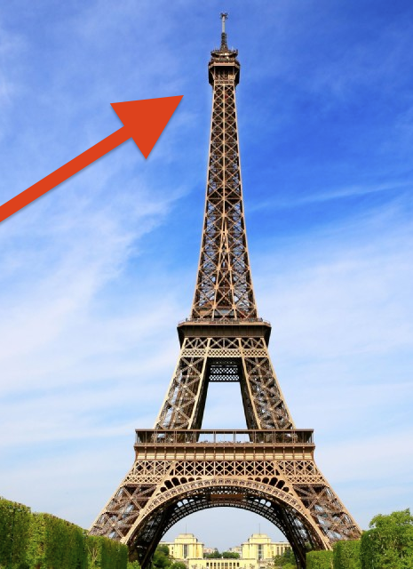
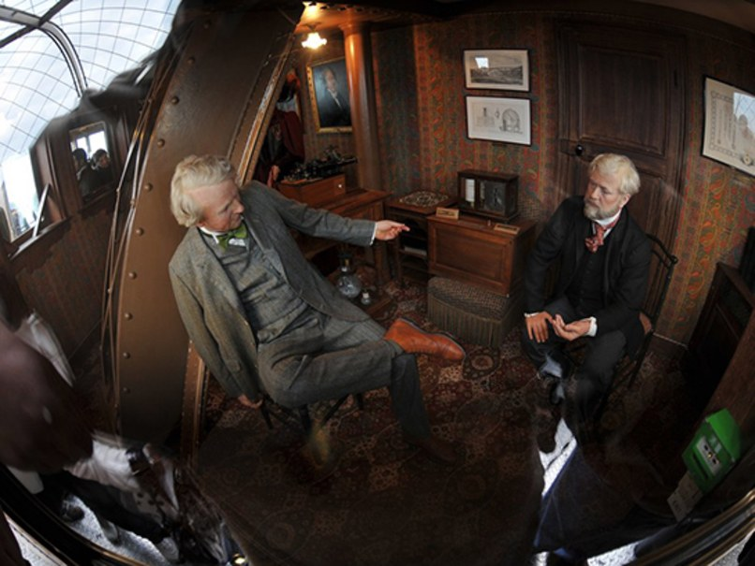
Edison
Eiffel

Slide 29

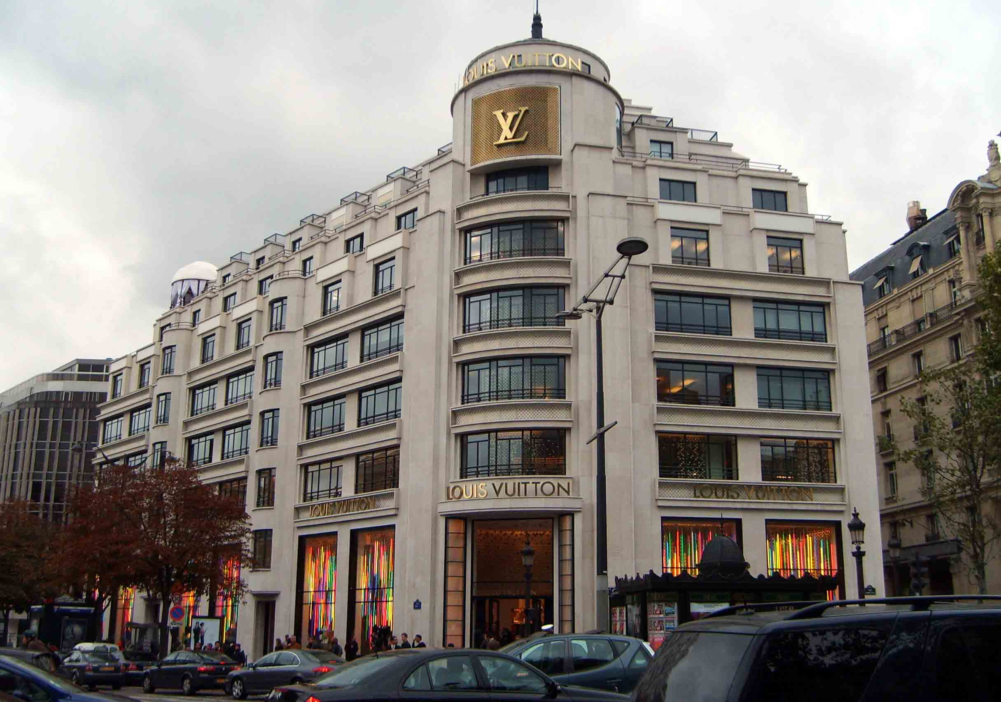
Representation Company

Slide 30
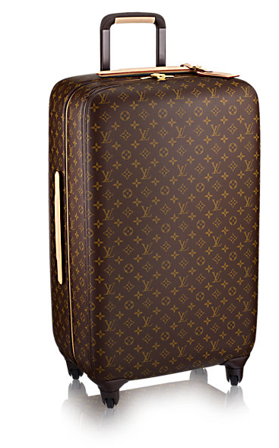
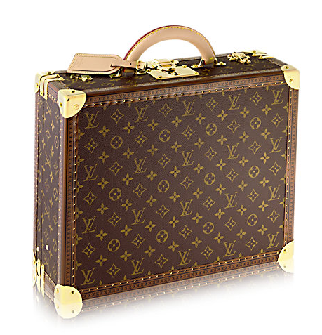
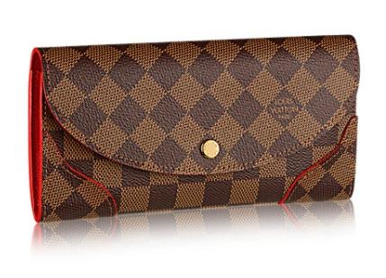
Major Products
$155,000
$155,000
$16,700

Slide 31
Profile
Headquarter: Paris France
Number of location: 3,708
Revenue: €30.638 billion
Number of employees:121,289

Slide 32
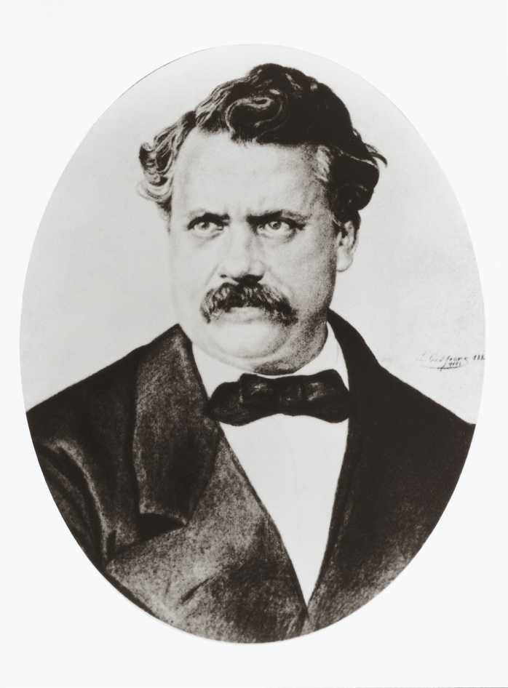
History
1854~1892
1892~1936
1936~

Slide 33
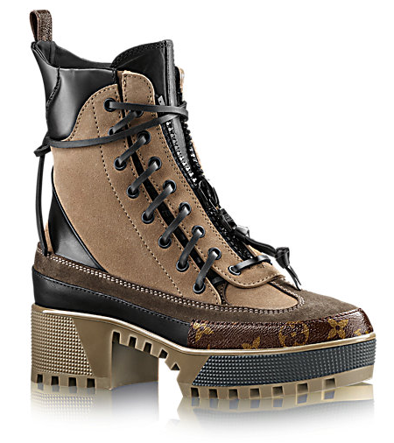
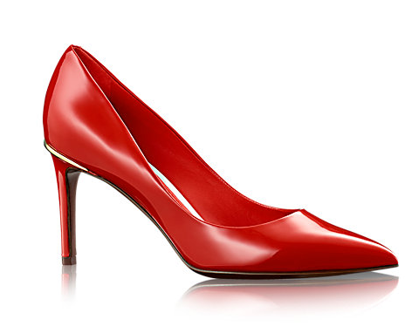
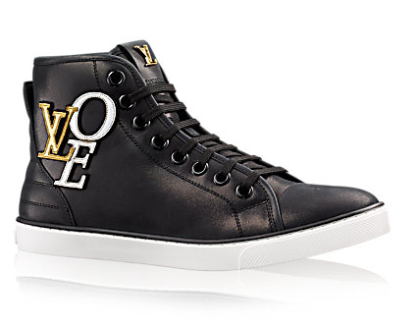
Other Products
$44,000
$32,300
$29,700

Slide 34

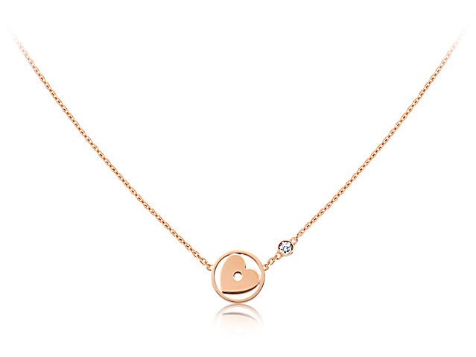
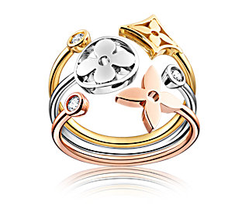
Other Products
$119,000
$77,000
$124,000

Slide 35
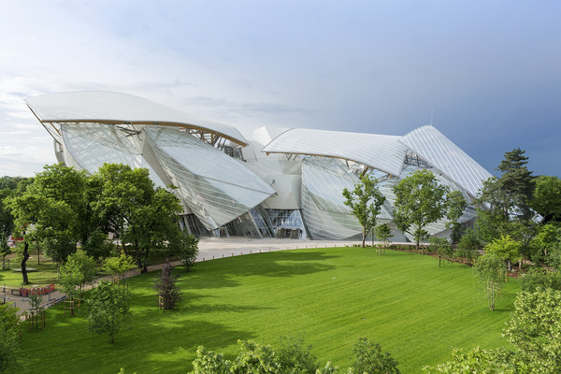
Future Plan
Louis Vuitton art foundation

Slide 36
Conclusion
Welcome to France

Slide 37

Thank you for your listening !

Slide 38
Reference
WIKI
  the GDP of France
https://en.wikipedia.org/wiki/List_of_countries_by_GDP_(nominal)
  the economy of France
    https://en.wikipedia.org/wiki/France#Economy
  Company-Louis Vuitton
    https://en.wikipedia.org/wiki/Louis_Vuitton
Fashion industry of France
  http://moodle.ncnu.edu.tw/mod/resource/view.php?id=223698
International tourism, receipts
  http://cn.knoema.com/WBWDIGDF2016Apr/world-development-indicators-wdi-april-2016
Louis Vuitton art foundation
  http://www.ettoday.net/news/20140716/376964.htm

Slide 39
Division of responsibility
Patty | Overview of country
Tina | Overview of country
Nick | Economy & Industry, Economy about France
Jim | Torisum, PPT maker
Shaina | Company－Louis Vuitton

Slide 40

Q/A

