Slide 1

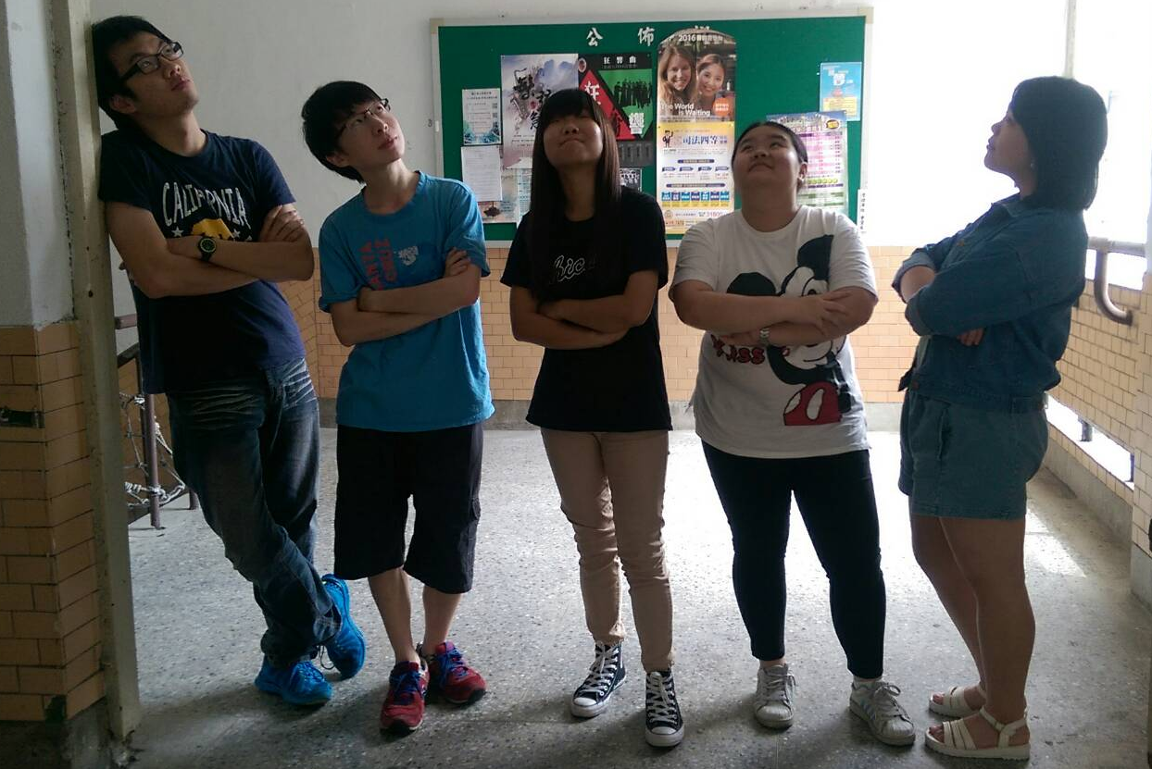
62Han Ting
64Sandy
79Hank
62Jane
67Gina
2016/05/12

Slide 2
Outline
Country Profile Han Ting , Gina
Entertainment Industry Sandy
High Tech Industry Hank
The Most Famous Company Jane
Our comments Han Ting

Slide 3
Country Profile
Geography , Capital
Political
Population
Weather
Language
Food

Slide 4
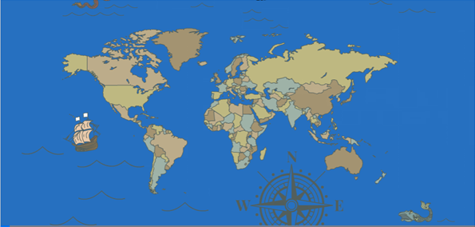
Geography

Slide 5
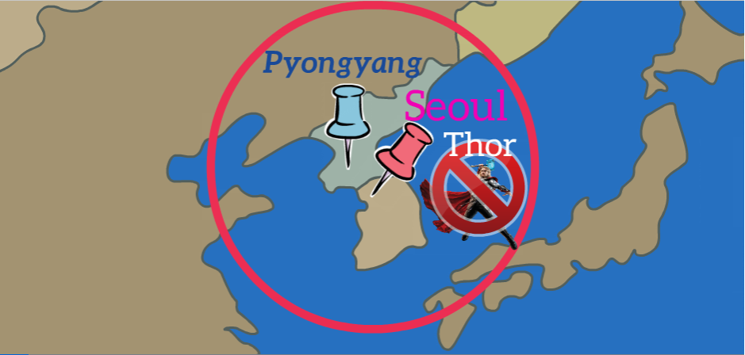


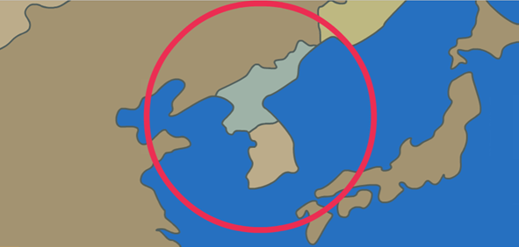
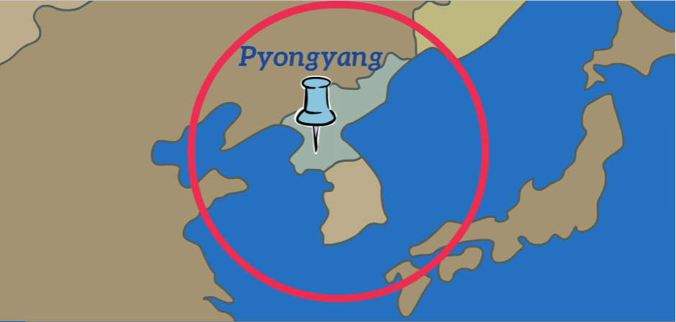
Capital

Slide 6
Political

Slide 7
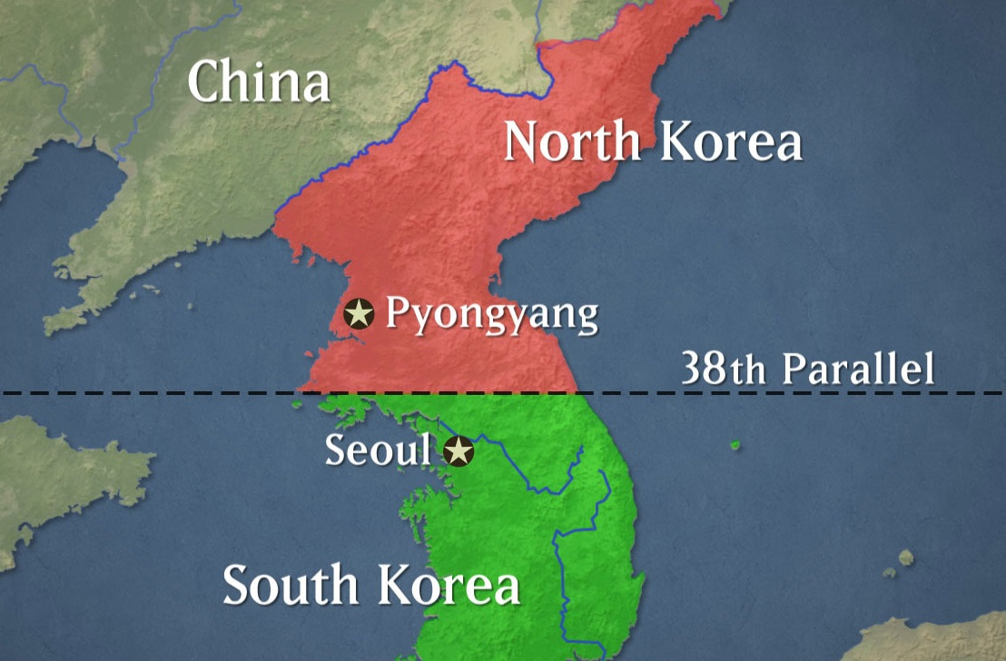

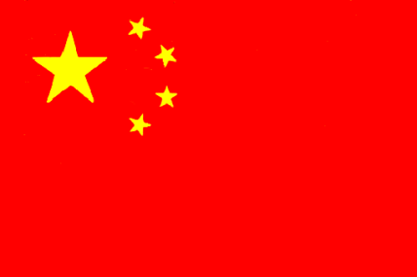


Slide 8
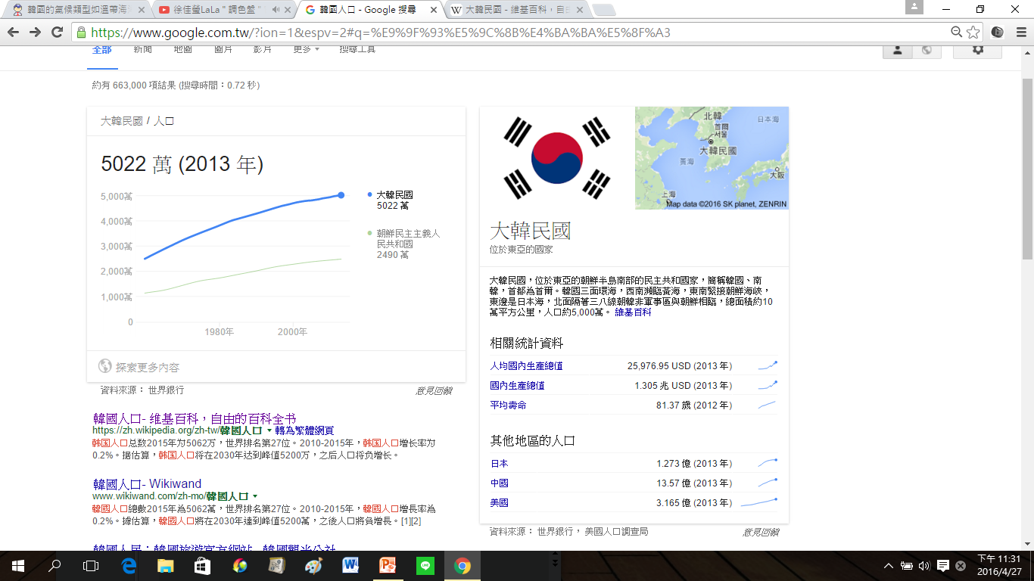
Population
Thousand
South Korea
North Korea

Slide 9
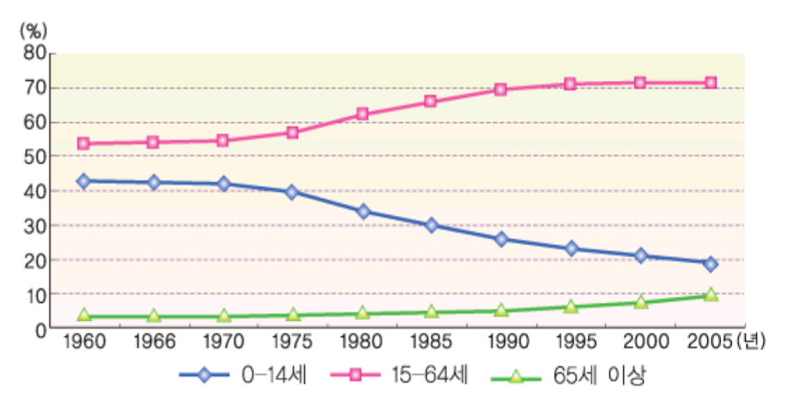
Population
year

Slide 10
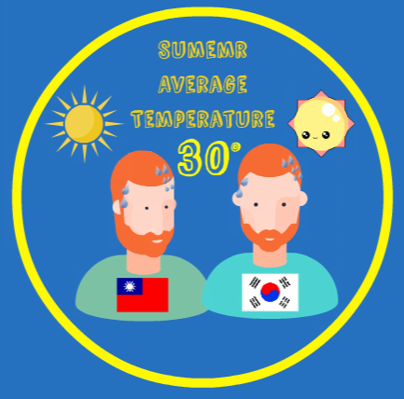
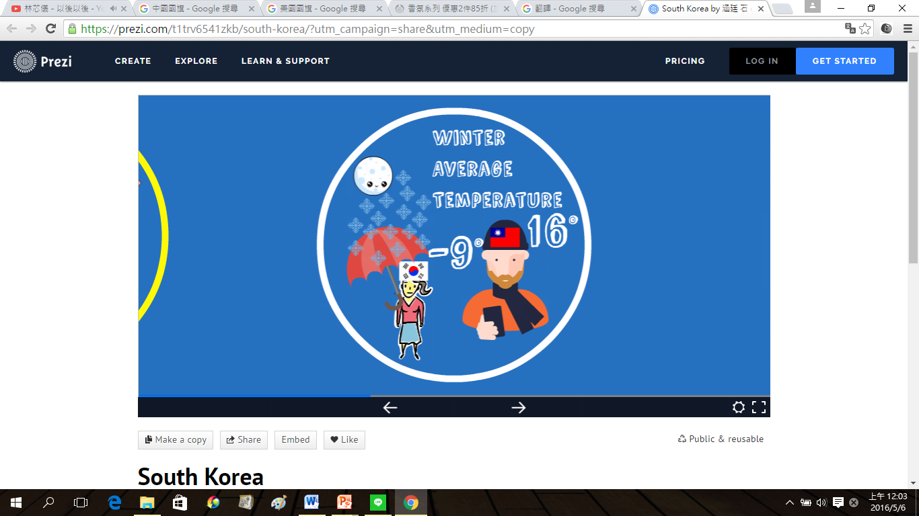
Weather

Slide 11
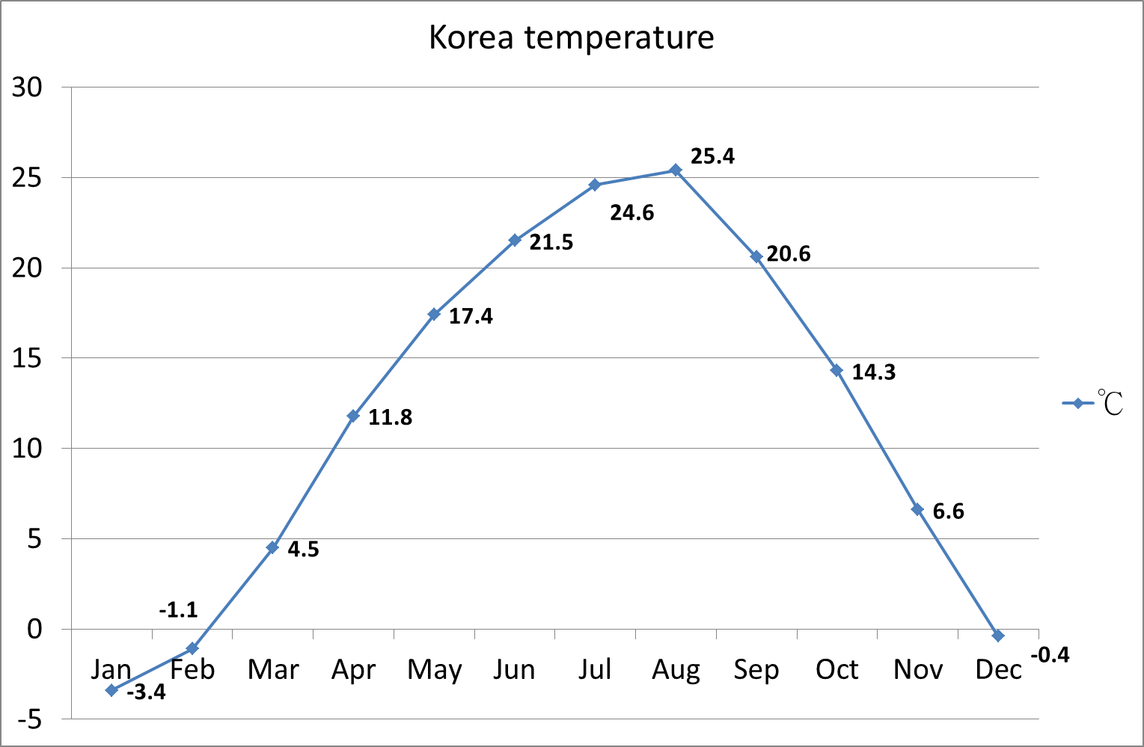
Weather

Slide 12
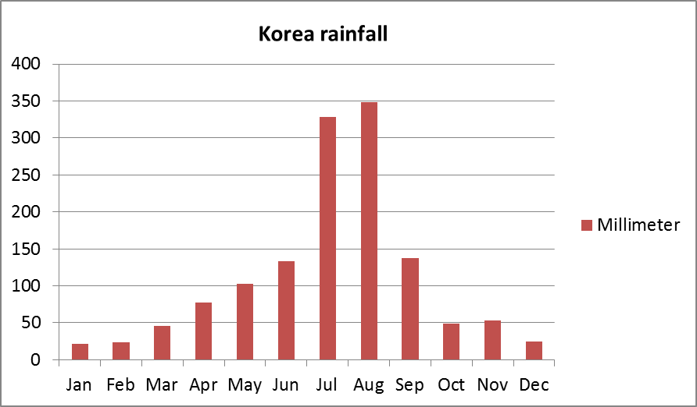
Weather

Slide 13
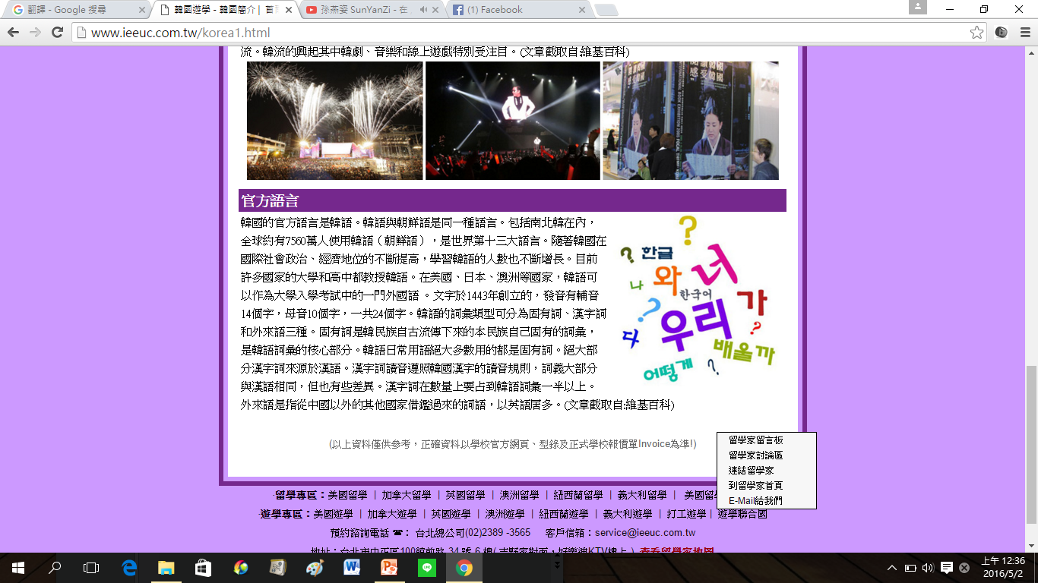
Language

Slide 14


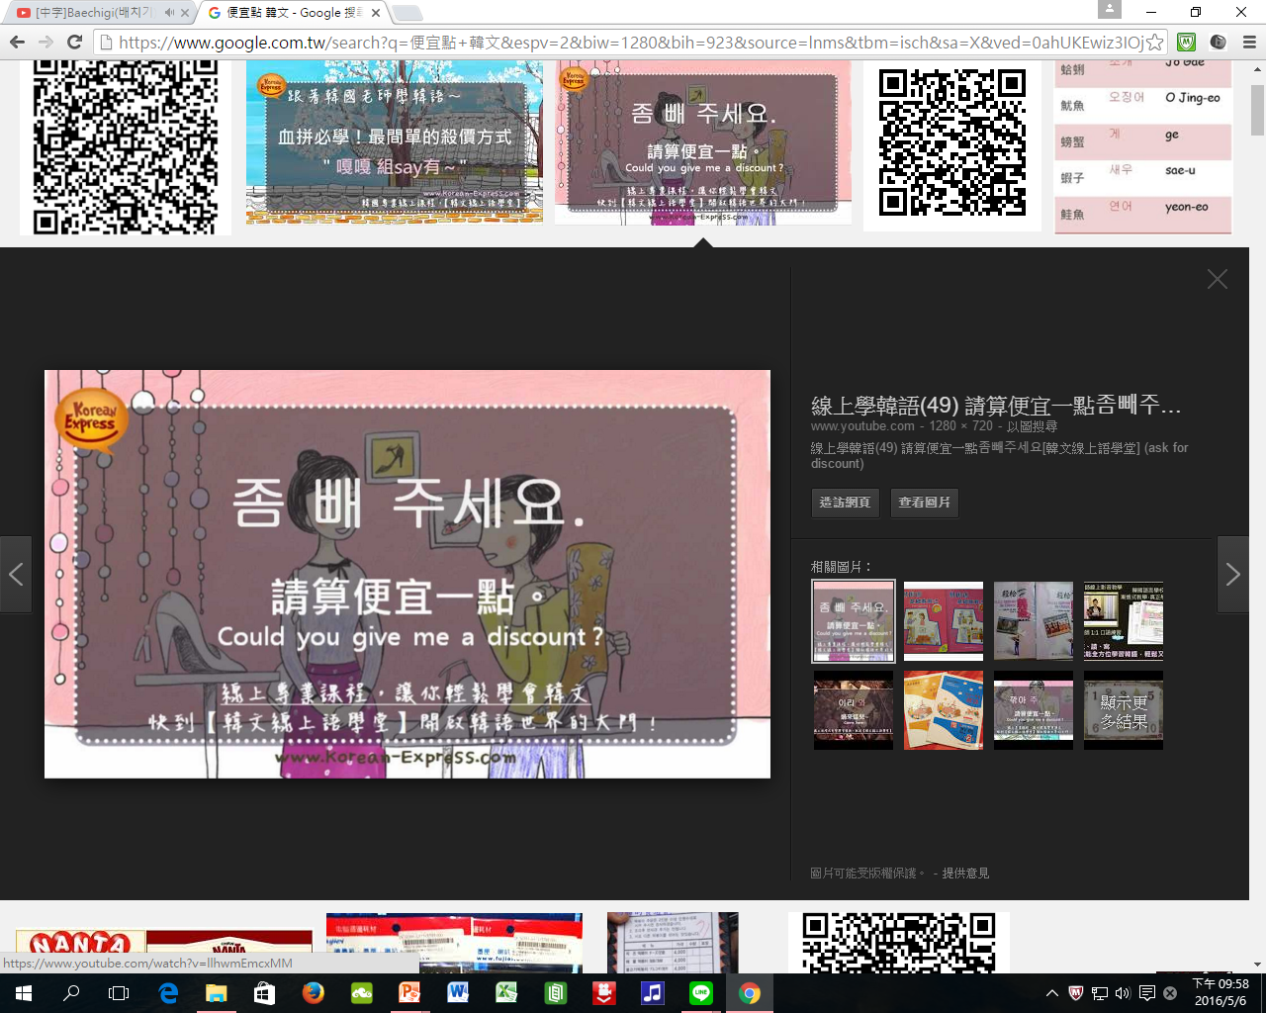

Language
CHEAPER
Thank you

Slide 15
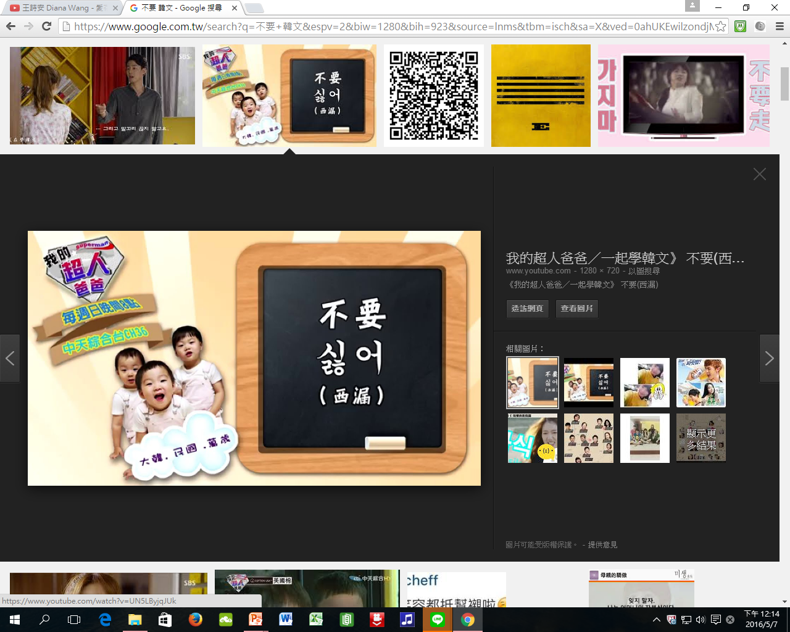

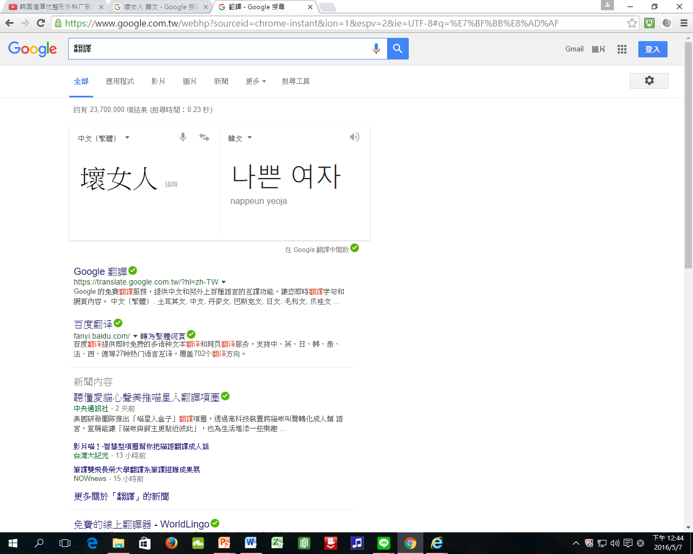

Language
Do Not
Get Out
Bad woman

Slide 16
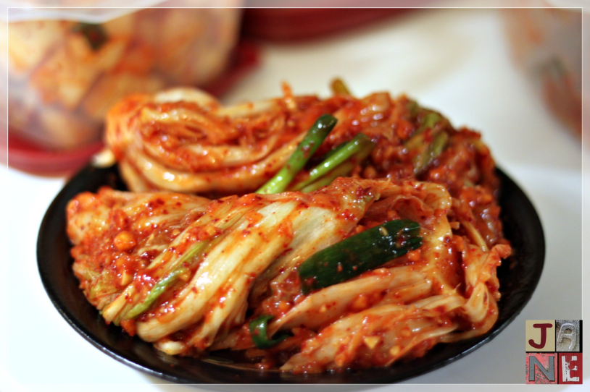
Food
Kimchi
One of the healthy food in the world

Slide 17
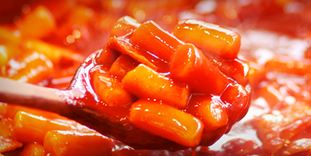
Food
Spicy Rice Cake

Slide 18
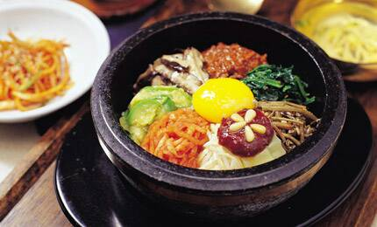
Food
Leftovers
Hot ishinabe
Chili sauce
Bibimbap

Slide 19
Entertainment Industry
Hallyu
Variety show
Idol

Slide 20

Entertainment Industry
Hallyu
NT＄ 330 billion of output value

Slide 21
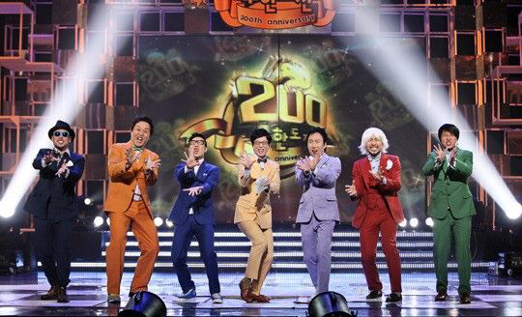
Entertainment Industry
Variety show

Slide 22
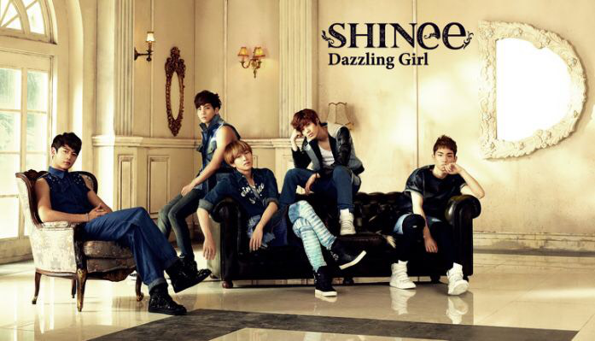
Entertainment Industry
Idol

Slide 23
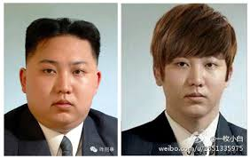
High Tech Industry
Medical beauty industry cosmetic operation
Five billion of output value
30% of Korean had cosmetic operation

Slide 24

High Tech Industry
Durable
Stable systems
Good price
Strong Specifications

Slide 25
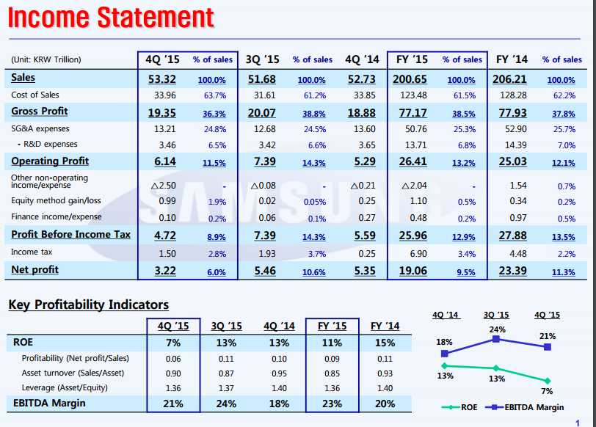
Income Statement of Samsung
High Tech Industry

Slide 26
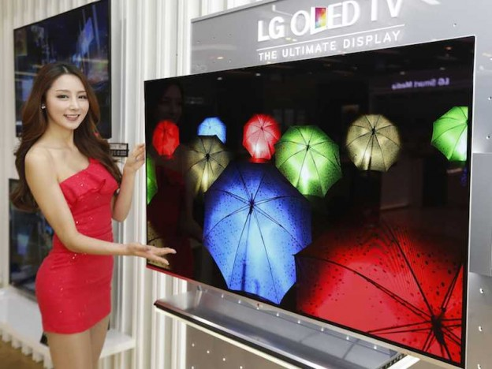
High Tech Industry
Characteristics of Samsung Panel Displays
Better screen
Lower price

Slide 27

High Tech Industry

Slide 28
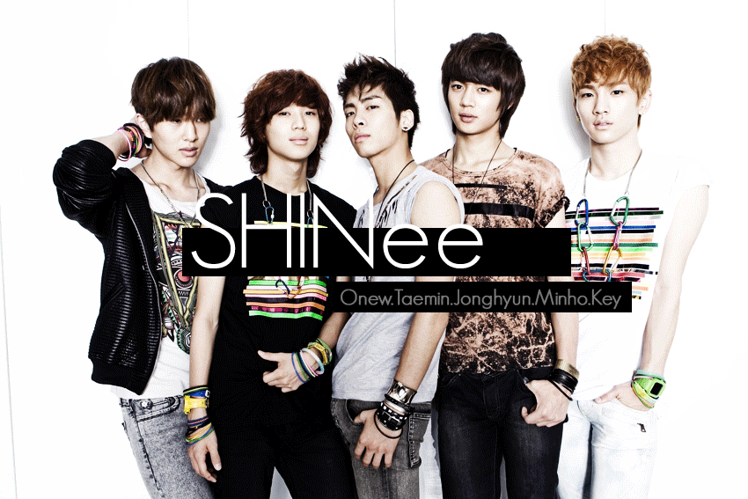
Entertainment Company
About S.M Entertainment
Strength
Music
Dance

Slide 29

About S.M Entertainment
The Most Famous Company
Be founded in 1998 by Suman Lee
Established 27 years
Sum of fiscal profit was 164.3 billion

Slide 30
Characteristic
The Most Famous Company
SM company
Concert | SMTOWN Live World Tour
Music festival | SMTOWN WEEK
 | SMTOWN Summer Concert
Famous groups | EXO
 | SHINee
 | Super Junior
 | Girls' Generation

Slide 31
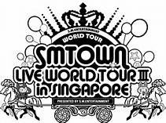
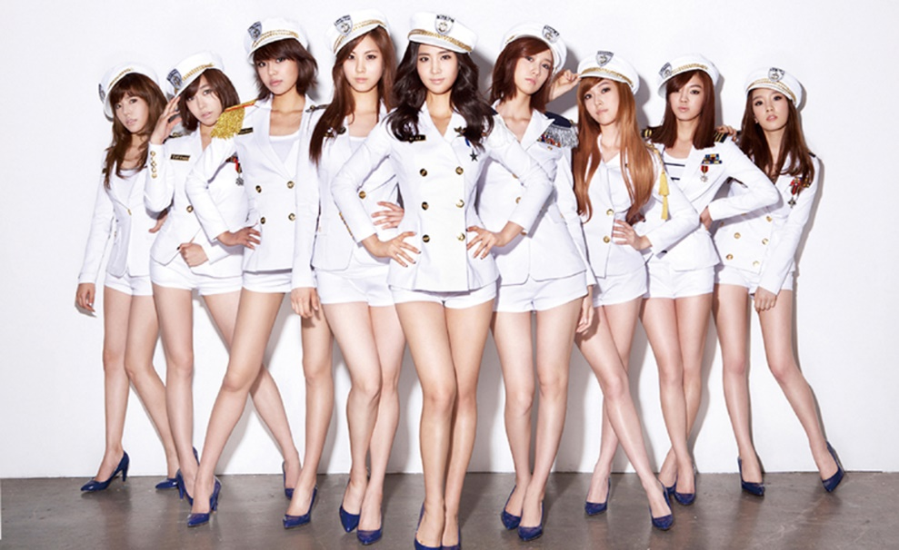
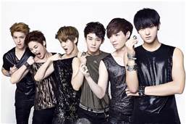
Entertainment Company

Slide 32
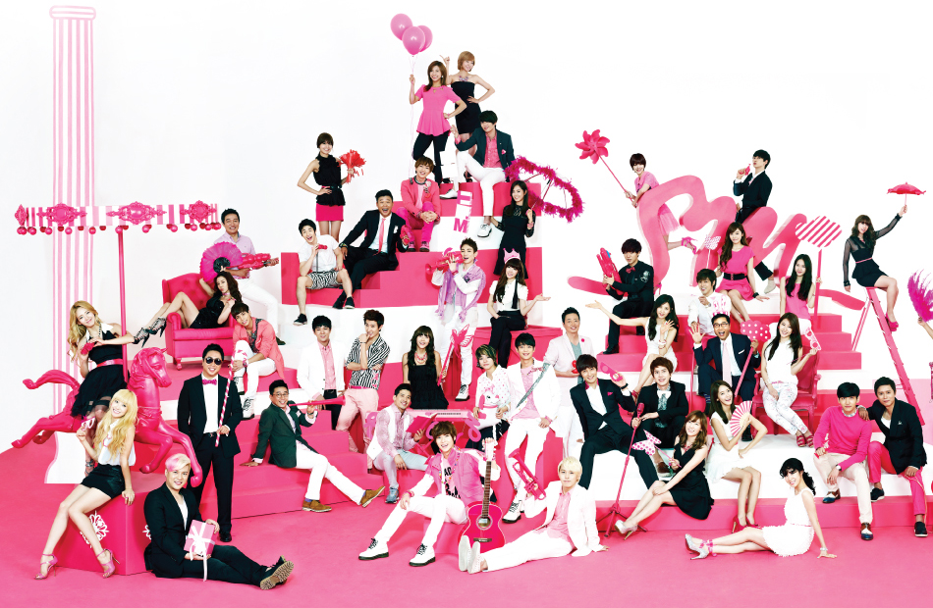
Strength
The Most Famous Company
Suit program
Good promotion strategy
Great broadcast opportunity

Slide 33

Music
The Most Famous Company
Music
Unique singing and dancing style
rock, jazz, Hip-Hop and other music elements

Slide 34
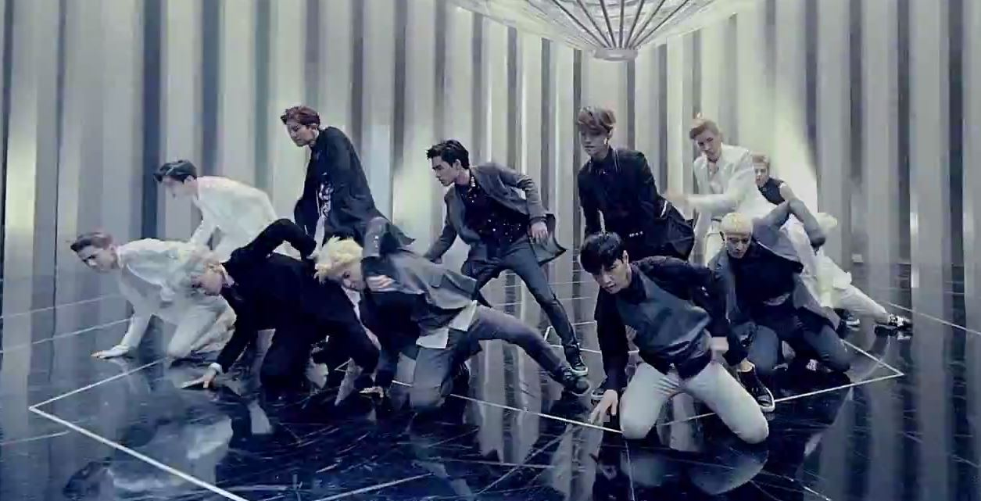
Dance
The Most Famous Company
Dance
Professional choreographers
Play an important Role in the field

Slide 35
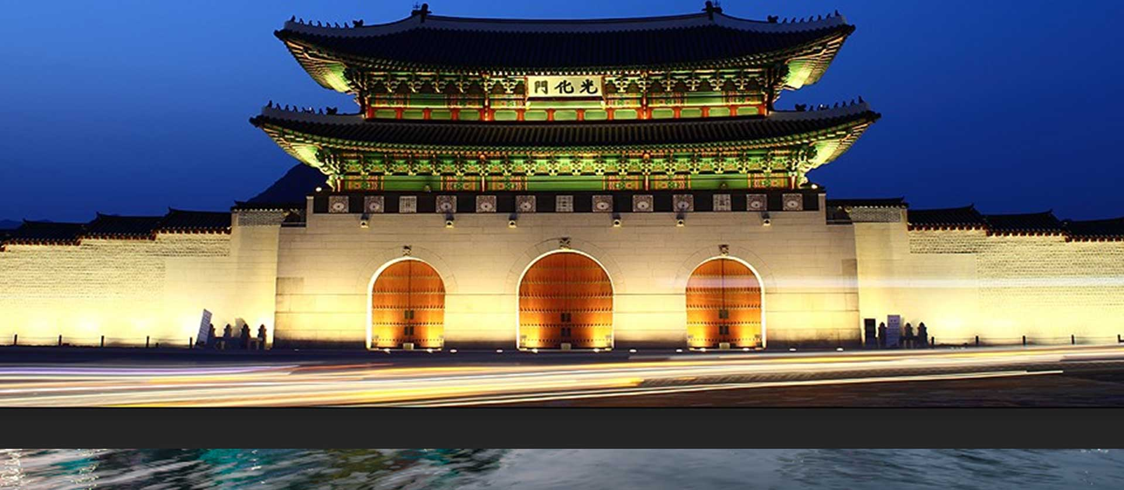
Characteristic
Our comments

Slide 36
Division of responsibility
Name | Work
62 Han Ting | PowerPoint maker, Country Profile
62 Jane | The Most Famous Company
64 Sandy | Entertainment Industry
67 Gina | PowerPoint maker, Country Profile
79 Hank | High Tech Industry

Slide 37

Reference
Country Profile
http://www.hko.gov.hk/wxinfo/climat/world/chi/asia/jp_ko/seoul_c.htm
https://zh.wikipedia.org/wiki/%E9%9F%93%E5%9C%8B%E4%BA%BA%E5%8F%A3
https://www.google.com.tw/#hl=zh-TW
Entertainment Industry
http://www.shs.edu.tw/works/essay/2010/11/2010111322580796.pdf
https://tw.news.yahoo.com/韓流-年創3-3千億產值-215005796--finance.html

Slide 38
Reference
High Tech Industry
https://www.youtube.com/watch?v=uVac2AcA7Kg
http://technews.tw/2016/01/28/samsung-2015-q4/
The Most Famous Company
https://zh.wikipedia.org/zh-tw/SM_Town https://en.wikipedia.org/wiki/SM_Town

Slide 39


Thank you
For your listening

