Slide 1

Japan
Penny(66) Lucy (68) Doris (69) Steve (70) Sally (85)
Group4
2016.5.19

Slide 2
Outline
Geographical Environment
Introduction
Culture
Economic Situation
Representative Company
Doris
Lucy
Penny
Steve
Sally

Slide 3
Geographical Environment
Country Location
Weather
Capital
Population
District

Slide 4
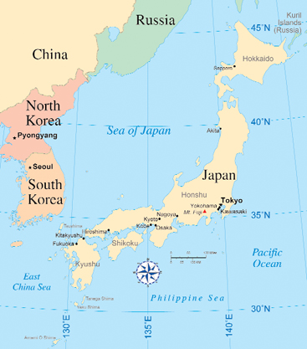
LOCATION

Slide 5
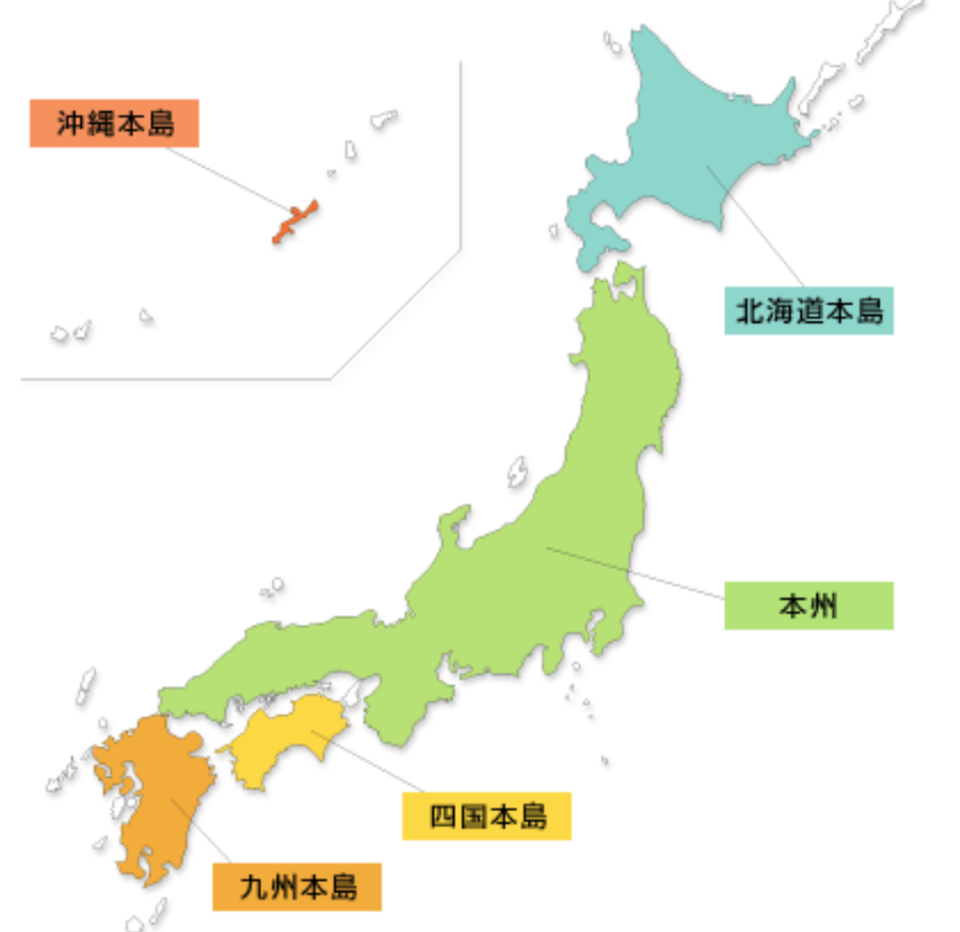
COUNTRY LOCATION
Hokkaido
Honshu
Shikoku
Kyushu
Okinawa

Slide 6
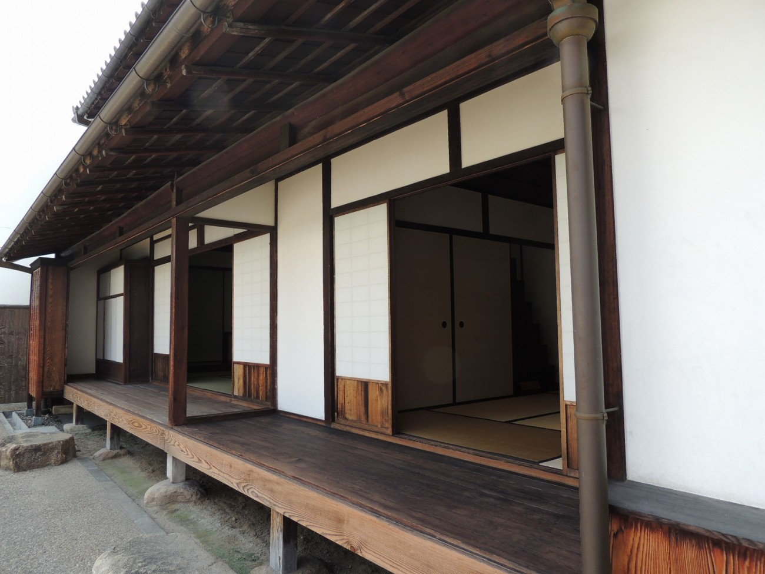
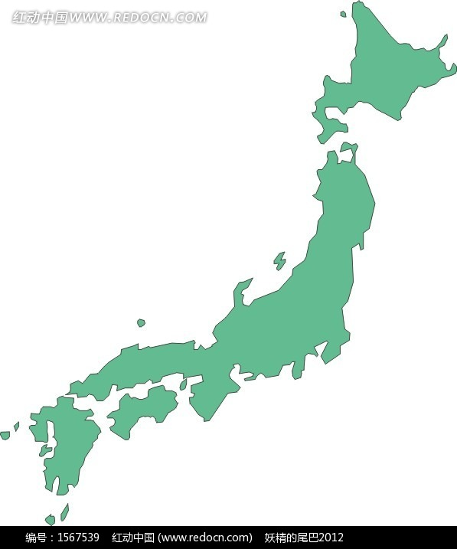
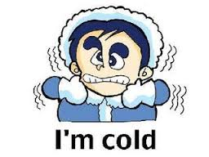

WEATHER
Because Japan has a wide range of latitude, north and south’s temperature difference is very significant.

Slide 7
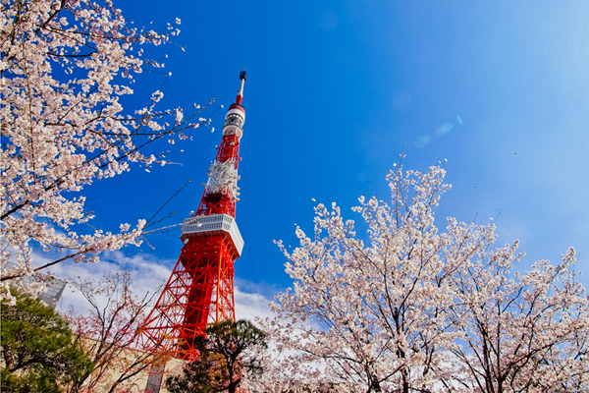
CAPITAL
Tokyo

Slide 8
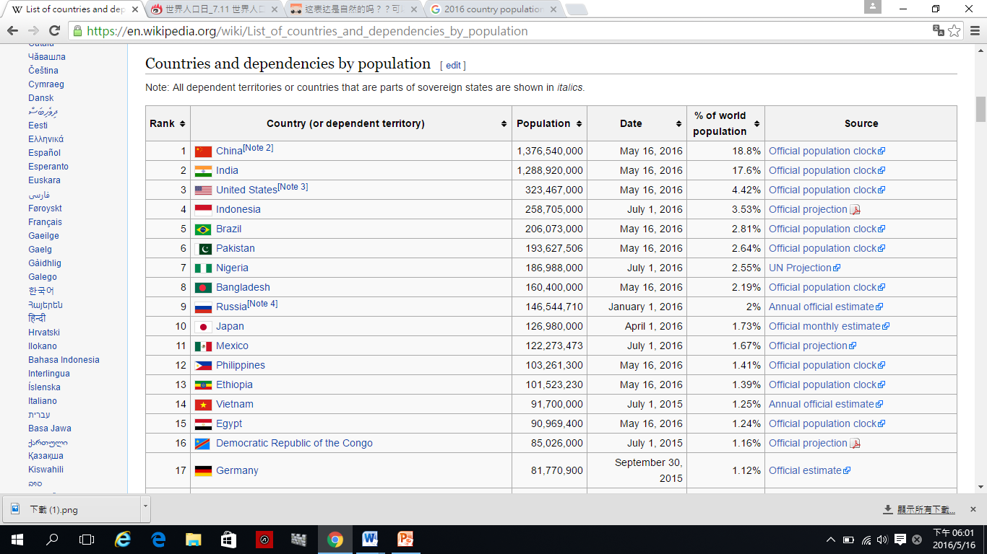
POPULATION

Slide 9
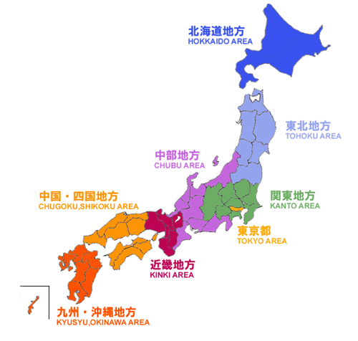
District

Slide 10
Country Introduction
National Flower
Flag
Mascot

Slide 11

NATIONAL FLOWER
Japanese people
Purity
Warm
Noble
Cherry blossoms

Slide 12
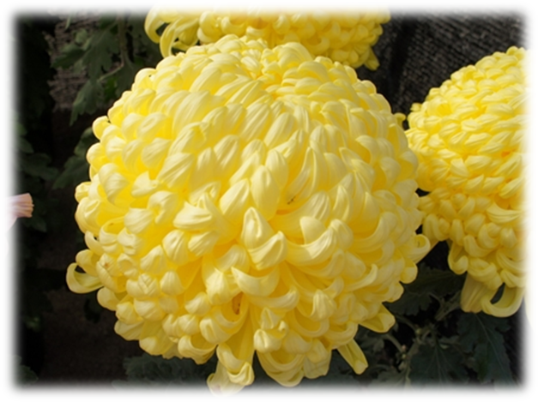
NATIONAL FLOWER
Japanese imperial family
Good luck
Happiness
Long life
Wealth
Chrysanthemum

Slide 13
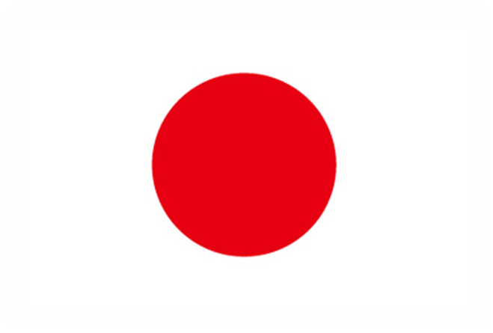
FLAG
White ：
Purity, peace and justice
Red ：
enthusiasm，vigor and universal brotherhood
Hinomaru

Slide 14
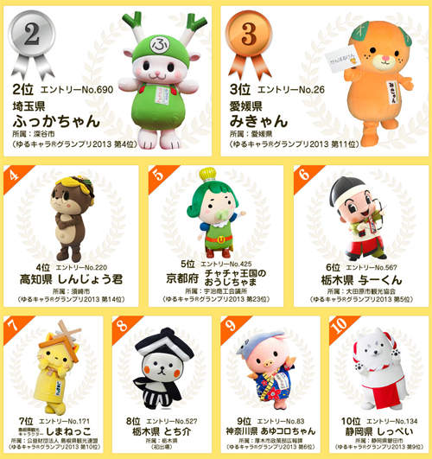
Mascot

Slide 15
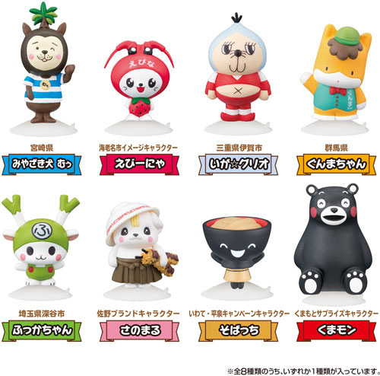
Mascot
Marketing Information
attract attention
Approachable
In people's minds

Slide 16
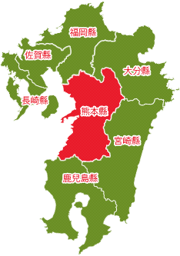

Kumamon

Slide 17
Culture
Diet
Etiquette
Custom

Slide 18
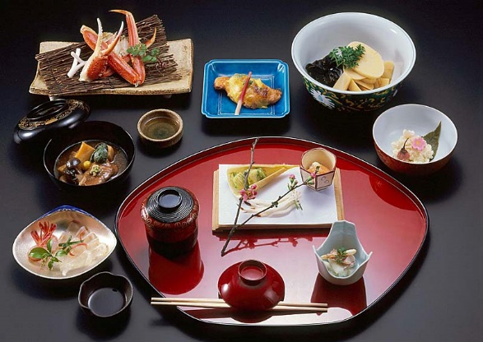
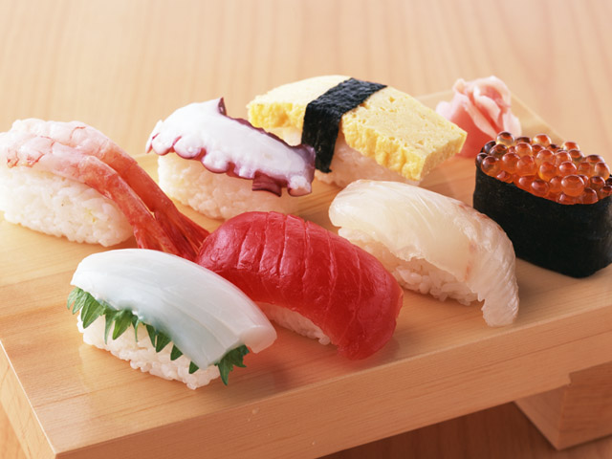
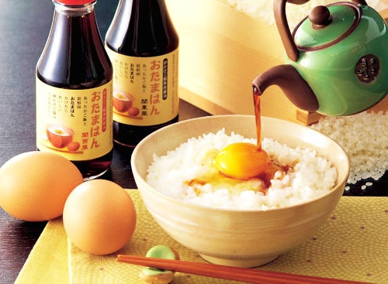
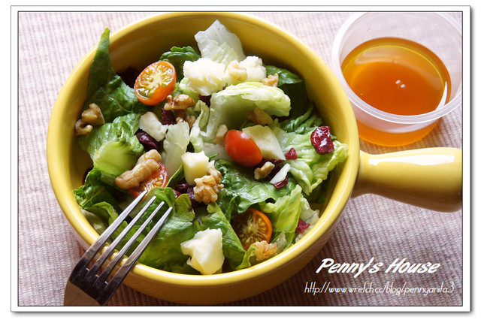
Diet
kaiseki

Slide 19

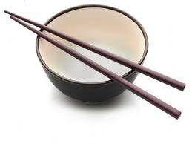
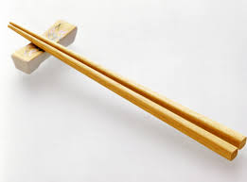
Etiquette
Table manners

Slide 20
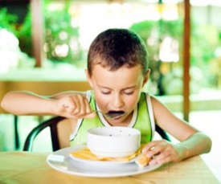
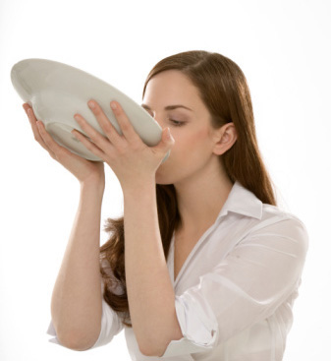
Etiquette
Table manners

Slide 21
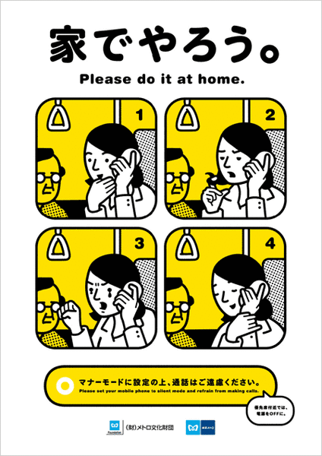
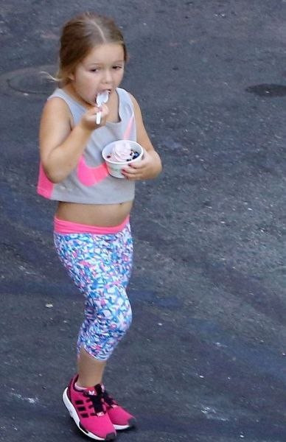
Etiquette
Life manners

Slide 22
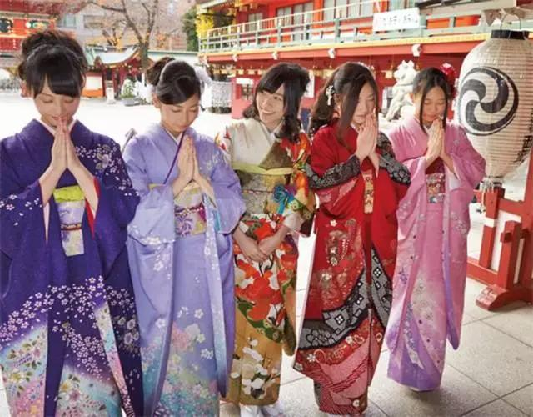
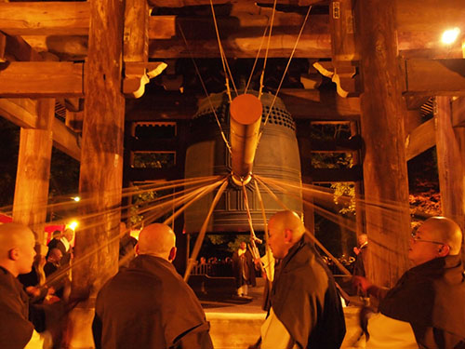
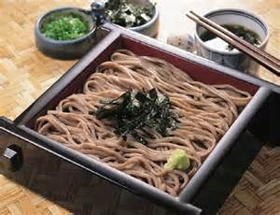
Custom
Celebrate the New Year

Slide 23
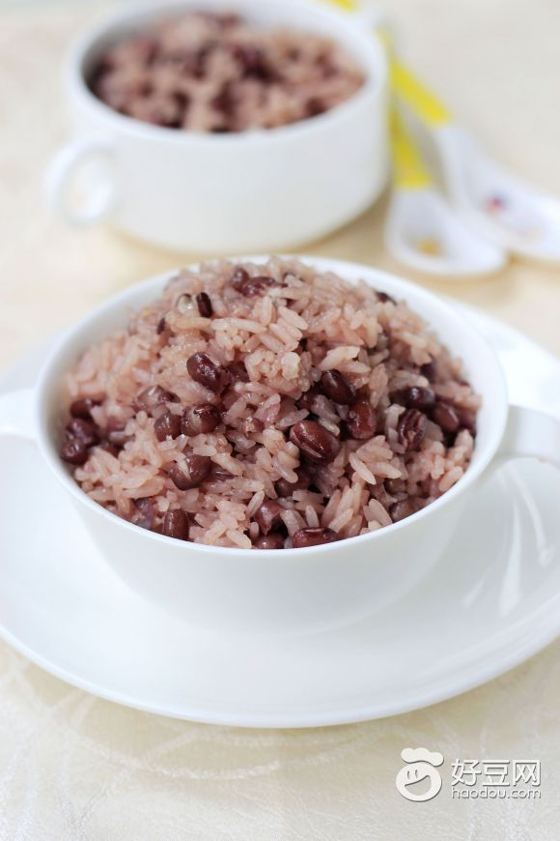
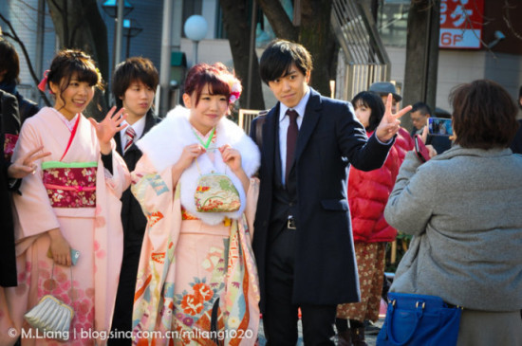
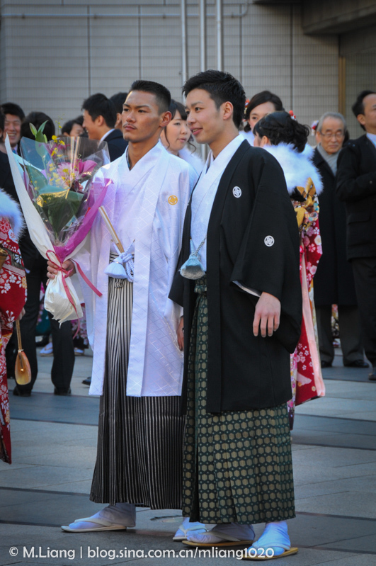
Custom
Celebrate the birthday

Slide 24
Economic Situation
Imports & Exports
Economy Rankings
Industry
Company

Slide 25
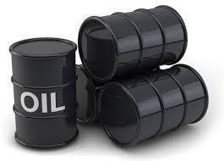

Imports :
Lack of resources
Mineral product

Slide 26


Slide 27



Slide 28
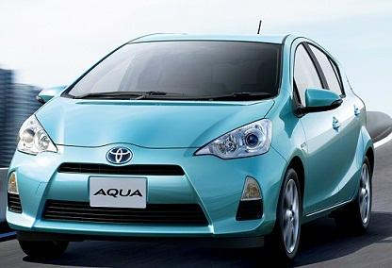
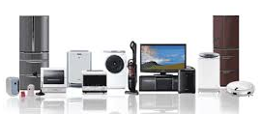
Exports :
High - tech products
Machine
Cars
Household Appliances

Slide 29
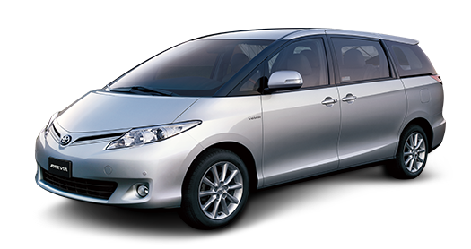
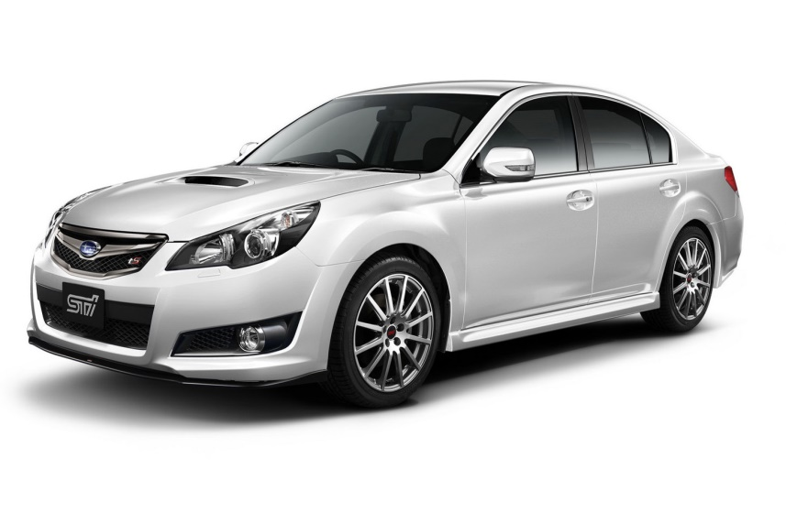


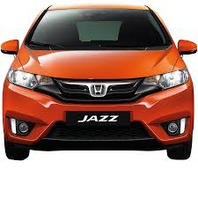


Slide 30
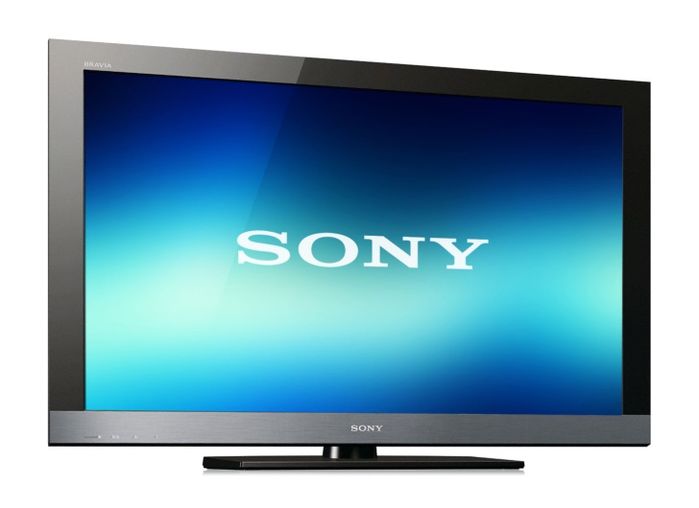
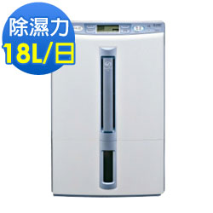


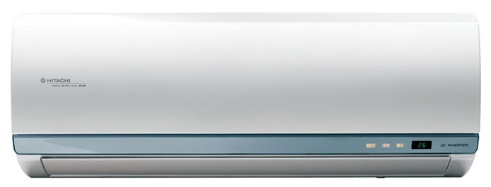


Slide 31
Total GDP Ranking
RANK | 2013 |  | 2014 |  | 2015
 | Country | GDP | Country | GDP | Country | GDP
1 | USA | 16,663 | USA | 17,348 | USA | 17,947
2 | CHINA | 9,519 | CHINA | 10,431 | CHINA | 10,983
3 | JAPAN | 4,909 | JAPAN | 4,596 | JAPAN | 4,123
4 | GERMANY | 3,746 | GERMANY | 3,874 | GERMANY | 3,358
5 | FRANCE | 2,811 | The U.K. | 2,992 | The U.K. | 2,849

Slide 32
The Global
Competitiveness Index
Evaluating the Competitiveness of a country's economy
An comprehensive index
Strength of the economy

Slide 33
Global
Competitiveness Index
RANK 2015~2016 | Country | Point
1 | Switzerland | 5.8
2 | Singapore | 5.7
3 | United States | 5.6
4 | Germany | 5.5
5 | Netherlands | 5.5
6 | Japan | 5.5
7 | Hong Kong SAR | 5.5

Slide 34
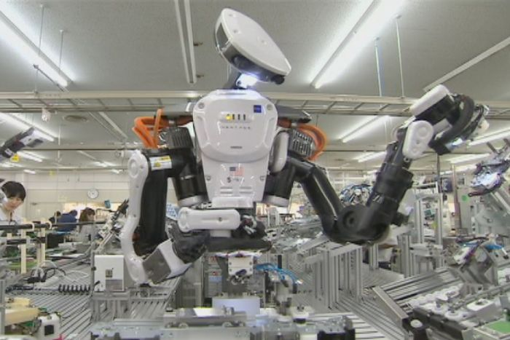
Industry - Robot

Slide 35
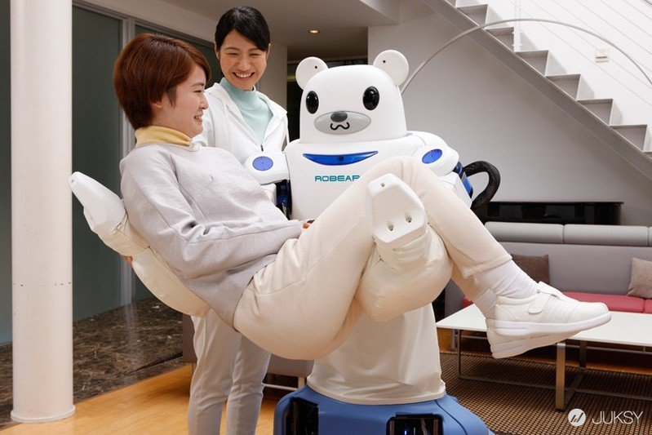
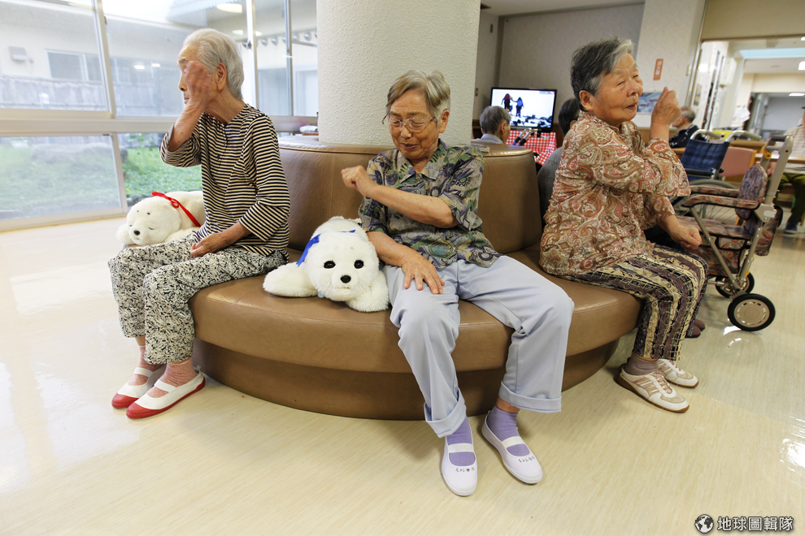
Human ­­­- Care Robot
Take care of a person
Accompanied a person

Slide 36
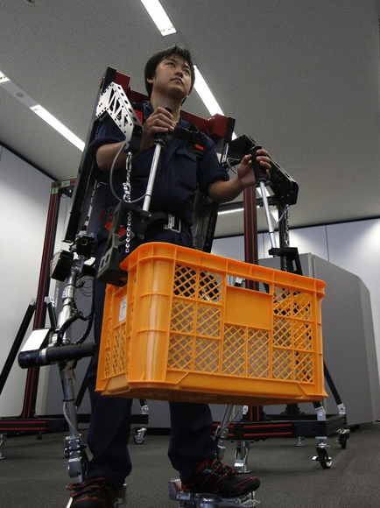
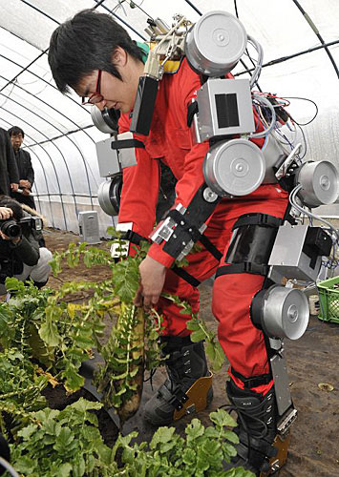
Wearable robot

Slide 37

Representative Company
Rakuten

Slide 38
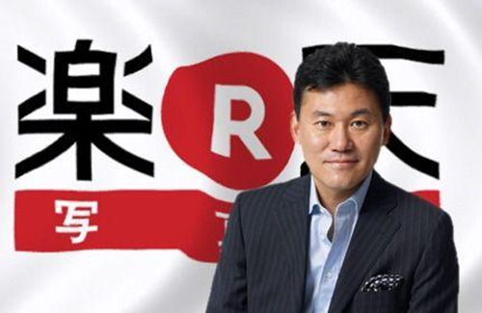
Found
Foundation in 1997/2/7
Founder: 三木谷浩史Mikitani Hiroshi

Slide 39
History
1997-1999 | Foundation of Rakuten and Launch of Internet shopping mall
2008 | First E-Commerce Expansion Overseas
2009 | Enforcing Rakuten Ecosystem
2014 | Enforcing Telecommunication and O2O Services
2015 | Enforcing Sports and Culture Businesses. Expanding Overseas Financial Services

Slide 40
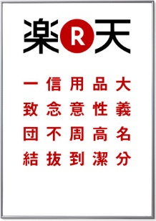
Brand Concepts
On a Mission
Behave Ethically
Professionalism
Get Things Done
Solidarity

Slide 41
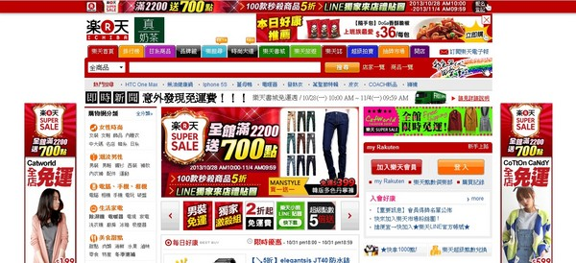


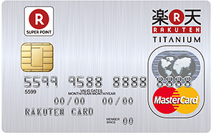
Major Businesses
Internet Services
Financial Services
Others

Slide 42
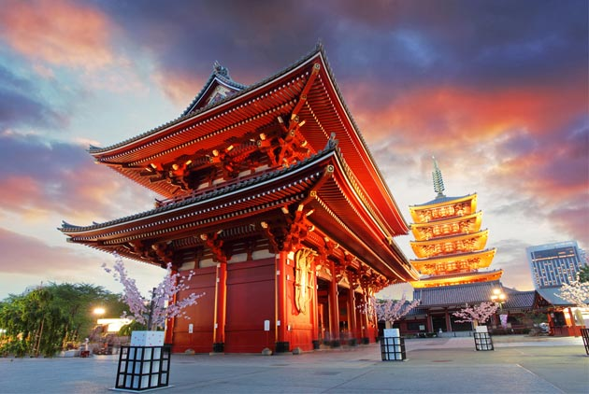
Conclusion

Slide 43
Division of responsibility
Name | Work
Penny | Culture, PPT
Doris | Geographical Environment, PPT
Lucy | Country Introduction, PPT
Steve | Economic Situation , PPT , Host
Sally | Company, PPT

Slide 44
Reference
Introduction：
http://tc.wangchao.net.cn/xinxi/detail_1884866.html http://atlas.media.mit.edu/en/profile/country/jpn/
https://zh.wikipedia.org/wiki/%E7%86%8A%E6%9C%AC%E7%86%8A
http://wish.cat2.me/3111Hello+Kitty%E5%8A%A8%E6%80%81%E8%B4%B4%E5%9B%BE/cn

Slide 45


Slide 46


