Slide 1
83 Angie

Slide 2
Outline
Overview of country
Culture
Economy & Industry
Company
Conclusion
Reference

Slide 3
Capital
Currency
Population
Language
Jeffrey
Flag & Anthem
Weather
Religion
Winnie
Animal
Introduction video
View
Daniel
Economy
Import & Export
Company
Conclusion
Angie

Slide 4
Overview of country

Slide 5
What do you know about Australia?

Slide 6
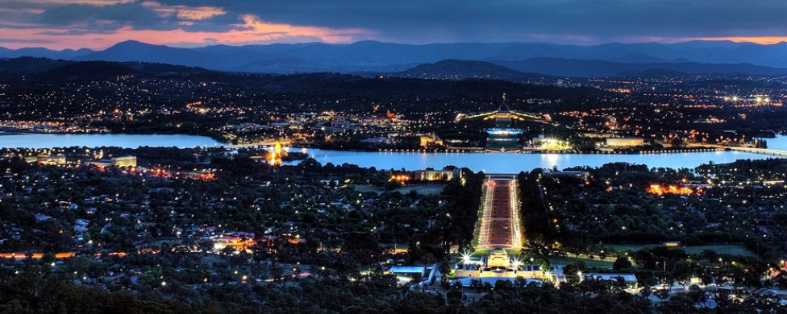
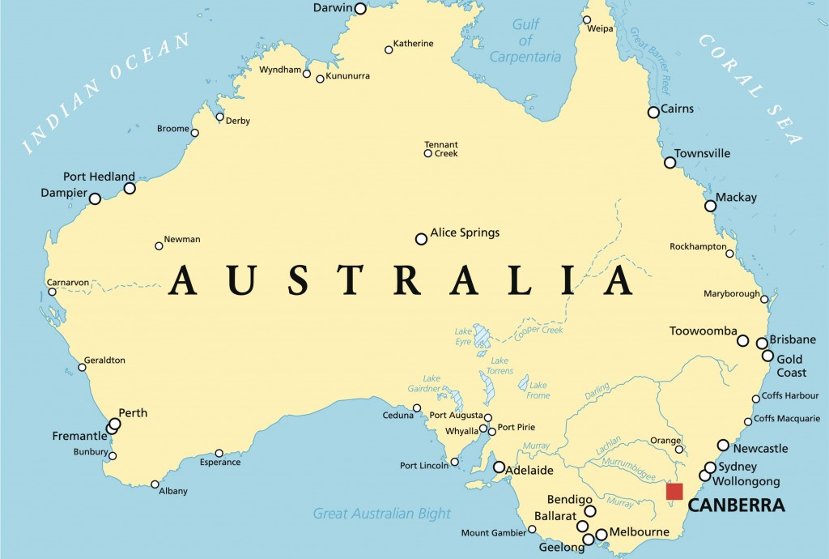
Capital

Slide 7
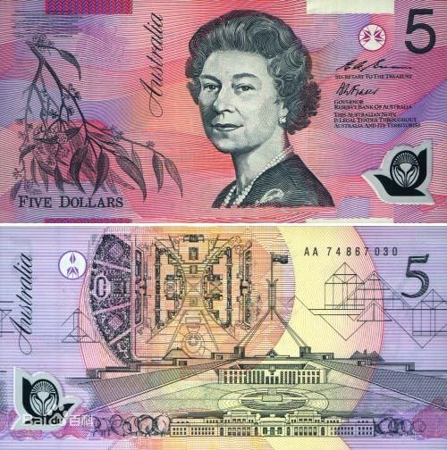
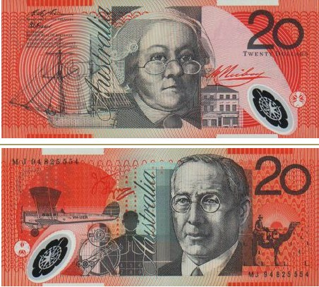
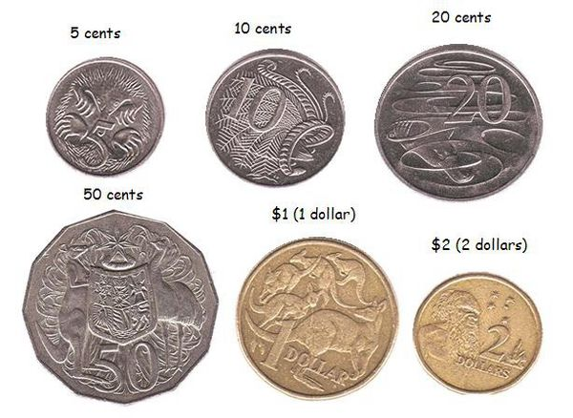
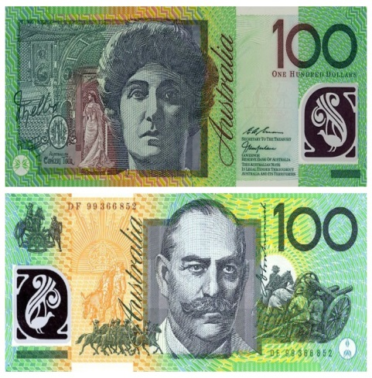
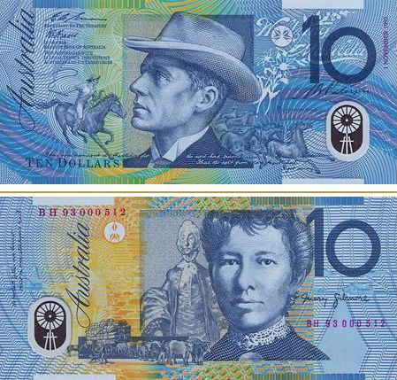
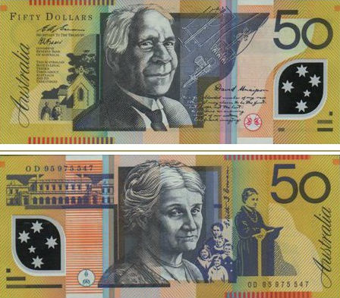
Currency
1AUD=23.7NTD

Slide 10


Flag

Slide 11
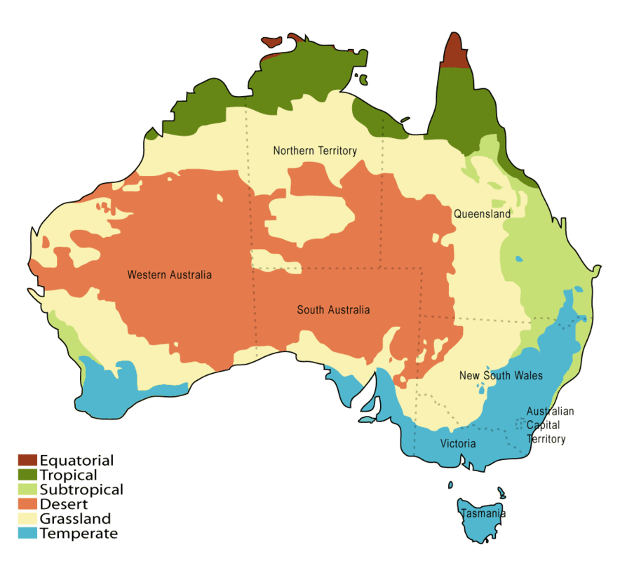

Slide 12
Culture

Slide 14
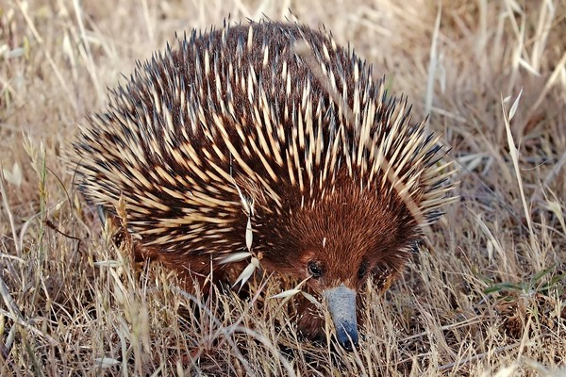
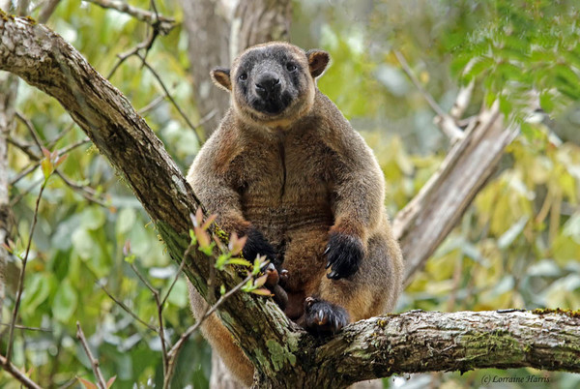
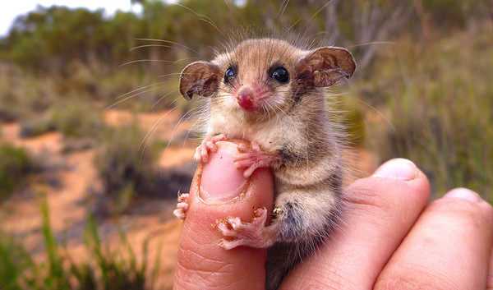
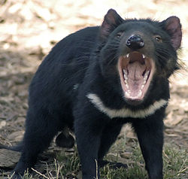
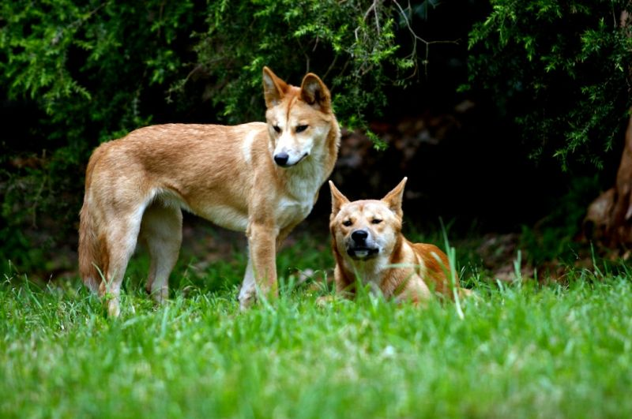
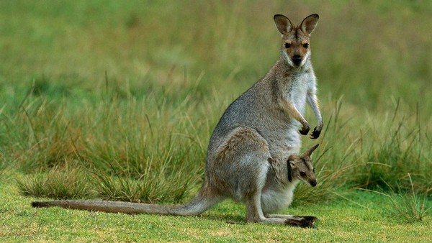
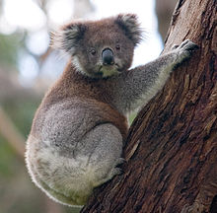
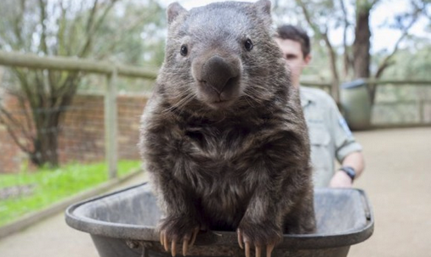
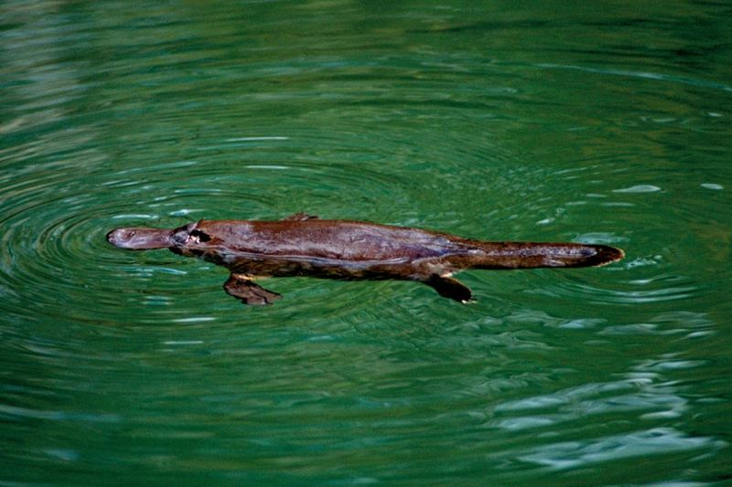
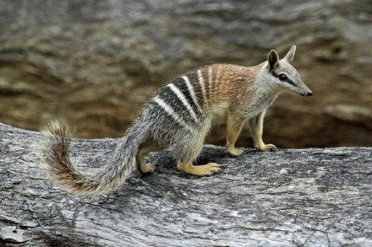
Mammal
Animal
Echidna
Pygmy possum
Tree Kangaroo
Dingo
Kangaroo
Tasmanian Devil
Koala
platypus
Wombat
Numbat

Slide 15
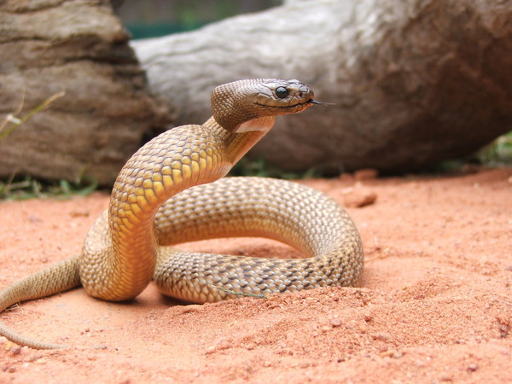
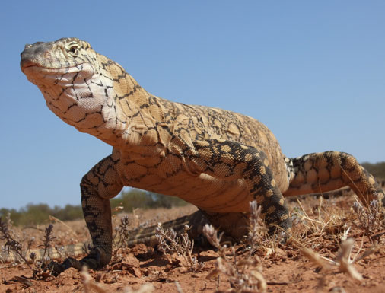
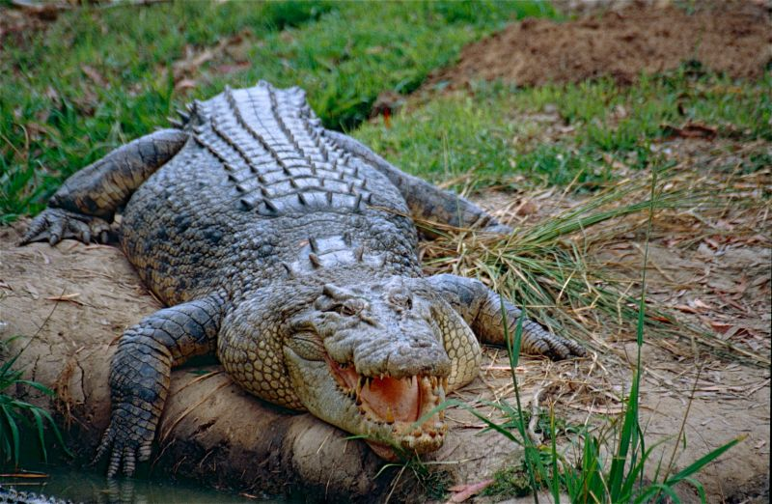
Reptile
Viper
lizard
crocodile

Slide 16
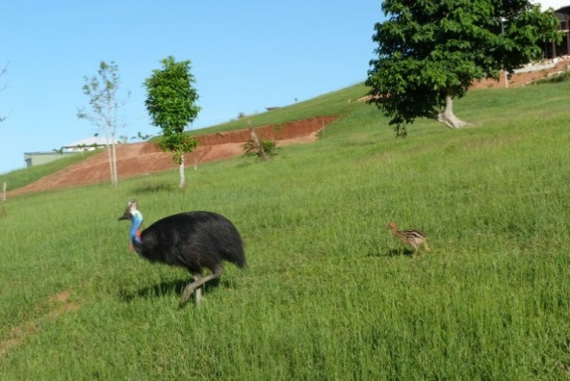
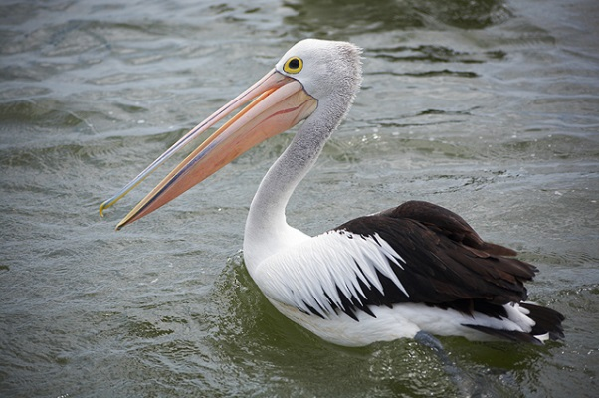
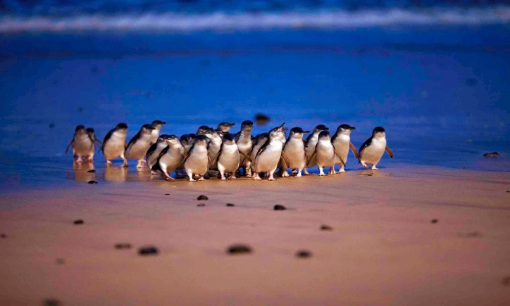
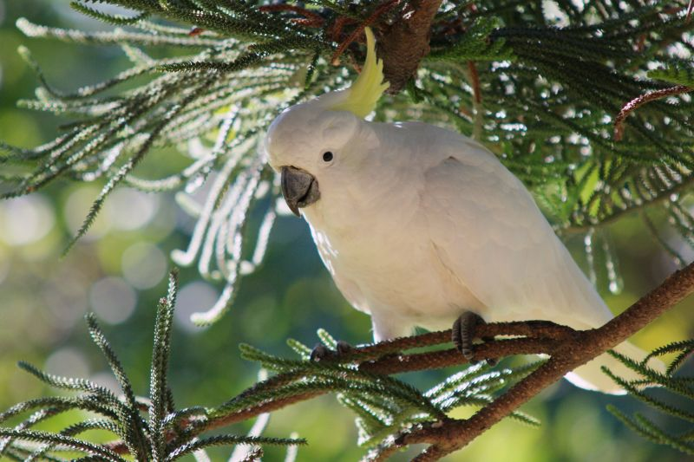
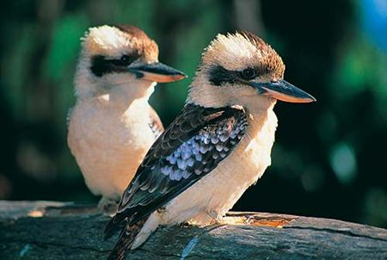
Birds
Turkey
Pelican
Penguin
Parrot
Kookaburra

Slide 17
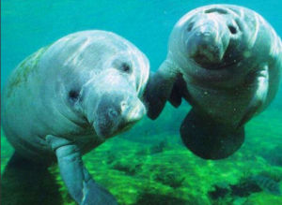
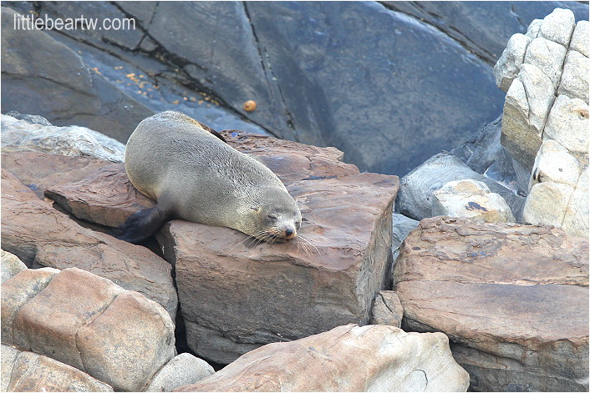
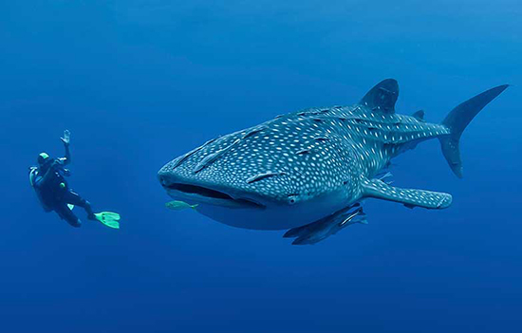
Aquatic
Dugong
Fur seal
Whale shark

Slide 18
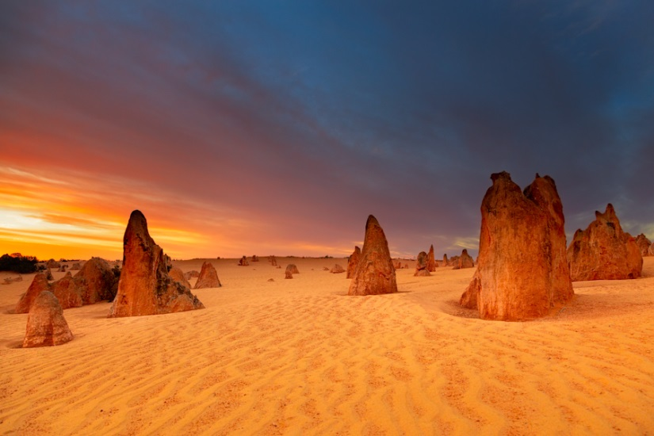
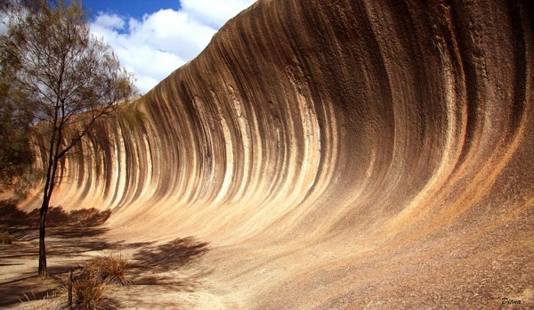
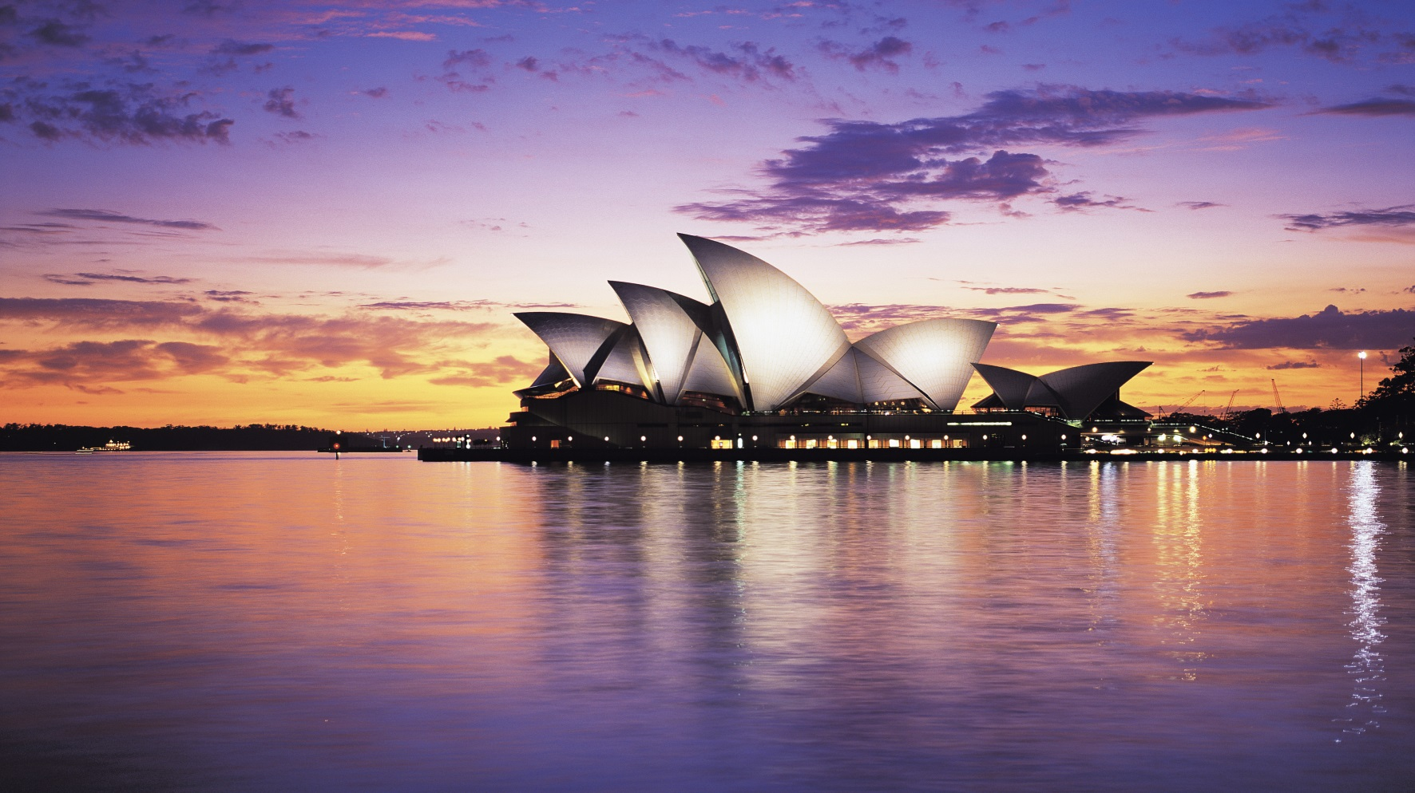
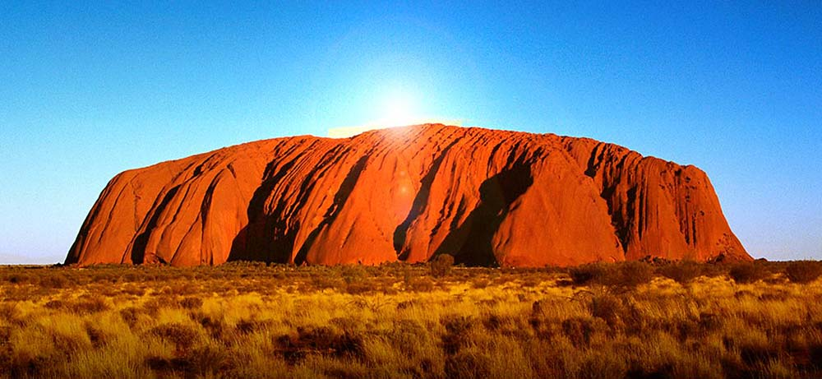
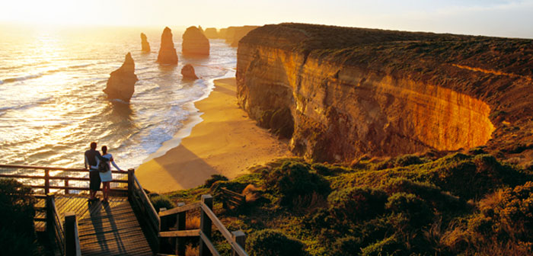
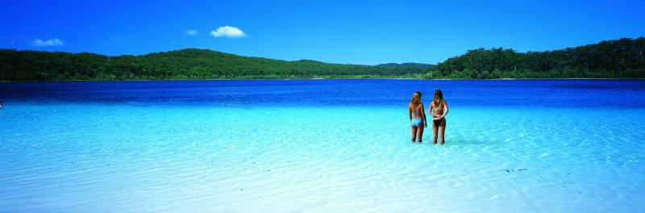
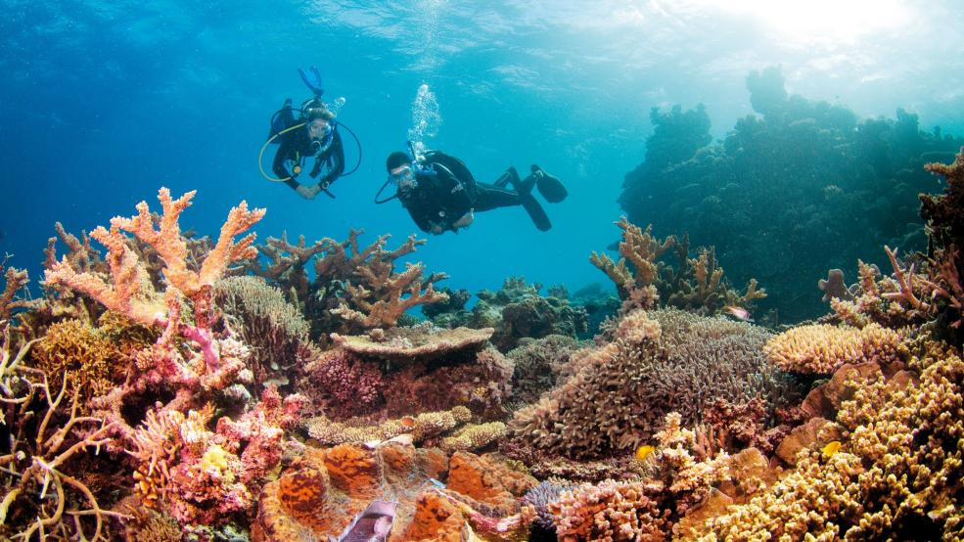
View
Sydney Opera House
Wave Rock
Fraser Island
Great Barrier Reef
Great Ocean Road
The Pinnacles
Ayers Rock

Slide 19
Economy & Industry

Slide 20
Economy
One of the wealthiest in the world.
12th-largest economy.
15th-highest per capita income in 2014.

Slide 23
Company

Slide 24

BHP Billiton
History：
1885 – BHP (58%)
1860 – Billiton PLC (42%)
2001 – creation of a DLC
HD: Melbourne

Slide 25
Five major business units
Revenue：$61.2 billion
Profit：$1.91 billion
Ｎｏ．１
* 1 AUD = 23~24 TWD
Coal
Copper
Iron ore
Petroleum
Potash

Slide 26
Conclusion

Slide 27
Reference
https://www.youtube.com/watch?v=jbAs616bjmU
https://www.youtube.com/watch?v=f58n8o3nUQk&feature=youtu.be
https://en.m.wikipedia.org/wiki/Australia
http://blog.xuite.net/vivianwu23/wretch/94664264-%E6%BE%B3%E6%B4%B2%E5%9C%8B%E6%97%97%E4%BB%8B%E7%B4%B9
http://www.australia.com/zh-hk/facts/australias-animals.html

Slide 28
END
Thanks your listening

Slide 29

Q & A
？

