Slide 1

TED Talk
&
Language Learning
2019/03/27
商務二乙
66 黃愉靖 Joyce
70 姚佩熲 Renee
72 張芷穎 Milly
76 簡辰芳 Nancy
82 蘇郁涵 Hannah

Slide 2
01
It’s origin
OUTLINE
02
What can we find
03
How to locate a talk
04
Recommend good talks
-Video Sharing
05
Comments on TED Talk
06
Conclusion

Slide 3

Origin
Hannah

Slide 4


Origin
T=Technology
E=Entertainment
D=Design
From science to business to global issues
In more than 100 languages

Slide 5

Origin
Non-profit organization
Free access to some of the world's greatest thinkers
More than 4000 talks on the website
Talks for 18 minutes or less

Slide 6
The find in TED
Joyce

Slide 7
What can you find in TED Talk
01
02
03
Different themes of talks
Interesting
&
Relaxing
Learn English skills
&
New knowledge

Slide 8
Locate a talk
Milly

Slide 9



How can we locate TED talk
Website
app
YouTube

Slide 10
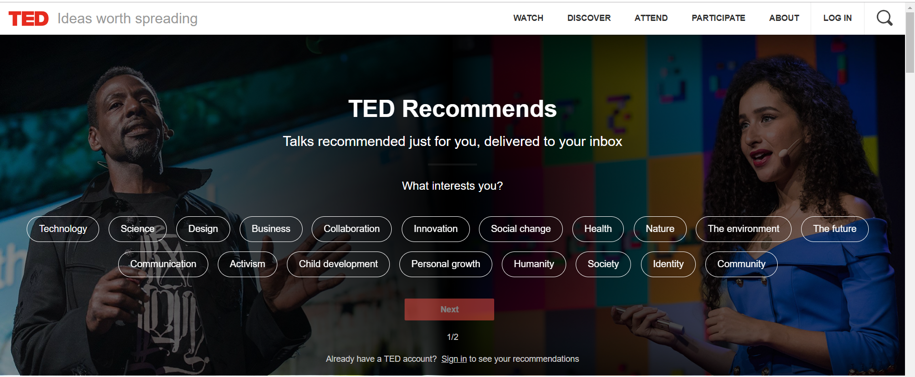
Website
www.ted.com

Slide 11
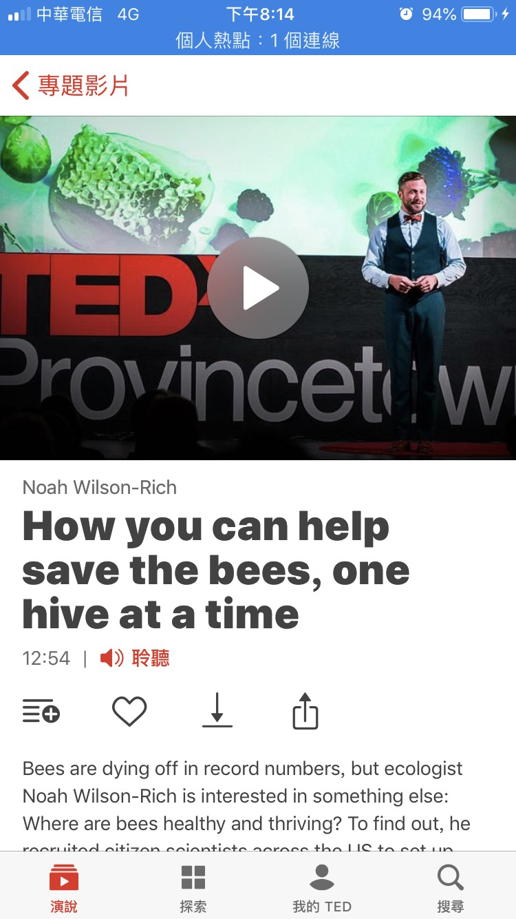

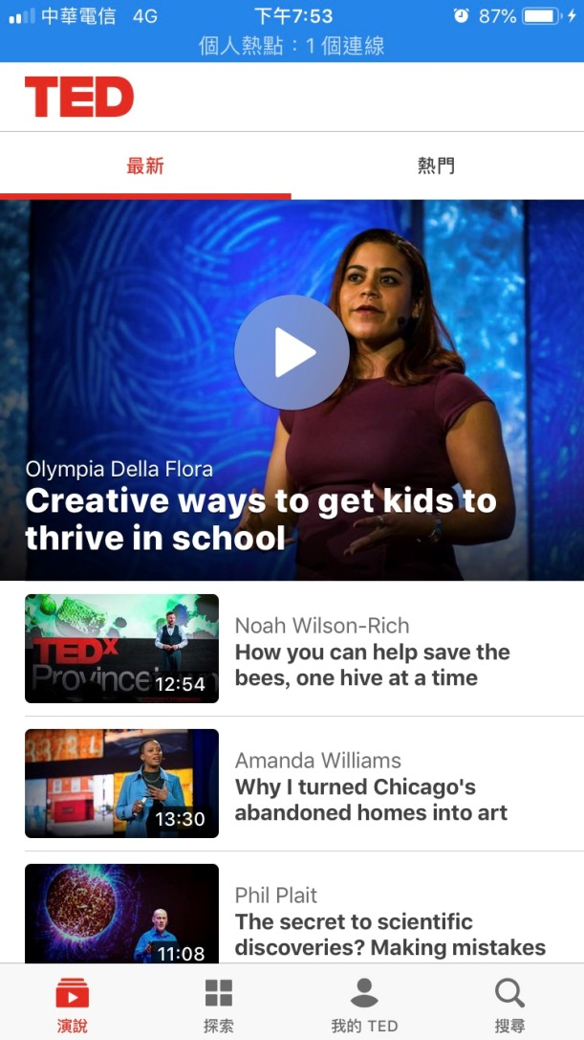
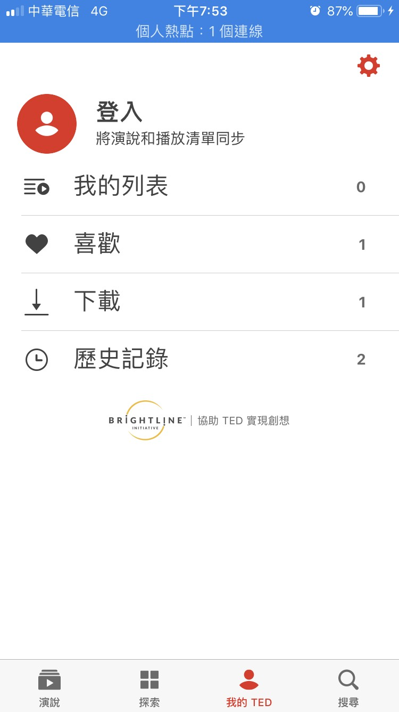
APP

Slide 12

YouTube

Slide 13
Recommend good talk
Nancy

Slide 14
There's more to life than being happy
Four pillars of a meaning life
Belonging
01
03
Transcendence
Purpose
02
04
Storytelling

Slide 15
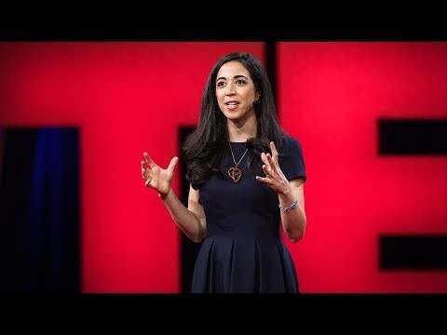
Good Talk Sharing
Emily Esfahani Smith:
There's more to life than being happy
https://www.youtube.com/watch?v=wD8f0h4_WwQ

Slide 16
Comments on TED
Renee

Slide 17
Website:
Detailed classification
01
-Improve listening & Enlarge vision
Make a plan
Three videos a week
For fun or for learning
03
02
Book sharing:
Keynote

Slide 18
Conclusion
Renee

Slide 19

Conclusion
Making English progress
Get closer to the world

Slide 20
JOB ASSIGNMENT
REFERENCE
Joyce | What can we find
Renee | Comments & conclusion
Milly | Locate a talk
Nancy | Recommend good talk
Hannah | Origin
Reference:
https://www.ted.com/about/our-organization
https://www.ted.com/about/our-organization/history-of-ted
Notes:
模板来自于 http://www.ypppt.com

Slide 21
Thanks for your attention

